Slide 1
Layered QoS and multi-layer transmission
Date: 2022-11-13
Authors:
Name | Affiliation | Address | Phone | Email
Ross Jian Yu | Huawei |  |  | ross.yujian@huawei.com
Mengyao Ma
Ying Li
Wei Ruan
Dan Wang
Ming Gan

Slide 2
Recap
In [1], it mentions metaverse applications trigger high throughput and stringent real-time delay requirements. Users expect enhanced throughput, enhanced reliability, reduced worst case delay and jitter, and improved power efficiency in supporting their applications over WLAN.
In [2], a detailed description on cloud VR use case has been presented, which needs high requirement on Tput and latency. Moreover, two aspects regarding latency reduction has been presented:
QoS enhancement
Unequal error protection (multi-layer transmission)
In this contribution, we will provide more details on those two aspects.

Slide 3
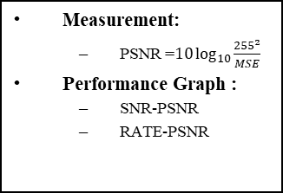
A brief introduction on Video Coding
Scalable video coding standard:
SVC (Scalable Video Coding)
SHVC (Scalable High efficiency Video Coding)
Application：
Video conferencing
Video surveillance
XR/VR
Raw
(2560x1440)
…
Source Coding
Scalability features | Scalable standard |  | Examples
 | SVC | SHVC
Temporal | √ | √ (in HEVC) | 30fps to 60fps
Spatial | √ | √ | 1080p to 4Kx2K
SNR(quality) | √ | √ | 33dB to 36dB
Hybrid codec |  | √ | AVC-coded BL
Bit depth |  | √ | 8 bit to 10 bit
Color gamut |  | √ | BT.709 to BT.2020
Base Layer
(1280x720)
I
B
P
B
I
…
BL_0
BL_1
BL_2
BL_3
BL_4
Enhancement Layer
(2560x1440)
residual_0
residual_1
residual_2
residual_3
residual_4
…
I frame (priority A):
An I-frame or a Key-Frame or an Intra-frame consists ONLY of macroblocks that use Intra-prediction.
P frame (priority B): :
P-frame stands for Predicted Frame and allows macroblocks to be compressed using temporal prediction in addition to spatial prediction. For motion estimation, P-frames use frames that have been previously encoded.
B frame (priority B/C): :
A B-frame is a frame that can refer to frames that occur both before and after it.
EL_0
EL_1
EL_2
EL_3
EL_4
Codec order (bitstream):
BL_0 EL_0 BL_2 EL_2 BL_1 EL_1 BL_4 EL_4 BL_3 EL_3
Decoding process of EL:
Rec(BL_i +EL_i) = upSampling(Rec(BL_i)) + Rec(EL_i);
Error concealment:
If (BL_2 is error) Rec(BL_2) = Rec(BL_0);
If (EL_2 is error) EL_2 = 0; (drop)
Measurement:
PSNR =$10\log_{10}{\frac{{255}^{2}}{MSE}}$
Performance Graph :
SNR-PSNR
RATE-PSNR

Slide 4
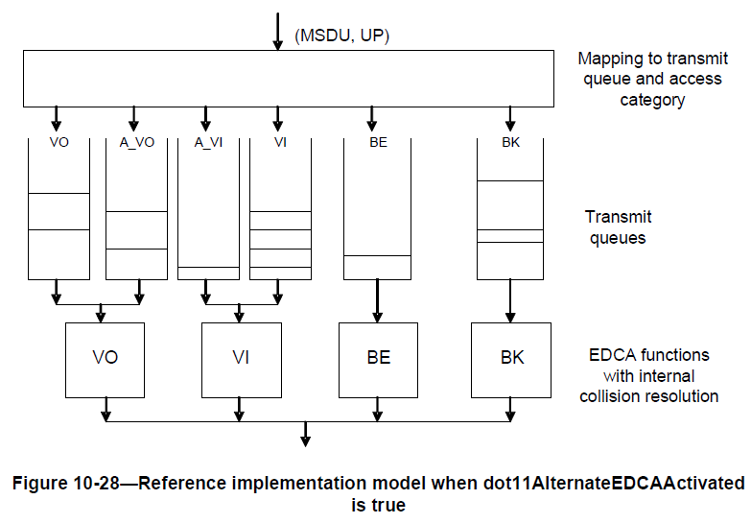
Layered QoS
For WLAN, layered QoS can be helpful on latency reduction. 802.11aa proposed alternative queues of VI to enable inter-AC prioritization of transport streams (I/P/B frame, or base layer/enhancement layer) [5][6][7]. This can also be helpful for different modalities of XR services (Audio/Video/Haptic Data/Sensor Data).
Layered QoS has been decided to be one key issue to solve for study item of XR enhancement in 3GPP R18 [3].

Slide 5
Multi-layer transmission
In [2], it mentions multi-layer transmission is one kind of unequal error protection at PHY layer that can provide different robustness to different services.
The base layer (I frame) is protected better with lower rate whilst the enhancement layer (P/B frame) is protected with higher rate.
Multi-layer transmission can achieve a good tradeoff between data rate and robustness. It can further reduce transmission latency.
One way of enabling unequal error protection (UEP) is to use different MCS for different frames in different PPDUs (time domain). An alternative way is to enable multiple PSDUs with different MCS within one PPDU.
Control Info
I frame
P/B frame
Other frame
In different SSs/RUs/
Constellation points
PHY
Resources
PHY
Resources
PHY
Resources
PHY
Resources
Multi-layer transmission (QAM, coding rate, NSS, ReTx times)
PPDU

Slide 6
Multi-layer transmission
Besides UEP for frames of different importance, multi-layer transmission can also take good advantage of the channel selective gain (e.g., divergence of eigenvalues between different spatial streams).
In 11n, UEQM (unequal modulation) MIMO enables different QAMs for different streams with the same coding rate. Here, we further assume coding rate can also be different. Below is an example.
Tput/MCS
Figure: MC (Multiple Coding)-MIMO vs SU-MIMO
MCS11
vs
MCS6
Legend
Post SNR
Tput of SSx for MC-MIMO
Tput of SSx for SU-MIMO
MCS10
vs
MCS6
Post SNR
SS0
MCS9
vs
MCS6
Post SNR
SS1
MCS6
vs
MCS6
Post SNR
SS2
SS0
SS1
SS2
Post SNR
SS3
SS3
PostSNR

Slide 7
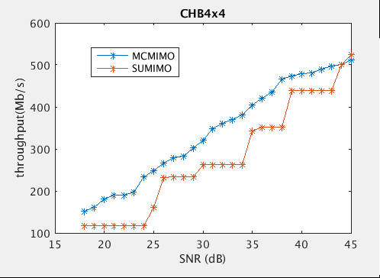
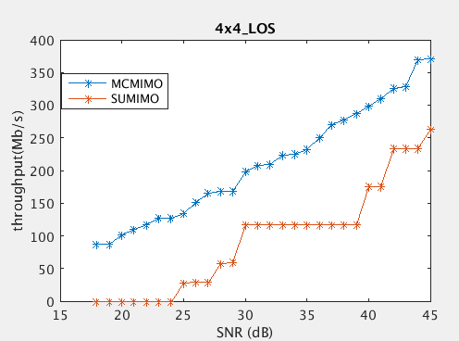
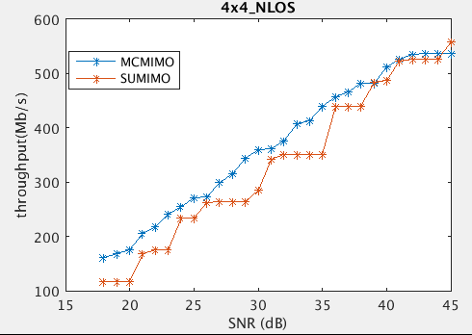
Multi-layer transmission
Below we show some simulation results comparing MC-MIMO and SU-MIMO.
4 Tx and 4 Rx and a 4SS MIMO, 20MHz channel.
X-axis: channel SNR, Y-axis: Tput
MC-MIMO has 10%~15% gain over baseline SU-MIMO.
(a) Channel B
(b) Shielding room
(c) Home environment

Slide 8
Multi-layer transmission
Below we also show some simulation results comparing MC-MIMO and SU-MIMO regarding different directions.
2 Tx and 2 Rx and a 2/1 SS MIMO, 20MHz channel.
Tput regarding different directions are compared (omni-direction antennas)

Slide 9
Multi-layer transmission
Besides spatial domain, multi-layer transmission can also be used in frequency domain (different RUs) or constellation domain, which can be further studied.
Besides the selective gain, multi-layer transmission is also very helpful for interference environment, which is a key problem WLAN currently meets. In case there is a strong interference within one RU, the error will not lead to errors on RUs. This part also needs further study.

Slide 10
Summary
In this contribution, we first presented Layered QoS for video transmission. Then we further presented multi-layer transmission. Both are helpful for latency reduction of video transmission.
Meanwhile, multi-layer transmission can further take advantage of the channel selective gain and good for interference environment.

Slide 11
Reference
[1] 11-22/1518r0, 802.11 UHR SG Proposed PAR, Ming Gan et.al., Huawei
[2] 11-22/0952r0, Cloud VR use case and requirements, Ross Jian Yu et.al., Huawei
[3] 3GPP 23700-60-120-v2-rm: 3rd Generation Partnership Project; Technical Specification Group Services and System Aspects; Study on XR (Extended Reality) and media services (Release 18)
[4] 11-18/1461r1, Discussions on the PHY features for EHT, Xiaogang Chen, Intel
[5] 11-10/0048r2 Alternate EDCA Parameter Set, Alex Ashley, NDS Ltd.
[6] 11-09/0022r1 Implementation for Intra-AC Differentiated Services, Jun Li, Thomson Inc.
[7] IEEE 802.11-2020

