Slide 1
Challenges to achieve deterministic low latency in next generation 802.11
Date: 2022-11-14
Authors:

Slide 2
Introduction
The need for deterministic (highly reliable) low latency and high throughput will only grow for consumer and autonomous applications
  AR/VR/XR, remote work, factory/process automation, robotics, audio/video, …
  Wi-Fi (802.11) needs to support these plus typical IT applications in a converged network
On the other hand serving deterministic traffic also impacts network’s ability to serve other traffic.
This presentation focuses on challenges and directions to address the low latency requirements of deterministic traffic in next generation 802.11 by exploiting the known traffic characteristics and scheduling requirements.
Notes:
Known scheduling requirements
Traffic periodicity
Latency bounds
Frame size

Slide 3
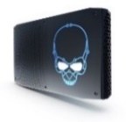






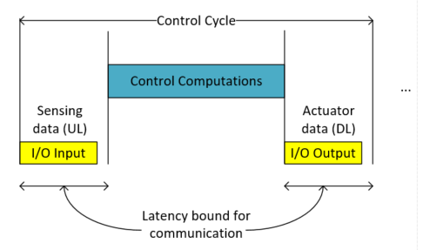
Applications that need deterministic ultra-low latency typically have a cyclic behavior
Extended Reality
Isochronous Industrial Control
Control
Edge
“Actuation”
“Sensing”
Sensing
Actuation
Client
Motion to Photon Cycle
Rendering
HMD state
Video
Latency bound for communication
Control Cycle: sensing (I/O input), computing (control algorithm) and actuation (I/O output)
Motion to Photon Cycle: user tracking, computing (rendering) and display
Intel Corporation

Slide 4
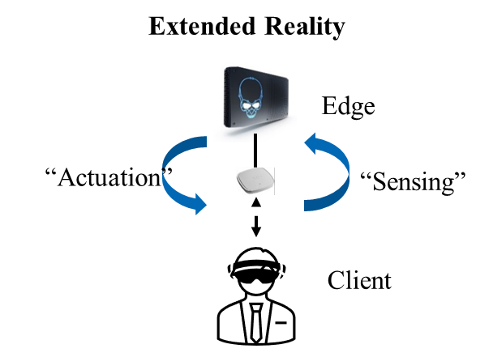

Traffic Patterns and Channel Access Requirements
Very frequent periodic channel access for small data
“Sensing” (Tracking)
2 msec
“Actuation” (Display)
Periodic channel access for large data volumes
10 msec
We already have tools for improving channel access for predictable traffic like
  Explicit triggering (SU or MU)
  SP reservation (e.g. rTWT/TWT or similar). Moreover, an AP-controlled SP assume triggered access for better efficiency.
In some scenarios the OTA overhead is too high or prohibitive to meet QoS requirements even with the existing mechanisms (see next slides), e.g.
  Increased number of channel access attempts because of medium fragmentation caused by frequent r-TWT SPs may increase overall OTA overhead
Hence, there is a need to improve signaling and efficient use of allocated resources

Slide 5

State of the Art: Scheduled access with 802.11ax/be
Periodic Data
256 Bytes
OTA overhead is comparable with the actual data transmission time, e.g.
  ~60%, 256B and 20Mhz @MCS8
  ~80%, 256B and 80Mhz @MCS8
  ~40%, 10Kb and 80Mhz @MCS8
Repetitive channel access cycles can be used to serve both latency sensitive and non-latency sensitive traffic
Overhead prevents shorter cycles and/or leaves less time to serve other traffic
…
2ms
…
UL MU PPDU
TF
…
BA
SIFS
SIFS
128µs
16µs
298 µs*
16µs
200µs
(53 µs PHY preamble)
658 µs
Major sources of overhead:
  Resource allocation (TF and DL MU PPDUs)
  Block ack
  PHY Preambles
Overhead $=\frac{T_{UL}−T_{Data}}{T_{UL}}=\frac{413}{658}=0.62$
*256 Bytes at MSC 8, 20 MHz channel, 802.11ax
Notes:
cycles can occur becuase of frequent r-TWT SPs

Slide 6






Simulation Scenario
Enterprise XR Scenario
Video Conf. Display
Traffic parameters
Source/Destination description | Num of links | Size, bytes | Interarrival time ms
Camera, UL, sc. update, 20Mbps | 4 | 25000 | 10
AR/VR DL, video, 50Mbps | 4 | 62000 | 10
AR/VR UL, IMU/tracking | 4 | 100 | 2
AR/VR Audio, DL/UL | 4/4 | 1000 | 30
Conf DL/UL Audio | 8/8 | 50 | 20
Conf. Video DL/UL, 20Mbps | 1/1 | 40000 | 16
8 video conf. audio users
Camera
AR/VR user
Holographic/shared view per user
2ms
XR + Video + Voice + BA
TF + UL Camera + BA
TF + XR IMU+ voice + BA
TF + XR IMU
TF +XR IMU + BA
TF + XR IMU + BA
DL Conf Video + Voice + BA
Display + BA
TF +XR IMU + BA
Model frame exchanges between STAs and AP using baseline .11be (single link) signaling
For a given bandwidth configuration an optimal RU allocation is used for OFDMA type transmission to minimize number of frame exchanges
time
UL
DL
UL
UL
UL
DL
UL
DL
UL
TXOP sequence duration defined by 2ms IMU traffic pattern

Slide 7
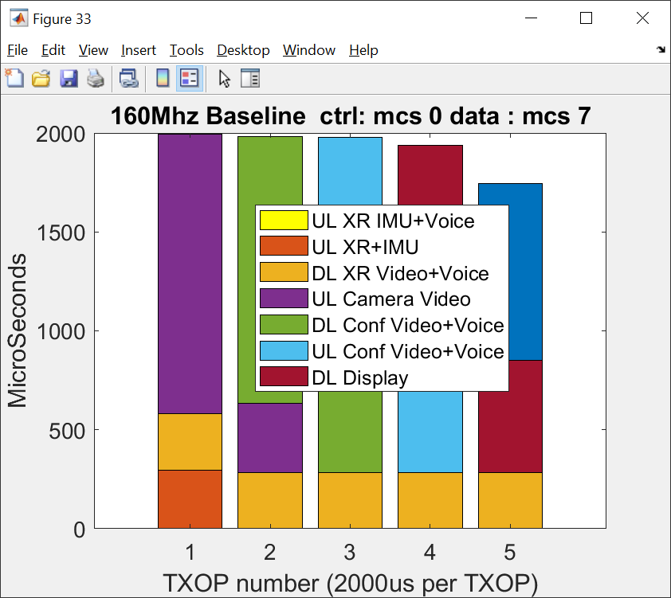
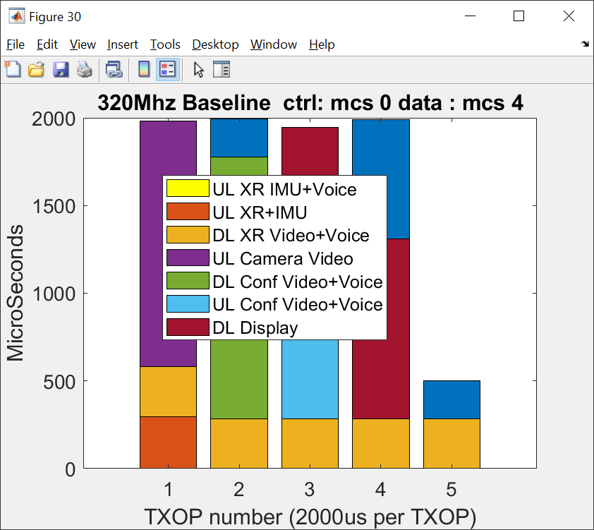
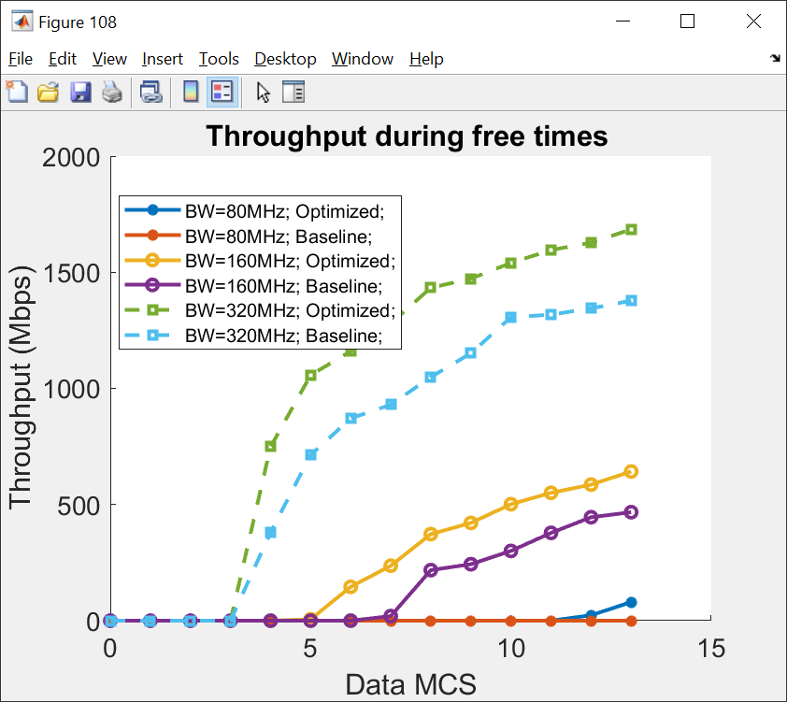
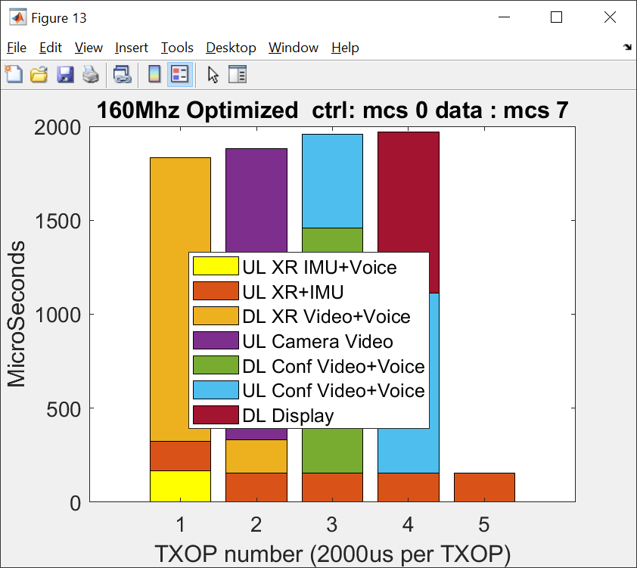
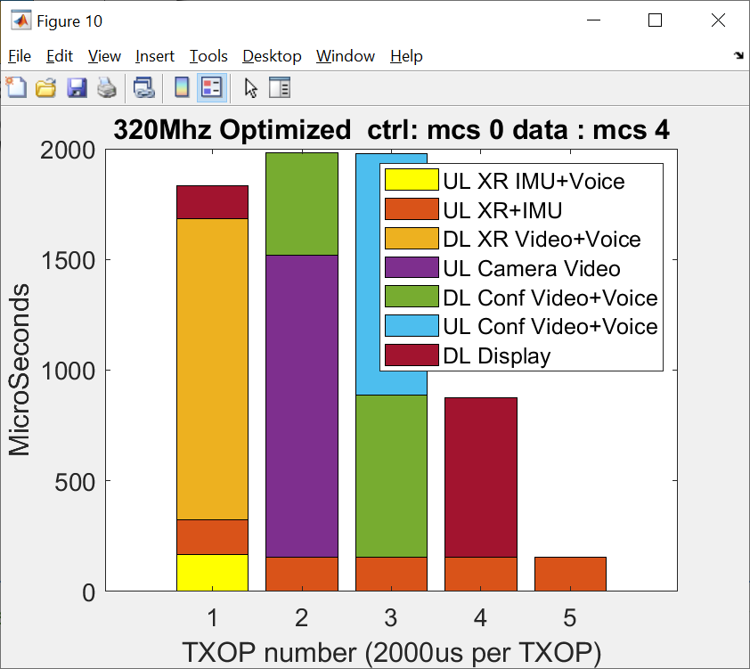
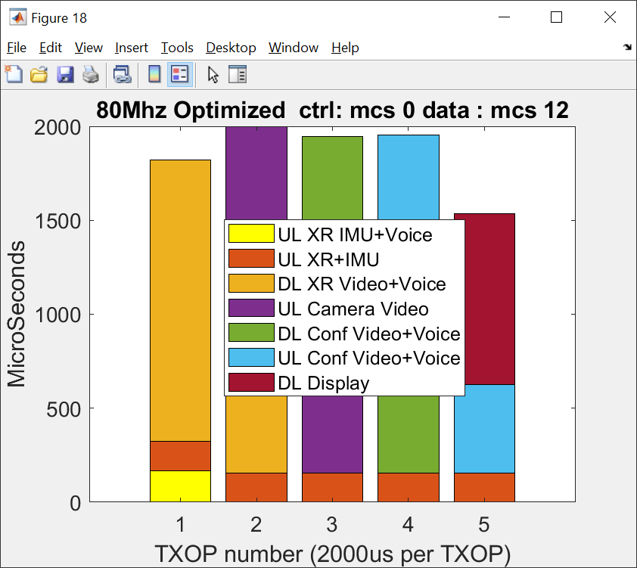
Performance evaluation – Enterprise XR scenario
With 160Mhz there is no room to support any other traffic or to support for possible recovery
The reduction of overhead translates of 10 ms into about >1.5ms of free time that can potentially be used
  to lower data MCS for improved (MCS5 can be used) reliability
  as an opportunity to transmit some other data
Can enable the use case using lower bandwidth (80MHz) which is impossible with baseline signaling
Each bar represent time necessary to deliver all buffered data for a given traffic stream assuming 1 ms TXOP
Throughput during free times: throughput using SU DL PPDU @ MCS7 during times left after serving all other scheduled traffic
Intel Corporation
Notes:
Model frame exchanges between STAs and AP using baseline .11be and optimized cheduling
IMU/User control data stream interarrival rate determine slot granularity – 2ms
Quantify gains in terms of ability to support time sensitive applications and measure possible throughput for non-time sensitive applications
For a given bandwidth configuration we select optimal RU allocation for OFDMA type transmission to minimize number of frame exchanges

Slide 8



Factory scenario
Factory Scenario
Traffic parameters
Source/Destination description | # of links | Frame size, bytes | Interarrival time (ms)
PLC, UL | 15 | 50 | 1
Camera UL | 6 | 1500 | 2
Robot control, DL | 6 | 50 | 2
Worker ArVr DL | 2 | 25000 | 10
ArVr IMU control, UL | 2 | 50 | 2
Camera
15 Controllers
.
.
.
Robot
Mobile Robot
1ms
Possible medium access pattern
AR/VR Worker
Safety Heartbeat
TF + Camera + BA
TF + PLC + Sync + BA
TF + PLC + AR + BA
TF + PLC + Sync + BA
TF + PLC + AR + BA
TF + PLC + Sync + BA
Robot + BA
ARVr + BA
ARVr + BA
time
UL
UL
UL
DL
UL
DL
UL
DL
UL
This scenario is a compilation of use cases and requirements for 5G and Wi-Fi:
https://avnu.org/wirelessTSN/
https://5g-acia.org/whitepapers/5g-quality-of-service-for-industrial-automation/
TXOP duration/sequence duration defined by 1ms PLC traffic pattern

Slide 9
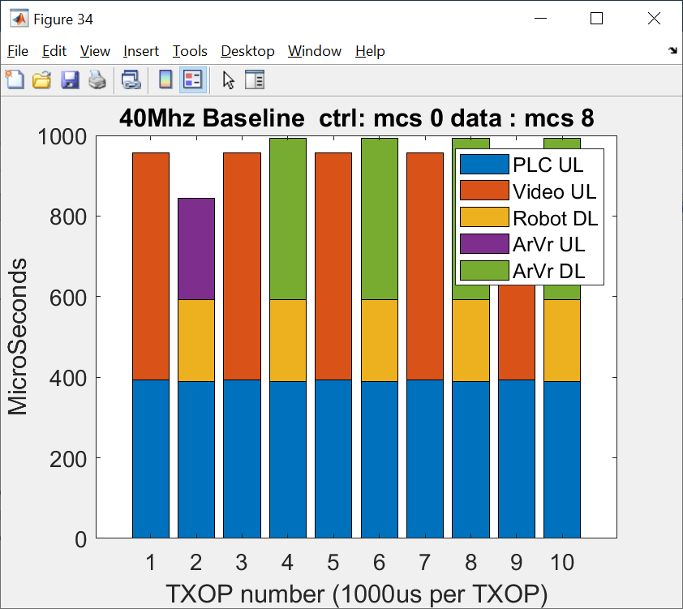
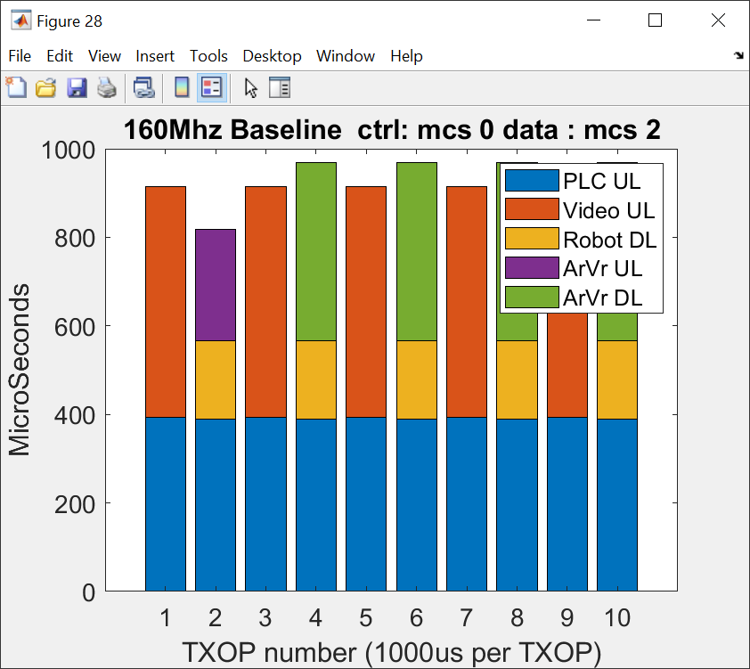
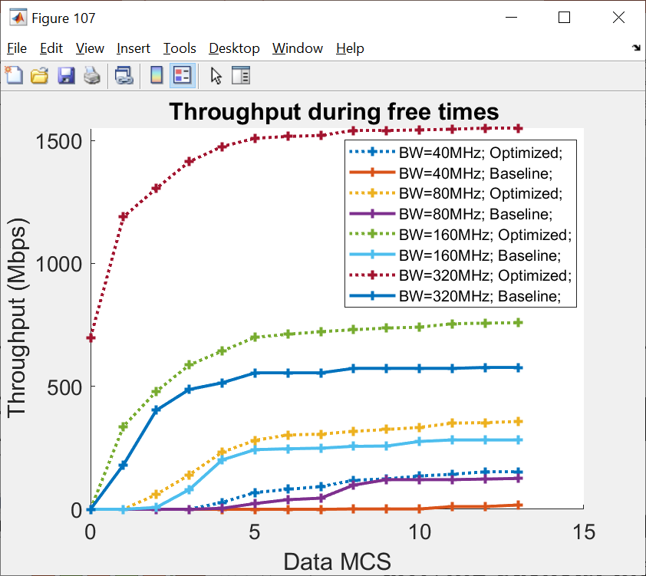
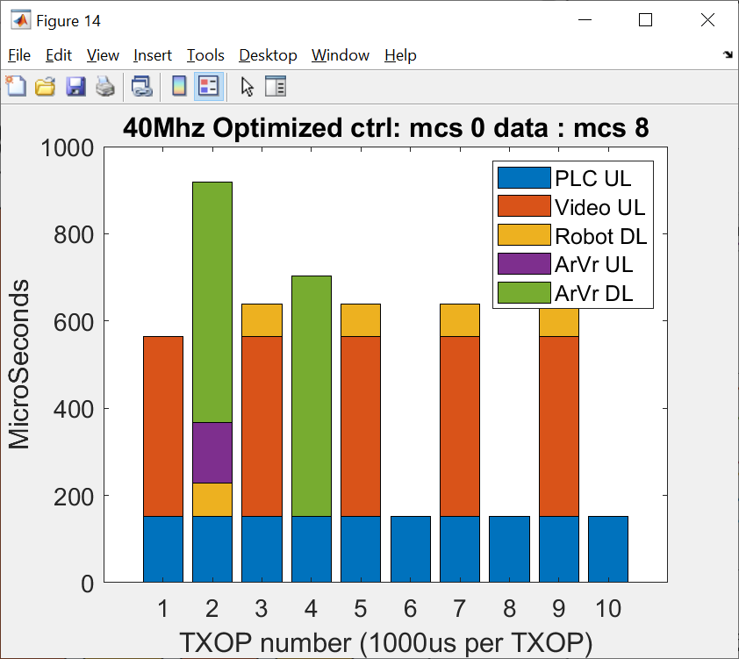
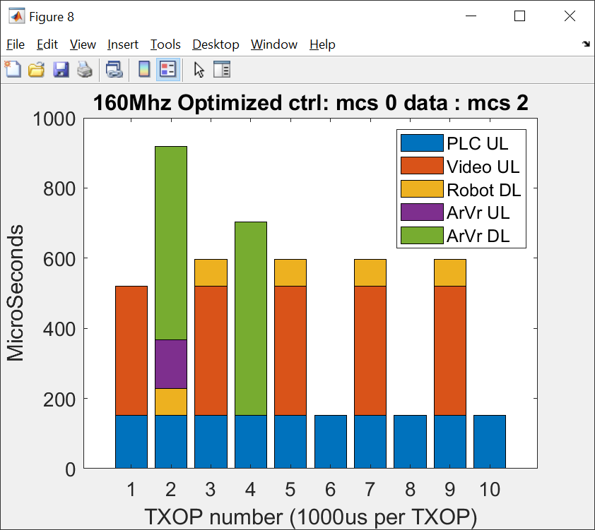
Performance evaluation – Factory case
In presence of small, frequently arriving packets, the OTA overhead consume almost all available time
256bytes payload is almost MCS independent as
The reduction of triggering overhead translates over a period of 10 ms into about >4ms of free time that can potentially be used
  To lower data MCS4 vs MCS8 for improved reliability
  as an opportunity to transmit some other data
Each bar represent time necessary to deliver all buffered data for a given traffic stream assuming 1 ms TXOP

Slide 10
Conclusion
There is a clear need to improve reliability and latency for many applications
While existing tools enable better control of channel access (i.e. OFDMA TF/ SP allocations/SCS ), they do not take full advantage of known scheduling requirements from applications, resulting in efficiency/capacity loss for the overall network
  For example, an AP can use low overhead TF when serving application with known characteristics (i.e. use same pre-negotiated resources)
Notes:
Gain is scenario dependent, more gain for scenarios with frequently arriving and/or traffic with small payloadt

Slide 11
BACKUP

Slide 12

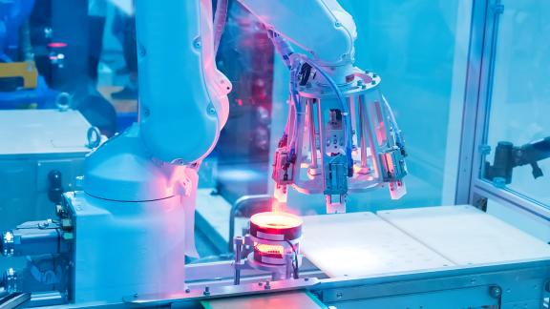
Time-Sensitive Applications Requirements
 | Immersive Environments, XR, xVerse | Industrial IOT
Traffic Profile | Cyclic/Video streaming and Events | Isochronous, Cyclic and Events
Throughput | 10 to 10000 Mbps Downlink (Depending on video encoding) < 1Mbps Uplink (cyclic) | Typically, low throughput with small packets (<1 – 10 Mbps)
Bounded Latency | 10 – 1msec (cyclic) 100 – 10 msec (events) | 0.1 – 10 ms (isochronous/cyclic) 1 – 100 ms (events)
Reliability | 99.9 to 99.99% | 99.9 to 99.9999%
Security | Authentication, integrity, and resilience to DOS/Interference | Auth., integrity, and resilience to DOS, time/QoS attacks, safety requirements
Power | Battery powered clients | Mains and battery powered clients
References:
https://avnu.org/wirelessTSN/
https://5g-acia.org/whitepapers/5g-quality-of-service-for-industrial-automation/

Slide 13
Use cases and requirements (examples)
Use cases |  | Intra BSS latency/ms | Jitter variance/ms [4] | Packet loss | Data rate/ Mbps
Real-time gaming [2] |  | < 5 | < 2 | < 0.1 % | < 1
Cloud gaming [15] |  | < 10 | < 2 | Near-lossless | <0.1 (Reverse link) >5Mbps (Forward link)
Real-time video [3] |  | < 3 ~ 10 | < 1~ 2.5 | Near-lossless | 100 ~ 28,000
Robotics and industrial automation [1] | Equipment control | < 1 ~ 10 | < 0.2~2 | Near-lossless | < 1
 | Human safety | < 1~ 10 | < 0.2 ~ 2 | Near-lossless | < 1
 | Haptic technology | <1~5 | <0.2~2 | Lossless | <1
 | Drone control | <100 | <10 | Lossless | <1 >100 with video
^{[1]}
The main issue is worst-case latency
Real-time applications need both low latency and low jitter
Higher reliability is also an important new requirement

Slide 14
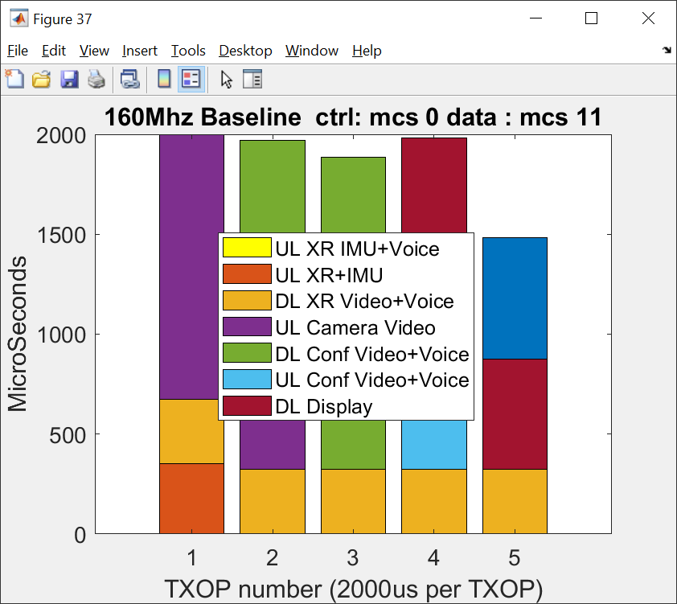
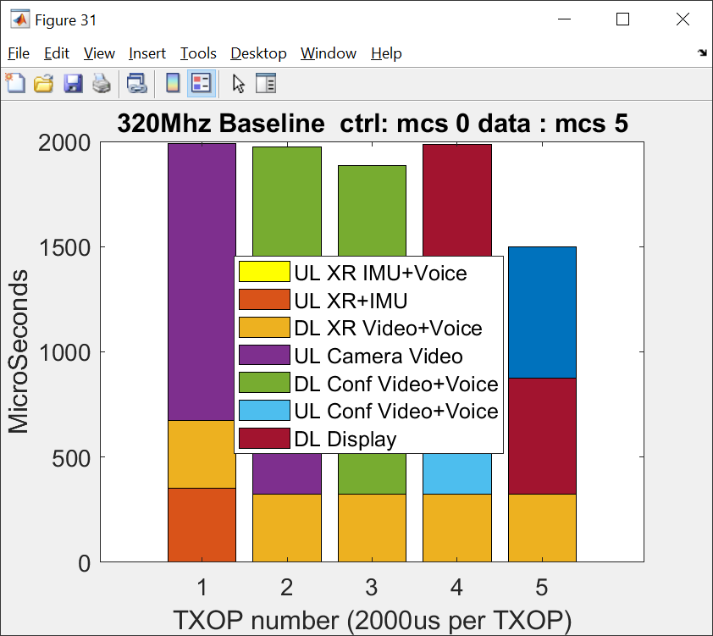
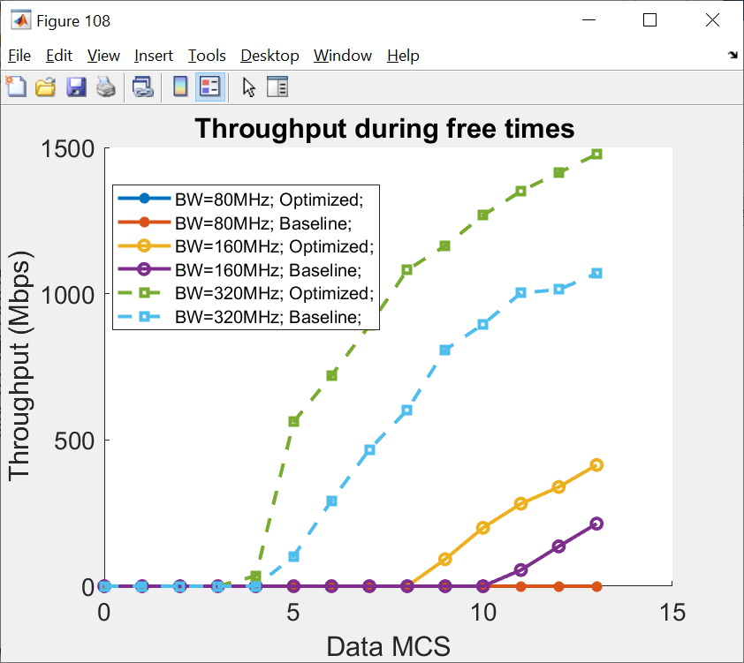
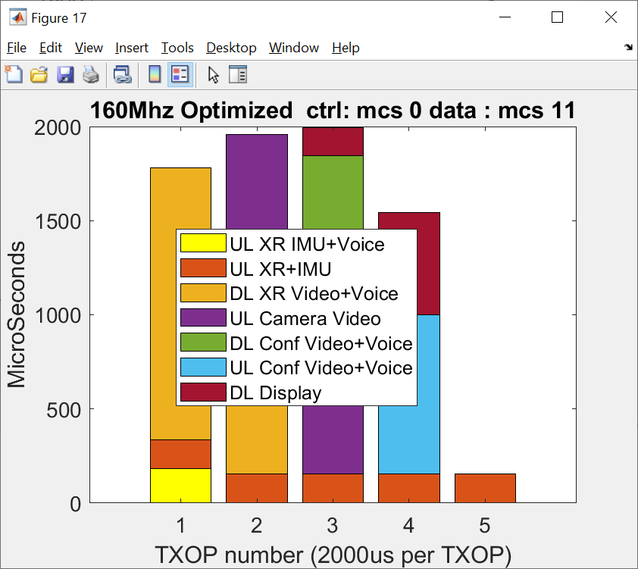
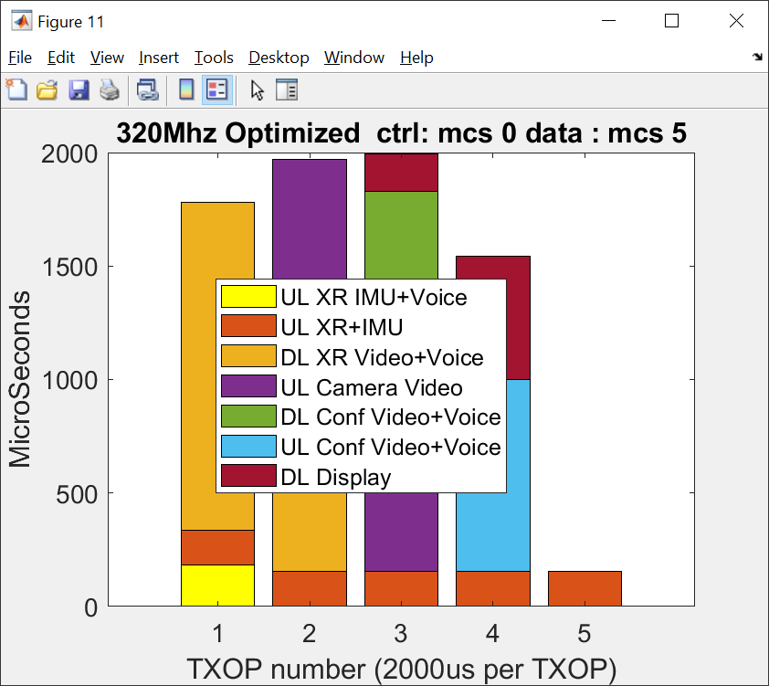
Performance evaluation – Enterprise XR scenario
8 XR and Camera clients
With 160Mhz there is no room to support any other traffic or to support for possible recovery; require high MCS which lower reliability
The reduction of overhead over a period of 10 ms translates into about >1ms of free time
  lower MCS can be used (MCS7 vs MCS11 for 160Mhz) or MCS4 vs MCS5 for 320Mhz
  opportunity to transmit some other data
Each bar represent time necessary to deliver all buffered data for a given traffic stream assuming 2 ms TXOP

Slide 15
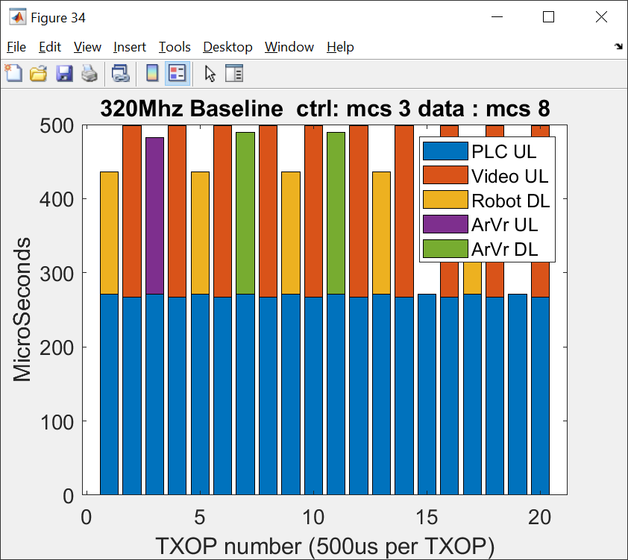
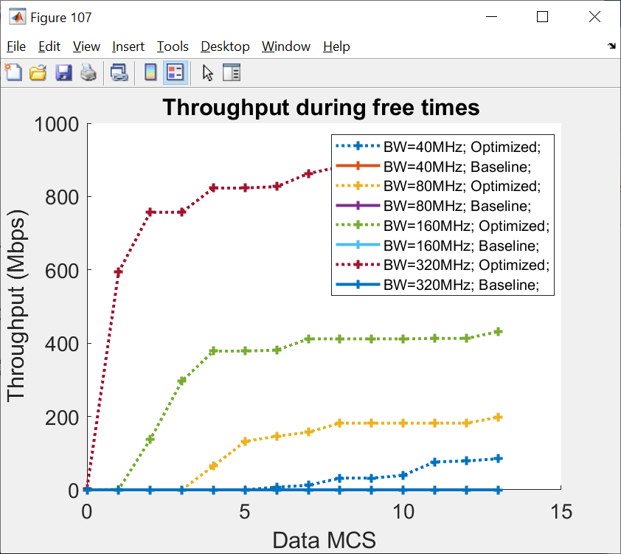
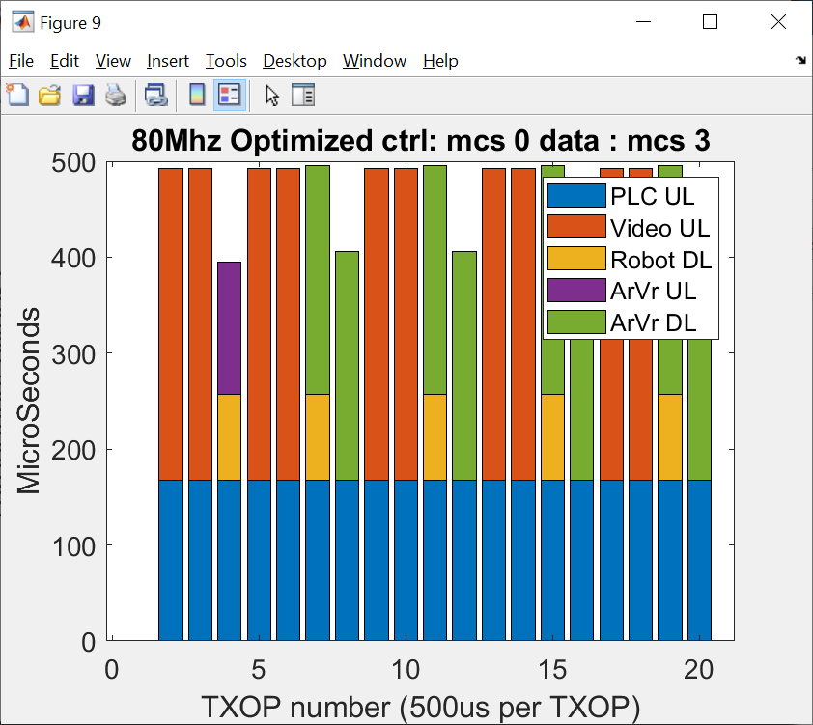
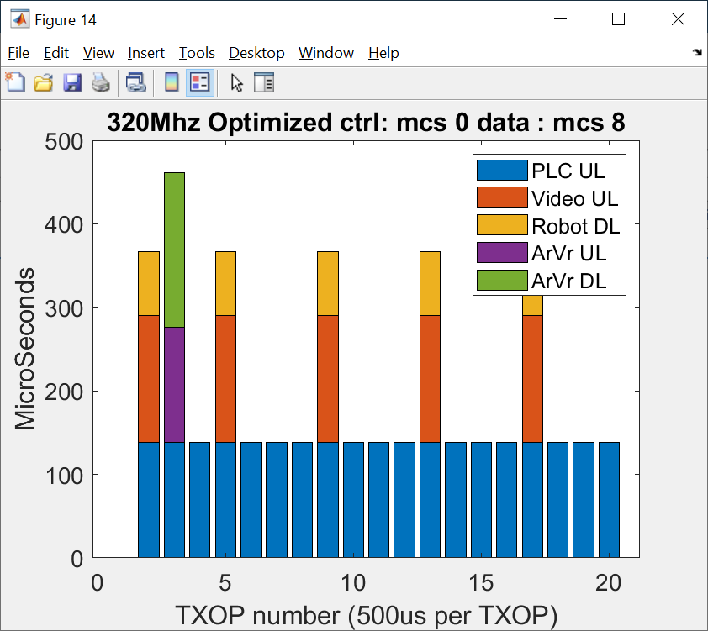
Performance evaluation – Factory case
PCL interarrival 500us
Baseline signaling make hard to support scenarios with traffic streams that require channel access at sub-millisecond periodicity;
Require extreme configuration (i.e. high MCS and wide band) to support this traffic configuration
Optimization is necessary to enable such use cases starting with 80Mhz channel width
Each bar represent time necessary to deliver all buffered data for a given traffic stream assuming 2 ms TXOP

Slide 16
Backoff
Second frame exchange with same allocation
Frame exchange finishes before start of next r-TWT SP
R-TWT SP start
R-TWT SP start
If r-TWT SPs are scheduled more frequently (potentially incl r-TWT SPs of OBSS in same channel), STAs (incl. APs) respecting start of those SPs would need to stop their non-LL frame exchanges frequently as well; also SP length could be smaller => Ctrl overhead may be high.

