Slide 1
Considerations on UHR PAR and KPIs
Date: 2023-01-17
Authors:
Name | Affiliations | Address | Phone | e-mail
Akira Kishida | NTT | 1-1, Hikarinooka Yokosuka-Shi, Kanagawa 239-0847, Japan | +81-46-859-2093 | akira.kishida.fs@hco.ntt.co.jp
Yusuke Asai | NTT
Yasushi Takatori | NTT
Kengo Nagata | NTT
Ryo Nagatsu | NTT

Slide 2
Introduction
Various use cases, such as the metaverse, cloud VR[1][2], enterprise [3], business solutions [4], and home residential[5][6], are proposed for UHR.
As described in the motion text in reference [7], UHR should consider enhancing reliability and include these use cases in the UHR PAR to expand the Wi-Fi market.
Enhancement of latency/jitter characteristics should be a good target to clarify the advancement of UHR compared to EHT and should be considered to add the baseline documents of PAR draft such as references [7][8][9].
This contribution discusses use cases that should be included in the PAR by referring to related contributions[1-4], past EHT PAR[11], and the RTA TIG report[12].
RTA report consolidates key discussions of RTA TIG about some real-time application scenarios, problems with current Wi-Fi networks, and requirements for future 802.11 standards.

Slide 3
Use cases and KPIs for latency/jitter in EHT PAR [10]
EHT PAR includes at least one feature that realizes improved worst case latency/jitter for the “Scope of the project”.
The target values of those metrics are not clarified and defined.
More specific use cases and KPIs are described in the “Need for the Project” of EHT PAR.
New use cases discussed in UHR SG should be included in the “Need for the Project” of UHR PAR to expand the Wi-Fi market and clarify the advancement of UHR compared to EHT.

Slide 4
EHT PAR [10]
5.2.b. Scope of the project:
This amendment defines standardized modifications to both the IEEE Std. 802.11 physical layers (PHY) and Medium Access Control Layer (MAC) that enable at least one mode of operation capable of supporting a maximum throughput of at least 30 Gbps, as measured at the MAC data service access point (SAP), with carrier frequency operation between 1 and 7.250 GHz while ensuring backward compatibility and coexistence with legacy IEEE Std. 802.11 compliant devices operating in the 2.4 GHz, 5 GHz, and 6 GHz bands.
This amendment defines at least one mode of operation capable of improved worst case latency and jitter.
5.5 Need for the Project:
Wireless LAN (WLAN) continues its growth and is more and more important for providing wireless data services in many environments such as home, enterprise and hotspots.
In particular video traffic will continue to be the dominant type of traffic in many WLAN deployments. The throughput requirements of these applications are in constant evolution due to the emergence of 4k and 8k video (uncompressed rate of 20 Gbps). New high-throughput, low latency applications will proliferate such as virtual reality or augmented reality, gaming, remote office and cloud computing (e.g., latency lower than 5ms for realtime gaming).

Slide 5
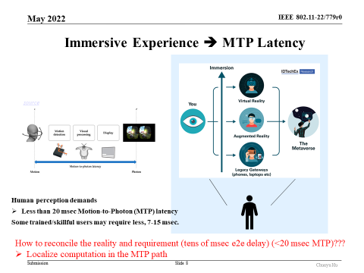
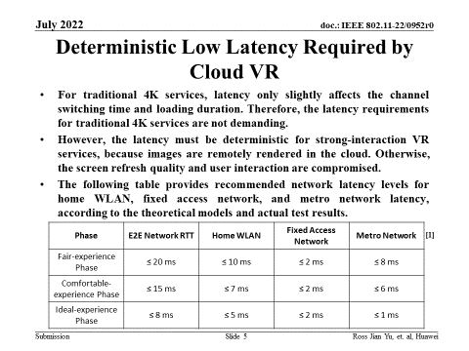
Use cases and KPIs for UHR PAR (Metaverse/VR)
Contributions [1][2] introduce use cases of the metaverse, AR/VR, and cloud VR in detail.
These are significant use cases for the Wi-Fi market. Therefore, including those use cases for the “Need for the Project” of UHR PAR should be considered.
Latency/jitter requirements are essential KPIs in those use cases.
Less than 20 msec Motion-to-Photon (MTP) latency may be required, and some trained/skillful users may require less than 7-15 msec for an immersive experience of the metaverse.
Less than 10 msec of home WLAN latency will be required for a fair-experience phase in cloud VR.

Slide 6
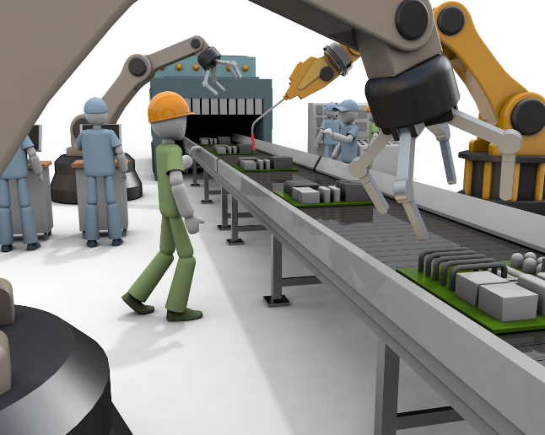
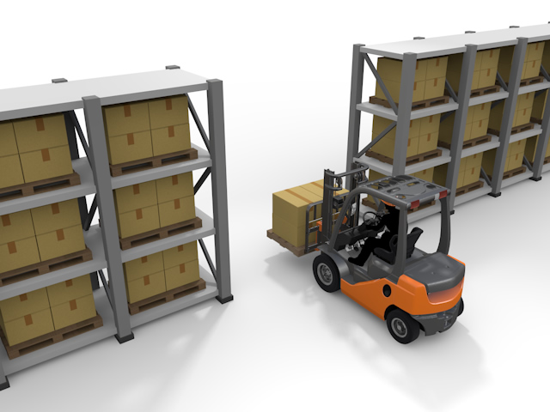
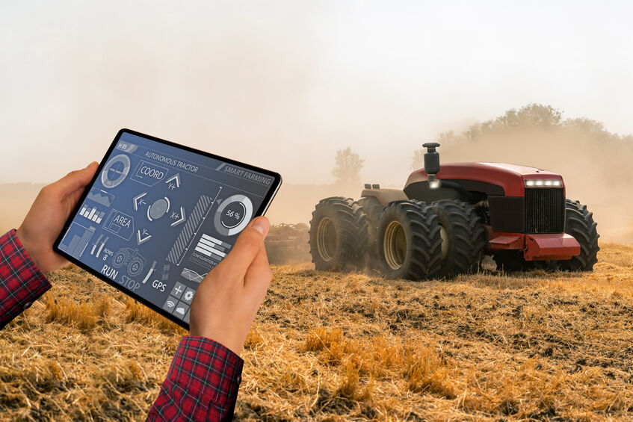
Use cases for UHR PAR (Enterprise/Business)
Contributions [3][4] introduce use cases for enterprises and business use cases such as industrial IoT (IIoT), logistics, and smart agriculture, respectively.
These are significant use cases for the Wi-Fi market as well, and including those use cases for the “Need for the Project” of UHR PAR should also be considered.
Latency/jitter requirements are also essential KPIs in those use cases.
Examples of Wi-Fi business use cases
Industrial IoT
Logistics
Smart Agriculture

Slide 7
Consideration of KPIs for Wi-Fi business use cases
RTA TIG was a Topic Interest Group that investigated real-time applications that require low latency and summarized their activities in the RTA report[12].
Wi-Fi business use cases introduced in [4] consist of multiple use cases analyzed in the RTA report [12].
Use cases |  | Intra BSS latency [ms] | Jitter variance [ms] | Packet loss | Data rate [Mbps]
Real-time gaming |  | < 5 | < 2 | < 0.1 % | < 1
Cloud gaming |  | < 10 | < 2 | Near-lossless | < 0.1 (Reverse link) > 5Mbps (Forward link)
Real-time video |  | < 3 ~ 10 | < 1~ 2.5 | Near-lossless | 100 ~ 28,000
Robotics and industrial automation | Equipment control | < 1 ~ 10 | < 0.2~2 | Near-lossless | < 1
 | Human safety | < 1 ~ 10 | < 0.2 ~ 2 | Near-lossless | < 1
 | Haptic technology | < 1 ~ 5 | <0.2~2 | Lossless | <1
 | Drone control | < 100 | <10 | Lossless | <1 >100 with video
These requirements are correspond to use cases introduced in a previous slide
Requirements of each use case (from RTA report)

Slide 8
Consideration on use cases and KPIs in UHR PAR
New use cases discussed in UHR SG should be included in the “Need for the Project” of UHR PAR to expand the Wi-Fi market and clarify the advancement of UHR compared to EHT.
Use cases such as robotics and industrial automation for industrial IoT, logistics, and smart agriculture are significant for UHR.
Latency/jitter should be essential KPIs for UHR.
Various real-time applications require those KPIs for high reliability.

Slide 9
Summary
We discussed use cases and KPIs that should be included in the UHR PAR.
The “Need for the Project” of UHR PAR should include Latency/jitter-sensitive use cases such as robotics and industrial automation for industrial IoT, logistics, and smart agriculture.

Slide 10
SP
Do you agree that the “Need for the Project” of UHR PAR should include use cases of the latency/jitter-sensitive applications such as robotics and industrial automation for industrial IoT, logistics, and smart agriculture, to expand the existing Wi-Fi market in addition to the proposed use cases so far?
-Yes
-No
-Abstain

Slide 11
References
[1] Chunyu Hu, “802.11bx: Enabling Metaverse -- Metaverse, AR/VR, and Wearables,” IEEE 802.11- 22/0779r0
[2] Ross Jian Yu, et al., “Cloud VR Use Case and Requirements,” IEEE 802.11-22/0952r0
[3] Brian Hart, et al., “A perspective on proposed Ultra-High Reliability (UHR) features for enterprise use cases,” IEEE 802.11-22/1280r1
[4] Akira Kishida, et al., “Use Cases for Wi-Fi Business Solutions in UHR,” IEEE 802.11-22/1493r1
[5] James Yee, et al., “Multi AP Coordination and Residential Wi-Fi,” IEEE 802.11-22/1512r0
[6] Amelia Andersdotter, et al., “Ultra-High Reliability (UHR) requirements for home-networking use cases,” IEEE 802.11-22/1790r0
[7] Rolf de Vegt, et al., “Beyond ‘be’ - Proposed Next Step,” IEEE 802.11-22/0708r1
[8] Ming Gan, et al., “802.11 UHR SG Proposed PAR,” IEEE 802.11-22/1518r0
[9] Laurent Cariou, “UHR Draft Proposed PAR,” IEEE 802.11-23/0078r0
[10] Tuncer Baykas, et al., “Project Authorization Request Proposal for 802.11 UHR SG,” IEEE 802.11- 22/1750r0
[11] Laurent Cariou, “802.11 EHT Proposed PAR,” IEEE 802.11-18/1231r6
[12] Kate Meng, et al., “RTA report draft,” IEEE 802.11-18/2009r6

