Slide 1
Details on 320 MHz NDP for Sensing
Date: 2022-11-07
Authors:
Name | Affiliations | email
Steve Shellhammer | Qualcomm | shellhammer@ieee.org
Ali Raissinia |  | alirezar@qti.qualcomm.com
Bin Tian |  | btian@qti.qualcomm.com

Slide 2
Introduction
Motion 141 said the following
Move to add the following to the TGbf SFD:
The HE Ranging NDP and HE TB Ranging NDP formats shall be used for 802.11bf sub-7 GHz sensing when PPDU BW ≤ 160 MHz
The EHT sounding NDP format (including specified preamble puncturing patterns) shall be used for 802.11bf sub-7 GHz sensing when PPDU BW = 320 MHz
Note: which preamble puncturing patterns to be supported are TBD.
Here we address some details on the 320 MHz NDP for 11bf

Slide 3
LTF Format
Multiple LTFs formats are supported in EHT
The 2x LTF with 0.8 µs GI
The 2x LTF with 1.6 µs GI
The 4x LTF with 32. µs GI
Only a single LTF format is supported in 802.11az
The 2x LTF with 1.6 µs GI
To limit options, it very desirable to limit the number of LTF formats, as was done in 802.11az
We propose to only allow the 2x LTF with 1.6 µs GI in the 320 MHz NDP within 802.11bf

Slide 4
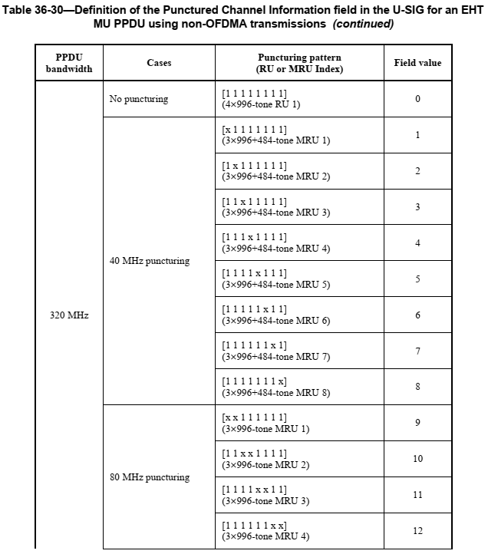
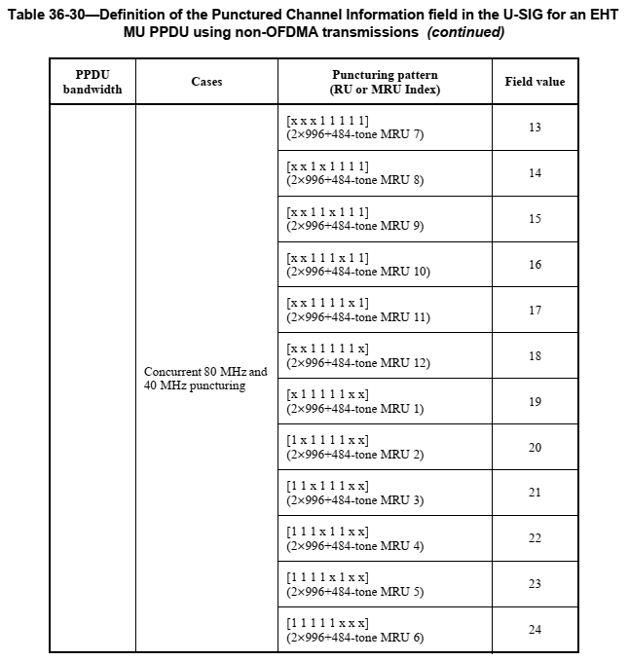
U-SIG Punctured Channel Info for non-OFDMA PPDU and NDP

Slide 5
Supported Preamble Puncturing Patterns
In Motion 141, the supported preamble punctuating patterns was left as TBD
In some RF Sensing applications, it is desirable to have continuous spectrum
However, sometimes a BSS must be set up with puncturing such that the utilized spectrum is discontinuous
So, it is desirable to support these puncturing configurations
Also, if the RF Sensing application works on continuous spectrum it can use the portion of the spectrum which is continuous
Hence, we propose supporting all the EHT preamble puncturing modes in 802.11bf
In the future we may want to make some of the puncturing cases optional

Slide 6
Straw Poll #1
Do agree that in the 320 MHz NDP, 802.11bf should only support the 2x LTF with 1.6 µs GI?

Slide 7
Straw Poll #2
Do agree that for the 320 MHz NDP, 802.11bf should support all the EHT puncturing patterns?
Note: These are identified in the U-SIG for the MU PPDU for non-OFDMA transmissions

