Slide 1
Recommendation on Ng Value for 320 MHz
Date: 2022-11-07
Authors:
Name | Affiliations | email
Steve Shellhammer | Qualcomm | shellhammer@ieee.org
Ali Raissinia |  | alirezar@qti.qualcomm.com
Bin Tian |  | btian@qti.qualcomm.com

Slide 2
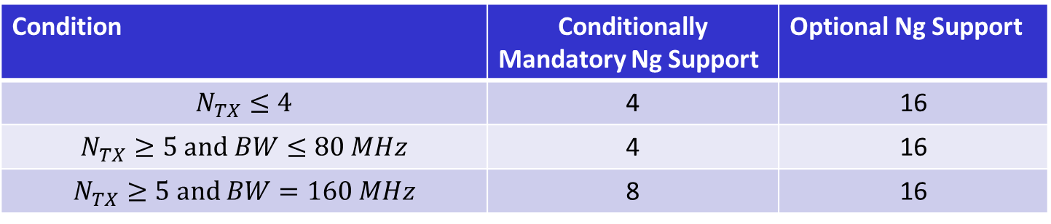
Background – The Draft specifies Mandatory and Optional Values of Ng for up to 160 MHz Bandwidth
The current draft supports the following optional and mandatory values of Ng
Condition | Conditionally Mandatory Ng Support | Optional Ng Support
$N_{TX}≤4$ | 4 | 16
$$N_{TX}≥5 and BW≤80 MHz$$ | 4 | 16
$$N_{TX}≥5 and BW=160 MHz$$ | 8 | 16
For Ng = 8 the following tones are specified
Channel Width | Ng | Indices
160 MHz | 8 | -1012, -1004, … -20, -12, 12, 20, … 1004, 1012

Slide 3
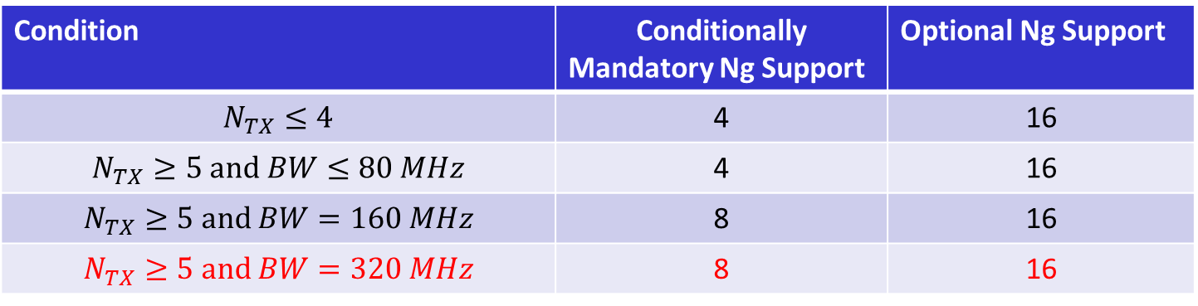
320 MHz NDP
Now that the task group has agreed to support the EHT 320 MHz NDP we need to specify the optional and mandatory values of Ng for 320 MHz
We propose adding the following optional and mandatory values of Ng for 320 MHz (as shown in Red)
Condition | Conditionally Mandatory Ng Support | Optional Ng Support
$N_{TX}≤4$ | 4 | 16
$$N_{TX}≥5 and BW≤80 MHz$$ | 4 | 16
$$N_{TX}≥5 and BW=160 MHz$$ | 8 | 16
$$N_{TX}≥5 and BW=320 MHz$$ | 8 | 16

Slide 4
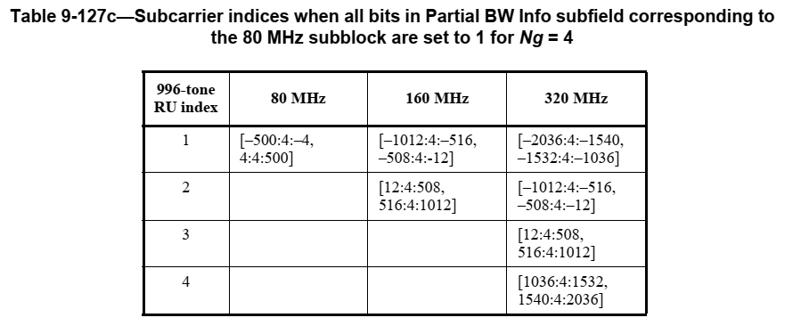
Specify Indices for 320 MHz with Ng = 8
Background – EHT specifies concatenation of 80 MHz subblocks
Here we show the subcarrier indices for Ng = 4
We can decimate this to get the case for Ng = 8

Slide 5
Proposal for Ng = 8 for 320 MHz
996-tone RU Index | Subcarrier Indices for Ng = 8 for 320 MHz
1 | [-2036 : 8 : -1540, -1532 : 8 : -1036]
2 | [-1012 : 8 : -516, -508: 8: -12]
3 | [12 : 8: 508, 516 : 8: 1012]
4 | [1036: 8 : 1532, 1540: 8 : 2036]

Slide 6
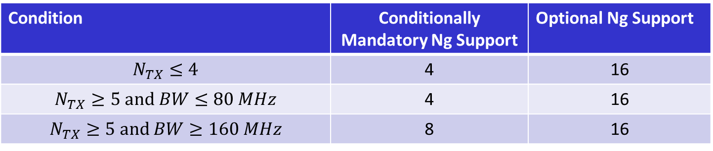
Straw Poll
Do you agree to make the following change to the 11bf table of conditionally mandatory and optionally supported Ng values in the first table below and do you support adding the second table specifying the indices of Ng = 8 for 320 MHz NDP to 11bf?
Condition | Conditionally Mandatory Ng Support | Optional Ng Support
$N_{TX}≤4$ | 4 | 16
$$N_{TX}≥5 and BW≤80 MHz$$ | 4 | 16
$$N_{TX}≥5 and BW≥160 MHz$$ | 8 | 16
996-tone RU Index | Subcarrier Indices for Ng = 8 for 320 MHz
1 | [-2036 : 8 : -1540, -1532 : 8 : -1036]
2 | [-1012 : 8 : -516, -508: 8: -12]
3 | [12 : 8: 508, 516 : 8: 1012]
4 | [1036: 8 : 1532, 1540: 8 : 2036]

