Slide 1
User offloading problem between multiple APs
Date: 2022-11-07
Authors:

Slide 2
Abstract
The Multi-AP coordination has been discussed as one of the main features in 11be.
It is proposed that sharing AP and shared AP can share resources through the configuration of AP protocol [1].
It is proposed that AP can avoid interference by controlling power. [2]
By using the proposed method of multi-AP coordination setting, AP can communicate with STA associated with neighboring AP [3].

Slide 3
Introduction
Due to the uneven distribution of APs, some APs are overloaded, the collision probability increases, the communication quality of some STAs decreases, the spectrum efficiency decreases, and STAs seize the channel resources.
We propose a multi-AP cooperative communication mode, which can balance the load among APs, reduce the transmission collision probability, increase the transmission rate of STA, reduce the time delay, improve the communication reliability and improve the spectrum efficiency of the system.
Unload some STAs in the overloaded AP network to the AP network with lower load through the coordinated scheduling mode of the main AP or the coordinated communication mode of the AP.

Slide 4
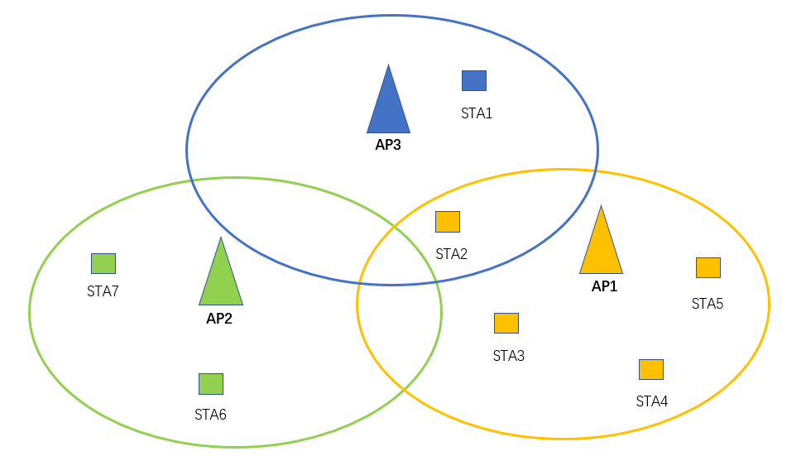
System Model
System Model
There are multiple AP networks in the system, and AP networks can communicate with each other [3]
SAT1~STA2 are in the BSS3 service set of AP3.
SAT6~STA7 are in the BSS2 service set of AP2.
SAT2~STA5 are in the BSS1 service set of AP1.

Slide 5
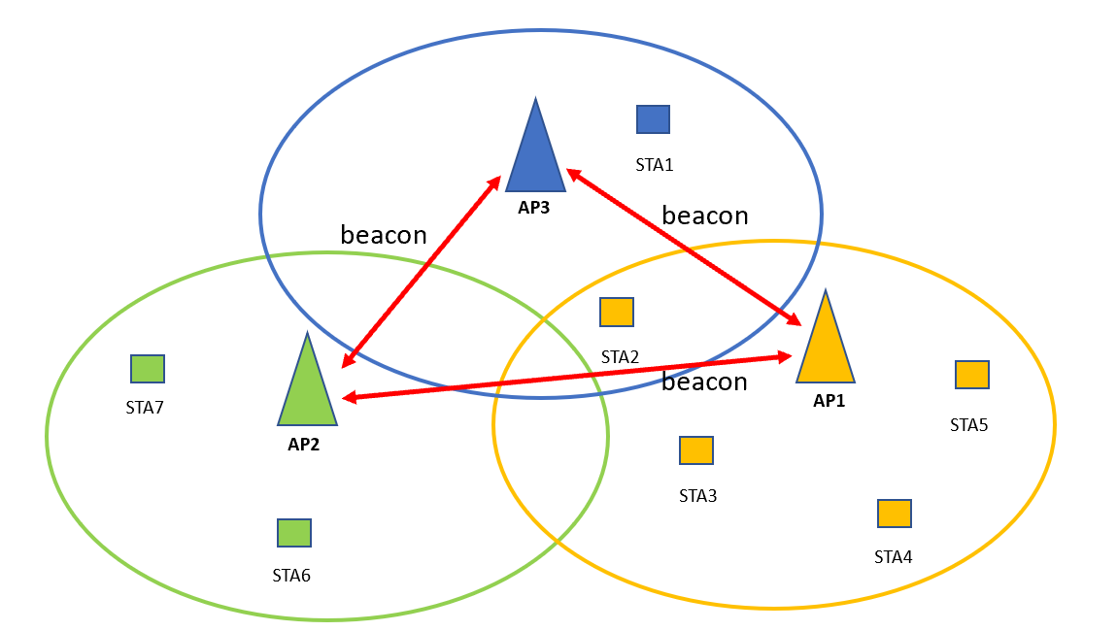
Step – 1: Setup Neighbor AP
Neighboring APs can discover each other by sending beacon frames.
Neighboring APs discover each other and establish AP groups

Slide 6
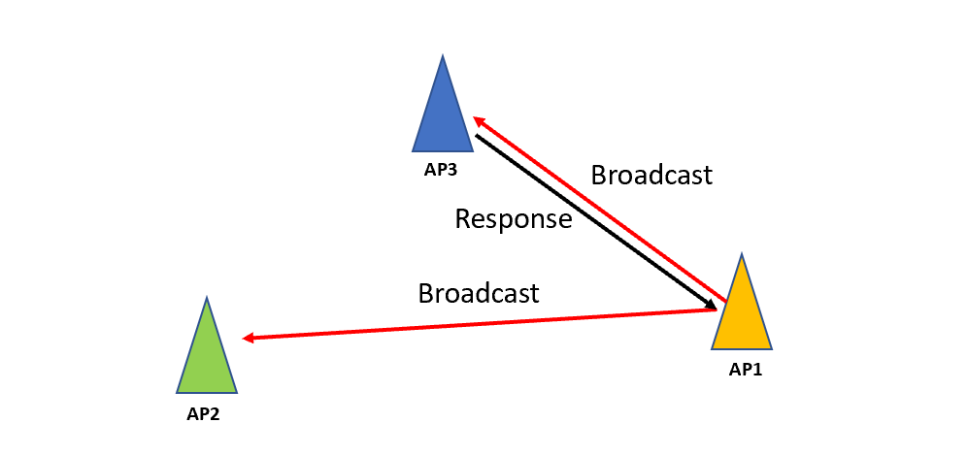
Step – 2: AP1 sends a broadcast for help
When the AP feels overloaded (the number of access users exceeds a threshold), it issues a request for help and reaches each AP in the group by broadcasting it within the group.
AP1 sends a request to other AP in the group.
source AP-id
source BSS-id
Suggest STA-List
AP3 response information to AP1 after simple calculation.
source AP-id
source BSS-id
Suggest STA-List

Slide 7
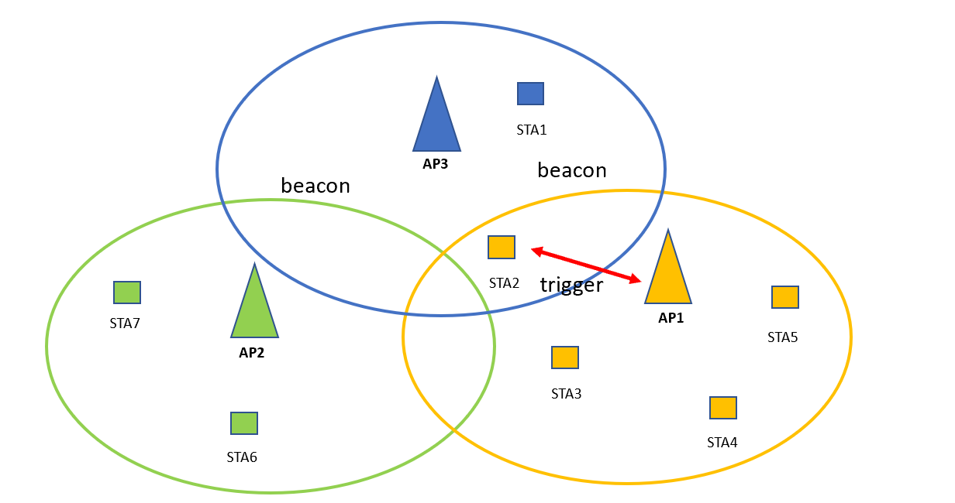
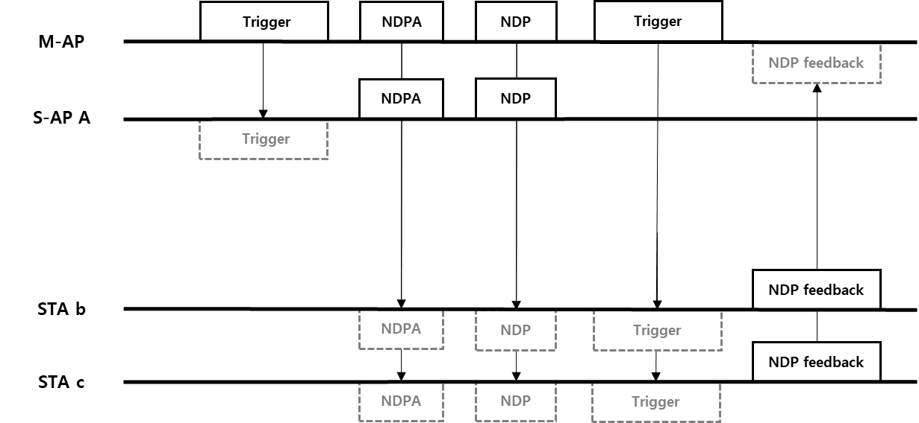
Step – 3: AP1 uninstalls users to AP3
During channel monitoring, AP1 tells the STA2 to uninstall to target AP3 through trigger, and sends the authentication in AP3 to the user.

Slide 8
Step – 4: Unload user access AP3
AP1
STA2
AP3
Association establishment
Uninstall successfully
Data transmission
AP1 has transmitted AP3 information to STA through the trigger, and STA can directly access AP3.
STA2 has established a connection with AP3 and feeds back to the AP, disconnecting AP1 from STA2
STA2 is successfully connected to AP3 and can transmit data

Slide 9
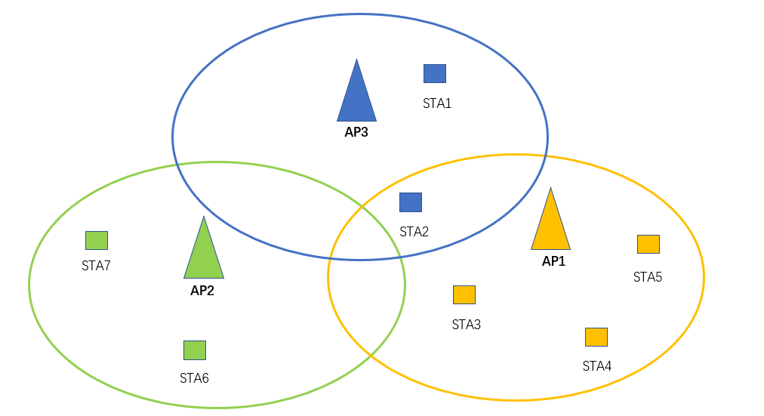
Summary - I
STA2 accesses AP3 and AP1 successfully unloads the user to AP3.

Slide 10
Summary - II
Summary: This paper describes in detail an STA transfer method based on multi-AP cooperation, which is applicable to multi-AP collaborative communication.
Contribution: Through the cooperation mode among multiple APs, the user unloading between APs is completed, the load balance between APs is achieved, the resources between Wi-Fi are fully utilized, and the communication quality of users is improved.

Slide 11
References
[1] 11-20-0560-00-00be-multi-ap-configuration-and-resource-allocation
[2] Coordinated Spatial Reuse Operation
[3] 11-19-1895-03-00be-setup-for-multi-ap-coordination
[4] C. Deng et al., "IEEE 802.11be Wi-Fi 7: New Challenges and Opportunities," in IEEE Communications Surveys & Tutorials, vol. 22, no. 4, pp. 2136-2166.

