Slide 1
Multi-AP Operation for Low Latency Traffic Delivery - Follow up
Date: 2022-11-06
Authors:
Name | Affiliation | Address | Phone | Email
Liuming Lu | OPPO |  |  | luliuming@oppo.com
Chaoming Luo
Pei Zhou
Liuming Lu (OPPO)

Slide 2
Recap
Mechanisms for Low Latency Traffic Delivery need to be improved
Enhance signaling and coordination among multiple co-channel APs
Extend the medium access protection mechanism to multiple BSSs
The mechanism to eliminate or mitigate OBSS interference
Multi-AP Coordination/Operation for Low Latency Traffic Delivery
The related information is shared among APs (i.e. co-channel APs not affiliated with the same MLD)
the resource (such as r-TWT SPs) to be protected
the interfering APs/STAs and/or their allowed transmit power/ RSSI
Multiple co-channel APs interoperate with each other to enhance medium access protection for SPs to provide predictable latency
ensure low-latency QoS Data frames to be first delivered during protected SPs
reduce impact on transmission efficiency in BSSs
spatial reuse can be considered to allow the medium to be reused during SPs

Slide 3
Requirements for Multi-AP Operation
Different Multi-AP operation schemes have different levels of requirements for interoperation
Multi-AP operation Type 1 (loose/light coordination)
transmission schemes may include OBSS PD-based/PSR-based spatial reuse etc.
The information（such as SPs, TX power constraints） is shared among APs
Specific time alignment – the alignment of start time and end time of SPs among BSSs
Interoperation level:
non-backhaul: such as beacon request/response, or co-channel signaling
Backhaul – mainly for information sharing
Multi-AP operation Type 2 (tight coordination)
transmission schemes may include coordinated OFDMA/MU-MIMO/Beamforming, Joint Transmission etc.
Real-time signaling among APs: strict time synchronization
Interoperation level:
non-backhaul – co-channel signaling
Backhaul - with different requirements for special transmission schemes

Slide 4
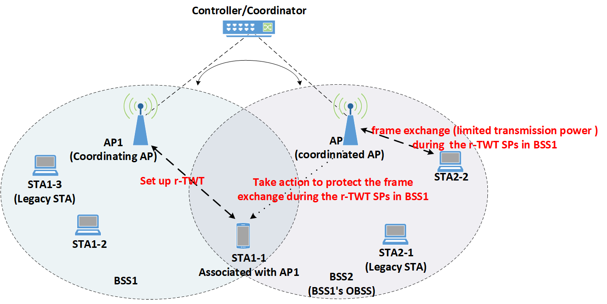
Scenario for Type1 Multi-AP operation
AP1 and AP2 can share the information through a backhaul with limited KPIs
AP1 and AP2 may not support coordinated OFDMA/MU-MIMO/Beamforming, Joint Transmission etc.
Under the condition of no multi-AP coordination for SP scheduling
OBSS interference from BSS2 would impact the STA1-1’s frame exchanges during r-TWT SPs in BSS1
Under the condition of multi-AP coordination for SP scheduling
AP2 take actions to protect the frame exchange during the r-TWT SPs in BSS1
Frame exchanges during the r-TWT SPs in BSS1 are limited in BSS2
Only STAs that satisfy the constraints are allowed to exchange frames with high priority
Transmission power is limited for STAs that exchange frames in BSS2
Figure. Scenario for Multi-AP operation Type1 (loose coordination)

Slide 5
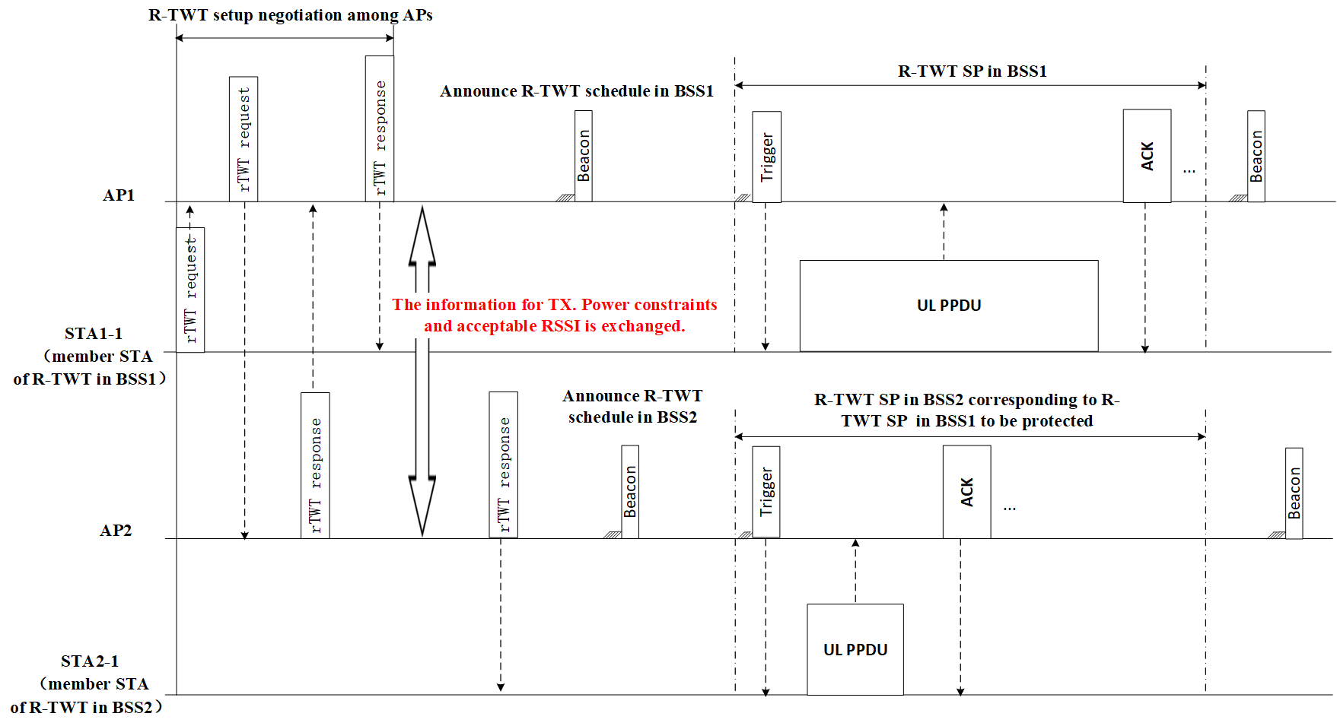
Signaling for Type1 Multi-AP operation
R-TWT setup is negotiated among APs
AP2 can accept or reject the R-TWT request from BSS1
The information for TX. Power constraints and acceptable RSSI of AP1 and STA1-1 is exchanged.
After successful R-TWT setup
STA1-1 exchanges frames initiated by AP1 during R-TWT SP in BSS1 with allowed TX. power.
AP2 initiates frame exchange with the STAs that satisfy the TX. constraints with allowed TX. power during R-TWT SP in BSS2 corresponding to R-TWT SP in BSS1 to be protected
Figure. Signaling for Multi-AP operation Type1 (loose coordination)

Slide 6
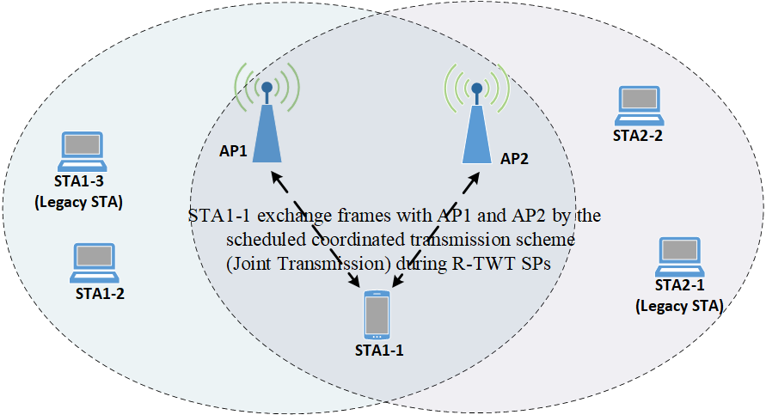
Scenario for Type2 Multi-AP operation
AP1 and AP2 communicate with each other by co-channel signaling or backhaul with better KPIs
AP1 and AP2 support one or more of coordinated transmission schemes, such as OFDMA/MU-MIMO/Beamforming, Joint Transmission etc.
Under the condition of no multi-AP coordination for SP scheduling
AP1 may not obtain the TXOP after the start time of R-TWT SPs
No guarantee for the frame exchange between AP1 and STA1-1 with the scheduled coordinated transmission scheme during R-TWT SPs
Under the condition of multi-AP coordination for SP scheduling
The R-TWT member STAs can exchange frames with AP1 and AP2 by the scheduled coordinated transmission scheme during R-TWT SPs
Figure. Scenario for Multi-AP operation Type1 (tight coordination)

Slide 7
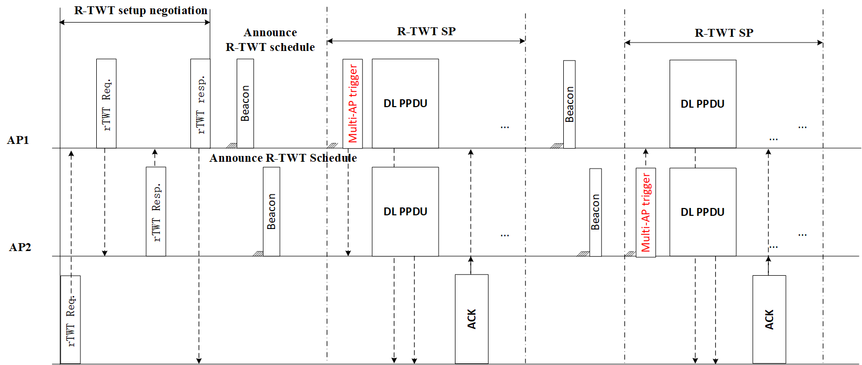
Signaling for Type2 Multi-AP operation
R-TWT setup is negotiated among APs
AP2 can accept or reject the R-TWT request from BSS1
the scheduled coordinated transmission scheme and related transmission parameters are exchanged.
After successful R-TWT setup
If obtaining the TXOP any AP (AP1 or AP2) initiate the frame exchanges with the R-TWT member STA by the scheduled coordinated transmission scheme during R-TWT SPs
Figure. Signaling for Multi-AP operation Type2 (tight coordination)

Slide 8
Summary
Multi-AP coordination/operation is suggested to provide higher reliability for delivering low latency traffic including enhanced medium access protection for reserved resource during scheduled time across different co-channel BSSs.
Two types of multi-AP coordination/operation for LL traffic delivery can be considered based on different levels of requirements for interoperation among APs
(1) Type1 Multi-AP coordination/operation
TX. Power constraints and acceptable RSSI for related STAs are negotiated among APs for SP scheduling.
The coordinated AP takes actions to protect the frame exchange during the scheduled SPs in BSS of the coordinating AP (such as transmission with limited TX. power)
(2) Type2 Multi-AP coordination/operation
the scheduled coordinated transmission scheme and related transmission parameters are exchanged for SP scheduling
The member STAs exchange frames with APs by the scheduled coordinated transmission scheme during scheduled SPs

Slide 9
Straw Poll
Do you agree that UHR should specify a mode of multi-AP coordination/operation to provide higher reliability for delivering low latency traffic including enhanced medium access protection for reserved resource during scheduled time among co-channel BSSs?

Slide 10
Reference
[1] IEEE 802.11be Draft 2.2
[2] https://mentor.ieee.org/802.11/dcn/22/11-22-1556-01-0uhr-multi-ap-coordination-for-low-latency-traffic-delivery.pptx
[3] https://mentor.ieee.org/802.11/dcn/22/11-22-1809-00-0uhr-a-perspective-on-uhr-features-for-operator-residential-deployments.pptx
Liuming Lu (OPPO)

