Slide 1
320MHz NTB/TB ranging
Date: 2022-11-11
Authors:
Name | Affiliations | Address | Phone | email
Yanjun Sun | Qualcomm
Ali Raissinia
Steve Shellhammer
George Cherian
Christine Zhang
Youhan Kim

Slide 2
Introduction
Background:
802.11az has been developed over 802.11ax and supports up to 160 MHz bandwidth
Motivation:
320 MHz operation has been defined in 802.11be
320 MHz BW can offer better resolution than 160 MHz BW in ranging
Objective:
Expand appropriate 11az frames and procedures with 320 MHz support

Slide 3
Scope of This Contribution
Focus on MAC related changes
Explore options to indicate 320 MHz BW in the following frames:
Ranging NDPA
Ranging Trigger variants
IFTMR/IFTM for session negotiation
Assumptions:
May support some non-OFDMA puncturing patterns (see [1])
Some regions may only have 240 MHz bandwidth
Still offers better accuracy than 160 MHz BW
Frame exchange sequence are expected to remain the same as in 11az to maximize the reuse of existing logics

Slide 4
NDPA Enhancement

Slide 5
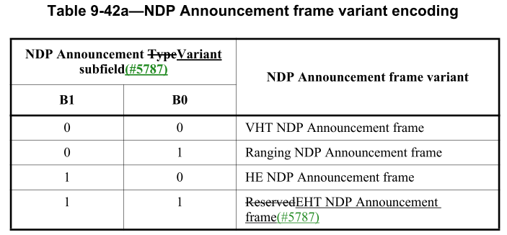
Recap: 11az Ranging NDPA
NOTE: AIDs of 2044 and 2045 also have unique formats
With secure LTF

Slide 6
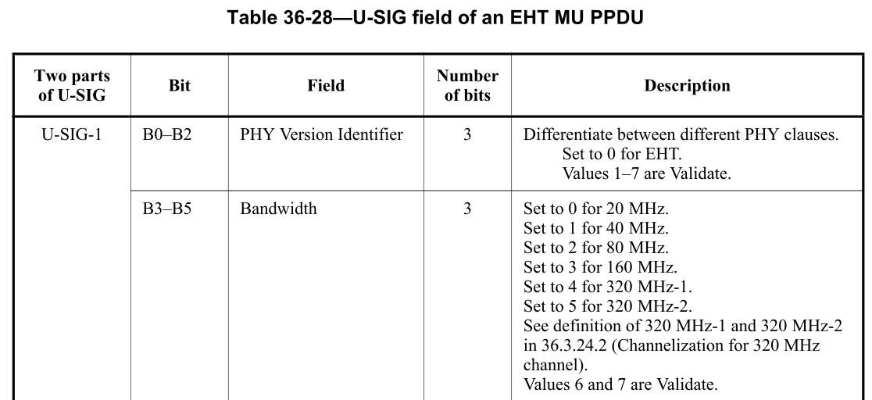
Recap: 320 MHz indication in EHT NDPA
For NDPA in non-HT Duplicate PPDU:
B7 in the SERVICE field is set to 1 to indicate 320 MHz based on the following 11be spec text:
“If the CH_BANDWIDTH_IN_NON_HT parameter in the TXVECTOR primitive is present and is equal to CBW320, then bit 7 of the SERVICE field is set to 1. The remaining 8 bits (8–15) of the SERVICE field shall be reserved for future use.”
For NDPA in EHT MU PPDU:
The U-SIG field can indicate 320 MHz

Slide 7
Proposal: 320 MHz for Ranging NDPA
Use existing Ranging NDPA variant encoding in 11az and existing 320MHz indication in 11be
No change to the Ranging NDPA MAC content
non-HT dup PPDU: set B7 in SERVICE field to 1 to indicate 320 MHz
EHT MU PPDU: set PHY header to indicate 320 MHz
Non-HT Duplicate PPDU
PHY preamble
Service
PSDU
Set B7 to 1 as defined in 11be
Use the existing Ranging NDPA format defined in 11az
EHT MU PPDU or
Future PPDU
PHY preamble
Service
PSDU
Use the Bandwidth field in the U-SIG field to indicate 320 MHz as defined in 11be
Use the existing Ranging NDPA format defined in 11az

Slide 8
Trigger Enhancement

Slide 9
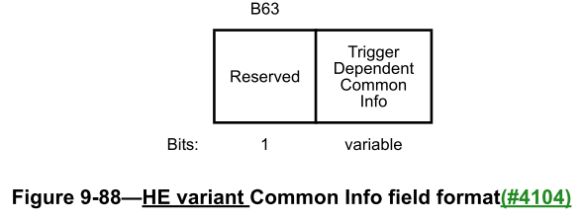
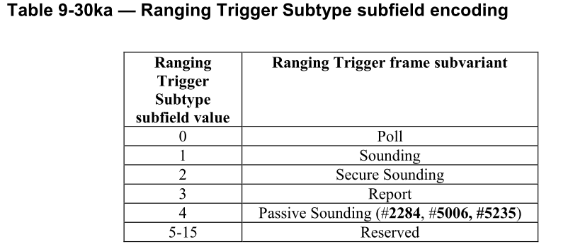
Recap: 11az Trigger frame variants

Slide 10
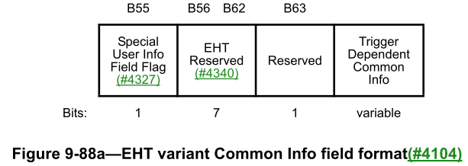
Recap: 320 MHz indication in EHT Trigger

Slide 11
Proposal: 320 MHz for Ranging Trigger
Add the Special User Info field defined in 11be to the Ranging Trigger frame variants defined in 11az
Benefit: simple
Set B55 to 0 to indicate the presence of the following Special User Info field, which uses the format defined in 11be to indicate 320 MHz
Set trigger type subfield to 8 to indicate the Ranging variant

Slide 12
Session Negotiation Enhancements

Slide 13
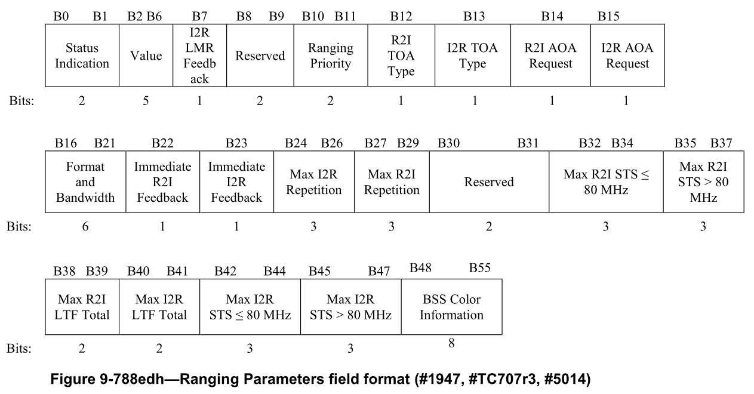
Recap: Negotiation with IFTMR
From 11md and 11az:
Expansion is needed
New subelement(s) for 11be related info

Slide 14
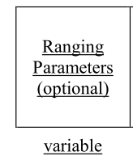
Recap: Negotiation with IFTM
Expansion is needed
New subelement(s) for 11be related info

Slide 15
Proposal: Additional Info for IFTMR/IFTM
Use the reserved entries in the Format And Bandwidth subfield to indicate 320 MHz
Use new subelements to indicate TPE and puncturing info for 320 MHz
Add entries for 320 MHz
Add a new subelement for TPE and/or a new subelement for puncturing pattern

Slide 16
Summary
This contribution explored options to indicate 320 MHz BW in the following frames by an 11be STA
Ranging NDPA
Ranging Trigger variants
IFTMR/IFTM for session negotiation
The analysis showed that the indications of 320 MHz defined in 11be can be applied to the above frames from 11az
As the 11be indications are outside the fields that carries the 11az-specific info

Slide 17
References
[1] Thoughts on 320 MHz Ranging NDP, 22/1981r0, https://mentor.ieee.org/802.11/dcn/22/11-22-1981-00-00az-thoughts-on-320-mhz-ranging-ndp.pptx, Steve Shellhammer et al.

Slide 18
Backup

Slide 19
On 320 MHz-1 and 320 MHz-2
36.3.24.2 Channelization for 320 MHz channel
The 320 MHz channel consists of any two adjacent 160 MHz channels in the 6 GHz band. Two type of channelizations for 320 MHz channel are defined: 320 MHz-1 and 320 MHz-2.
320 MHz-1 is defined as 320 MHz channel with channel center frequency numbered 31, 95, and 159. 320 MHz-2 is defined as 320 MHz channel with channel center frequency numbered 63, 127, and 191.
Credit: source of the image

