Slide 1
Transition period during MAC address change
Date: 2022-10-10
Authors:

Slide 2
Abstract
Current contribution describes the mechanism to put in place in order to proceed to a MAC address change while associated without breaking the ongoing communications.
Previous contribution [2] described a mechanism to allow a seamless change of the MAC address of a non-AP STA while associated to an AP, both the current and the new MAC addresses need to be valid during the same period of time called transition period.
Current contribution explicits mechanisms to handle the transition period by providing rules for data selection and by determining the end of the transition period thanks to the usage of a BSR to indicate quantity of remaining packets addressed with an old MAC address.

Slide 3
Overview
11bi requirement document [1] includes requirements (Req 7 and 8) mandating a mechanism for a station to change its MAC address in “State 4 without any loss of connection”.
[2] proposed a mechanism to support such constraint by providing a transition period to change from one MAC address to another one
This contribution proposes a mechanism for data selection during transition period in which the two MAC addresses are potentially used.
This contribution proposes a mechanism to determine the end of this transition period based on Buffer Status Report (BSR) exchange.

Slide 4
11bi requirement
7 | 11bi shall define a mechanism for a CPE Client to initiate changing its own OTA MAC Address used with a CPE AP in Associate STA State 4 without any loss of connection. | I3 | Approved | Proposed - 22/107r2 (9 March 2022) To be motioned –agreed by unanimous consent 4/21/2022 Approved (Motion #13, 13 November 2022)
8 | 11bi shall define a mechanism for a CPE AP to initiate changing the OTA MAC Addresses of all associated CPE Client’s in the BSS (those CPE Clients in Associate STA State 4) simultaneously without any loss of connection Edited to: 11bi shall define a mechanism for a CPE AP to initiate changing the OTA MAC Addresses of a set of associated CPE Client’s in the BSS (those CPE Clients in Associate STA State 4) without any loss of connection. | I3 | Approved | Proposed - 22/107r2 (9 March 2022) To be motioned –agreed by unanimous consent 4/21/2022 Approved (Motion #13, 13 November 2022)

Slide 5
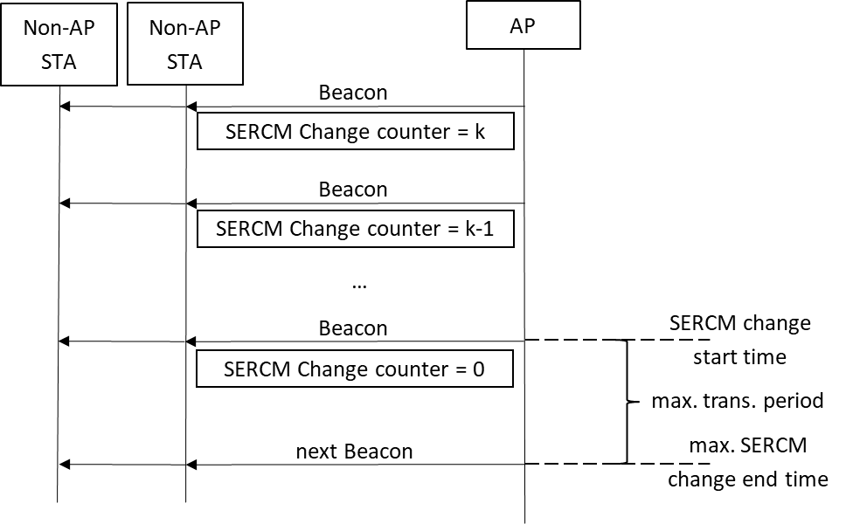
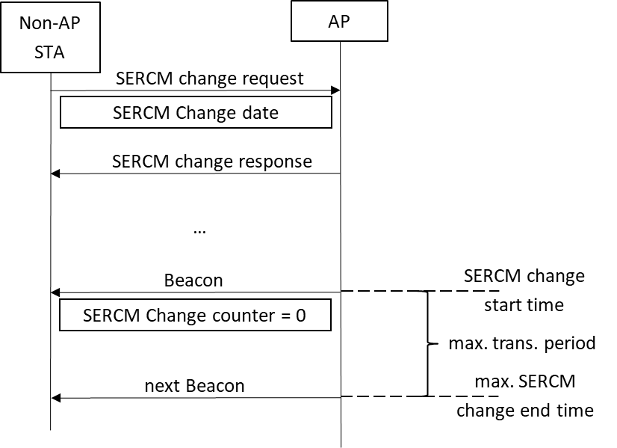
Main principle [2]
AP Initiation
Non-AP Initiation
@MAC (n)
@MAC (n)
@MAC (n)
&
@MAC (n+1)
@MAC (n)
&
@MAC (n+1)
@MAC (n+1)
@MAC (n+1)
@MAC (n+1) = PRF-128/46( ERCM Key, “ERCM”, @MAC (n) , 128)

Slide 6
STA1
AP
Pkt with TA = @MAC (n)
  Beacon
empty transmission buffer for STA1
Pkt with TA = @MAC (n+1)
non-empty transmission buffer
ERCM Change counter=k-1
BSR(AC₀, AC₁, AC₂, AC₃)
…
  Beacon
transition period
ERCM Change counter=0
AC₀, AC₁, AC₂, AC₃
support both :
STA1 TA = @MAC (n)
STA1 TA = @MAC(n+1)
Support both
@MAC (n)
@MAC (n+1)
BSR (0,x,y,z), TA=@MAC (n)
BSR (0,x,y,z), TA=@MAC (n)
BA : RA=@MAC (n)
buffering new packet for STA1 with RA = @MAC(n+1)
buffering new packet
TA = @MAC(n+1)
BSR (0,0,y,z), TA=@MAC (n+1)
BSR (0,0,y,z), TA=@MAC (n+1)
BA : RA=@MAC (n+1)
BSR (0,0,0,0), RA=@MAC (n+1)
Ack : TA=@MAC (n+1)
support only
@MAC(n+1)
BSR (0,0,0,0), TA=@MAC (n)
Support only :
STA1 TA = @MAC(n+1)
Ack : RA=@MAC (n)

Slide 7
Data selection process during transition period:
Classical EDCA rules applies:
  When a backoff counter corresponding to an Access category queue reaches zero, the station selects data from the corresponding queue.
However:
  if the station is in a transition period, the station should not transmit data with different source addresses in the same transmission opportunity (TXOP). So, if the selected AC contains data addressed with the old and the new MAC address, the station should refrain from transmitting a frame with a different source address than the one of the first packet it transmits during the TXOP

Slide 8
BSR exchange during the transition period:
A station that is in a transition period, computes BSR based on the quantity of data buffered that are addressed only with the old MAC address.
  In particular, if a station determines that there is no more data buffered in any queues that are addressed with the old MAC address, the station creates an “empty” BSR (a BSR indicating no remaining buffered data).
If a station receives an empty BSR (a BSR indicating no remaining buffered data) and the station is in a transition period, the station considers that the remote station is ready to finish the transition period.
When both non-AP STA and AP are ready to finish the transition period, then the transition period ends and both non-AP station and AP release the old MAC address

Slide 9
Benefits
User privacy is enhanced by allowing a station to change its MAC address while associated without break of ongoing communication.
The change of a MAC address is not easily detectable since additional mechanism described here are based on existing signaling (BSR).
The duration of the transition period is reduced and the BSR may be also used to indicate old data to be scheduled

Slide 10
Straw Poll #1
Do you support using a BSR based mechanism to determine the end of the transition period as described in slide 6 ?
Yes
No
Abstain

Slide 11
References
[1] IEEE 802.11-21/1848r16 : Requirements Document
[2] IEEE 802.11-22/0114r3 : Enhanced Randomized and Changing MAC address

