Slide 1
Latency and Reliability enhancements for UHR
Date: 2022-11-15
Authors:
Name | Affiliations | Address | Phone | email
Thomas Handte | Sony Group Corporation |  |  | Thomas.Handte@sony.com
Yusuke Tanaka |  |  |  | Yusuke.YT.Tanaka@sony.com
Dana Ciochina
Daniel Verenzuela
Ken Tanaka
Pukar Shakya
Kosuke Aio
Ryuichi Hirata
Liangxiao Xin
Qing Xia

Slide 2
Introduction
The UHR study group was formed to investigate technologies to improve reliability, latency, manageability, throughput and power consumption [1]
Various technologies have been suggested for consideration in UHR such as
Multi-AP [2-5]
Preemption [6]
mmWave MLO [7-8]
MIMO enhancements [9]
Power save [10-11]
In this presentation, we highlight
Technological trends with low-latency and reliability requirement
Technical solutions to address those trends and which improve performance of UHR beyond EHT
Low-latency EDCA
Preemption
Soft combination (HARQ)
Performance gains obtained by initial simulation studies

Slide 3
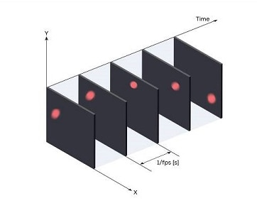
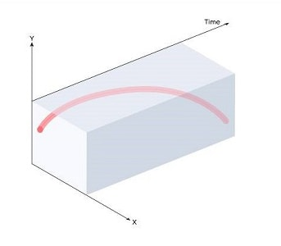
Technical Trends
Demand for event-based low-latency data transfer
Content rendering corresponding to the user’s input/motion (e.g. VR, gaming)
Event-based vision sensors (e.g. neuromorphic camera)
Image sensors with varying data rate depending on perceived scene
Sparse time-critical events (e.g. limit switch, emergency stop)
Neuromorphic computing
Transition from DNN to SNN
Low-latency traffic is event-driven and non-static in such applications
Demand for high reliability
Smart manufacturing (industry 4.0) asks for high(er) reliability
E.g. robotics and M2M communications
Demand for high reliability goes hand in hand with low-latency requirements
A timely delivered data unit has little value if erroneous
High reliability may translate into long range communication with lower reliability
High reliability is more important as throughput improvement for such applications

Slide 4
Improving low-latency
EHT provides some improvements for low-latency data delivery
MLO increases likelihood of channel access
EHT SCS can be used to provision low-latency traffic
(R-)TWT may provide additional priority to low-latency traffic
These mechanisms require that low-latency traffic has predictable and (quasi-)static characteristics
UHR should support event-driven (i.e. non-predictable) low-latency traffic
Using EHT is not good solution, because mapping of event-driven traffic to static schedules may cause
Additional queuing delay
Packet loss due to expired MSDU lifetime
Waste of resources if there is nothing to transmit
Currently, low-latency traffic cannot be sent once a device is occupied by communication that it has already started

Slide 5
How to improve latency for event-based traffic?
(Re)considering EDCA instead of triggered access
Need EDCA variant of EHT SCS [12]
Need to seek improvement for EDCA to make it more suitable for low-latency [13-15]
Cooperation among STAs of a BSS
Channel access on secondary channels
Preemption
Suspend low-priority traffic in favor of low-latency packets [6]
Different levels of preemption can be envisioned

Slide 6
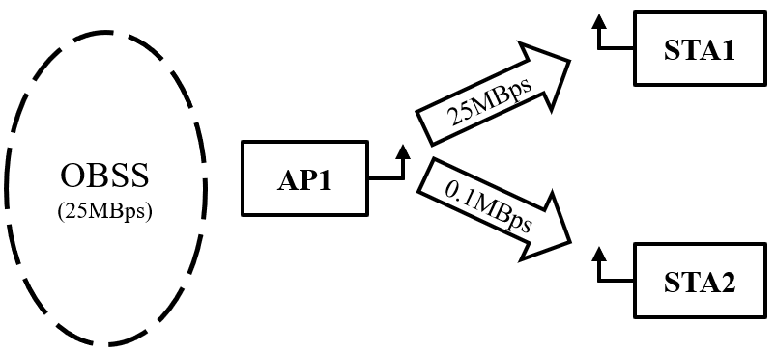
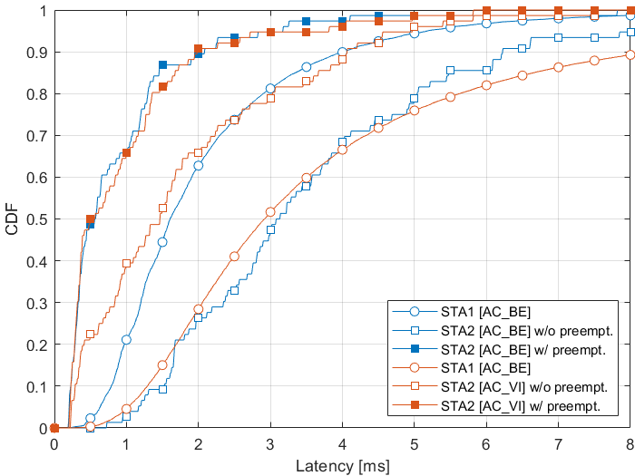
Latency improvement by Preemption
Preemption simulation and results
Simulation setup (details see Appendix)
AP1 serves 2 STAs in Downlink with CBR
STA1 with 25MBps (AC_BE)
STA2 with 100kBps (AC_BE / AC_VI / AC_VO)
AP1 uses “Intra-PPDU w/ PPDU reuse” preemption type
STA1’s traffic is suspended for delivery of STA2’s traffic
OBSS traffic with 25MBps in Downlink (AC_BE)
HT PHY 20MHz, MCS 7, 1SS, 800ns GI, 65MBps
Analysis of application layer latency
Preemption reduces latency
Latency gain of STA2 is
AC_BE: 2.6 / 4.0 ms for 50 / 90 %ile
AC_VI: 1.0 / 1.9 ms for 50 / 90 %ile
AC_VO: 1.0 / 2.1 ms for 50 / 90 %ile (see Appendix)
About 60-80% reduction in the considered scenario
Scenario 1
Scenario 2

Slide 7
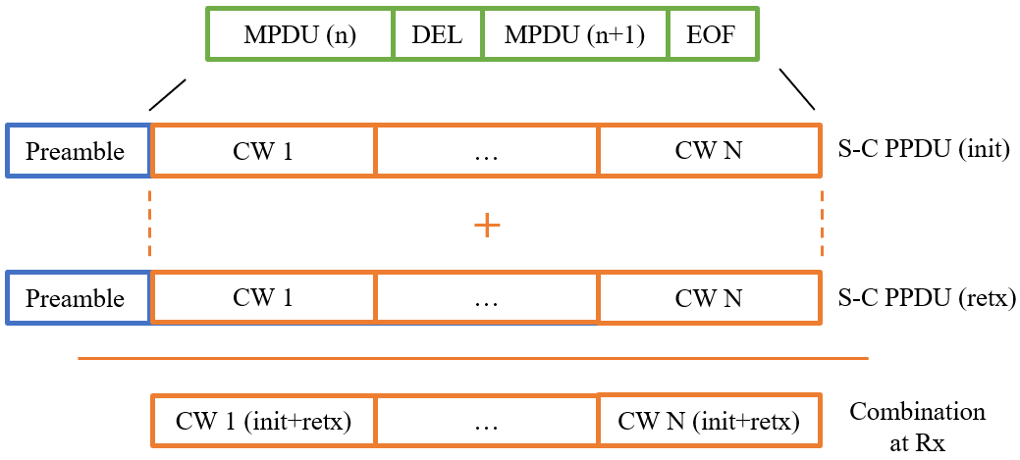
How to improve reliability?
Considering soft combining (HARQ type II)
With ARQ (HARQ type I) earlier transmissions are wasted
Next generation ARQ is yet unexploited in WLAN
During early EHT/TGbe discussions, concerns have been raised about complexity
Mainly due to the MPDU/CW misalignment
Soft combining on PPDU level
A soft-combinable (S-C) PPDU can be combined at a receiver with another related S-C PPDU
same data (as contained in initial S-C PPDU) is retransmitted
soft combination is per codeword
Loss due to repeating an entire PPDU instead of fragments is low
targeted high-reliability applications tend to have small data units
A-MPDU would be rarely used
PPDU sizes tend be small

Slide 8
How to improve reliability?
Implementation
An S-C PPDU should reuse current PPDU structure
Chase combining with or without different parity information may be applicable
Each S-C PPDU stays self-decodable
Can limit maximum S-C PPDU length to meet memory requirements at Tx/Rx
Can reuse FCS to determine if a S-C PPDU contained erroneous data

Slide 9
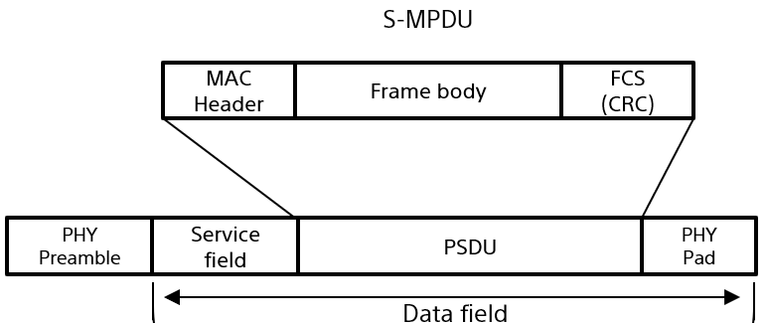
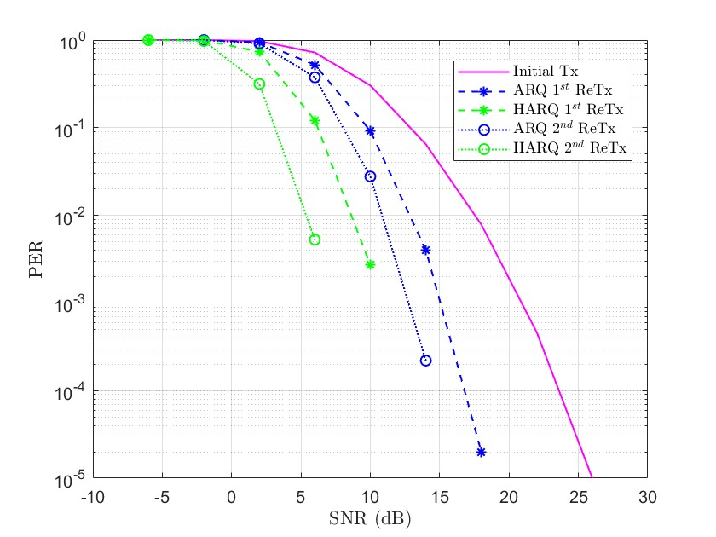
Reliability enhancement by soft combination
Soft combination simulation and results
Simulation of S-C PPDU and comparison with ARQ
11ac PPDU, 20 MHz, LDPC, channel D, S-MPDU with 1500 Bytes payload
Details of encoding and decoding see Appendix
PER performance is increased by
3.97 dB compared to ARQ after 1st retransmission
6.64 dB compared to ARQ after 2nd retransmission

Slide 10
Conclusion
Technical trends show future demand of
Event-driven low-latency data delivery
High reliability data delivery
To support those demands, UHR should consider technologies such as
Improvements to EDCA to better deal with low-latency traffic
Preemption: Suspension of ongoing traffic in favor of low-latency traffic
Soft combination (HARQ)
HARQ on PPDU level is sufficient for most of the envisioned applications and comes with low implementation complexity
Initial simulation results show that significant gains are achievable
Preemption may result in solid latency gains, even for high priority ACs
Soft combination may achieve several dBs improvement in PER
UHR should therefore consider those technologies

Slide 11
Straw Poll #1
Do you agree that preemption as described on slide 5 is a promising technology for UHR to lower latency?
Yes
No
Abstain

Slide 12
Straw Poll #2
Do you agree that soft-combination of PPDUs is a promising technology for UHR to enhance reliability?
Yes
No
Abstain

Slide 13
References
[1] 11-22/708 “Beyond be - Next Step”
[2] 11-22/1516 “Considerations on Multi-AP Coordination”
[3] 11-22/1530 “Multi AP coordination for next-generation Wi-Fi”
[4] 11-22/1567 “C-OFDMA throughput analysis in various mesh backhaul scenarios”
[5] 11-22/1556 “Multi-AP Coordination for Low Latency Traffic Delivery”
[6] 11-22/1393 “Latency Reduction Scheme for UHR”
[7] 11-22/1395 “Thoughts on high frequency band”
[8] 11-22/1595 “Some questions to answer in the SG”
[9] 11-22/1649 “MIMO interference suppression for enhanced reliability”
[10] 11-22/1790 “Green AP and resilience requirements for home networks”
[11] 11-22/1414 “Low Power Listening Mode”
[12] 11-22/1935 “LB266 - Resolution for CID 10924”
[13] 11-21/1656 “Primary and Secondary User in R-TWT”
[14] 11-20/1691 “TXOP rules to reduce worst-case latency”
[15] 11-21/1852 “Overlaid UL transmissions enabling low latency for emergency use cases”

Slide 14
Appendix

Slide 15
Preemption simulation details
BSS1
AP1 transmits UDP packets of size 1472 Bytes to STA1 and STA2 with CBR traffic model
STA1 receives 25 MBps with AC_BE
STA2 receives 100 kBps with AC_BE / AC_VI / AC_VO
AP1 uses HT PHY 20MHz, MCS 7, 1SS, 800ns GI, 65MBps
AC_BE has TXOP length setting of 0
If preemption is enabled, downlink traffic to STA2 can get channel access via its own EDCAF or via the EDCAF of the preempted traffic (if different)
Round robin scheduling among receiver STAs of same AC
OBSS (BSS2)
AP2 (not shown) transmits UDP packets of size 1472 Bytes to STA3 (not shown) with CBR traffic model
STA3 receives 25 MBps with AC_BE
AP2 uses HT PHY 20MHz, MCS7, 1SS, 800ns GI, 65MBps
AC_BE has TXOP length setting of 0
General
There are no hidden STAs

Slide 16
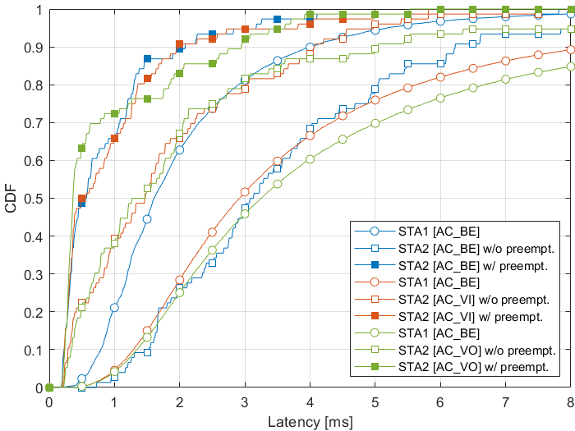
Additional preemption simulation results
The Figure is same as on slide 6 but includes results for downlink traffic to STA2 using AC_VO (Scenario 3)
Scenario 1
Scenario 2
Scenario 3

Slide 17
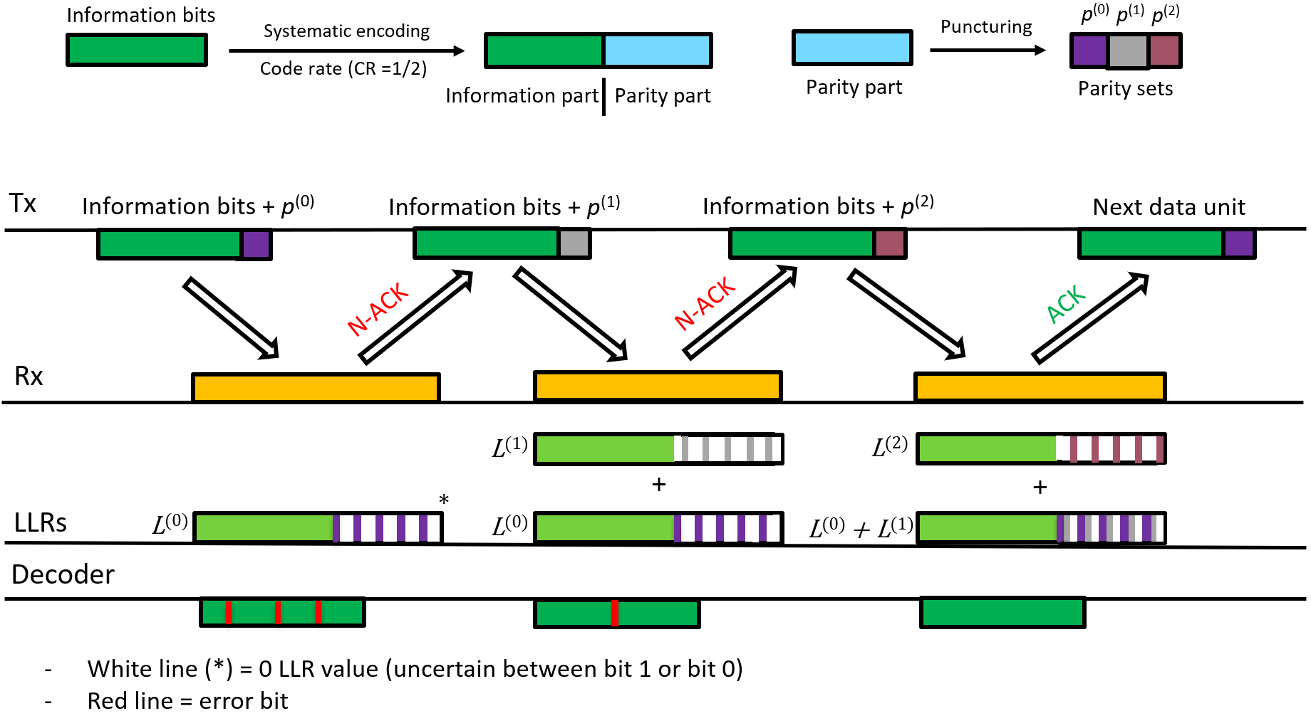
HARQ encoding and decoding
Soft combination is done per codeword (CW)
In a retransmission, each CW consist of
Same information part compared to initial transmission
Different parity part compared to previous transmission
Different parities are created by puncturing of WLAN CR ½ LDPC
In the example we have CR ¾ in each transmission
LLRs of information part and parity part are appropriately combined (added) at receiver
The following is done for each CW

