Slide 1
Latency and Reliability enhancements for UHR
Date: 2022-11-10
Authors:
Name | Affiliations | Address | Phone | email
Thomas Handte | Sony Group Corporation |  |  | Thomas.Handte@sony.com
Yusuke Tanaka |  |  |  | Yusuke.YT.Tanaka@sony.com
Dana Ciochina
Daniel Verenzuela
Ken Tanaka
Pukar Shakya
Kosuke Aio

Slide 2
Introduction
The UHR study group was formed to investigate technologies to improve reliability, latency, manageability, throughput and power consumption [1]
Various technologies have been suggested for consideration in UHR such as
  Multi-AP [2-5]
  Preemption [6]
  mmWave MLO [7-8]
  MIMO enhancements [9]
  Power save [10-11]
In this presentation, we highlight
  Technological trends with low-latency and reliability requirement
  Technical solutions to address those trends and which improve performance of UHR beyond EHT
    Low-latency EDCA
    Preemption
    Soft combination (HARQ)
  Performance gains obtained by initial simulation studies

Slide 3
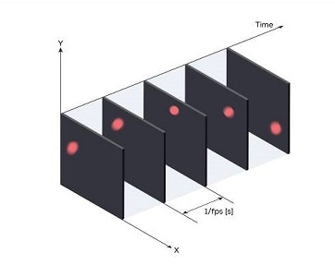
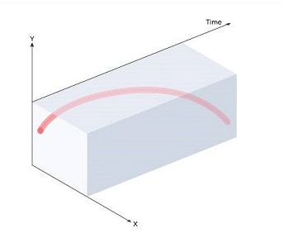
Technical Trends
Demand for event-based low-latency data transfer
  Content rendering corresponding to the user’s input/motion (e.g. VR, gaming)
  Event-based vision sensors (e.g. neuromorphic camera)
    Image sensors with varying data rate depending on perceived scene
  Sparse time-critical events (e.g. limit switch, emergency stop)
  Neuromorphic computing
    Transition from DNN to SNN
  Low-latency traffic is event-driven and non-static in such applications
Demand for high reliability
  Smart manufacturing (industry 4.0) asks for high(er) reliability
    E.g. robotics and M2M communications
  Demand for high reliability goes hand in hand with low-latency requirements
    A timely delivered data unit has little value if erroneous
  High reliability may translate into long range communication with lower reliability
  High reliability is more important as throughput improvement for such applications

Slide 4
Improving low-latency
EHT provides some improvements for low-latency data delivery
  MLO increases likelihood of channel access
  EHT SCS can be used to provision low-latency traffic
  (R-)TWT may provide additional priority to low-latency traffic
  These mechanisms require that low-latency traffic has predictable and (quasi-)static characteristics
UHR should support event-driven (i.e. non-predictable) low-latency traffic
  Using EHT is not good solution, because mapping of event-driven traffic to static schedules may cause
    Additional queuing delay
    Waste of resources if there is nothing to transmit
    Packet loss due to expired MSDU lifetime
  Currently, low-latency traffic cannot be sent once a device is occupied by communication that it has already started

Slide 5
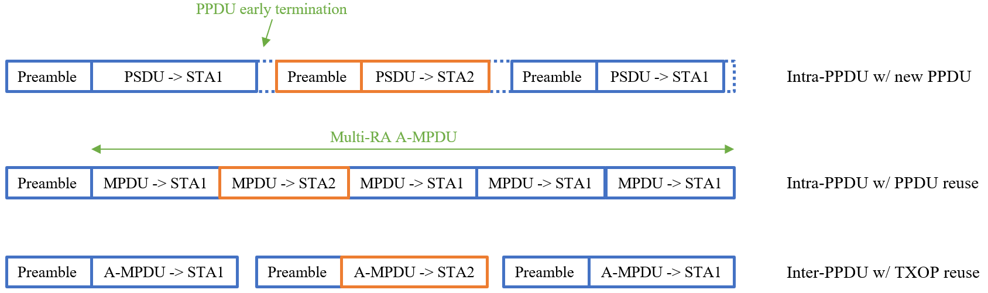
How to improve latency for event-based traffic?
(Re)considering EDCA instead of triggered access
  Need EDCA variant of EHT SCS [12]
  Need to seek improvement for EDCA to make it more suitable for low-latency [13-15]
    Cooperation among STAs of a BSS
    Channel access on secondary channels
Preemption
  Suspend low-priority traffic in favor of low-latency packets [6]
  Different levels of preemption can be envisioned

Slide 6
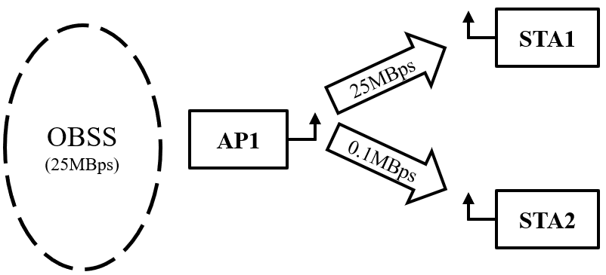
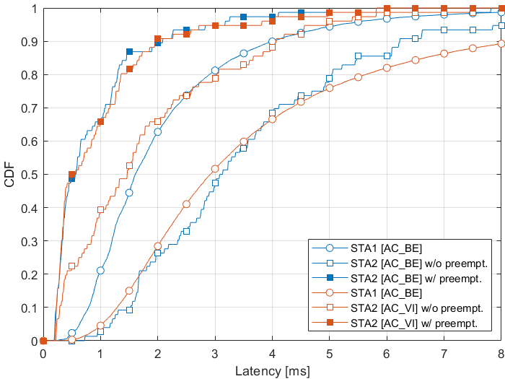
Latency improvement by Preemption
Preemption simulation and results
  Simulation setup (details see Appendix)
    AP1 serves 2 STAs in Downlink with CBR
      STA1 with 25MBps (AC_BE)
      STA2 with 100kBps (AC_BE / AC_VI / AC_VO)
    AP1 uses “Intra-PPDU w/ PPDU reuse” preemption type
      STA1’s traffic is suspended for delivery of STA2’s traffic
    OBSS traffic with 25MBps in Downlink (AC_BE)
    HT PHY 20MHz, MCS 7, 1SS, 800ns GI, 65MBps
  Analysis of application layer latency
Preemption reduces latency
  Latency gain of STA2 is
    AC_BE: 2.6 / 4.0 ms for 50 / 90 %ile
    AC_VI: 1.0 / 1.9 ms for 50 / 90 %ile
    AC_VO: 1.0 / 2.1 ms for 50 / 90 %ile (see Appendix)
  About 60-80% reduction in the considered scenario
Scenario 1
Scenario 2

Slide 7
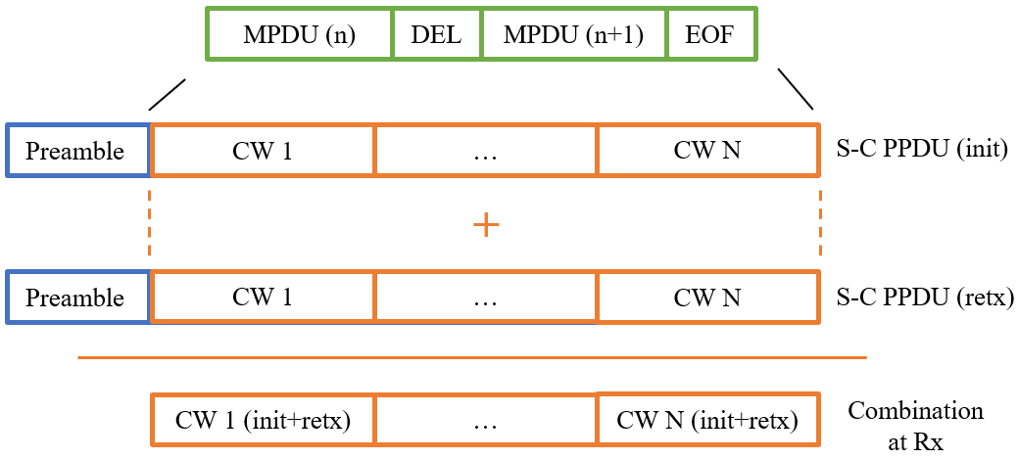
How to improve reliability?
Considering soft combining (HARQ type II)
  With ARQ (HARQ type I) earlier transmissions are wasted
    Next generation ARQ is yet unexploited in WLAN
  During early EHT/TGbe discussions, concerns have been raised about complexity
    Mainly due to the MPDU/CW misalignment
Soft combining on PPDU level
  A soft-combinable (S-C) PPDU can be combined at a receiver with another related S-C PPDU
    same data (as contained in initial S-C PPDU) is
    retransmitted
    soft combination is per codeword
  Loss due to repeating an entire PPDU instead of
  fragments is low
    targeted high-reliability applications tend to have
    small data units
      A-MPDU would be rarely used
      PPDU sizes tend be small

Slide 8
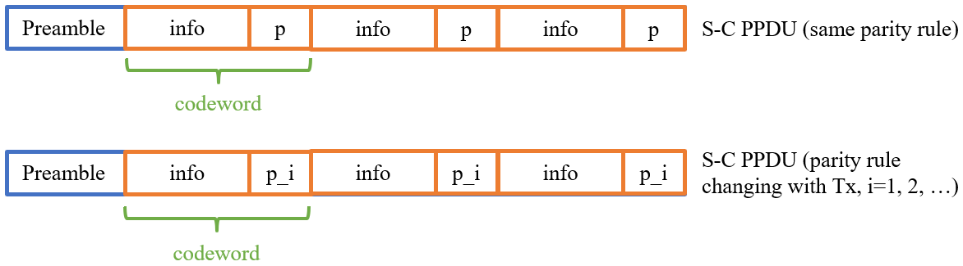
How to improve reliability?
Implementation
  An S-C PPDU should reuse current PPDU structure
    Chase combining with or without different parity information may be applicable
    Each S-C PPDU stays self-decodable
  Can limit maximum S-C PPDU length to meet memory requirements at Tx/Rx
  Can reuse FCS to determine if a S-C PPDU contained erroneous data

Slide 9
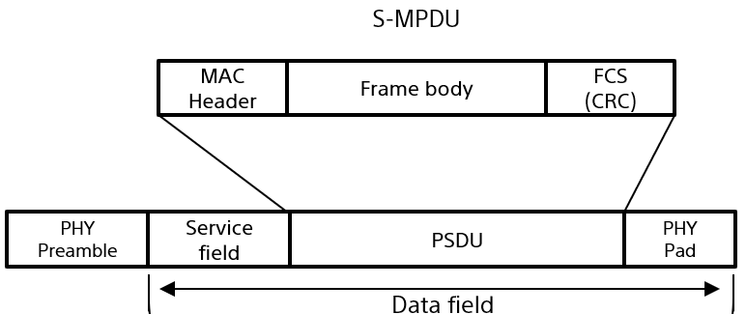
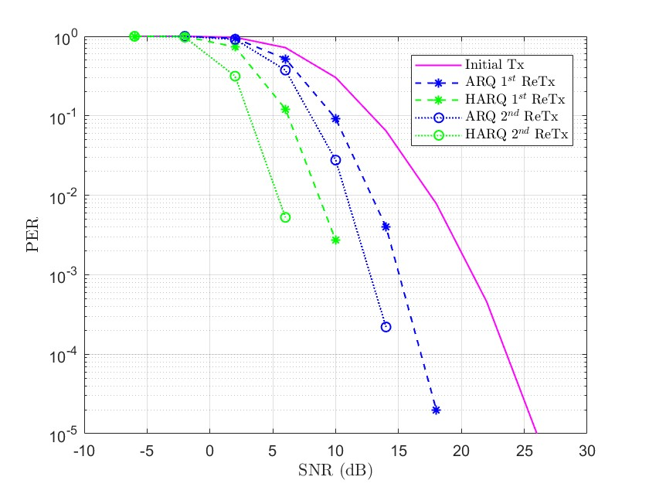
Reliability enhancement by soft combination
Soft combination simulation and results
  Simulation of S-C PPDU and comparison with ARQ
    11ac PPDU, 20 MHz, LDPC, channel D, S-MPDU with 1500 Bytes payload
    Details of encoding and decoding see Appendix
  PER performance is increased by
    3.97 dB compared to ARQ after 1st retransmission
    6.64 dB compared to ARQ after 2nd retransmission

Slide 10
Conclusion
Technical trends show future demand of
  Support of event-driven low-latency data traffic
  High reliability data delivery
To support those demands, UHR should consider technologies such as
  Improvements to EDCA to better deal with low-latency traffic
  Preemption: Suspension of ongoing traffic in favor of low-latency traffic
  Soft combination (HARQ)
    HARQ on PPDU level is sufficient for most applications and comes with low implementation complexity
Initial simulation results show that significant gains are achievable
  Preemption may result in solid latency gains, even for high priority ACs
  Soft combination may achieve several dBs improvement in PER
UHR should therefore consider those technologies

Slide 11
Straw Poll #1
Do you agree that preemption as described on slide 5 is a promising technology for UHR to lower latency?
  Yes
  No
  Abstain

Slide 12
Straw Poll #2
Do you agree that soft-combination of PPDUs is a promising technology for UHR to enhance reliability?
  Yes
  No
  Abstain

Slide 13
References
[1] 11-22/708 “Beyond be - Next Step”
[2] 11-22/1516 “Considerations on Multi-AP Coordination”
[3] 11-22/1530 “Multi AP coordination for next-generation Wi-Fi”
[4] 11-22/1567 “C-OFDMA throughput analysis in various mesh backhaul scenarios”
[5] 11-22/1556 “Multi-AP Coordination for Low Latency Traffic Delivery”
[6] 11-22/1393 “Latency Reduction Scheme for UHR”
[7] 11-22/1395 “Thoughts on high frequency band”
[8] 11-22/1595 “Some questions to answer in the SG”
[9] 11-22/1649 “MIMO interference suppression for enhanced reliability”
[10] 11-22/1790 “Green AP and resilience requirements for home networks”
[11] 11-22/1414 “Low Power Listening Mode”
[12] 11-22/1935 “LB266 - Resolution for CID 10924”
[13] 11-21/1656 “Primary and Secondary User in R-TWT”
[14] 11-20/1691 “TXOP rules to reduce worst-case latency”
[15] 11-21/1852 “Overlaid UL transmissions enabling low latency for emergency use cases”

Slide 14
Appendix

Slide 15
Preemption simulation details
BSS1
  AP1 transmits UDP packets of size 1472 Bytes to STA1 and STA2
  with CBR traffic model
    STA1 receives 25 MBps with AC_BE
    STA2 receives 100 kBps with AC_BE / AC_VI / AC_VO
  AP1 uses HT PHY 20MHz, MCS 7, 1SS, 800ns GI, 65MBps
  AC_BE has TXOP length setting of 0
  If preemption is enabled, downlink traffic to STA2 can get channel access via its own EDCAF or via the EDCAF of the preempted traffic (if different)
  Round robin scheduling among receiver STAs of same AC
OBSS (BSS2)
  AP2 (not shown) transmits UDP packets of size 1472 Bytes to STA3 (not shown) with CBR traffic model
    STA3 receives 25 MBps with AC_BE
  AP2 uses HT PHY 20MHz, MCS7, 1SS, 800ns GI, 65MBps
  AC_BE has TXOP length setting of 0
General
  There are no hidden STAs

Slide 16
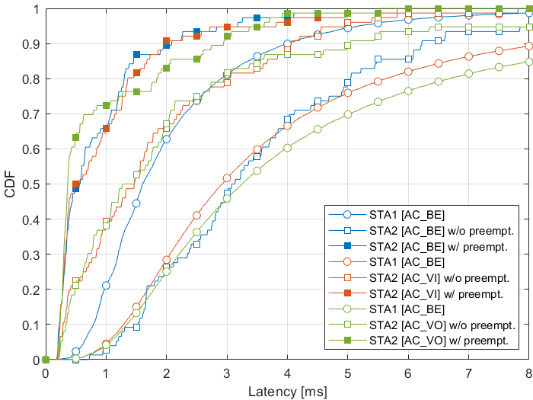
Additional preemption simulation results
The Figure is same as on slide 6 but includes results for
downlink traffic to STA2 using AC_VO (Scenario 3)
Scenario 1
Scenario 2
Scenario 3

Slide 17
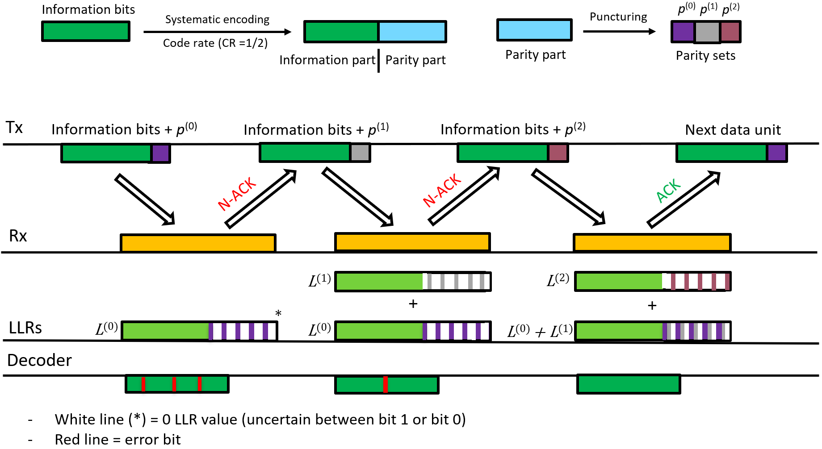
HARQ encoding and decoding
Soft combination is done per codeword (CW)
In a retransmission, each CW consist of
  Same information part compared to initial transmission
  Different parity part compared to previous transmission
    Different parities are created by puncturing of WLAN CR ½ LDPC
    In the example we have CR ¾ in each transmission
LLRs of information part and parity part are appropriately combined (added) at receiver
The following is done for each CW

