Slide 1
TXBF based on the Optimal SVD (for Next Gen WiFi)
November 2022
Doc.: IEEE 802.11-22/1869r1
Date: 2022-11-02
Authors:
Name | Affiliation | Address | Phone | Email
Aiguo Yan | Zeku | 2479 E Bayshore Rd, Palo Alto, CA 94303 |  | aiguo.yan@zeku.com
Yi-Hsiu Wang | Zeku
Xiaogang Chen | Zeku

Slide 2
Outline
November 2022
Doc.: IEEE 802.11-22/1869r0
Background
Application of the Optimal SVD in TXBFing
Potential changes for the new standards
Simulation Results of the Optimal SVD Based TXBF
Summary
Reference
Backup Slides

Slide 3
Background
November 2022
Doc.: IEEE 802.11-22/1869r0
Objectives of UHR/SG [WNG02,WNG03]
Improve reliability of WLAN connectivity,
reduce latencies,
increase manageability,
increase throughput including at different SNR levels and
reduce device level power consumption.
Some Key takeaways from Sept/2022 Meetings [UHR01,UHR02]
Features which address multiple objectives would be considered with higher priority.
Background and Advantage of the Optimal SVD based TXBF [WNG01]
We had a high-level presentation in WGN in Sept/2022
We received many suggestions/comments/questions.
Many were eager to see simulations results
Now, simulation are showing 2.1 - 2.9 dB gains on average.
This kind of gain can be translated into multiple benefits
Notes:
BW, Modulation Order, Coding, ……….

Slide 4
Optimal SVD Based TXBFing (hide standards-related details temporarily)
November 2022
Doc.: IEEE 802.11-22/1869r0
Optimal SVD:
SVD is not unique.
Choose a SVD that meets our pre-defined optimization criteria.
BFer
BFee
BF Feedback $\{ \overline{V}\left(k\right) \}$
Raw Channel $\{ H\left(k\right) \}$
BFed Channel $\{ H\left(k\right)\overline{V}\left(k\right) \}$

Slide 5
Optimal SVD Based Feedbacks (see another presentation for details)
November 2022
Doc.: IEEE 802.11-22/1869r0
Optimal SVD:
SVD is not unique.
Choose a SVD that meets our pre-defined optimization criteria.
BFer
BFee
BF Feedback $\{ \overline{V}\left(k\right) \}$
Raw Channel $\{ H\left(k\right) \}$
BFed Channel $\{ H\left(k\right)\overline{V}\left(k\right) \}$

Slide 6
Current Situation in Standards and Potential Changes
November 2022
Doc.: IEEE 802.11-22/1869r0
The Normalized V matrices (i.e., the last row is non-negatively real) are feedbacked
The best V matrices for either BFed channel or V re-construction are often not the normalized V matrices
Potential Changes to Consider
Enable feedback of the Optimal V matrices
Limit freedom of TXBFers on re-construction of pro-coding matrices
Improve Sounding Accuracy
……

Slide 7
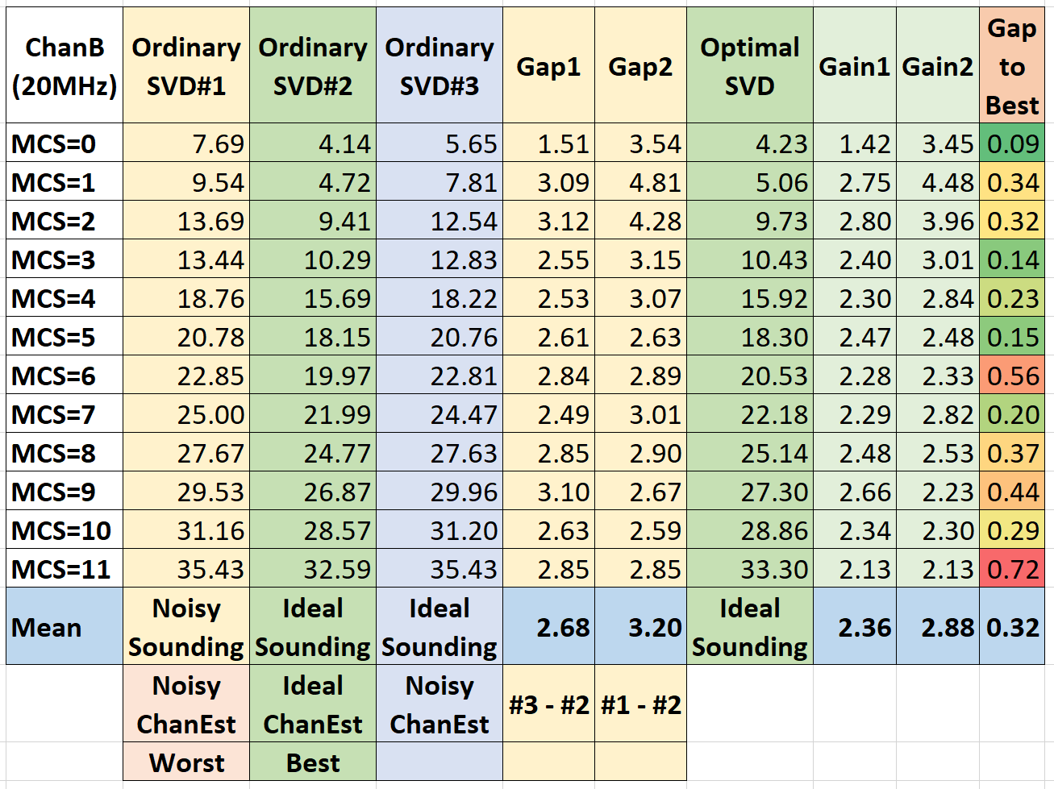
Optimal SVD based BFing (11AX PER with the Channel-B)
November 2022
Doc.: IEEE 802.11-22/1869r0
Proof of Concept here. Further optimization is possible.

Slide 8
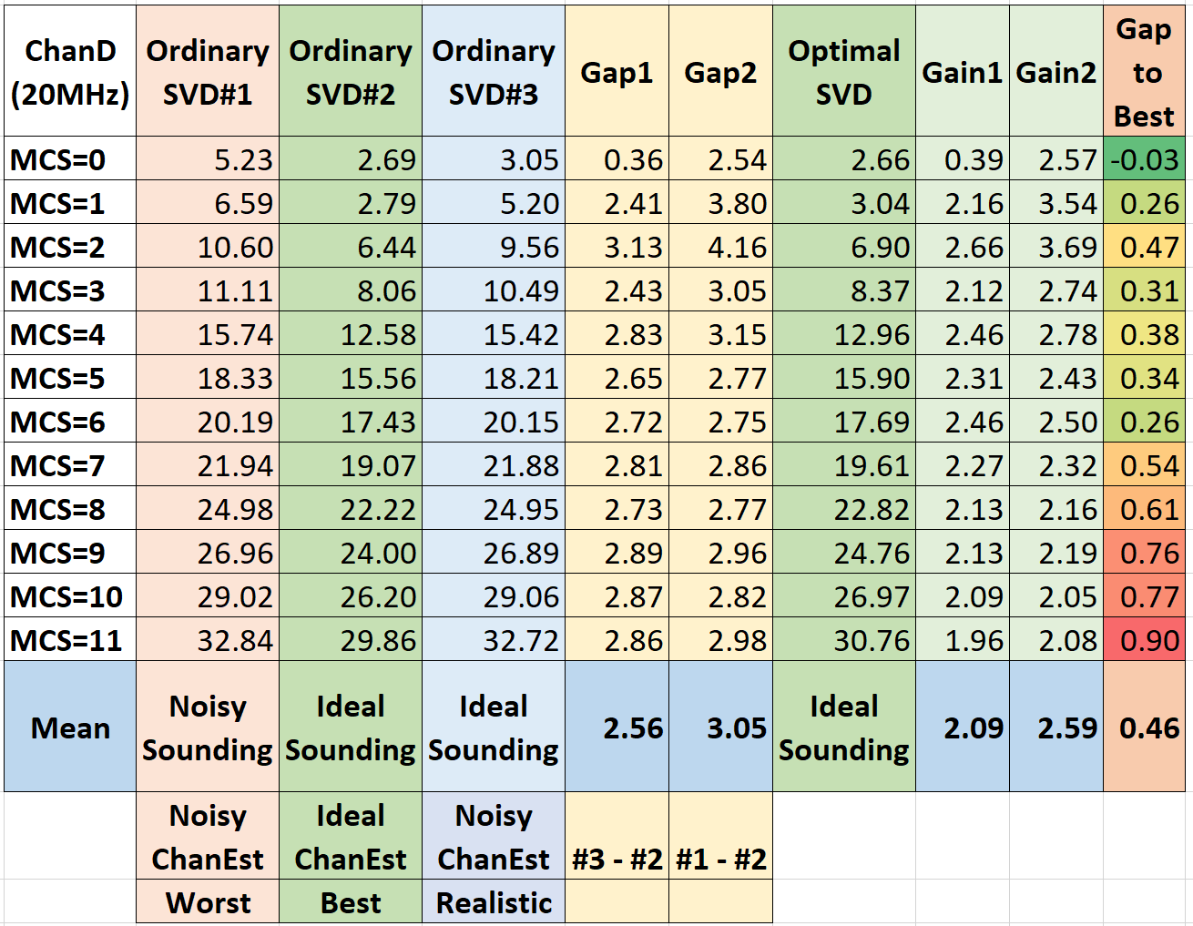
Optimal SVD based BFing (11ax PER with the Channel-D)
November 2022
Doc.: IEEE 802.11-22/1869r0

Slide 9
Summary
November 2022
Doc.: IEEE 802.11-22/1869r0
Introduced essences of the Optimal SVD and its application to TXBFing
Shared performance simulation results of the Optimal SVD based TXBF, along with BFed channel est smoothing.
There always exist Multiple Options on detailed implementations and/or standardizations.
Is further analyzing if and what kind of helps from standardization is required

Slide 10
Selected References
November 2022
Doc.: IEEE 802.11-22/1869r0
[WNG01]: 11-22-1413-01-0wng-thoughts-on-high-reliability-communications , [Aiguo Yan and et al of Zeku]
[WNG02]: 11-22-0708-03-0wng-beyond-be-next-step, [Rolf De Vegt and et al of Qualcomm]
[WNG03]: 11-22-0418-00-0wng-considerations-of-next-generation-beyond-11be (Jianhan Liu and et al of MediaTek).
[UHR01]: 11-22-1567-00-0uhr-c-ofdma-throughput-analysis-in-various-mesh-backhaul-scenarios.pptx (Sigurd Schelstraete and et al.)
[UHR02]: 11-22-1566-00-0uhr-views-on-uhr.pptx (Sigurd Schelstraete and et al.)
[TXBF01]: C. Shen and M. P. Fitz, "MIMO-OFDM Beamforming for Improved Channel Estimation," in IEEE Journal on Selected Areas in Communications, vol. 26, no. 6, pp. 948-959, August 2008, doi: 10.1109/JSAC.2008.080811.
[TXBF02]: W. Hu, F. Li and Y. Jiang, "Phase Rotations of SVD-Based Precoders in MIMO-OFDM for Improved Channel Estimation," in IEEE Wireless Communications Letters, vol. 10, no. 8, pp. 1805-1809, Aug. 2021, doi: 10.1109/LWC.2021.3081583.
[TXBF03]: E. Jeon, M. Ahn, S. Kim, W. B. Lee and J. Kim, "Joint Beamformer and Beamformee Design for Channel Smoothing in WLAN Systems," 2020 IEEE 92nd Vehicular Technology Conference (VTC2020-Fall), 2020, pp. 1-6, doi: 10.1109/VTC2020-Fall49728.2020.9348441.
[TXBF04] F. Jiang, Q. Li and X. Chen, "Channel Smoothing for 802.11ax Beamformed MIMO-OFDM," in IEEE Communications Letters, vol. 25, no. 10, pp. 3413-3417, Oct. 2021, doi: 10.1109/LCOMM.2021.3099167.
[TXBF05]: Yi Jiang, J. Li and W. W. Hager, "Joint transceiver design for MIMO communications using geometric mean decomposition," in IEEE Transactions on Signal Processing, vol. 53, no. 10, pp. 3791-3803, Oct. 2005, doi: 10.1109/TSP.2005.855398.
Notes:
Rolf

Slide 11
Backup
November 2022
Doc.: IEEE 802.11-22/1869r0

Slide 12
Importance of GMD based TXBFing
November 2022
Doc.: IEEE 802.11-22/1869r0
The idea of “Unequal MCS” (originally proposed in 802.11n) is gaining additional attention for the next gen standard.
GMD based TXBFing is an alternative to “Unequal MCS” technique.
The essence of the Optimal SVD based TXBFing can be extended to the Optimal GMD based TXBFing.

Slide 13
Optimal GMD Based TXBFing (hide standards-related details temporarily)
November 2022
Doc.: IEEE 802.11-22/1869r0
Optimal GMD:
GMD is not unique.
Choose a GMD that meets our pre-defined optimization criteria.
BFer
BFee
BF Feedback $\{ \overline{V}\left(k\right) \}$
Raw Channel $\{ H\left(k\right) \}$
BFed Channel $\{ H\left(k\right)\overline{V}\left(k\right) \}$

Slide 14
Optimal GMD Based TXBF Feedback (hide standards-related details temporarily)
November 2022
Doc.: IEEE 802.11-22/1869r0
Optimal GMD:
GMD is not unique.
Choose a GMD that meets our pre-defined optimization criteria.
BFer
BFee
BF Feedback $\{ \overline{V}\left(k\right) \}$
Raw Channel $\{ H\left(k\right) \}$
BFed Channel $\{ H\left(k\right)\overline{V}\left(k\right) \}$

