Slide 1
Considerations on the PHY for 60 GHz
Date: 2022-11-08
Authors:

Slide 2
Abstract
In [1], it was suggested to standardize multi-link (ML) with bands in sub-7 GHz combined with bands in the 45-72 GHz range
  It was suggested to re-use one of the sub-7 GHz PHYs for the mmWave bands
The phase noise (PN) in 60 GHz is larger than sub-7 GHz, so upclocking of the sub-7 GHz PHY may be needed [1, 2]
  8x upclocking mentioned in [1]
  4x/8x upclocking of 11ac, 16x upclocking of 11ax/be mentioned in [2]
3GPP has standardized subcarrier spacing as low as 120 kHz for FR2 (52.6-71 GHz)
We discuss the impact of phase noise on the choice of the OFDM numerology for operation in the range 45-72 GHz

Slide 3
Recap: 802.11ac/ax PHY efficiency
The .11ax PHY is considerably more efficient than the .11ac PHY
Data rates (160 MHz, 1 SS)
Modulation and coding | 802.11ac, 0.4 us GI (Mbps) | 802.11ax. 0.8 us GI (Mbps)
64 QAM r=2/3 | 520.0 | 576.5
64 QAM r=3/4 | 585.0 | 648.5
64 QAM r=5/6 | 650.0 | 720.6
256 QAM r=3/4 | 780.0 | 864.7
256 QAM r=5/6 | 866.7 | 960.7

Slide 4
Recap: phase noise in OFDM systems
Phase noise can cause two types of impairments to an OFDM signal
  A common random phase rotation (CPE) (same on each subcarrier); and
  Inter-carrier interference (ICI) between subcarriers
Different sub-carrier spacings (SCS) affect the relative strengths of these two types of impairments
In general, a large SCS tends to reduce the level of ICI experienced by the OFDM signal
Illustration of CPE and ICI using the 802.11ad PN model (see Appendix A)
BW 1280 MHz
SCS (kHz) | CPE (dBc) | ICI (dBc) | Total (dBc)
312.5 | -35.3 | -25.1 | -24.7
625 | -32.5 | -25.5 | -24.7
1250 | -30.0 | -26.2 | -24.7
2500 | -28.0 | -27.4 | -24.7
8x11ax
8x11ac

Slide 5
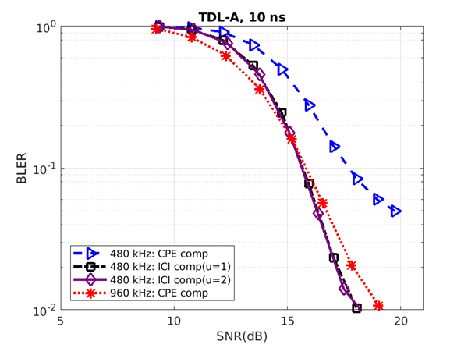
Phase noise compensation in 3GPP
3GPP Rel 15 supports distributed PTRS (similar to 802.11 pilots)
3GPP has concluded that ICI mitigation is feasible
  [4] shows that a low-complexity 3-tap de-ICI filter gives significant gain (recap in Appendix B)
It has been shown [4] that OFDM systems with smaller sub-carrier spacing equipped with simple ICI compensation can outperform systems with larger sub-carrier spacing equipped with only CPE compensation
BLER for 480 kHz SCS in TDL-A 10 ns channel with Rel-15 PTRS structure, MCS22, BW 400 MHz, FR2 (52.6-71 GHz) [4]

Slide 6
Subcarrier spacing for mmWave in 3GPP
3GPP has chosen the subcarrier spacing based partially on the effectiveness of low complexity ICI mitigation
3GPP supports subcarrier spacings of 120 kHz and 480 kHz in mmWave

Slide 7
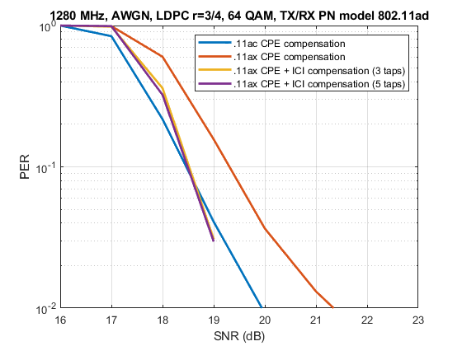
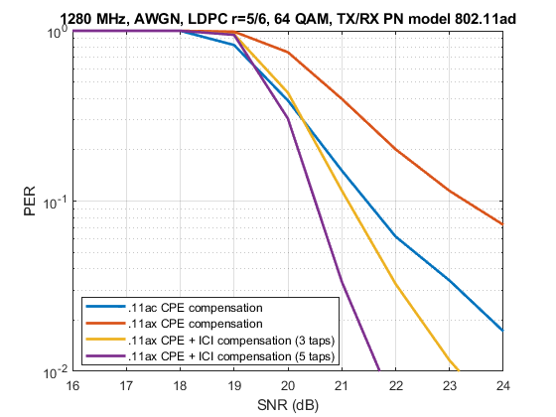
CPE and ICI compensation for upclocked 802.11 OFDM PHYs
Low complexity CPE and ICI compensation is feasible for the IEEE 802.11 sub-7 GHz PHYs
No changes to the PHYs are required (except upclocking)
  The pilots are also useful for CPE and ICI compensation
ICI compensation might also be beneficial for increased reliability
SCS:
.11ac: 2.5 MHz
.11ax: 625 kHz.
SCS:
.11ac: 2.5 MHz
.11ax: 625 kHz.

Slide 8
Observations
The 802.11 ax/be PHY is significantly more efficient than the 802.11ac PHY
The 11ax/be PHY is better suited for future enhancements than the 11ac PHY
  E.g. there might be a need to support multi-user techniques (e.g. OFDMA) in future versions of the standard, or there might be a need for larger bandwidths (e.g. upclocking 320 MHz)
OFDM systems with smaller sub-carrier spacing equipped with simple ICI compensation can outperform systems with larger sub-carrier spacing equipped with only CPE compensation
  3GPP has designed the OFDM numerology for mmWave taking into account ICI mitigation
Effective, low complexity CPE and ICI mitigation for upclocked 802.11 OFDM PHYs can be performed based on the pilots
  Phase noise mitigation can be performed without the need to modify the 802.11ac/ax/be PHYs
  There is no need to standardize the phase noise compensation algorithms (proprietary solutions)
ICI mitigation may also help improve reliability

Slide 9
Conclusions
The 11ax/11be PHYs are more efficient and future proof than the 802.11ac PHY
The current 802.11ac/ax/be OFDM PHY pilots can be used in low complexity, proprietary algorithms to compensate for the degradation due to CPE and ICI
The choice of the OFDM numerology for 45/60 GHz should be made considering ICI mitigation
ICI compensation may also be beneficial for increased reliability

Slide 10
Straw Poll
If a new PHY for 45GHz/60GHz based on a sub-7 GHz PHY is standardized, do you agree that the PHY selection incorporates ICI mitigation?
  Note 1: The only change made to the sub-7 GHz PHYs is upclocking
  Note 2: CPE and ICI compensation are proprietary
  Note 3: This straw poll is for information only
Y/N/A:

Slide 11
References
Some questions to answer in the SG, https://mentor.ieee.org/802.11/dcn/22/11-22-1595-01-0uhr-some-questions-to-answer-in-the-sg.pptx
Thoughts on High Frequency Band, https://mentor.ieee.org/802.11/dcn/22/11-22-1395-00-0uhr-thoughts-on-high-frequency-band.pptx
11ay Evaluation Methodology, https://mentor.ieee.org/802.11/dcn/15/11-15-0866-04-00ay-11ay-evaluation-methodology.doc
On phase noise compensation for OFDM, https://www.3gpp.org/ftp/TSG_RAN/WG1_RL1/TSGR1_102-e/Docs/R1-2005922.zip

Slide 12
Appendix A
802.11ad Phase noise model
In 11ad/ay the following phase noise model was proposed [3]:
PSD(0) = -90 dBc/Hz
Pole frequency f_{p} = 1 MHz
Zero frequency f_{z} = 100 MHz
Corresponding PSD(infinity) = -130 dBc/Hz

Slide 13
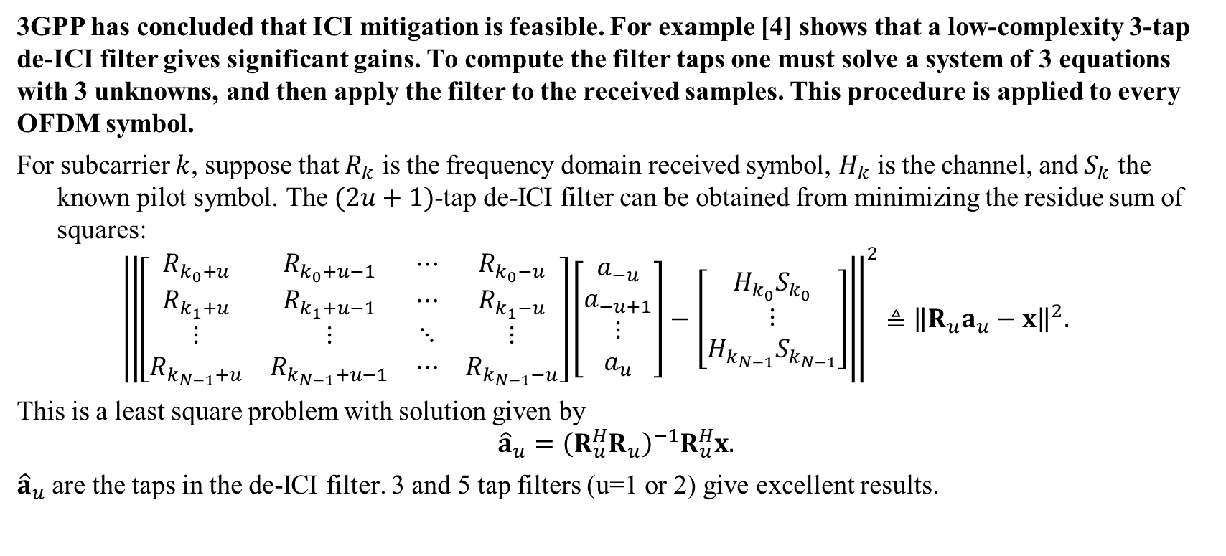
Appendix B: phase noise compensation in 3GPP
3GPP has concluded that ICI mitigation is feasible. For example [4] shows that a low-complexity 3-tap de-ICI filter gives significant gains. To compute the filter taps one must solve a system of 3 equations with 3 unknowns, and then apply the filter to the received samples. This procedure is applied to every OFDM symbol.
For subcarrier $k$, suppose that $R_{k}$ is the frequency domain received symbol, $H_{k}$ is the channel, and $S_{k}$ the known pilot symbol. The $(2u+1)$-tap de-ICI filter can be obtained from minimizing the residue sum of squares:
$${\left\|\left[\begin{matrix}R_{k_{0}+u} & R_{k_{0}+u−1} & ⋯ & R_{k_{0}−u} \\ R_{k_{1}+u} & R_{k_{1}+u−1} & ⋯ & R_{k_{1}−u} \\ ⋮ & ⋮ & ⋱ & ⋮ \\ R_{k_{N−1}+u} & R_{k_{N−1}+u−1} & ⋯ & R_{k_{N−1}−u}\end{matrix}\right]\left[\begin{aligned}a_{−u} \\ a_{−u+1} \\ ⋮ \\ a_{u}\end{aligned}\right]−\left[\begin{aligned}H_{k_{0}}S_{k_{0}} \\ ⋮ \\ H_{k_{N−1}}S_{k_{N−1}}\end{aligned}\right]\right\|}^{2}≜{\left\|R_{u}a_{u}−x\right\|}^{2}.$$
This is a least square problem with solution given by
$${\hat{a}}_{u}={\left(R_{u}^{H}R_{u}\right)}^{−1}R_{u}^{H}x.$$
${\hat{a}}_{u}$ are the taps in the de-ICI filter. 3 and 5 tap filters (u=1 or 2) give excellent results.

