Slide 1
Support for high-bandwidth and multi-Tx CFR capture
Date: 2022-xx-xx
Authors:
Lihua Zhu, Ruijie Networks Inc

Slide 2
Introduction
This submission briefly discusses:
- The application of CFR
- The pros of supporting high-bandwidth and Multi-tx CFR capture
- How to overcome the challenges that may be introduced
- Call for developing a uniform format and interface for CFR
Lihua Zhu, Ruijie Networks Inc

Slide 3
The application of CFR
CFR characterizes channel status information, which is crucial for reliable communication with high data rates in multi-antenna systems
It can be used for multi-user scheduling, time/frequency/power resource allocation, pre-coded, rate adaption and network parameter optimizing
Lihua Zhu, Ruijie Networks Inc

Slide 4
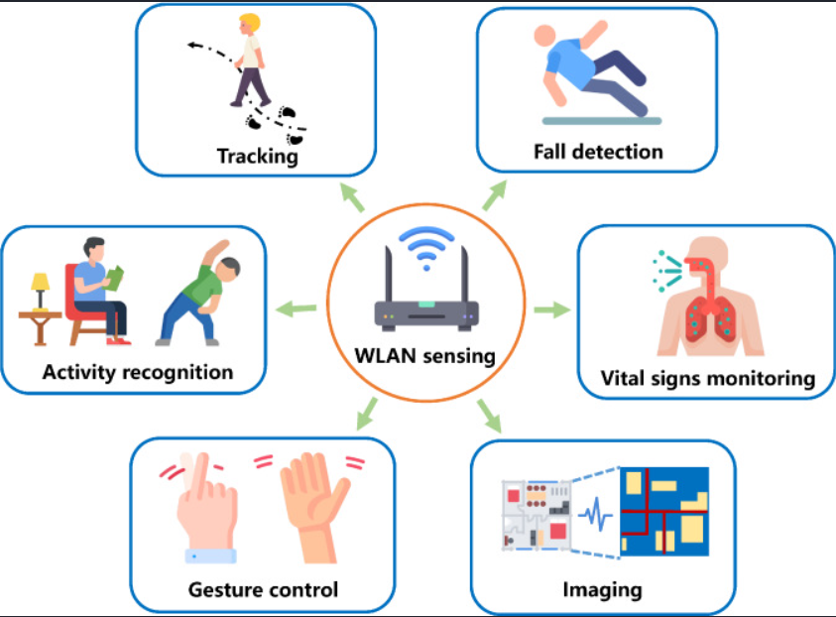
The application of CFR
Also, its role in wlan sensing has attracted more research. It can sense the activity of target in given environment, so it will play important role in Smart home, Gesture recognition, Gaming control and Presence detection^{[1]}
Example application of WLAN sensing^{[3]}
Lihua Zhu, Ruijie Networks Inc

Slide 5
Need for high-bandwidth and Multi-tx CFR capture
The existing open source driver only support 20MHZ/40MHZ/80MHZ bandwidth CFR capture basing on some fixed network cards
802.11be is adding 320MHZ bandwidth operating modes, the use of which can improve the accuracy and resolution of wlan sensing
Also, STA(tx) is usually treated as a single antenna under many CFR capture mode. But CFR of SIMO can not reflect the true channel state
Basing on CFR of MIMO system, we can get the maximum multiplexing and diversity gain of MIMO; Also wlan sensing will get great benefits from it
Lihua Zhu, Ruijie Networks Inc

Slide 6
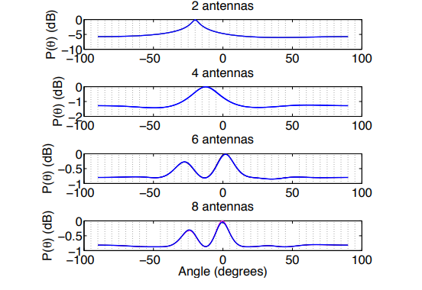
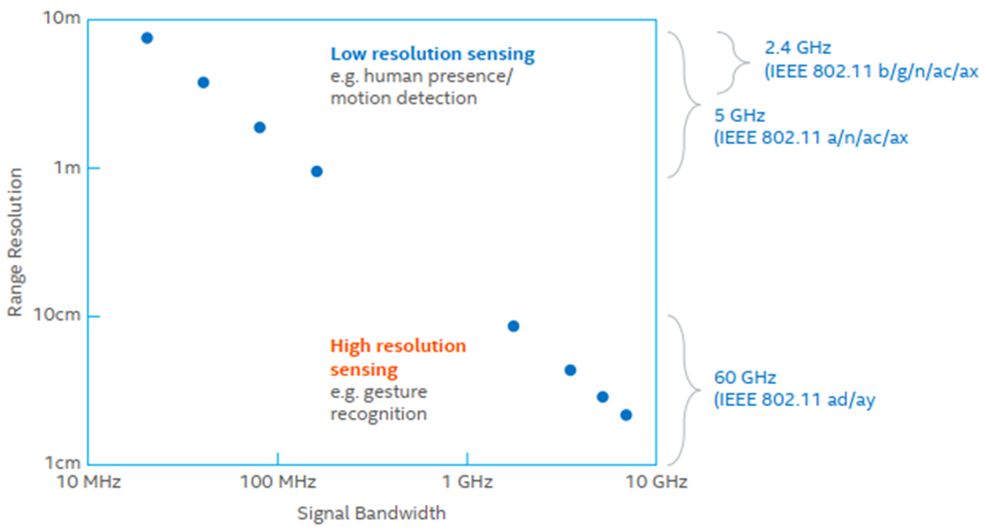
Need for high-bandwidth and Multi-tx CFR capture
More antennas improve resolution and accuracy. Resolution and accuracy benefit localization^{[2]}
Signal bandwidth VS the resolution of sensing^{[1]}
Lihua Zhu, Ruijie Networks Inc
Notes:
we show the AoA pseudospectra plot for the
same packet with two, four, six and eight antennas. We
plot them in Cartesian coordinates as it’s more clearly
viewed than polar plot. A two-antenna arrangement
generates one peak. Four antennas yield better resolution than two antennas with the measured bearing
closer to the true bearing. However, with four antennas,
it is not possible to differentiate two incoming signals
within a 45 degree range. The direct path and reflected
path are around 30 degrees apart from each other, so
they can not be differentiated with four antennas. Instead, one peak at an angle between the two incoming
signals is generated. However, this bearing is usually
close to the true bearing. Once six antennas are applied, we find that both the direct path and multipath
components are visible. With eight antennas, we have
even better resolution and more accurate results.

Slide 7
Challenges & Solution
Higher bandwidth means more CFR of subcarriers should be capture; And more TX antennas also lead to an increase in CFR data.
Challenges:
Deterioration of the communication quality
Take up more storage space
Possible solution:
Set priorities
Compress CFR data(Lossy or lossless compression algorithms)
Lihua Zhu, Ruijie Networks Inc

Slide 8
Summary
CFR of high-bandwidth and multi-TX operation mode is important for improving communication performance and WLAN sensing.
In order to further promote the application of CFR, the format and interface of CFR should be customized.
Lihua Zhu, Ruijie Networks Inc

Slide 9
References
[1] “IEEE 802-11-Overview-and-Amendments-Under-Development” 2022 July
[2] “ArrayRrack: A Fine-Grained Indoor Location System”
[3] “ An Overview on IEEE 802.11bf:WLAN sensing”
Lihua Zhu, Ruijie Networks Inc

