Slide 1
Channel Information Feedback for Smooth Beamforming
Date: 2022-11-03
Authors:

Slide 2
Introduction
Beamforming is a key solution that can achieve one of the goals for UHR. - Increase throughput including at different SNR levels
However, it still needs improvement to combine with the channel smoothing [1].
Channel smoothing can enhance the PER performance by about 1~2dB especially for low (or mid) SNR regions, under the condition that channel frequency response is smooth.
The risk of combination with the beamforming is due to the existence of discontinuities in the beam-steering matrix across subcarriers.
If Beamformed field is set to 1 in EHT-SIG, the receiver should not perform the channel smoothing.
In this contribution, we analyze why discontinuities occur in the beam-steering matrix.
Based on the analysis, we introduce to feedback of channel information to resolve the discontinuity for UHR.

Slide 3
Recap: Compressed Beamforming Feedback
After receiving NDP, BFee compresses channel state information with the following process and feeds back it to BFer where the beam-steering matrix is reconstructed for beamforming.
SVD (Singular Value Decomposition): SVD(H) = U$Σ$V^{h}
U, V: unitary matrix, $Σ$: diagonal matrix with singular values.
Column-wise phase shift
Multiply a diagonal matrix $D$ to V for column-wise phase shift, which makes the elements in the last row to become non-zero real number. (i.e., 𝐐=𝐕𝐃)
Example
$Q=\underset{V}{\underbrace{\left[\begin{matrix}\left|v_{11}\right|e^{jφ_{11}} & \left|v_{12}\right|e^{jφ_{12}} \\ \left|v_{21}\right|e^{jφ_{21}} & \left|v_{22}\right|e^{jφ_{22}}\end{matrix}\right]}}\underset{D}{\underbrace{\left[\begin{matrix}e^{−jφ_{21}} & 0 \\ 0 & e^{−jφ_{22}}\end{matrix}\right]}}=\left[\begin{matrix}\left|v_{11}\right|e^{j{(φ}_{11}−φ_{21})} & \left|v_{12}\right|e^{j{(φ}_{12}−φ_{22)}} \\ \left|v_{21}\right| & \left|v_{22}\right|\end{matrix}\right]$
Givens rotation
Q is decomposed by a series of Givens rotation matrices, each of which is expressed with {$φ$, $ψ$} angles.
Quantization
{$φ$, $ψ$} angles are quantized with a limited number of bits for feedback.

Slide 4
Channel Information Feedback for Smooth Beamforming (Case 1: $N_{rx}=1$)
Analysis on discontinuity
We observed that the column-wise phase shift incurs the discontinuities in the beam-steering matrix.
The discontinuity occurs when the magnitude of the element in the last row of 𝐕 is near zero.
This is because the phase changes suddenly across subcarriers around this point.
Example
$Q=e^{−jφ_{21}}\underset{V}{\underbrace{\left[\begin{matrix}\left|v_{11}\right|e^{jφ_{11}} \\ \left|v_{21}\right|e^{jφ_{21}}\end{matrix}\right]}}= \left[\begin{matrix}\left|v_{11}\right|e^{j(φ_{11}−φ_{21})} \\ \left|v_{21}\right|\end{matrix}\right]$
When $\left|v_{21}\right|≈0$, sudden change of $φ_{21}$ happens between adjacent tones.
As a result, smoothness is broken in $\left|v_{11}\right|e^{j(φ_{11}−φ_{21})}$.

Slide 5
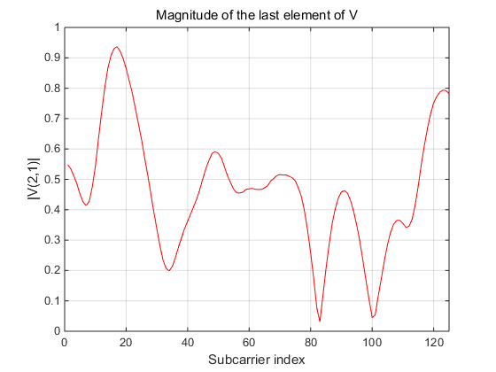
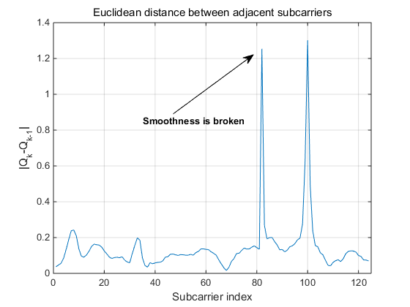
Channel Information Feedback for Smooth Beamforming (Case 1: $N_{rx}=1$)
Analysis on discontinuity
As shown in the figures below, Euclidean distance between two adjacent beam-steering matrices becomes large when the magnitude of the element in the last row of V is near zero.
Measure of the smoothness
Euclidean distance between two adjacent beam-steering matrices
ED = $\left\|Q_{k−1}−Q_{k}\right\|$, where $Q_{k}$ is the beam-steering matrix for the k-th subcarrier.

Slide 6
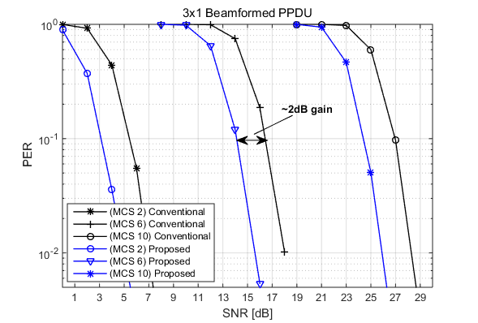
Channel Information Feedback for Smooth Beamforming (Case 1: $N_{rx}=1$)
Solution
Feedback of the phase information for the last row of V
Feedback $φ_{N_{r}1}$ , if the size of the beam-steering matrix is $N_{r}×1$
PER performance
Feedback of $φ_{31}$ makes the channel smoothing to be possible.
Conventional: Beamformed PPDU w/o channel smoothing
Proposed: Beamformed PPDU w/ channel smoothing

Slide 7
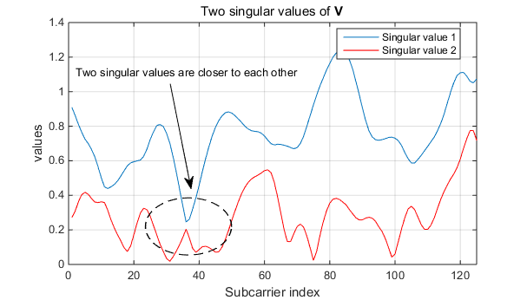
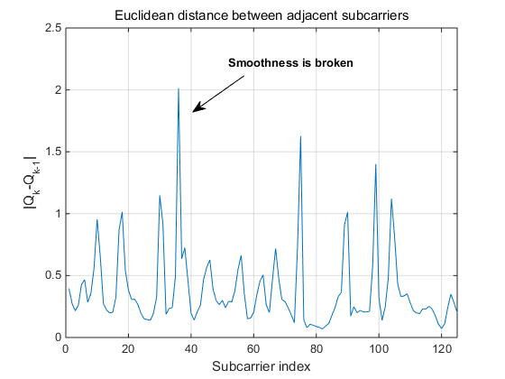
Channel Information Feedback for Smooth Beamforming (Case 2: $N_{rx}>1$)
Analysis on discontinuity
The column-wise phase shift operation is the one reason that incurs the discontinuity in the beam-steering matrix.
In addition, if two singular values are closer to each other in the SVD operation, the discontinuity happens between two adjacent beam-steering matrices [2].

Slide 8
Channel Information Feedback for Smooth Beamforming (Case 2: $N_{rx}>1$)
Solution
How to determine the phase information is implementation dependent.
One possible way is to solve the following optimization problem, which minimizes the Euclidean distance between two adjacent beam-steering matrices (i.e., $Q_{k−1}$ and $Q_{k}$).
$D_{k}^{∗}=arg \min_{D_{k}}\left\|Q_{k−1}−{Q_{k}D}_{k}\right\|$
where $D_{k}=diag\left(e^{jφ_{N_{r}1}},e^{jφ_{N_{r}2}},…,e^{jφ_{N_{r}N_{c}}}\right)$
The closed-form solution is given in [3].
Feedback$φ_{N_{r}1}^{∗}$, $φ_{N_{r}2}^{∗}$, ….,$φ_{N_{r}N_{c}}^{∗}$ in $D_{k}^{∗}$, if the size of the beam-steering matrix $N_{r}×N_{c}$

Slide 9
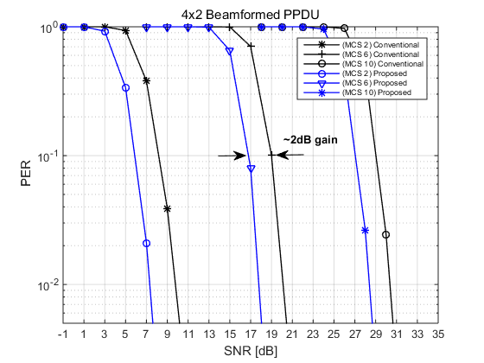
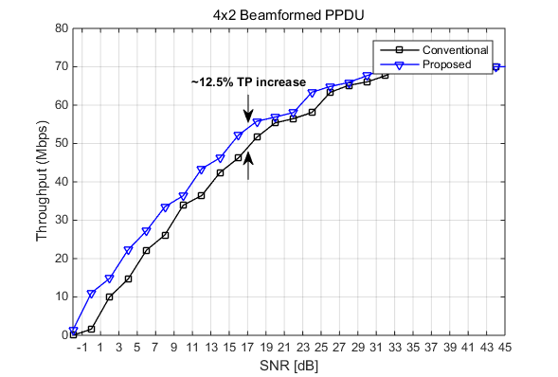

Channel Information Feedback for Smooth Beamforming (Case 2: $N_{rx}>1$)
PER & throughput performance
Throughput is calculated with considering the feedback overhead.
${Throughput}_{SU}=\frac{L_{data}}{T_{NDPA}+T_{NDP}+T_{CBR}+2T_{SIFS}+T_{Data}}×\left(1−PER\right)$
Conventional: Beamformed PPDU w/o channel smoothing
Proposed: Beamformed PPDU w/ channel smoothing

Slide 10
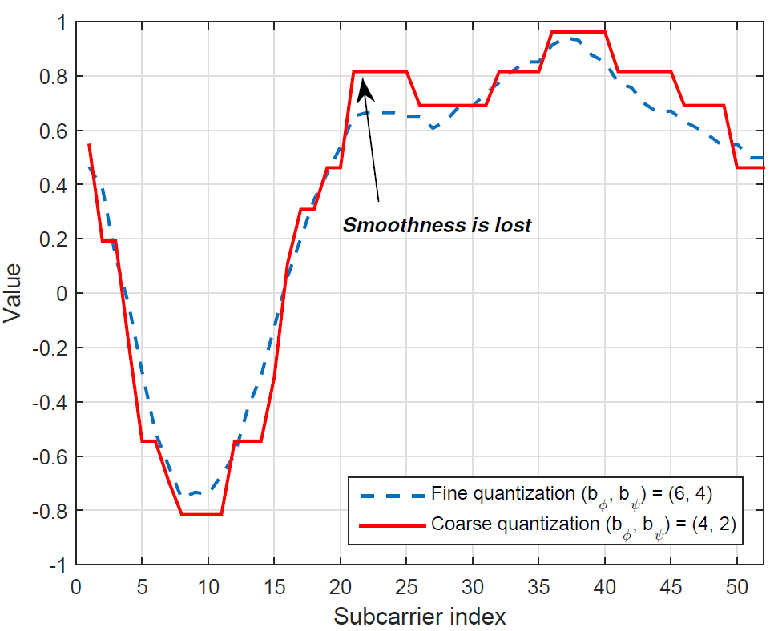
Remarks
Effect of quantization on discontinuity
The quantization of {$φ$, $ψ$} angles produces the discontinuities in the beam-steering matrix.
The quantization produces piece-wise constant values in beam-steering matrix, where discontinuity occurs at the change of the constant values.
Solution
BFer can resolve the discontinuity caused by quantization by applying a smoothing filter to the beam-steering matrix across subcarriers or by using the fine quantization option.

Slide 11
Summary
We introduced a scheme to feedback channel information to support the smooth beam-steering matrix, which enables the channel smoothing for beamformed PPDU.
$N_{rx}=1$ case
Feedback of phase information of last element in $V$
$N_{rx}>1$ case
How to determine the phase information is implementation dependent

Slide 12
SP
Do you agree to improve the compressed beamforming feedback scheme for channel smoothing in UHR?
Baseline: 11be feedback scheme
This SP is for information gathering.
Y/N/A:

Slide 13
Reference
[1] 802.11-22/1392r0, Beamforming Improvement for UHR, Samsung.
[2] J. S. Sadowsky, T. Yamaura and J. Ketchem, “WWiSE Preambles and
MIMO Beamforming,” IEEE, Tech. Rep. 802.11-05/1635r1, Jan. 2005.
[3] E. Jeon, M. Ahn, S. Kim, W. B. Lee and J. Kim, "Joint Beamformer and Beamformee Design for Channel Smoothing in WLAN Systems," in Proc. IEEE 92nd Veh. Technol. Conf. (VTC2020-Fall), Nov. 2020, pp. 1-6.
[4] F. Jiang, Q. Li and X. Chen, “Channel Smoothing for 802.11ax Beamformed MIMO-OFDM”, IEEE Comm. Lett., vol. 25, no. 10, Oct. 2021.

