Slide 1
DMG CID 356 introduction
Authors:
Date: 2022-10-30

Slide 2
Abstract
Introduction to the use of the DMG SP for sensing purposes (CID 356)

Slide 3
Summary of the CBAP DMG sensing schedule
The DMG sensing measurement consists of bursts and instances characterized by inter-burst (distance between bursts) and intra-burst (distance between instances) intervals. Intra-burst<Inter-burst.
The DMG sensing measurement may comprise multiple bursts
One burst may contain multiple instances
The time of the instance is limited by the TXOP Limit. The burst is limited by the beacon interval duration
The inter-burst time is suitable to define more than one burst inside the beacon interval and separating the bursts by one beacon interval or more

Slide 4
DMG Service Period
The PCP/AP may schedule SPs or CBAPs only during the DTI of a beacon interval
The schedule is communicated through the Extended Schedule element by the beacon or announce frames
Only an STA identified as the source DMG STA or destination DMG STA of an SP shall transmit during the SP
An SP allocation within an Extended Schedule element may comprise one or more individual allocations.
The start time of each individual allocation = A_start + (i – 1) × A_period
A_start is the value of the Allocation Start field
A_period is the value of the Allocation Block Period field
i is an integer greater than 0 and less than or equal to the value of the Number of Blocks field
The end of the i^{th} individual SP or CBAP allocation is computed by adding the start time of the i^{th} individual allocation to the value of the Allocation Block Duration field

Slide 5
Summary
Existent Extended Schedule element supports:
Service Period suitable for the DMG sensing instance
Periodical bursting comprised multiple instances
Inter-burst interval less than beacon interval
Existent Extended Schedule element does not support:
Inter-burst interval of multiple beacon intervals

Slide 6
Solution
Append new value “SP for DMG sensing” to the table
Table 9-294—AllocationType subfield values
Bit 4 | Bit 5 | Bit 6 | Meaning
0 | 0 | 0
1 | 0 | 0
0 | 1 | 0
1 | 1 | 0
0 | 0 | 1 | SP for DMG sensing
All other combinations |  |  | Reserved

Slide 7
Solution cont.
Allocation Start
Allocation Start | Distance Between DMG sensing Bursts
Octets: 3 1
Distance Between DMG sensing Bursts subfield, when set to a nonzero value indicates the number of the beam intervals between the beacon intervals in which the successive DMG sensing Bursts lie. The zero value indicates DMG sensing Bursts in the subsequent beacon intervals.

Slide 8
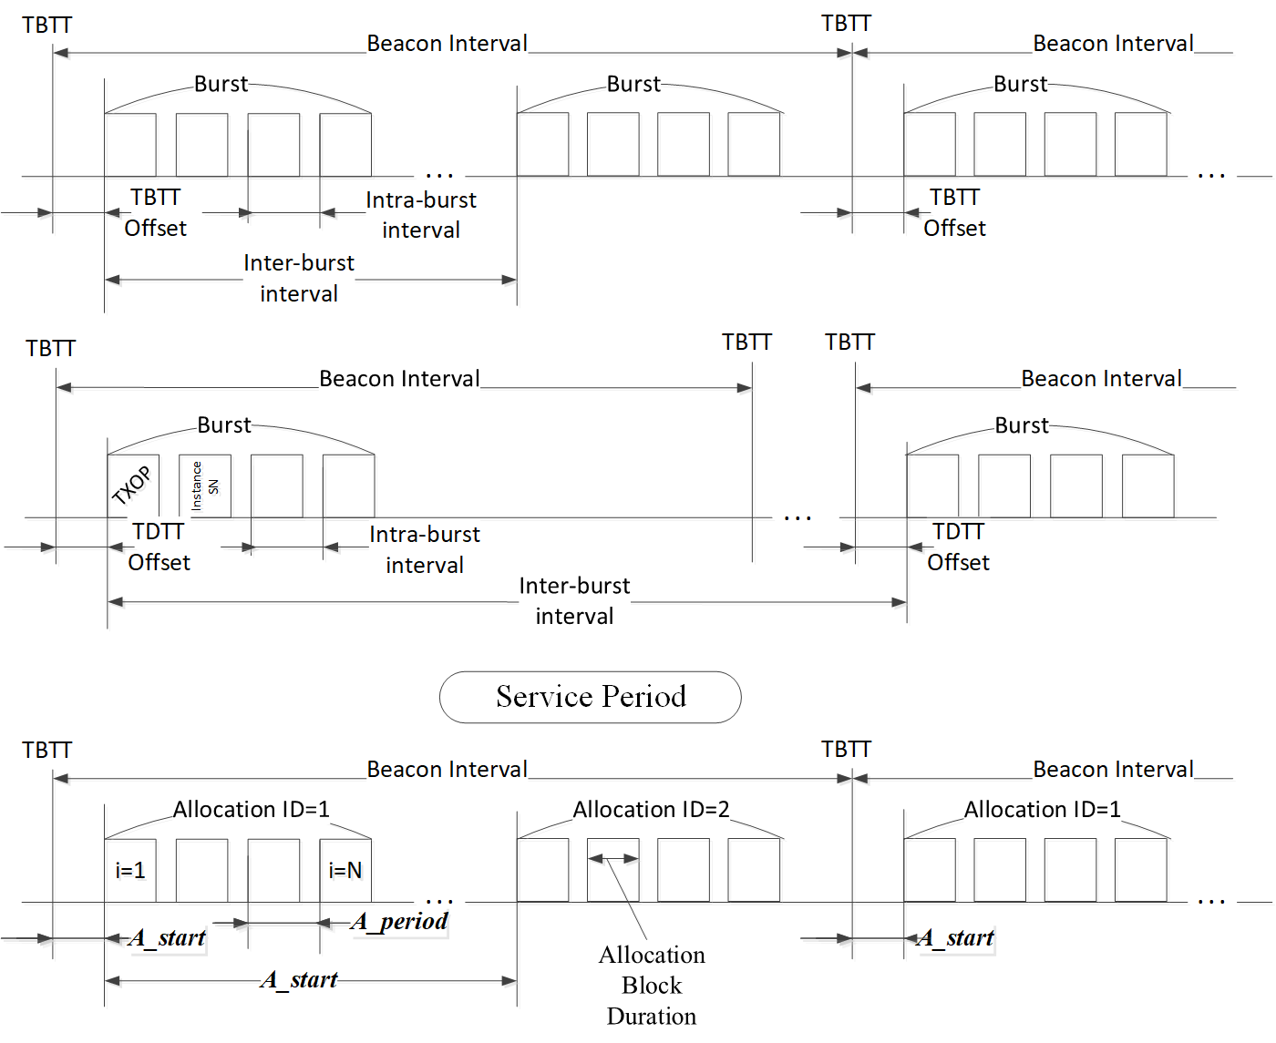

Slide 9
References

