Slide 1
Recap on Coordinated Spatial Reuse Operation
Date: 2022-12-13
Authors:
Name | Company | Address | Phone | Email
Kosuke Aio | Sony Group Corporation |  |  | Kosuke.Aio@sony.com
Yusuke Tanaka |  |  |  | Yusuke.YT.Tanaka@sony.com
Ryuichi Hirata |  |  |  | Ryuichi.Hirata@sony.com

Slide 2
Introduction
Multi-AP coordination is a candidate feature for next TG as a technology to realize the several objectives and use cases of UHR [1].
Coordinated Spatial Reuse (Co-SR) is one of Multi-AP coordination schemes for TGbe.
Co-SR is a simpler coordination scheme compared to Joint transmission and Coordinated Beamforming (Sync and CSI collection are unnecessary).
Contributions presented in TGbe[2-5] showed that Co-SR achieves significant performance improvement, e.g. higher throughput than 11ax SR (OBSS_PD).
In this contribution, we consider on the operation of Co-SR and offer a simulation result.

Slide 3
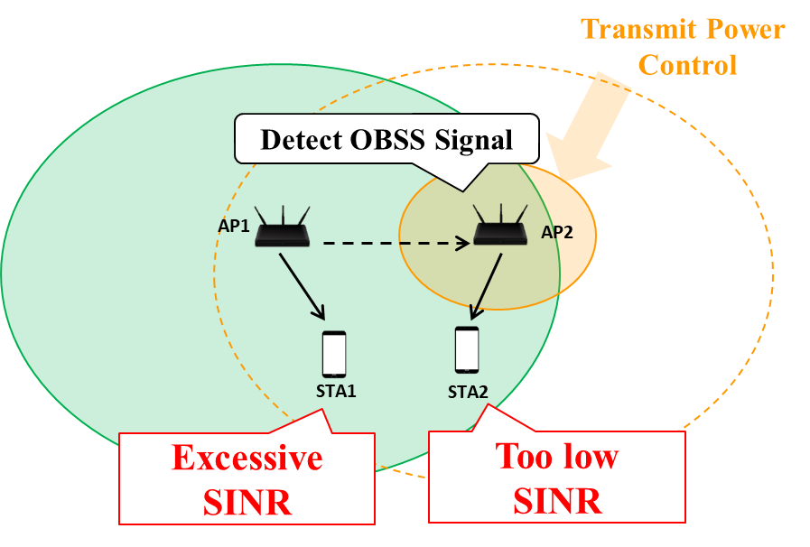
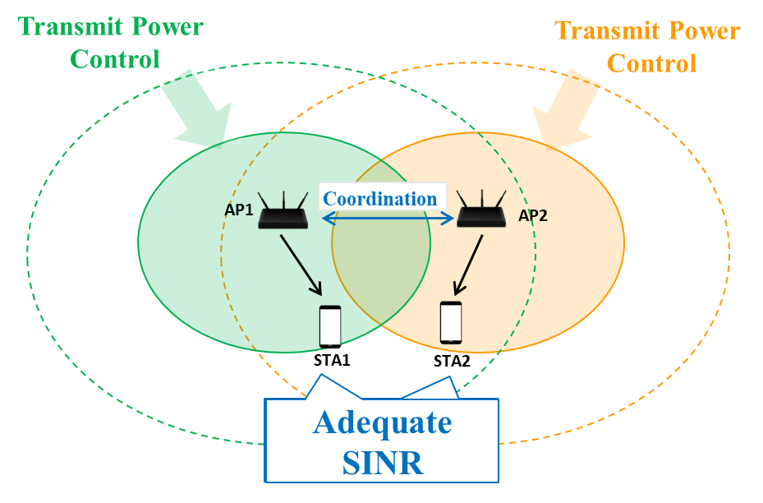
Recap: Coordinated SR
APs control Tx power cooperatively to improve area throughput in every transmission.
Co-SR allows parallel transmission for multi-APs.
For adequate SINR at all STAs, APs mitigate interference by Tx power controlling.
With 11ax SR, which isn’t a coordinated way, one AP can transmit data with max Tx power and the other APs should decrease Tx Power. Hence, some STAs will get too low SINR.
The Concept of 11ax SR
The Concept of Coordinated SR

Slide 4
Benefits of Co-SR
Co-SR can achieve low latency by reducing queuing delay, as with other coordination types.
Co-SR can achieve higher throughput gain than Time/Freq Scheduling and Co-OFDMA.
Co-SR allows parallel transmission with the same resource for multi-APs.
Co-SR can be implemented easier than Co-BF and Joint Tx.
Co-SR does not require strict synchronization like Co-BF and Joint Tx.
Co-SR requires just low overhead measurement because AP only needs to know RSSI information of interference links.
Co-SR can work with just very simple calculation algorism.
This presentation recaps on the simple operation of Co-SR.

Slide 5
Co-SR Operation: Measurement Phase
AP can request intra-BSS STAs to measure OBSS signal by “Measurement Request/Response”.
Example Procedure
AP sends “Measurement Request Element” to intra-BSS STAs
STA responses “Measurement Report Element” to the AP
Beacon measurement type is used well for RSSI measurement because typically Tx power is static.
OBSS STA1
1. Measurement Request
STA1
OBSS AP1
AP1
2. Measure OBSS Signal
3. Measurement Report
OBSS AP2
OBSS STA2
Notes:
この前に導入

Slide 6
Co-SR Operation: Transmission Phase (1/3)
Sharing AP performs backoff and obtains TXOP.
Sharing AP collects information from Candidate APs.
Information is for instance;
AIDs of STAs which potential Shared APs intend to transmit data to
Target SINR of those STAs
Trigger frame
Sharing AP
DATA
time
DATA
Candidate AP1
(Shared AP1)
time
Candidate AP2
(Shared AP2)
DATA
time

Slide 7
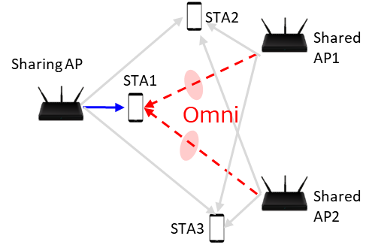
Co-SR Operation: Transmission Phase (2/3)
Sharing AP estimates SINR of STA(s) which Sharing AP intends to serve and calculates “coordinated Tx power” for each AP.
Only to satisfy target SINR of the STA(s).
Without considering BF of interference (just omni)
If AP can calculate more, it may be OK that Sharing AP estimates SINR of all STAs to maximize area throughput.
Simulation results are added in Appendix.

Slide 8
Co-SR Operation: Transmission Phase (3/3)
Sharing AP transmits a Trigger frame to Shared APs to allow transmission, where a Trigger frame includes;
“coordinated Tx power” of Shared APs.
Tx power of Sharing AP (to be used by Shared APs to set optimal MCS)
Sharing AP and Shared APs transmit data SIFS after the Trigger frame.
Shared APs can set indicated its “coordinated Tx power”.
Shared APs can set optimal MCS by estimating SINR of the STA with the indicated Tx Power information of all APs.
Trigger frame
Sharing AP
DATA
time
DATA
time
Shared AP1
Shared AP2
DATA
time
Slide 8

Slide 9
Performance Analysis: Simulation Setup (1/2)
Metrics
Sum of throughput of all STAs
Considering only data payload. (not including MAC and PHY preamble overhead)
Optimal MCS based on theoretical PER and SINR per STA
Assumption
DL only.
Each AP transmits data to one associated-STA.
APs obtain TXOP in turn with every probability.
Each AP operates Tx Beamforming
Perfect measurement of RSSI

Slide 10
Performance Analysis: Simulation Setup (2/2)
Following schemes are compared
TDD
One AP transmits data with max Tx power. The Shared APs don’t transmit data.
11ax SR (OBSS_PD)
One AP transmits data with max Tx power. (The AP is selected randomly)
The Shared APs transmit data with Tx power calculated by OBSS_PD equation. [6]
OBSS_PDmin = -82dBm/20MHz, OBSS_PDmax = -62dBm/20MHz
Co-SR
Target SINR = 26dB.

Slide 11
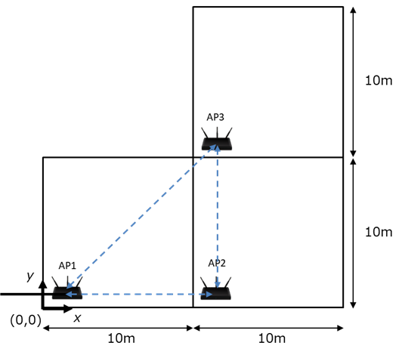
Performance Analysis: Simulation Scenario
<Layout of Nodes>
Home Mesh Scenario based on [6]
Layout
3APs are deployed as shown in the right figure.
One STA per room is dropped randomly to be associate with an AP in the same room.
Parameter
Frequency, Bandwidth | 5180MHz, 80MHz
Max Tx Power | 21dBm per AP
NF | 7dB
Tx/Rx Ant | (AP, STA) = (4, 1)
Stream | 1/STA
Precoding | SVD
MCS | 0 - 11
Fading Model | TGac_D NLOS for all the links
Pathloss Model | Eq.(1)
Shadowing | 5dB log-normal for all link
PPDU | HE PPDU with 0.8us GI
Eq.(1) : PL(d) = 40.05 + 20*log10(freq/2.4)+ 20*log10(min(Dis, bp)) + (Dis > bp) .* (35*log10(Dis/bp)) + Wn * 10dB
(“freq” = 5.18GHz, “Dis” = Tx/Rx distance, “bp” = 5m, “Wn” : Num. of wall)

Slide 12
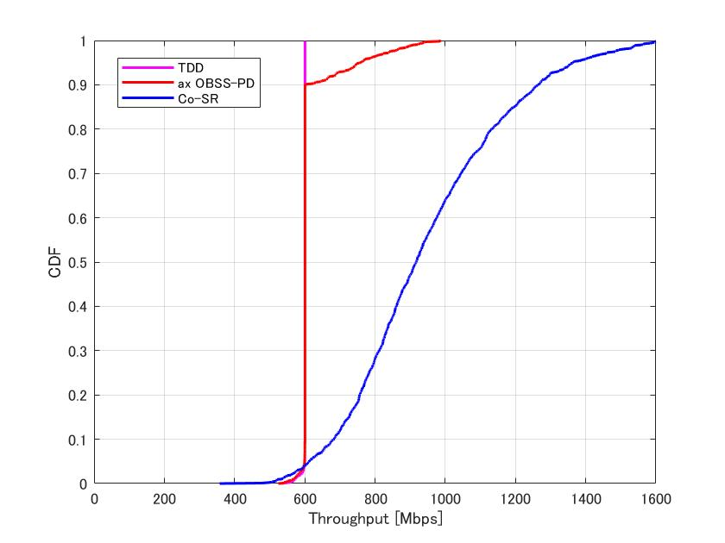
Performance Analysis: Simulation Result
Sum of throughput
Throughput Gain compared to TDD
at cdf=0.9
- ax SR : x1.0
- Co-SR : x2.1
Throughput Gain compared to TDD
at cdf=0.5
- ax SR : x1.0
- Co-SR : x1.7
Co-SR can achieve good throughput gain.
Even if very simple operation (using only RSSI info, calculate only SINR of STA that Sharing AP intends to serve)

Slide 13
Further Discussion Items
Consideration on measurement accuracy
We are assuming perfect measurement of RSSI. However, there are variations in RSSI measurement accuracy among STAs.
It may depend on MCS selection algorism. Co-SR must take it into account.
RSSI measurement procedure
We are assuming beacon measurement as an example of RSSI measurement. However, it will take long time to get OBSS beacon.
We should consider how to reduce measurement overhead more.
Uplink Co-SR procedure
We’re assuming only DL case and should consider UL case as well.
The procedure is almost the same as DL, but there are some points to note, such as how to send trigger frames from multiple APs simultaneously.

Slide 14
Summary
We reviewed the concept of Coordinated SR (Co-SR) and proposed the very simple operation of Co-SR.
Sharing AP measures only RSSI information of interference link.
Sharing AP estimates SINR of STA(s) which Sharing AP intends to serve and calculates “coordinated Tx power” for each AP to satisfy target SINR.
We evaluated the proposed operation of Co-SR compared with TDD and 11ax SR and confirmed high throughput gain even if very simple operation.

Slide 15
Reference
[1] Yusuke Tanaka (Sony Group Corporation), “Considerations on Multi-AP Coordination,” 22/1516r0, September 2022.
[2] Kosuke Aio (Sony Corporation), “Coordinated Spatial Reuse Performance Analysis,” 19/1534r1, September 2019.
[3] Kosuke Aio (Sony Corporation), “Discussion on Coordinated Spatial Reuse Operation,” 20/0457r1, April 2019.
[4] Jason Yuchen Guo (Huawei Technologies Co. Ltd.), “coordinated spatial reuse operation,” 20/0033r1, February 2020.
[5] Jianhan Liu (Mediatek Inc.), “On Coordinated Spatial Reuse in 11be,” 20/0073r0, January 2020.
[6] Kosuke Aio (Sony Corporation), “Consideration on Multi-AP Home Mesh Scenario,” 20/0032r0, January 2020.

Slide 16
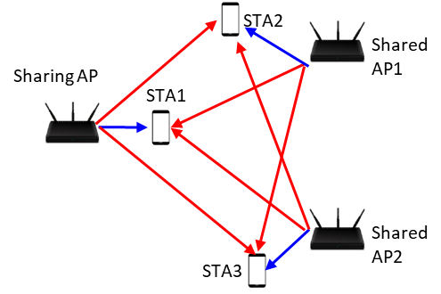
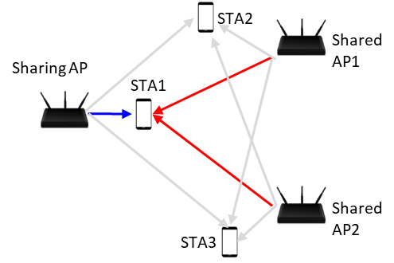
Possible constraints of Tx Power Calculation (1/2)
Estimate All Link with BF Interference [2]
Estimate My Link with BF Interference
Sharing AP estimates SINR of all receiving STAs and calculates “coordinated Tx power” for each AP.
First, to satisfy target SINR of at least a STA which Sharing AP intends to serve.
Then, to satisfy SINR of STAs in the TXOP to the extent feasible
Sharing AP estimates SINR of STA(s) which Sharing AP intends to serve and calculates “coordinated Tx power” for each AP.
Only to satisfy target SINR of a STA which Sharing AP intends to serve.
Notes:
シンプルにしました

Slide 17
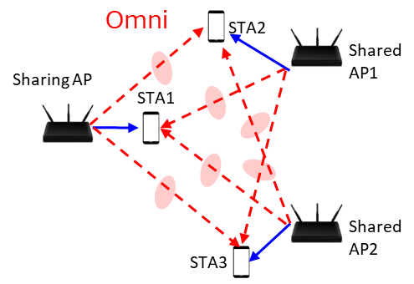
Possible constraints of Tx Power Calculation (2/2)
Estimate All Link with Omni Interference
Estimate My Link with Omni Interference
Sharing AP estimates SINR of all receiving STAs and calculates “coordinated Tx power” for each AP, without considering BF of interference.
How to calculate coordinated Tx power is same as “1. Estimate All Link”.
Sharing AP estimates SINR of STA(s) which Sharing AP intends to serve and calculates “coordinated Tx power” for each AP, without considering BF of interference.
How to calculate coordinated Tx power is same as “2. Estimate My Link”.

Slide 18
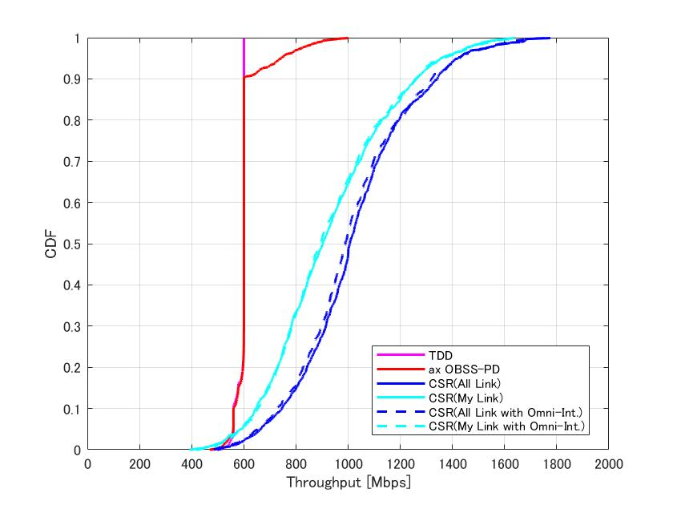
Performance Analysis: Simulation Result
Sum of throughput
Throughput Gain compared to TDD at cdf=0.9
- ax SR : x1.0
- C-SR(All Link w/ BF-Int) : x2.2
- C-SR(My Link w/ BF-Int) : x2.1
- C-SR(All Link w/ Omni-Int) : x2.2
- C-SR(My Link w/ Omni-Int) : x2.1
Throughput Gain compared to TDD at cdf=0.5
- ax SR : x1.0
- C-SR(All Link w/ BF-Int) : x1.7
- C-SR(My Link w/ BF-Int) : x1.5
- C-SR(All Link w/ Omni-Int) : x1.7
- C-SR(My Link w/ Omni-Int) : x1.5
Estimation of all receiving STAs can achieve a bit more than estimation of only my STA, but all constraints can achieve good throughput gain.
As for interference, performance are almost same whether BF is considered or not. (because no correlation between all links)

Slide 19
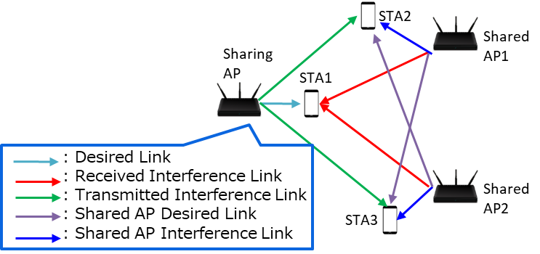
Comparison on System Overhead
Required Information for Sharing AP (Considering BF)
 | All Link w/ BF-Int | (2) My Link w/ BF-Int | (3) All Link w/ Omni-Int | (4) My Link w/ Omni-Int
Desired Link | BF Matrix | BF Matrix | BF Matrix | BF Matrix
Received Interference Link | BF Matrix | BF Matrix | RSSI | RSSI
Transmitted Interference Link | BF Matrix | - | RSSI | -
Shared AP Desired Link | BF Matrix | - | BF Matrix | -
Shared AP Interference Link | BF Matrix | - | RSSI | -
System Overhead
All Link w/ BF-Int : High
My Link w/ BF-Int : Medium
All Link w/ Omni-Int : Medium
My Link w/ Omni-Int : Low

Slide 20
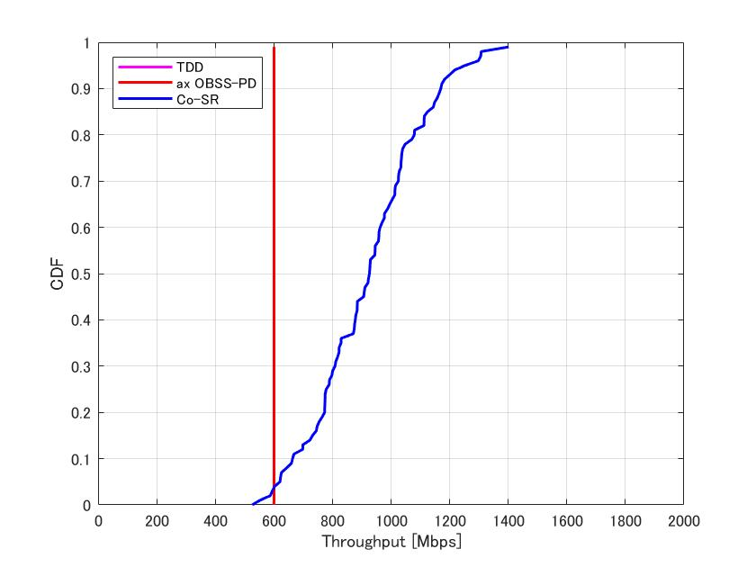
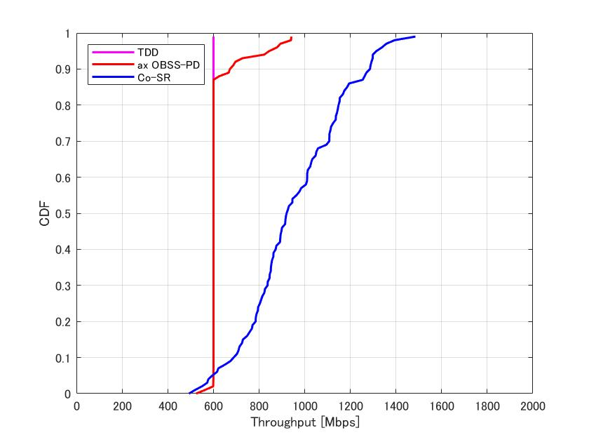
Appendix. Additional Simulation
Change only room size
Room Size = 5m x 5m
Room Size = 10m x 10m

Slide 21
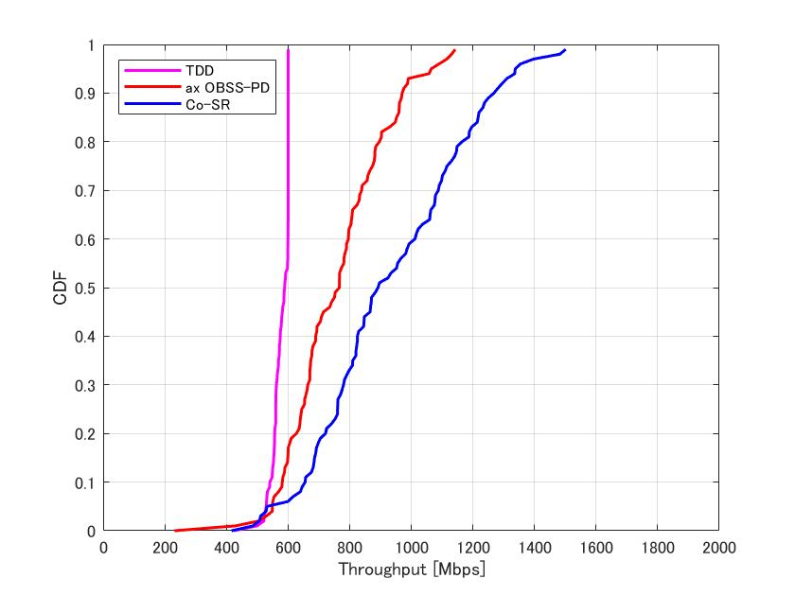
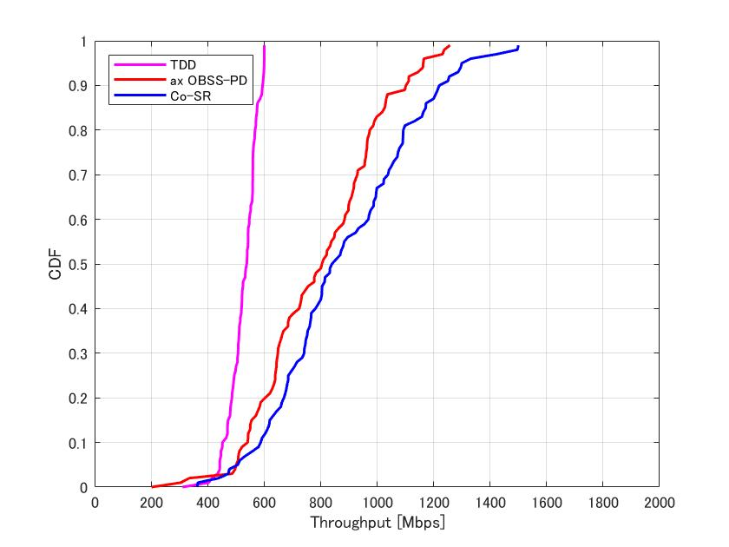
Appendix. Additional Simulation
Change only room size
Room Size = 20m x 20m
Room Size = 30m x 30m

Slide 22
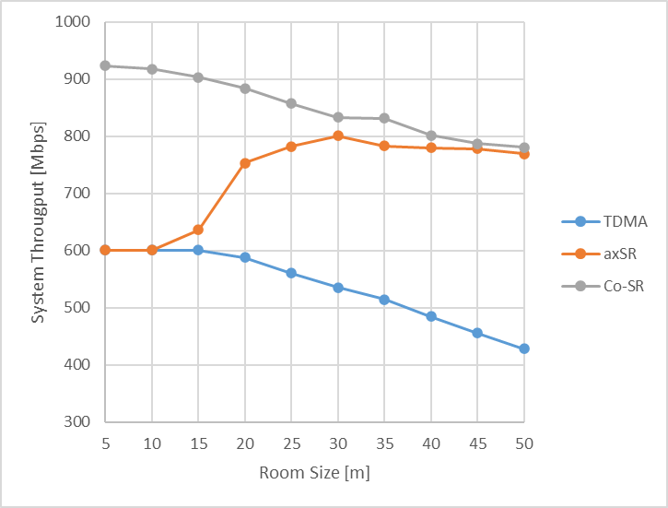
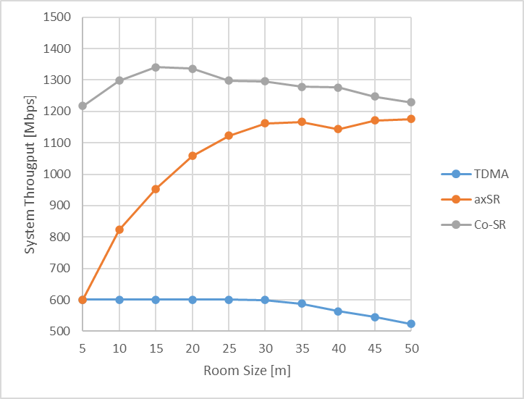
Appendix. Additional Simulation
Change only room size
System Throughput at 50%-tile
System Throughput at 95%-tile
As the room size increases and the SINR begins to vary, ax SR performance improve and the difference with Co-SR narrows. In any case, however, Co-SR is still the best performer.

