Slide 1
System Level Simulation of Co-BF and Joint Tx
Date: 2022-11-12
Authors:
Name | Company | Address | Phone | Email
Kosuke Aio | Sony Group Corporation |  |  | Kosuke.Aio@sony.com
Yusuke Tanaka |  |  |  | Yusuke.YT.Tanaka@sony.com
Ryuichi Hirata |  |  |  | Ryuichi.Hirata@sony.com
Thomas Handte |  |  |  | Thomas.Handte@sony.com
Dana Ciochina |  |  |  | Dana.Ciochina@sony.com
Ken Tanaka |  |  |  | Ken.A.Tanaka@sony.com

Slide 2
Introduction
Multi-AP coordination is a candidate feature for next TG as a technology to realize the several objectives and use cases of UHR [1].
Some types of Multi-AP coordination schemes have been discussed in TGbe and approved to be added to the SFD:
Joint Transmission (Joint TX) [2]
Coordinated Beamforming (Co-BF) [3]
Coordinated Spatial Reuse (Co-SR) [4]
Coordinated OFDMA (Co-OFDMA) [5]
Time/Freq Scheduling [6]
This contribution recaps on some of the factors that impact the advanced coordination schemes (Co-BF and Joint Tx) and show an initial evaluation of their effects on the performance.

Slide 3
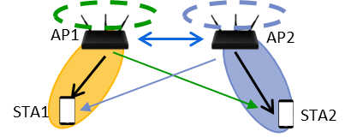
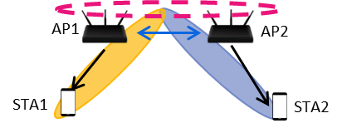
Advanced Coordination Types
Coordinated Beamforming (Co-BF)
Each AP independently performs beamforming to reduce interference to other devices.
Less difficult to realize than Joint Tx (no need of tight synchronization and data sharing)
Joint Transmission (Joint Tx)
Multiple APs perform beamforming with sharing Tx antennas to reduce interference to other devices.
Theoretically expect the highest throughput gain by using more spatial streams than Co-BF, but there are several issues to be addressed (HW impairment, Data sharing overhead, etc.)
x₂
Coordinated BF
Joint Transmission

Slide 4
Current Status about Joint Tx issues
HW impairments
Joint Tx requires tight time/frequency synchronization between multiple APs.
This issue had been discussed/considered in TGbe.
The use of like sync trigger before Joint Tx can synchronize transmission time [7].
CFO of around 20 Hz between APs is feasible to implement [8]
The use of mid-amble in addition to 20 Hz CFO between APs allows the phase drift during Joint Tx to be properly compensated and keep its characteristics. [9]
Data Sharing Overhead
Joint Tx sends the same data between APs, so the time required for pre-sharing can be a system overhead.
TGbe has discussed at least 10Gbps backhaul speed will be required to achieve high performance [10]
To see how much Data Sharing Overhead is affected, we conducted simulation evaluation of system performance of Co-BF and Joint Tx.

Slide 5
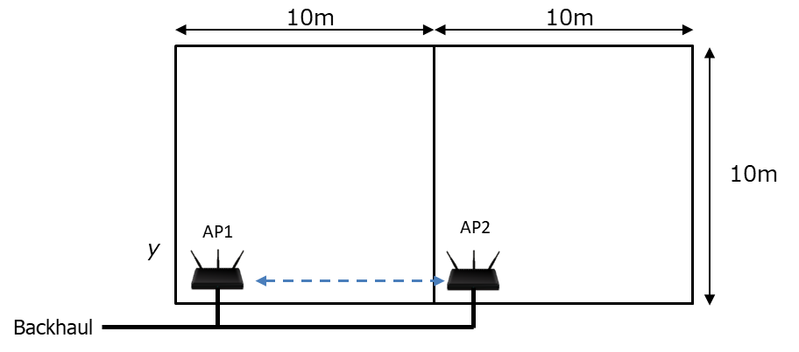
Simulation Assumption
Two Criteria:
System Throughput & Latency (Queuing Delay)
Wired Backhaul Case
Lan cable speed is 10Gbps. No jitter/No error.
AP1 makes decision of the coordination availability, Shared AP from candidates APs(AP2), and sends weight for Joint TX.
Coordination Protocol Policy
AP1/AP2 exchange coordination request/response frames to setup coordination.
Only when Joint Tx, AP1/AP2 share data via backhaul.
When Candidate AP has no traffic, only Sharing AP transmits data (after coordination req./resp. exchange).
An example sequence is shown on the next page (Other sequences are in Appendix)

Slide 6
Example of Coordination Protocol Sequence
Skip in Co-BF
Coord.
Req
Coord.
Set
Coord.
Trigger
AP1
(Sharing AP)
Data Sharing
Data
AP2
(Shared AP)
Data
Coord.
Resp
STAs
Block Ack
AP1 becomes Sharing AP.
AP1 and AP2 exchange Coordination Req./Resp to decide if coordination should be started or not, who is Shared AP, and which packets will be sent based on information obtained.
AP1 sends Coordination Set to AP2 to start Data Sharing between them via backhaul.
During Data Sharing, AP1 and AP2 wait transmission for a certain period.
For Co-BF, this phase is skipped.
AP1 sends Coordination Trigger to AP2 to start Coordination transmission.
AP1 and AP2 receives Block Ack from each intra-BSS STA.
Block Ack is sent by UL OFDMA in 20MHz units. Trigger frames is included in Data frame

Slide 7
Simulation Scenario
Scenario
Parameters
Freq, BW | 5180MHz, 80MHz
Packet Size | 1500 byte
Max Aggregation Size | 64 or 256
PPDU | HE, short Guard Interval
MCS | Data: MCS0 – 11, Control : Fixed MCS0
Num. of Ant | (Tx, Rx) = (4,2)
Tx Power | AP: 21dBm, STA:15dBm
Tx Spatial Stream per STA, Coding | 1 or 2, SVD-MMSE
Fading Model | TGac_D NLOS for all the links
Pathloss Model | Eq.(1)
Shadowing | 5dB log-normal for all link
RTS/CTS | Enable
BF Matrix Parameters | (ψ, φ) = (9, 7), Grouping = 4
Doppler Frequency | 0Hz
Sounding Interval | 100ms
1 STA per room is dropped randomly to be associated with an AP in the same room. Evaluate 100 drops.
Simulation time of each drop is 20s.
Eq.(1) : PL(d) = 40.05 + 20*log10(freq/2.4)+ 20*log10(min(Dis, bp)) + (Dis > bp) .* (35*log10(Dis/bp)) + Wn * 10dB
Assumption
(“freq” = 5.18GHz, “Dis” = Tx/Rx distance, “bp” = 5m)
Compared only non-coordination (TDMA), Coordinated BF, and Joint Tx.
All new control frames for coordination are set to 40byte.
No HW impairments are considered at this stage.

Slide 8
Simulation Setup
We prepare two setups for system throughput evaluation and low latency (queuing delay) evaluation each.
 | Setup(A) System Thruput Evaluation | Setup(B) Latency Evaluation
Traffic Model | AP1: DL-only, CBR, 1600Mbps AP2: DL-only, CBR, 1600Mbps (Both Full Traffic) | AP1: DL-only, CBR, 100Mbps AP2: DL-only, FTP, File size = 30kByte, arrival rate = 10/1s
Max Aggregation Number | 256 | 64
TxSS per STA | 1 or 2 | 1
MCS | Optimization by SINR^{*1} (max MCS11) | Fixed. AP1 = MCS7, AP2=MCS4
Metric | Throughput of total AP1 and AP2 | Queuing delay of AP2 (from queuing to transmission start)
*1 : Maximum MCS that satisfies PER=5% or less for given SINR

Slide 9
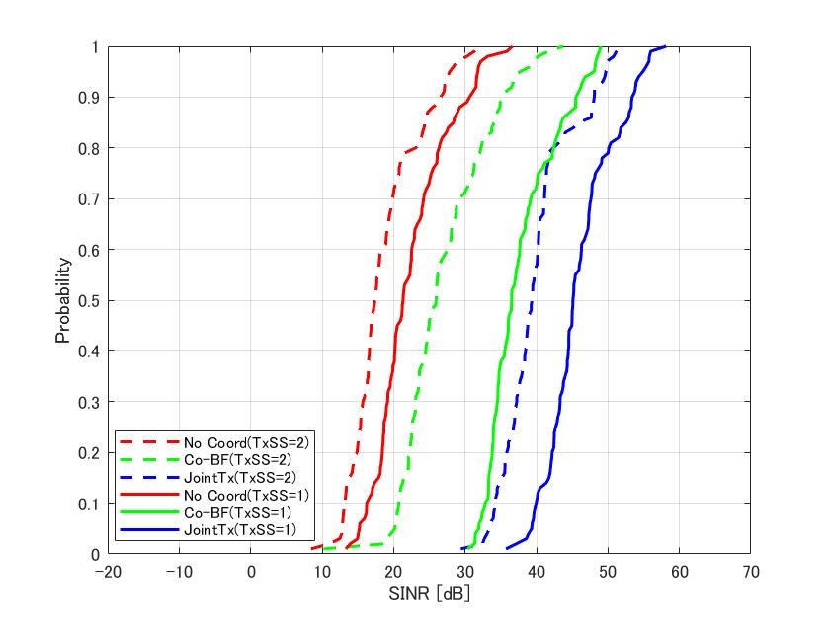
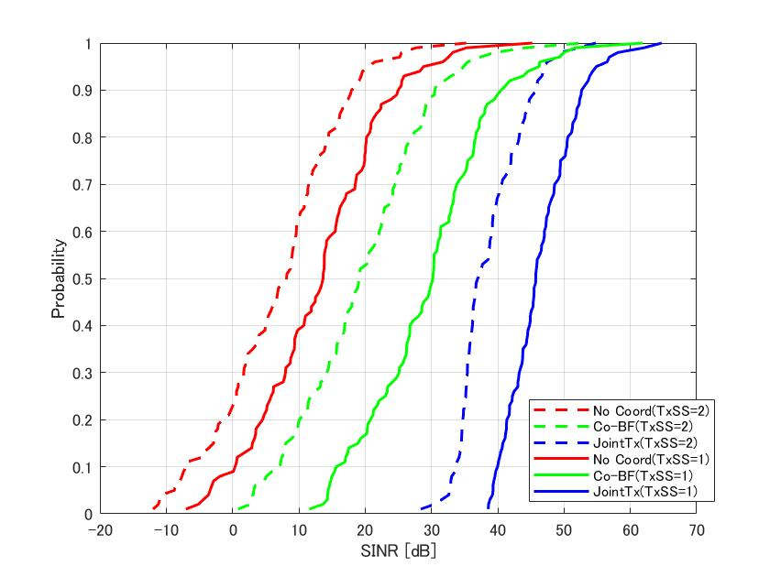
Simulation Result (1/4)
TxSS=2: plot min SINR between 1st and 2nd stream
No Coordination: plot SINR when AP1/AP2 sends at the same time
SINR at STA
SINR at STA1
SINR at STA2
SINR Gain From No Coord.
at cdf=0.5
- Co-BF (TXSS=1) : 15.2dB
- Co-BF (TXSS=2) : 6.5dB
- Joint Tx (TXSS=1) : 23.8dB
- Joint Tx (TXSS=2) : 21.9dB
SINR Gain From No Coord.
at cdf=0.5
- Co-BF (TXSS=1) : 16.6dB
- Co-BF (TXSS=2) : 11.9dB
- Joint Tx (TXSS=1) : 32.1dB
- Joint Tx (TXSS=2) : 28.9dB
CDF
CDF
Joint Tx can achieve stable and high SINR (>30dB, TxSS irrelevant)
Co-BF is likely to have unstable SINR and low MCS as the number of TxSS increases (especially STA2)

Slide 10
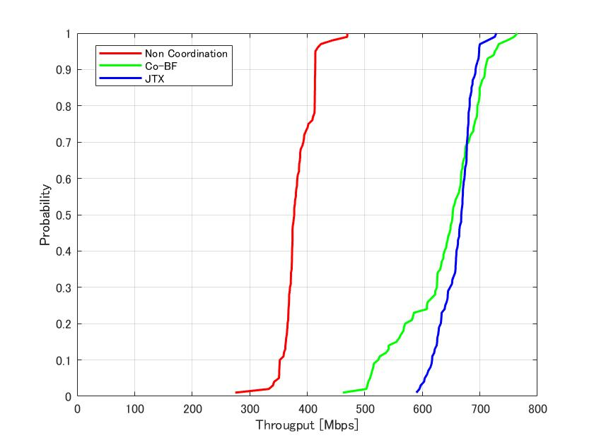
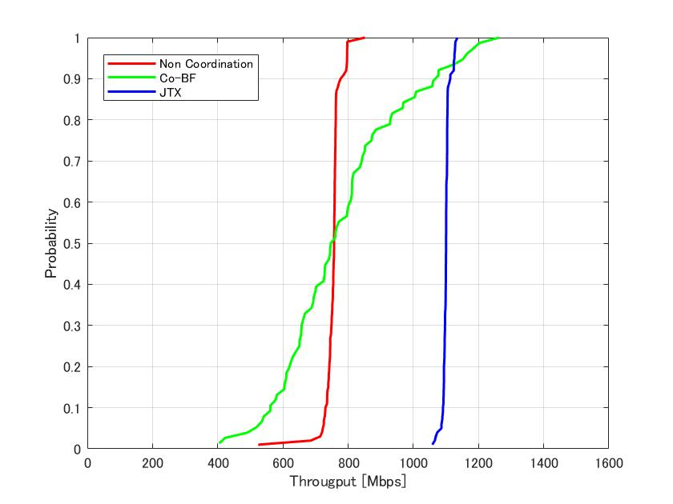
Simulation Result (2/4)
System Throughput Evaluation Result
TxSS per STA = 1
TxSS per STA = 2
Throughput Gain From No Coord. at cdf=0.5
- Co-BF : x1.73
- Joint Tx :x1.77
Throughput Gain From No Coord. at cdf=0.5
- Co-BF : x0.99
- Joint Tx :x1.45
CDF
CDF
When TxSS=1, Joint TX and Co-BF performance do not change significantly, but when TxSS=2, Co-BF deteriorates in some cases compared to non-coordination.
TDMA at high MCS is better than simultaneous transmission at low MCS in many cases.

Slide 11
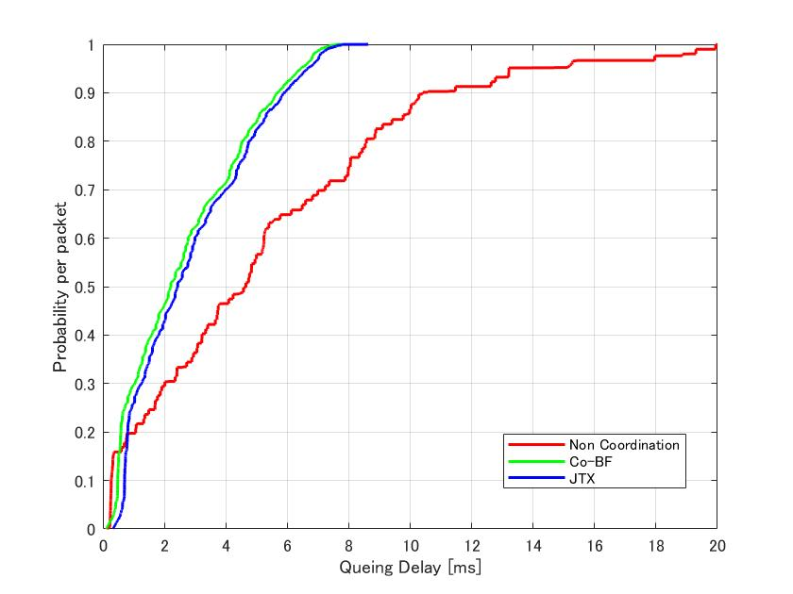
Simulation Result (3/4)
Latency Evaluation Result (CDF in on example drop)
Delay | Prob <5ms | Avg | Worst
No Coord. | 56.65% | 5.28ms | 35.76ms
Co-BF | 83.90% | 2.64ms | 8.41ms
Joint Tx | 82.38% | 2.86ms | 8.63ms
CDF
Both types can decrease the queuing delay much. Co-BF achieves slightly lower queuing delay than Joint Tx due to data sharing overhead.

Slide 12
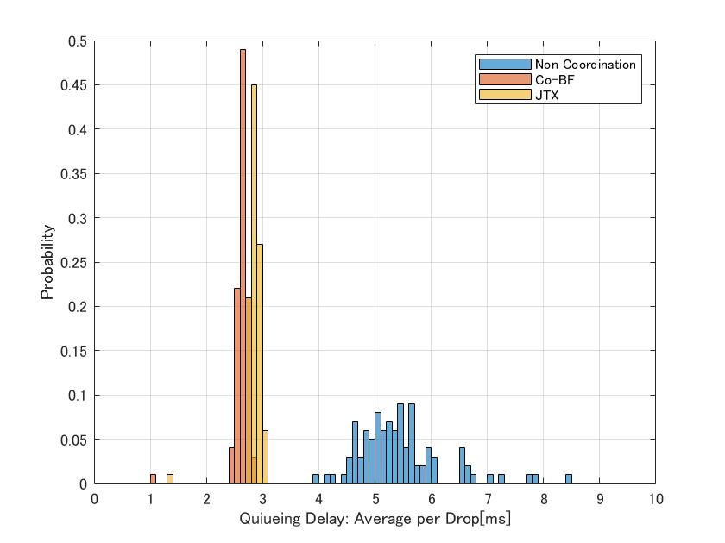
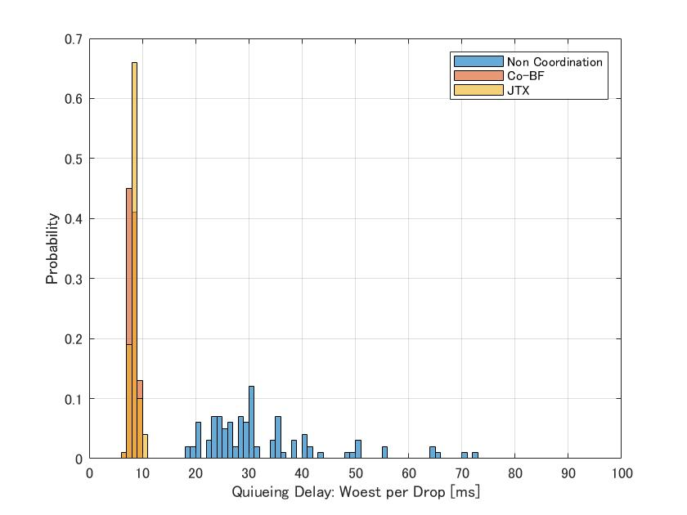
Simulation Result (4/4)
Latency Evaluation Result (Histogram in All Drops)
Average
Worst
Mean Value
- No Coord.: 5.30ms
- Co-BF : 2.63ms
- Joint Tx :2.85ms
Mean Value
- No Coord.: 29.25ms
- Co-BF : 8.05ms
- Joint Tx :8.27ms
Both types can decrease the queuing delay significantly, especially worst-case delay.

Slide 13
Observation
Even if considering data sharing overhead, Joint Tx has the potential to simultaneously satisfy high throughput and low latency.
When TxSS = 2, only Joint Tx can achieve high system throughput gain.
Queuing delay is slightly higher than Co-BF, but still lower than when uncoordinated.
If 10Gbps Ethernet cables become the mainstream in the future, we can expect this level of performance from Joint Tx, even if including data sharing overhead.
Also, Co-BF can achieve good performance in situations where high throughput is not required and there is room for antenna freedom.
When TxSS = 1, system throughput gain is much high and almost same as Joint Tx.
Co-BF can achieve lower queuing delay than Joint Tx due to data sharing overhead.
If we include not only queuing delay but also other delays (e.g. retransmission delay), the difference with Joint Tx may be even larger
We prefer to use these two methods of coordination, depending on the environment and requirements.

Slide 14
Further Discussion
In order to increase the number of situations where Joint Tx can be deployed, several remaining factors regarding data sharing must be considered in the future.
Low Backhaul Speed (Old Ether cable, Wireless backhaul, and so on)
Internal Delay via Upper layer of AP (such as Linux)
Solution to reduce data sharing can be further discussed in the next TG. For example:
Complete data sharing in advance, not just before Joint Tx.
For Mesh environment, data sharing will become overhead-less.
Increasing complexity of packet management will be a big concern.
During data sharing, packet transmission to other STAs to improve efficiency.
It would be a good way to start Joint Tx discussion with a simple scenario first, and then discuss possible extensions in the future.

Slide 15
Summary
We discussed issues of advanced coordination types (Joint Tx and Co-BF)
We provided simulation results to show the potential performance of Joint Tx and Co-BF.
Joint Tx in 10Gbps LAN scenario has the potential to simultaneously satisfy high throughput and low latency, even if data sharing overhead.
Co-BF can achieve very high performance in situations where high throughput is not required and there is room for antenna freedom.
It seems that standardization of both coordination methods makes sense such that the implementation can choose the appropriate coordination type depending on the environment and requirements.

Slide 16
Reference
[1] Yusuke Tanaka (Sony Group Corporation), “Considerations on Multi-AP Coordination,” 22/1516r0, September 2022.
[2] Ron Porat (Broadcom), “Joint transmission for 11be,” 20/0071r1, April 2020.
[3] Roya Doostnejad (Intel), “Coordinated beamforming for 802.11be,” 20/0099r1, April 2020.
[4] Jason Yuchen Guo (Huawei), “Coordinated spatial reuse operation,” 20/0033r1, February 2020.
[5] Liwen Chu (NXP), “Coordinated OFDMA,” 19/1919r3, January 2020.
[6] Lochan Verma (Qualcomm), “Coordinated AP time/frequency sharing in a transmit opportunity in 11be,” 19/1582r2, January 2020.
[7] Ron Porat (Broadcom), “Distributed MU MIMO Simulations,” 18/1962r0, November 2018.
[8] Ron Porat (Broadcom), “Joint Processing MU-MIMO Update,” 19/0800r0,May 2019.
[9] Sudhir Srinivasa (Marvell), “Joint BF Simulations,” 19/1094r0, July 2020.
[10] Sigurd Schelstraete (Quantenna Communications), “Multi-AP backhaul analysis,” 19/1588r0, September 2019

Slide 17
Appendix. Other Example of Coordination Protocol Sequence (1/3)
Skip in Co-BF
Coord.
Set
Coord.
Trigger
AP1
(Sharing AP)
Data Sharing
Data
AP2
(Shared AP)
Data
Coord.
Req
STAs
Block Ack
AP2 becomes Sharing AP.
AP2 sends Coordination Req. to AP1 to confirm whether or not to perform a coordinated transmission.
AP1 decides if coordination should be initiated and which packets to send based on information obtained.
(The rest is the same as in Slide.6)

Slide 18
Appendix. Other Example of Coordination Protocol Sequence (2/3)
Coord.
Req
AP1
(Sharing AP)
Data
AP2
(Shared AP)
Coord.
Resp
STAs
Block Ack
When AP1 decides not to perform coordination transmission, AP1 alone sends data to the STA.
Possible reasons are as follows.
No candidate APs have traffic to send.
No response from candidate AP2.
Etc..

Slide 19
Appendix. Other Example of Coordination Protocol Sequence (1/3)
Grant frame
AP1
(Sharing AP)
AP2
(Shared AP)
Data
Coord.
Req
STAs
Block Ack
When AP1 decides not to perform coordination transmission, AP1 sends Grant frame to AP2 to allow AP2 to alone send data to the STA.
Possible reasons are as follows.
No candidate APs (including Mater AP) have traffic to send.
Etc..

