Slide 1
Accuracy and Compression of TXBF Feedbacks based on the Optimal SVD
October 2022
Doc.: IEEE 802.11-22/1820r0
Date: 2022-10-27
Authors:
Name | Affiliation | Address | Phone | Email
Aiguo Yan | Zeku | 2479 E Bayshore Rd, Palo Alto, CA 94303 |  | aiguo.yan@zeku.com
Yi-Hsiu Wang | Zeku
Xiaogang Chen | Zeku

Slide 2
Outline
October 2022
Doc.: IEEE 802.11-22/1820r0
Background
Optimal SVD based TXBF Feedback (Decimation)
Simulation Results
Summary and Recommendations
References

Slide 3
Background
October 2022
Doc.: IEEE 802.11-22/1820r0
Background of the Optimal SVD [WNG01]
We had a high-level presentation in WGN in Sept/2022
We received many suggestions/comments/questions.
Many were eager to see simulations results
Background on TXBF Feedback Overhead Reduction
In last decade, Many contributions emphasized importance of overhead reduction and proposed ways to reduce these overheads. But none of these ideas got into standards. [BFOR01]
Recently, CSI Feedback Overhead Reduction was proposed as the top use cases in AIML-TIG meeting. [BFOR02/03]
CSI Feedback Overhead Reduction was also one of top use cases in 3GPP/5GNR AI/ML activities.
Notes:
BW, Modulation Order, Coding, ……….

Slide 4
A Subset of Existing Proposals on Overhead Reduction
October 2022
Doc.: IEEE 802.11-22/1820r0
 | Scheme | Pros | Cons
1 | ϕ only feedback | exists in 802.11ah | single data stream only
2 | time domain channel | exists in 802.11ad/ay | may need additional signaling to identify tap positions and the extra matrix
3 | Differential Givens Rotation | Simple improvement from 802.11ax, variant in 11ay | Additional processing, Error Propagation
4 | Variable Angle Quantization | simple improvement from 802.11ax | additional processing
5 | Multi-component Feedback | Well understood, reduced feedback overhead | May need additional design
6 | Codebook based Feedback | Well understood, reduced feedback overhead | May need additional design
7 | Two way channel training | Do not need calibration, reduced feedback overhead | May need additional design
8 | Implicit Feedback | Simple improvement from 802.11n | Needs calibration
The Table is from “11-19-0391-00-0eht-feedback-overhead-reduction-in-802-11be.pptx” (Komi Oteri and et al.)
Notes:
There are more proposals in IEEE802.11 document server.

Slide 5
Additional Overhead Reduction Proposals
October 2022
Doc.: IEEE 802.11-22/1820r0
11-15-1347-00-00ax-strategies-to-reduce-mimo-feedback-overhead.pptx, [Filippo Tosato and etl of Toshiba]
11-15-1129-01-00ax-feedback-overhead-in-dl-mu-mimo.pptx, [Filippo Tosato and etl of Toshiba]
Cosine-sine Decomposition
Grassmannian Representation
11-20-0041-00-00be-additional-overhead-reduction-in-mixed-beamforming-feedback.pptx; [Genadiy Tsodik and etl of Huawei]
“Sub-band” Method
11-19-1018-01-00be-feedback-overhead-reduction.pptx; [Wook Bong Lee and etl of Samsung]
11-19-1495-02-00be-further-discussion-on-feedback-overhead-reduction.pptx [Wook Bong Lee and etl of Samsung]
Dimension Reduction
Notes:
BW, Modulation Order, Coding, ……….

Slide 6
Optimal SVD Based Feedbacks (hide standards-related details temporarily)
October 2022
Doc.: IEEE 802.11-22/1820r0
Optimal SVD:
SVD is not unique.
Choose a SVD that meets our pre-defined optimization criteria.
BFer
BFee
BF Feedback $\{ \overline{V}\left(k\right) \}$
Raw Channel $\{ H\left(k\right) \}$
BFed Channel $\{ H\left(k\right)\overline{V}\left(k\right) \}$

Slide 7
Essences of Compressive TXBF Feedbacks
October 2022
Doc.: IEEE 802.11-22/1820r0
Decimation (indicated by the parameter Ng) and Re-construction of V matrices
Decimation is one of key compression methods
This is the focus of this contribution
Goal is to minimize error caused by decimation, 11ac: Ng = 1, 2 or 4; 11ax/be: Ng = 4 or 16
Angle {ϕ , ψ} Extraction from V – not considered
Quantization – not considered

Slide 8
Current Situation in Standards and Potential Changes
October 2022
Doc.: IEEE 802.11-22/1820r0
The Normalized V matrices (i.e., the last row is non-negatively real) are feedbacked
The best V matrices for V re-construction are often not the normalized V matrices
Potential Changes
Enable feedback of the Optimal V matrices

Slide 9
Reconstruction of V Matrices in TXBFers
October 2022
Doc.: IEEE 802.11-22/1820r0
There is no restriction on how a TXBFer should reconstruct the SU V (precoding) matrices based on received feedbacks.
Many researchers did propose different ways.
We easily summarized 7 potential ways for reconstruction, even with a simple 1st order linear interpolation
There are also multiple ways to calculate errors
It is also very important/beneficial for TXBFee to know the accuracy of the reconstructed V (or precoding) matrices
Would like to feedback in such a way that TXBFees have high confidence of reconstruction accuracy “regardless” of methods used by TXBFers!!!

Slide 10
Simulation Assumptions
October 2022
Doc.: IEEE 802.11-22/1820r0
11ax; 20MHz; Channel D and B
Ng = 4 or Ng = 16 according to 11ax specs
Ng = 2 is the “new proposal”
The simple linear interpolation is assumed
SNR is defined as below
Note: SNR here is not a perfect indicator, but it provides reasonable mathematical guidance.
For example, 11be 4KQAM needs SNR of 30+dB; RF IRR needs to be better than -50dBc. Error of V doesn’t impact PER the same way as other imperfections normally do. So we have to use these numbers with a grain of salt

Slide 11
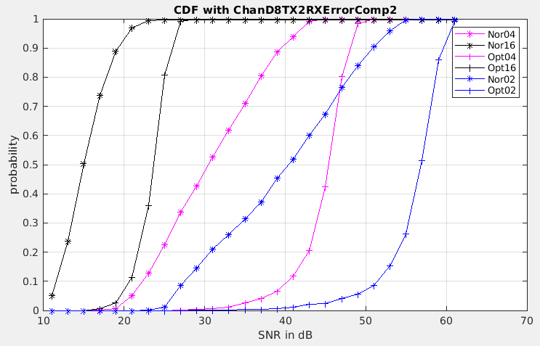
Observation with Channel-D (SNR2)
October 2022
Doc.: IEEE 802.11-22/1820r0
Ng=04
Ng=02
Ng=16
Assuming a threshold/requirement of 30dB; ~50% of time with Ng=4, (or ~20% with Ng=2), can’t meet the requirement. Potential Problem?
Notes:
What is a reasonable threshold? How does it compare to MCS SNR requirement?
Think about 4KQAM and 16KQAM.
3 questions here
1: What value is a reasonable threshold?
2: Do we have a problem for highest MCS?
3: Optimal SVD – modify protocol?
4: Smaller Ng – modify protocol?

Slide 12
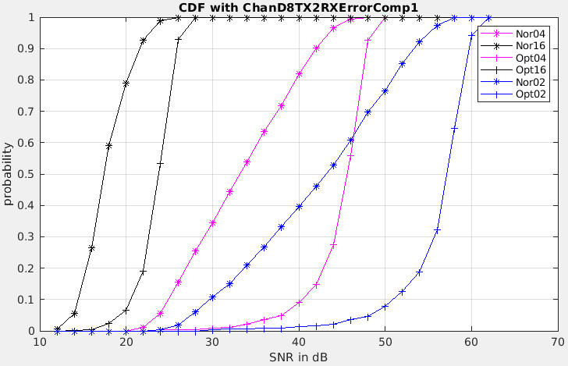
Observation with Channel-D (SNR1)
October 2022
Doc.: IEEE 802.11-22/1820r0
Ng=04
Ng=16
Ng=02
Assuming a threshold/requirement of 30dB; ~35% of time with Ng=4, (or ~10% with Ng=2), can’t meet the requirement.
Notes:
What is a reasonable threshold? How does it compare to MCS SNR requirement?
Think about 4KQAM and 16KQAM.

Slide 13
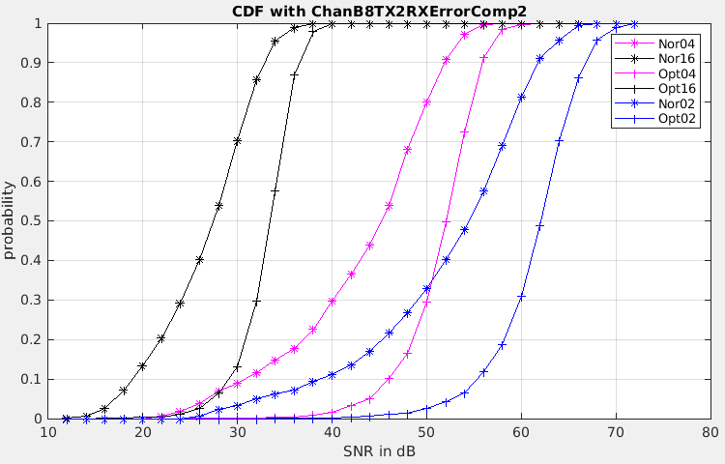
Observation with Channel-B (SNR2)
October 2022
Doc.: IEEE 802.11-22/1820r0
Ng=04
Ng=02
Ng=16
Optimizing V seems much more efficient than halving Ng, ChanD/B

Slide 14
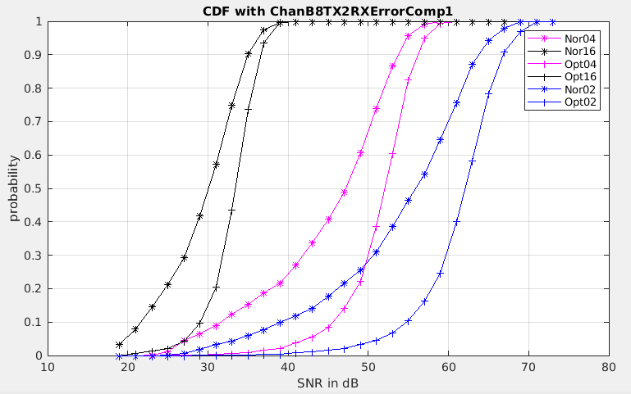
Observation with Channel-B (SNR1)
October 2022
Doc.: IEEE 802.11-22/1820r0
Ng=04
Ng=02
Ng=16
Optimizing V seems much more efficient than halving Ng, ChanD/B

Slide 15
Overhead Calculation (# of Angles)
October 2022
Doc.: IEEE 802.11-22/1820r0
 | Normalized | Optimal | +Overhead
04TX2RX | 10 | 10+2 | 20%
08TX2RX | 26 | 26+2 | 7.7%
16TX2RX | 66 | 66+2 | 3.0%
08TX4RX | 44 | 44+4 | 9.1%
16TX4RX | 108 | 108+4 | 3.7%
Pros/Cons of falling back to 11ac with Ng = 01 ?
Notes:
P56 of 11ac specs
Theoretic Formula

Slide 16
Summary and Suggestions
October 2022
Doc.: IEEE 802.11-22/1820r0
Introduced essences of Optimal SVD (and GMD), and TXBF feedback schemes based on the Optimal SVD (and GMD).
Shared simulation results of the Optimal SVD based TXBF Feedbacks.
Exposed a potential limitation of existing TXBF feedback scheme???
Suggested options (mainly following existing method for minimum modifications) for the community to think about.
Reduce Ng (increase accuracy and significant overhead);
Enable feedback of the optimal V matrices;
(increase significant accuracy and small overhead);
Both (1) and (2), specially for next gen cases demining higher accuracy
(increase significantly both accuracy and overhead);
Will change quantization as a natural consequence if needed

Slide 17
Selected References
October 2022
Doc.: IEEE 802.11-22/1820r0
[WNG01]: 11-22-1413-01-0wng-thoughts-on-high-reliability-communications , [Aiguo Yan and et al of Zeku]
[WNG02]: 11-22-0708-03-0wng-beyond-be-next-step, [Rolf De Vegt and et al of Qualcomm]
[WNG03]: 11-22-0418-00-0wng-considerations-of-next-generation-beyond-11be.pptx (Jianhan Liu and et al of MediaTek).
[TXBF01]: C. Shen and M. P. Fitz, "MIMO-OFDM Beamforming for Improved Channel Estimation," in IEEE Journal on Selected Areas in Communications, vol. 26, no. 6, pp. 948-959, August 2008, doi: 10.1109/JSAC.2008.080811.
[TXBF02]: W. Hu, F. Li and Y. Jiang, "Phase Rotations of SVD-Based Precoders in MIMO-OFDM for Improved Channel Estimation," in IEEE Wireless Communications Letters, vol. 10, no. 8, pp. 1805-1809, Aug. 2021, doi: 10.1109/LWC.2021.3081583.
[TXBF03]: E. Jeon, M. Ahn, S. Kim, W. B. Lee and J. Kim, "Joint Beamformer and Beamformee Design for Channel Smoothing in WLAN Systems," 2020 IEEE 92nd Vehicular Technology Conference (VTC2020-Fall), 2020, pp. 1-6, doi: 10.1109/VTC2020-Fall49728.2020.9348441.
[TXBF04] F. Jiang, Q. Li and X. Chen, "Channel Smoothing for 802.11ax Beamformed MIMO-OFDM," in IEEE Communications Letters, vol. 25, no. 10, pp. 3413-3417, Oct. 2021, doi: 10.1109/LCOMM.2021.3099167.
[BFOR01]: 11-19-0391-00-0eht-feedback-overhead-reduction-in-802-11be.pptx” (Komi Oteri and et al of InterDigital)
[BFOR02]: 11-22-1563-02-aiml-ai-ml-use-case, [Zinan Lin of InterDigital]
[BFOR03]: 11-22-0950-02-aiml-discussion-on-interaction-between-ai-ml-wireless-lan, , [Zinan Lin of InterDigital]
Notes:
Rolf

