Slide 1
A Perspective on UHR Features for Operator Residential Deployments
Date: 2022-11-15
Authors:
Name | Affiliation | Address | Phone | Email
Lili Hervieu | CableLabs |  |  | l.hervieu@cablelabs.com
Carol Ansley | Cox |  |  | Carol.Ansley@cox.com
Matthew Chappell | Cox |  |  | matthew.chappell2@cox.com
Allen Huotari | Comcast |  |  | allen_huotari@comcast.com
Loay Kreishan | Charter |  |  | loay.kreishan@charter.com
Luther Smith | CableLabs |  |  | l.smith@CableLabs.com
Trilok Mutyala | Comcast |  |  | trilok_Mutyala@comcast.com
Darshak Thakore | CableLabs |  |  | d.thakore@cablelabs.com
Amelia Andersdotter | Sky Group/Comcast |  |  | amelia.ieee@andersdotter.cc

Slide 2
Introduction
This contribution highlights a set of features to be considered by next gen 802.11 to enhance operator residential deployment use cases
Encompass a wide variety of deployments from large isolated homes to very dense appartement complexes.
This submission addresses
Residential deployments backgrounds
Multi-AP coordination: deployments with backhaul
Multi-AP coordination: deployments without backhaul
Multi-AP coordination: AP placement
Multi-AP coordination: roaming and mobility
Consideration to extend coverage
Consideration to reduce latency
Consideration for AP power saving modes

Slide 3
Residential Deployments Background
Coverage in residential deployments remains challenging
Single family units (SFU) with brick/mortar walls typically found in Europe
Large (multi-level) SFUs with drywalls typically found in US
More IoT devices deployed at the edge or surrounding of the homes
Doorbell, speakers, webcams
Most homes in US do not have pre-installed wired LAN connectivity (cat5) and rely on WLAN only
Homes with wired connectivity are often based on powerline (HomePlug®) in Europe (up to 200 Mbps throughput in field tests) and Coax (MoCA®) in US
“Mesh AP” deployments are becoming mainstream
15 to 20 % of homes in US may benefit from “Mesh APs”/extenders in US
Typically 1 to 3 “Mesh APs”/extenders with 1-hop connectivity to the broadband AP gateway for 2.4 GHz and 5 GHz deployments

Slide 4
Residential Deployments Background
Multi-dwelling deployments (MDUs) are challenging due to the high number of OBSSs, especially at 2.4 GHz and 5 GHz.
Examples below show the number of OBSSs in MDUs at 5 GHz (U-NII-1)
10 floor MDU in Maryland with 8 to 21 appartements per floor.
Up to 163 BSSIDs broadcasted by 39 APs. The average number of BSSIDs is 58, and the mean number of APs is 13.
Estimated beacon airtime utilization up to 63% (400-μs beacons with a beacon interval of 102.4 ms)
Two-tower complex in Washington state with 6 floors and 141 appartements.
Up to 57 BSSIDs broadcasted by 19 APs. The average number of BSSIDs is 22, and the mean number of APs is 7.
Estimated beacon airtime utilization up to 23% (400-μs beacons with a beacon interval of 102.4 ms)
Across Wi-Fi 6 SFU and MDU deployments, one operator have recorded the following downlink PHY rates for data frames at 5 GHz:
630M samples over 3 days:
80.84% samples from min=390 Mbps to max=1300 Mbps
11.59% samples are 1201 Mbps (MCS11, 800 nsec GI)
1180M samples over 4 days:
80.97% samples from min=390 Mbps to max=1300 Mbps
9.86% samples are 1201 Mbps (MCS11, 800 nsec GI)

Slide 5
Multi-AP Technologies for Residential Settings
Multi-AP technologies have been proposed in EHT TG and UHR SG [1][2][3]
Multi-AP should address different residential deployments
Deployment #1: with backhaul
management, coverage, mobility/roaming
Deployment #2: without backhaul
management, spectrum efficient & interference reduction
Wireless Gateway
Apt A
Apt B
Wireless Gateway
Wireless Gateway
AP#1
AP#2
AP#a
AP#b
Apt C
Apt D
AP#3
Wireless Gateway
Wireless Gateway
AP#4
AP#c
AP#d
3-floor Single Family Unit
“Mesh AP”/Extenders
One SSID: “My_Home”
Wireless (or wired) backhaul between APs
Apartment complex - 1 AP per apartment
Same or different operators
No backhaul between APs
No user data shared between APs (no joint transmission)

Slide 6
Multi-AP Coordination: Deployments with Backhaul
Multi-AP coordination must operate over wireless and wired backhauls typically found in residential settings
Consider wireless and wired backhauls with different bandwidth, latency, etc.…
WLAN backhaul operating on the same or different channel than fronthaul
Different Multi-AP coordination technologies such as C-SR, C-BF, C-OFDMA will have different backhaul requirements
Consider clarifying the backhaul KPIs when defining a multi-AP coordination technology
Method to measure latency and throughput – E.g., what comprises the one-way latency
Define a method to characterize backhaul KPIs so APs can decide what Multi-AP technology is possible
Features must show improvements in the presence of legacy devices
Collect and share management information between APs to configure multi-APs
Enhance WFA EasyMesh performance

Slide 7
Multi-AP Coordination: Deployments without Backhaul
Multi-AP coordination benefits for these deployments (e.g., non-managed MDUs):
Collect and share information for management
Seamless roaming (e.g., community Wi-Fi)
Reduce co-channel interference and increase spectrum efficiency
No support for coordinated joint transmission
Deployment scenarios
Operator managed APs in non-managed MDUs based on
Trusted APs you can coordinate with
For example, APs managed by the same operator
Consider controller based and coordinated autonomous APs
Multi-AP coordination between “independent” APs
Consider methods for independent APs to coordinate spectrum sharing e.g., managed by different operators or off-shelf APs
Proposed Multi-AP schemes are based on shared and sharing APs [4]
Consider distributed deployments approach

Slide 8
Multi-AP Coordination: AP Placement
Sometimes, deploying extenders/“Mesh APs” in residential settings makes 802.11 performance worse
User may not follow operator’s guidelines for “Mesh APs”/extenders placement. For example:
The user may place the extender too close to the gateway resulting in a smaller coverage
The user may place the extender too far away from the gateway resulting in poor user experience
The user may use more extenders than necessary
The user may voluntarily move (or remove) an extender within the residence
Multi-AP coordination may help determine a poor AP placement
Proper AP placement will be critical for C-OFDMA, C-BF, C-SR…
Define methods to mitigate AP placement related issues

Slide 9
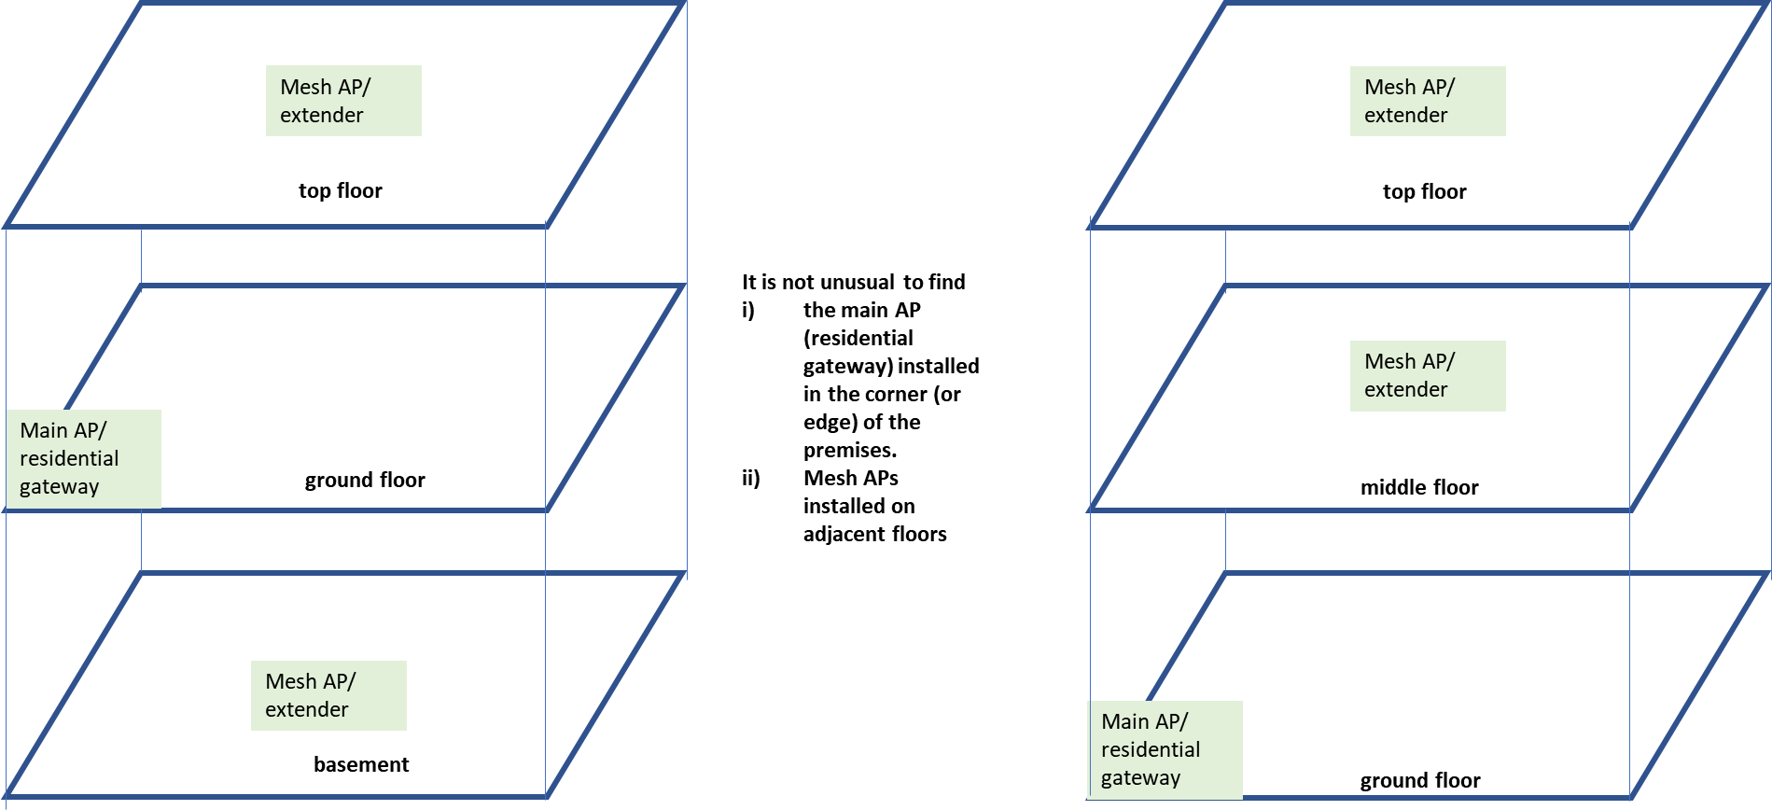
Multi-AP Coordination: AP Placement
Residential AP placement often involves deploying multiple APs across multiple floors
Placement and orientation is often for convenience and/or aesthetics (therefore can be very arbitrary)

Slide 10
Multi-AP Coordination: Roaming and Mobility
Mobility and roaming in residential deployments include many scenarios:
“Mesh-APs”/extenders (mainly SFUs)
Community Wi-Fi (SFUs/MDUs)
Property-wide Wi-Fi (managed MDUs) – “Enterprise like” deployments
Some clients make bad roaming decisions (do not roam as suggested by the AP) or do not roam at all
Impact the user QoE and other clients as well.
Multi-AP coordination should address seamless roaming
Several contributions have proposed Virtual BSS (V-BSS) [18] and hitless roaming [19]
Need to consider a “non-AP STA mandatory roaming” mode (optional feature) for “trusted Multi-APs” systems
Seamless roaming to address deployments
Without backhaul
With wired and wireless backhauls, different backhaul capacity/latency

Slide 11
Consideration to Extend Coverage
Exploratory discussion:
Consider optimizing Coordinated APs WLAN fronthaul and backhaul running on same channel and radio
Consider a new non-AP STA class of devices (e.g., proxy non-AP STA) to extend coverage
Use case example: doorbell to extend coverage to the backyard.
Target is to extend range for limited traffic IoT devices
Low complexity & cost constraints
Act as a relay, not a signal repeater
Ideally support legacy devices (e.g., 802.11n)

Slide 12
Consideration To Reduce Latency
Bottleneck links are often where packet buffering (latency/loss) happens
Slowest link in the path between sender and receiver
Most commonly the Wi-Fi or access network link (CM/DSL)
Congestion Control legacy: Reno relies on the network to:
Provide deep packet buffers and drop packets when buffers overflow
Try to keep those buffers full, leading to latency and packet loss for non-TCP traffic too
Consider supporting new IETF technologies such as
IETF “L4S” “Low-Latency Low-Loss Scalable”
IETF NQB (non-Queue Building) DSCP
Consider Reducing burstiness caused by Wi-Fi links to best support L4S and NQB

Slide 13
Consideration for AP Power Saving Modes
Battery life is a known top priority in the handset market
However, aggregate total household energy consumption is rapidly emerging
Every household device matters:
Environmentally conscious consumers
Variable energy-price sensitive consumers
Regulatory pressure on household appliance and equipment vendors make some markets subject to requiring stand-by modes with as low as <8W power consumption
The AP also matters!
Need for configuring “Green AP low power modes“
AP low power modes has been proposed in [7]
This is challenging when each generation of .11 technologies focuses on higher-throughput
We need alternative priorities too
Harmonized industry support for opportunistically disabling functionality that consumes more power and/or powering down subsystems in AP
Without standardized “low power modes” there may be a risk of inadvertently disconnecting client devices when a “green profile” is enabled (or disabled) on the AP
Could be a toolbox for quick power up/down of mechanisms currently available that remain configurable by vendors

Slide 14
Conclusion
In this contribution, we provide our considerations on the next major MAC/PHY amendment in 802.11:
Muti-AP coordination is a key technology for residential deployments
Support for “Mesh APs/extenders with various WLAN backhaul capabilities and configurations
Support for “trusted” APs w/o backhaul in non-managed MDU deployments
Method to assist AP placements when deploying “Mesh APs”/extenders
Seamless roaming
Consider methods for non-AP STA to extend coverage
Consider new IETF technologies such as L4S & NQB to reduce latency
Consider implementing AP power saving modes

Slide 15
References
[1] 11-19-0140r1, “Discussion on Multi-AP Coordination Type”
[2] 11-22-1530r1: “Multi AP coordination for next-generation Wi-Fi”
[3] 11-22-1512r0: “UHR SG and Multi-AP”
[4] 11-19-1895r2: “Setup for Multi-AP coordination”
[5] 11-22-1394r1, “Virtual BSS And Multi AP Transmissions”
[6] 11-22-1580r1, “A perspective on proposed Ultra-High Reliability (UHR) features for enterprise use cases”
[7] 11-22-1790r0, “Ultra-High Reliability (UHR) requirements for home-networking use cases”

