Slide 1
Enhancement of RRCM
Date: 2022-10-25
Authors:

Slide 2
Abstract
This document provides enhancement of the current Rule-based Random and Changing MAC (RRCM) proposal 818/r4

Slide 3
Recap-1
The main idea of current RRCM is that each side (non-AP STA and AP) locally generates the same Random MAC - RMA (that is used by the non-AP STA in next association(s)) based on the same formula and parameters.
STA and AP generate one or more RMA(s) locally at their sides using,
- Key (RMA key) – locally generated private key
- Seed – exchanged between two sides to feed into RMA generation formula
- Counter – exchanged between two sides to make sure both sides generate the same number of RMA(s)
The STA will use the generated RMA(s) in its next association. Since AP also generates the same RMA(s), it will identify the STA.
If STA generates a single RMA -> STA can use it in all message exchanges If STA generates multiple RMA(s) -> STA can use them in different message exchanges (e.g. RMA1 in probe request frame, RMA2 in other frames).

Slide 4
Recap-1
Non-AP STA
AP
Associate with MAC1
Generate and store a secret key locally
Generate and store a secret key locally
1st Assoc
Generate and store RMA(s) based on the key. (e.g. RMA1, RMA2)
Generate and store RMA(s) based on the key (e.g. RMA, RMA2)
Use RMA1&RMA2 (e.g. ANQP Req– RMA1, Auth/Assoc/4-way HS - RMA2)
2nd Assoc
Generate new RMA(s) if desired

Slide 5
Recap-1
Concerns about RRCM
Using MAC address (sent in the clear)
exposes the identity
Causes high risk of trackability
Attacks are possible (e.g. replay attack, MAC spoofing)
An attacker can listen to the non-AP STA or AP’s frames and impersonate the non-AP STA or AP, especially in pre-association.
-> using multiple temporary RMAs avoids these concerns to some extent
To avoid this, we propose to make sure that the frames come from a legitimate STA and AP, when the STA returns to ESS. -> idea similar to 802.11w Protected Management Frames (PMF):

Slide 6
Recap-2
802.11w Protected Management Frames (PMF)
In 802.11w, when a non-AP STA associates with AP, they determine a secret key and protect the unicast/broadcast management frames as follows:
Broadcast/multicast management frames are protected by MMIE (Management MIC Information Element) with IGTK. MMIE IPN (IGTK packet number) protects replay attack, MIC (Message Integrity Code) makes sure the frame is not changed (i.e. “integrity”).
Unicast management frames are protected by encrypting the payload (as in data frames) with PTK. Note that encrypted payload contains PN (packet number) and MIC to provide protection for replay attack and integrity.
Beacon is protected by MMIE (as in broadcast management frames) but with BIGTK.

Slide 7
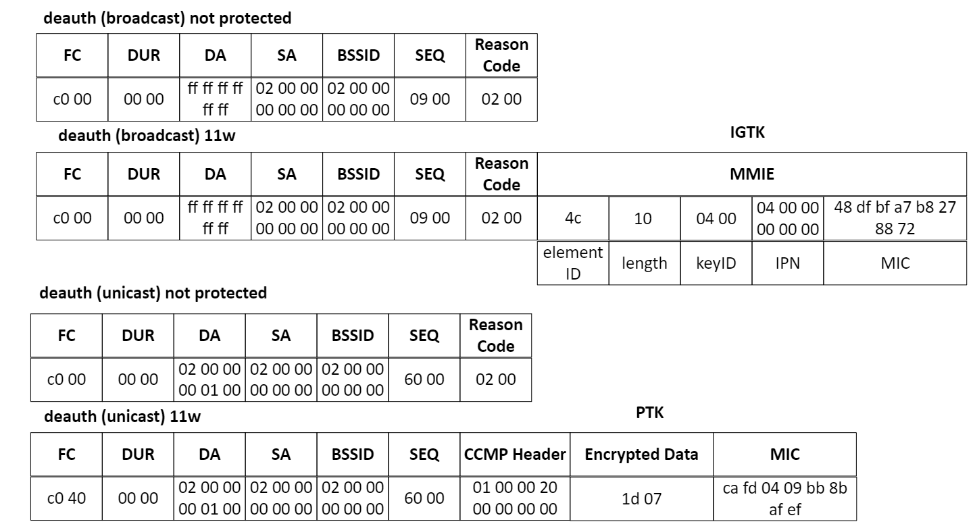
Recap-2
How to protect management frames when non-AP STA returns to the same ESS?
An example of 802.11w:

Slide 8
Proposal – Enhanced RRCM
In the first association,
Non-AP STA associates with AP through common RRCM procedure: -> RMA(s) for non-AP STA are generated for future association.
Non-AP STA and AP determine and store a secret key to protect pre-association management frames (such as ANQP, authentication, association etc.) when non-AP STA returns (second association) [enhancement]
In the second association,
Non-AP STA uses previously generated RMA(s) and gets identified by the AP.
Additionally, non-AP STA and AP send management frames protected (using previously generated secret key). [enhancement]
By doing so, both parties (non-AP STA and AP) make sure that the management frames come from a legitimate non-AP STA/AP.

Slide 9
Proposal – Enhanced RRCM
How to protect management frames when non-AP STA returns to the same ESS?
In enhanced RRCM,
After non-AP STA associates with AP and gets identifier (RMA), non-AP STA and AP store a secret key to protect management frames when non-AP STA returns (in addition to storing generated RMA(s)). In other words, non-AP STA and AP perform “802.11w on a pre-determined secret key” or “802.11w on pre-association management frames”.
Both parties (non-AP STA and AP) protect their management frames:
Which management frames to protect?
To keep it simple, some unicast management frames (such as ANQP、 authentication/association) can be considered, even though nothing limits the types of frames to be protected.
Is the complexity too high?
Because protection and identification happen at the same time, complexity is not high: The AP identifies the non-AP STA as soon as AP receives frames from non-AP STA (RMA in MAC header). Because AP identifies the non-AP STA, it knows which key to use for protection.

Slide 10
Proposal – Enhanced RRCM
Non-AP STA
AP
Non-AP STA and AP go through RRCM: non-AP STA and AP generate and store RMA(s) for second association.
1st Assoc
Non-AP STA and AP determine and store a secret key for pre-association management frame protection in future association
2nd Assoc
Non-AP STA sends protected management frames (Authentication “Req”, Association Req) using the secret key from 1st Association. Non-AP STA also uses RMA(s) from RRCM.
AP sends protected management frames (Authentication “Resp”, Association Resp) using the secret key from 1st Association.

Slide 11
Proposal – Enhanced RRCM
Non-AP STA
AP
MAC Header
MAC Payload
IE
When the non-AP STA returns to the ESS, it protects its management frames (such as ANQP, authentication/association request).
Similarly, when AP sends response frames (such as authentication/association response), it protects them.
Because only legitimate non-AP STA and legitimate AP have the key for protection, their IEs (IPN&MIC) are accepted (non-legitimate STAs are not accepted because of failed IE value)
✓
Attacker AP
RMA1
IPN & MIC
MAC Header
MAC Payload
IE
✓
MAC Header
MAC Payload
IE
AP_MAC
IPN & MIC
✗
AP_MAC
IPN & MIC
Attacker non-AP STA
MAC Header
MAC Payload
IE
✗
RMA1
IPN & MIC

Slide 12
Thanks ☺

