Slide 1
New Use Case for AMP IoT Devices: Smart Grid
October 2022
Doc.: IEEE 802.11-22/1800r0
Date: 2022-10-25
Authors:
Name | Affiliation | Address | Phone | Email
Yinan Qi | OPPO |  |  | v-qiyinan@oppo.com
Weijie Xu |  |  |  | xuweijie@oppo.com
Xu Zhao | Beijing Smart Chip Microelectronics Technology Co., Ltd. |  |  | zhaoxu@shchip.sgcc.com.cn

Slide 2
Background
October 2022
Doc.: IEEE 802.11-22/1800r0
Following use cases have been discussed in earlier meetings
Use case 1 Smart manufacturing: inventory/attendance check, real-time inspection and tracing, asset tracking/positioning, and industrial environment/production line sensing and monitoring [1]-[2]
Use case 2 Data center: environmental monitoring, facility monitoring and asset management [3]
Use case 3 Smart home: asset management, home environment monitoring and home security [1].
Use case 4 Logistics and warehouse: goods tracking and inventory check [1]
Use case 5 Smart agriculture: monitoring of soil moisture, soil fertility, temperature, wind speed, plant growth etc., and controlling of the agricultural facilities [1]
Use case 6 Indoor positioning: positioning in giant shopping mall, factories, warehouses, etc. [4]
New use case
Use case 7 Smart Power Grid: Sensing of sound, heat, pressure, etc., smart meter to achieve awareness of device/equipment status

Slide 3
Smart Power Grid: State of the Art
October 2022
Doc.: IEEE 802.11-22/1800r0
State of the Art
Large-scale application of power sensors in power transmission, substation and power distribution has been realized.
The wide deployment of hundreds of sensors to detect leakage current, vibration and pressure, enabling the collection of electrical, non-electrical, environmental data.
Tower Tilt Partial Discharge Water in cabinet Wire Icing

Slide 4
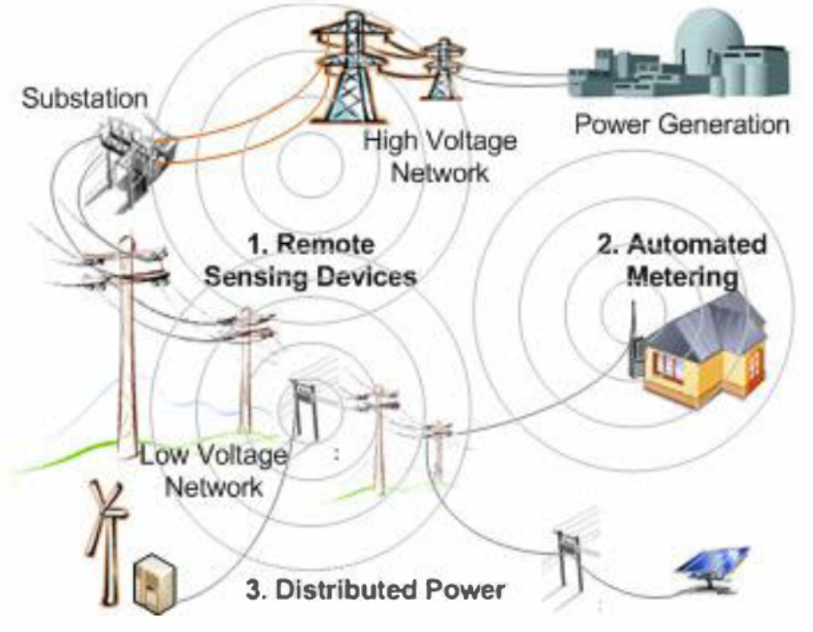
Smart Power Grid: State of the Art
October 2022
Doc.: IEEE 802.11-22/1800r0
State of the Art
Collet various physical quantities such as sound, light, electricity, heat, magnetism, force and other physical quantities of power equipment during operation to achieve awareness of device/equipment status.
Support the comprehensive perception and intelligent application of information in the production and operation process of the smart power grid.
Fig. Smart Power Grid with sensing and metering [5]

Slide 5
Smart Power Grid: Main Issues
October 2022
Doc.: IEEE 802.11-22/1800r0
Main Functionalities
Real-time monitoring of power grid equipment status and operating environment;
Timely discovering and handling potential safety hazards in the overhaul and operation and maintenance of power equipment.
Current Issues
Demand for equipment status awareness has increased sharply;
Diversification of urban and rural areas;
High cost and poor deployment flexibility.
Difficult to maintain the sensing network with active devices driven by conventional battery
Low flexibility of communication rate, transmission distance and power sensing services

Slide 6
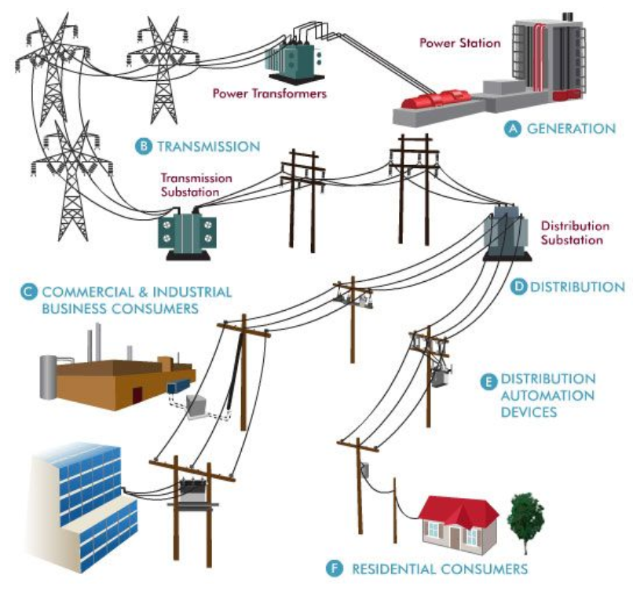
Use Case 7-1: Substation Status Sensing and Metering
October 2022
Doc.: IEEE 802.11-22/1800r0
Services and applicable scenarios
Sub-station plays a vital role in the electrical power system to guarantee the continuity of the electrical power supply.
Massive number of sensors and meters to monitor temperature, humidity, etc.
Service area: <50 000 m²
Requirements
Massive deployment: ultra-low cost and massive connection
Inaccessible location: maintenance-free and battery-less for long service time
Data rate: 20kbps
Coverage: 10-30 m for indoor case and up to 100 meters for outdoor

Slide 7
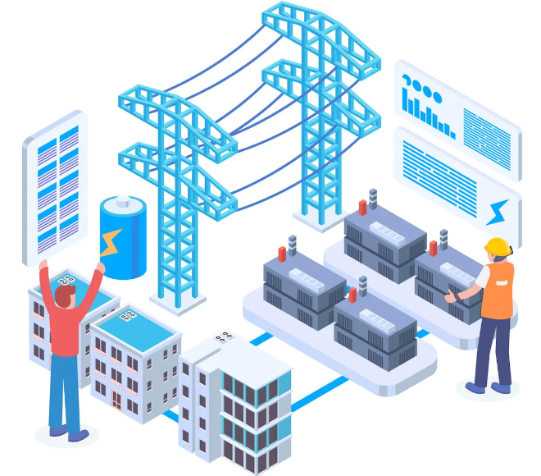
Use Case 7-2: High Voltage Transmission Lines Sensing and Monitoring
October 2022
Doc.: IEEE 802.11-22/1800r0
Services and applicable scenarios
High voltage transmission lines deliver electricity over long distances to reduce the amount of energy lost during the distance. .
Sensing and monitoring of high voltage transmission lines and towers for operation faults such as power leakage, tower tilting, etc.
Requirements
Inaccessible location: maintenance-free
Long service time: battery-less with ultra low power consumption
Data rate: 3kbps
Coverage: 200 m for outdoor case
China's State Grid plans to invest more than 150 billion yuan ($22 billion) in the second half of 2022 in ultra high voltage (UHV) power transmission lines

Slide 8
Summary
October 2022
Doc.: IEEE 802.11-22/1800r0
This submission presents
New use cases: Smart Power Grid
Current issues and expectation
Services and applicable scenarios
Typical requirements

Slide 9
Reference
October 2022
Doc.: IEEE 802.11-22/1800r0
IEEE 802.11-22/0963r0, Use Cases for AMP IoT Devices.
IEEE 802.11-22/1339r0, Use Cases of smart manufacturing.
IEEE 802.11-22/1341r1, Use Cases of Data Center Infrastructure Management.
IEEE 802.11-802.11-22/1559r0, Updated Use Cases for AMP IoT Devices
M. El Brak, S. El Brak, and D. Benhaddou, “Wireless Sensor Network applications in smart grid,” in Proc. of 2014 International Renewable and Sustainable Energy Conference (IRSEC)

