Slide 1
DMG MLME primitives introduction
Authors:
Date: 2022-10-11

Slide 2
Abstract
Introduction to the DMG MLME primitives (CID 327)

Slide 3
Assumptions and preconditions
A DMG sensing procedure is composed of one or more of the following, see the table:
# | Name | Covered in the contribution
1 | DMG sensing session setup | No
2 | DMG measurement setup | Yes
3 | DMG sensing burst | Yes
4 | DMG sensing instance | Yes
5 | DMG measurement setup termination | Yes
6 | DMG sensing session termination | No

Slide 4
Assumptions and preconditions (cont.)
Several report types are defined (already in the draft)

Slide 5
Assumptions and preconditions (cont.)
Some of the report types require computation (2-7)
The computation of some of the report types may require accumulation of more than one sensing measurement result (3-7)
Algorithms of the computation are implementation dependent and not presented in the spec
The computation is provided by the SME, thus keeping the MAC/MLME definition independent of the computation

Slide 6
MLME primitives
MLME-DMG-SENSMSMTSETUP.request/ indication/response/confirm – SME to SME DMG sensing measurement agreement establishment
The DMG MAC/MLME is responsible to maintain all phases of the DMG sensing instance per the schedule agreed on in the DMG measurement setup
  MLME-DMG-SENSMSMTSTART.request/confirm – SME to MAC/MLME - initiates the polling, sounding, and reporting phases at the DMG sensing Initiator. The MAC/MLME performs the polling for the sounding or reporting depending on the schedule
  MLME-DMG-SENSMSMT.indication – MAC/MLME to SME - delivers the measurement result (Raw) at the DMG sensing Responder

Slide 7
MLME primitives (cont.)
  MLME-DMG-SENSREPORT.request/indication – SME to SME delivery of the Channel Measurement Feedback Elements and/or DMG Sensing Report elements to the DMG sensing Initiator. Depending on the Report Type the exchange happens once per the burst (3-7) or at each instance (1, 2).
MLME-DMG-SENSMSMTTERMINATION.request/ indication/confirm- SME to SME termination of the DMG sensing measurement setup.

Slide 8
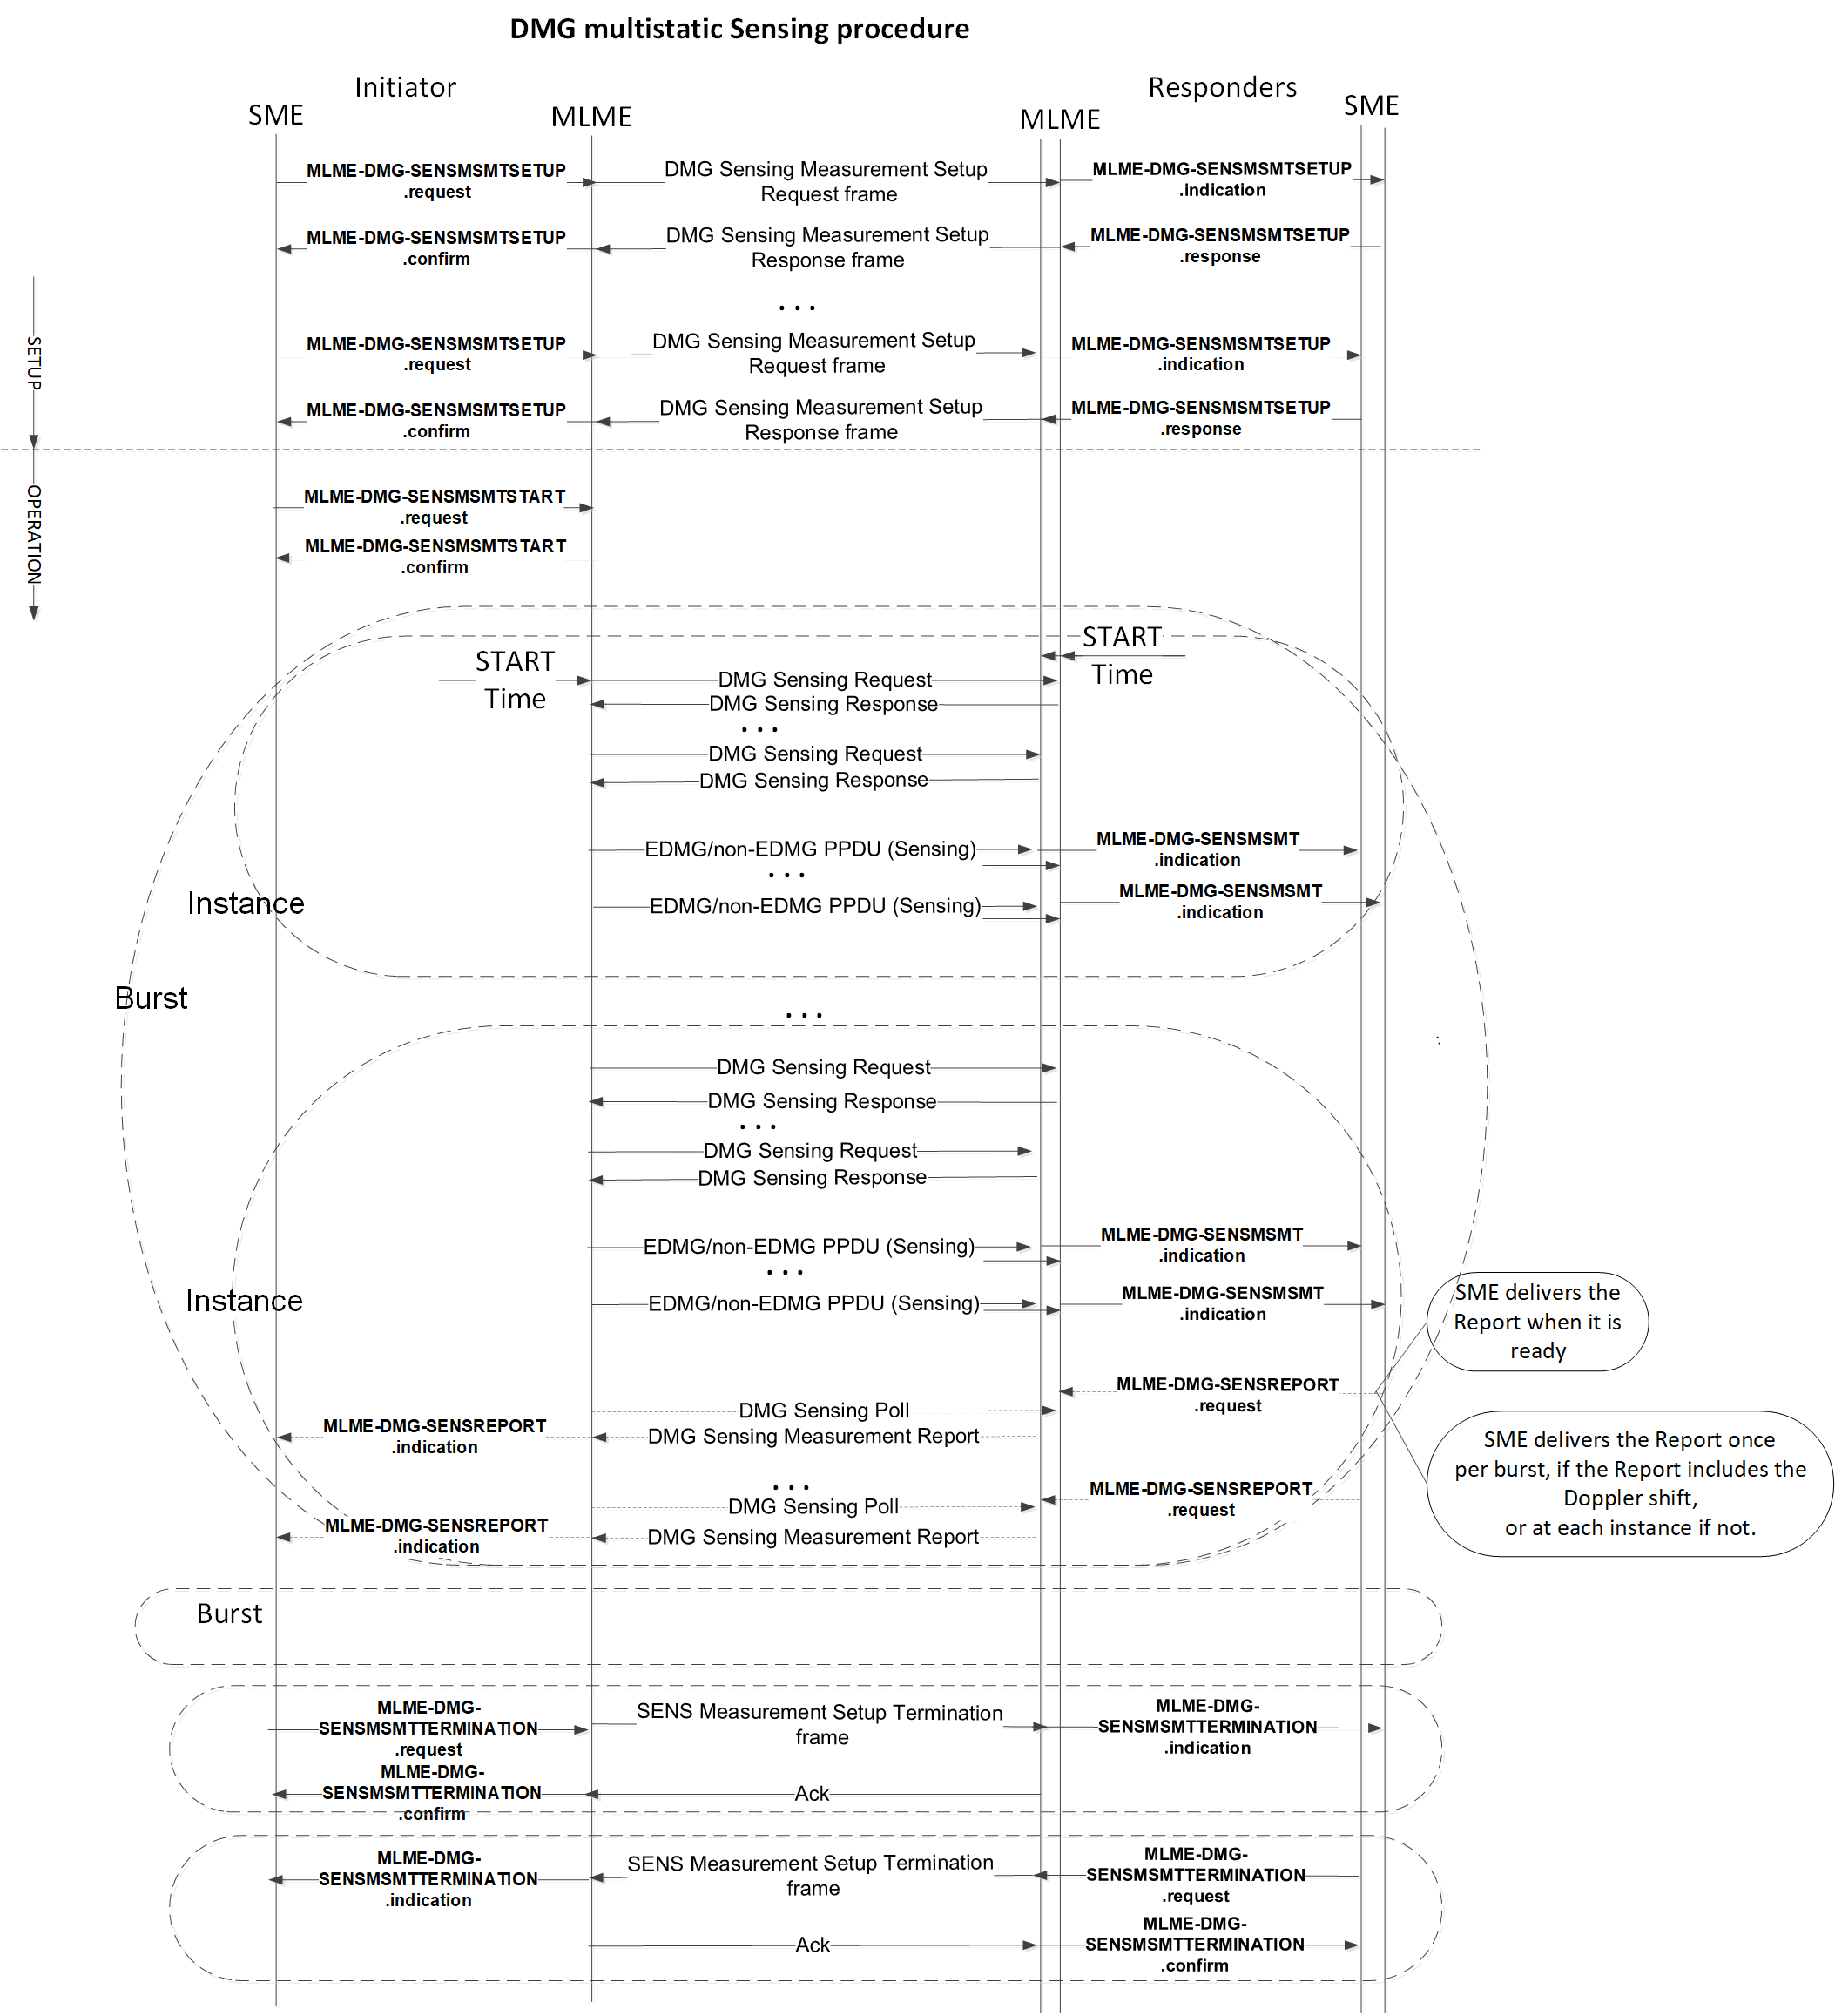

Slide 9
References

