Slide 1
Resolution for CID19 and CID20
Date: 2022-10-11
Authors:

Slide 2
Abstract
CID19 and CID20 focus on
  PASN (Pre-Association Security Negotiation) and
  FTM (Fine Tuning Measurement)
Defined in 802.11az - Enhancements for positioning (draft)
And
  WUR (Wake Up Radio) maybe? – defined in 802.11ba - Wake-Up Radio Operation
This document proposes a solution for CID19 and CID20

Slide 3
CID | Commenter | Comment | Subclause | Proposed Change
19 | Jonathan Segev | It is not clear how the Device ID mechanism supports unassociated PASN operation. the PASN operation is required to support management procedure that do not require data transfer, examples are FTM and 11ba. | 12.2.11 | Add support for Device ID in PASN.
20 | Jonathan Segev | The mechanism for device ID should be such that to a single network a device with an on going unassociated session should be identifiable as single device to the network (ESS). An example of such operation is the need to two way report for FTM; The client STA reports measurement conducted to each individual AP while the multiple outstanding FTM sessions are in progress, the NW is able to associate the measurement from multiple sessions to be attributed to a single client and thus can identify client location. This client may not be associated to the network. | 12.2.11 | Add a functionality that allows a device to be identified to the ESS as a single entity.

Slide 4
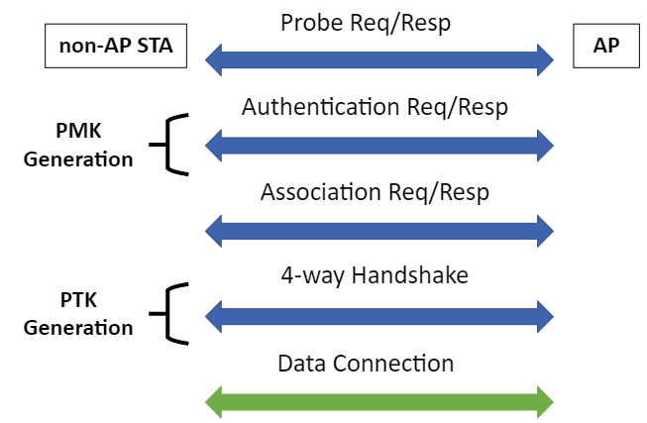
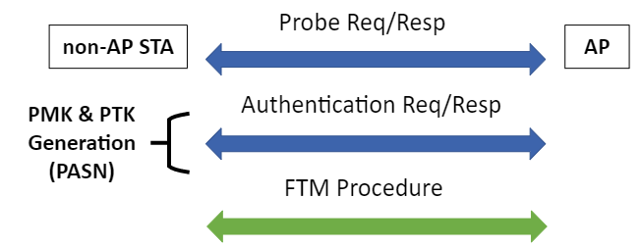
Recap
PASN (Pre-Association Security Negotiation): establishing a PTKSA and the corresponding shared keys between a PASN capable STA and AP (defined in 11az).
PASN PMK and PTK Generation
Conventional PMK and PTK Generation

Slide 5
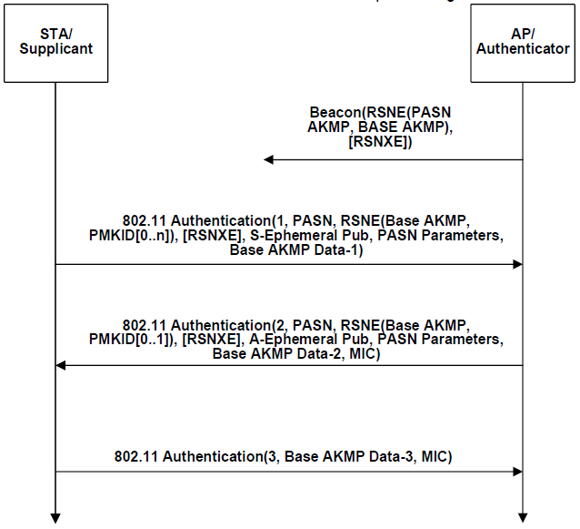
Recap
PASN (Pre-Association Security Negotiation): It consists of three Authentication frames.
PTK
PTK

Slide 6
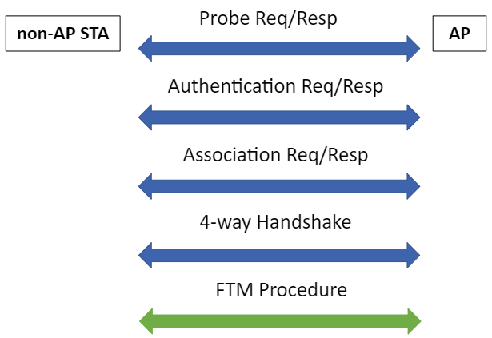
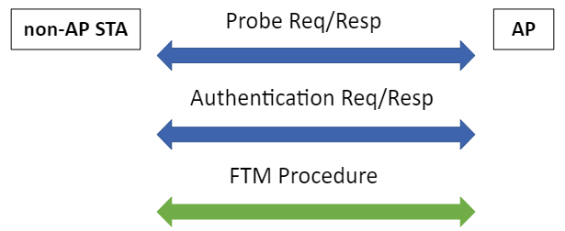
Recap
FTM (Fine Timing Measurement): The FTM procedure allows a STA to determine its range relative range and its direction to or from another STA using Time Of Flight (TOF) time difference of arrival and phase measurement. Basically, determining location.
PMK
PMK&PTK
PTK
Unassociated STA FTM procedure
Unassociated STA never goes into 4-way HS, so it will never get device ID in 4-way HS.
-> unassociated STA with RMA will never be identified
Associated STA FTM procedure

Slide 7
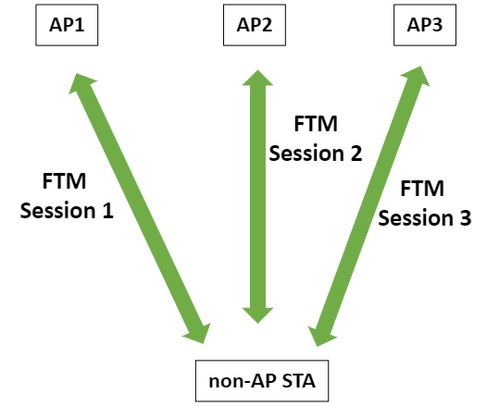
Recap
FTM (Fine Timing Measurement): Multi-session FTM in ESS is also possible.
ESS
APs (AP1, AP2, AP3 et.) belong to the same ESS.
Non-AP STA may establish multiple FTM sessions with multiple APs for location purposes.
Non-AP STA may use different RMAs in different sessions to avoid being tracked.

Slide 8
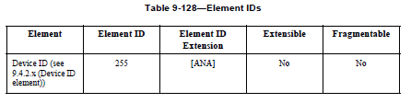
Possible Solutions for CID19
Exchange the Device ID in authentication frame exchange in PASN.
Use already existing IE (“Device ID IE” defined for FILS) in Authentication frames
AP assigns device ID in Authentication Msg2
Non-AP STA provides device ID in Authentication Msg1
Note that Authentication Frame Body is not encrypted, it is better to use opaque ID (derived from Device ID) in Device ID IE.

Slide 9
Possible Solutions for CID19
Idea: Exchange the Device ID in authentication frame exchange in PASN.
Use already existing IE (“Device ID IE” defined for FILS) in Authentication frames
Note that Authentication Frame Body is not encrypted.
There are 3 possible approaches to exchange device ID in authentication frames:
  Unencrypted Solution
  Encrypted Solution v1
  Encrypted Solution v2

Slide 10
Solution for CID19 (unencrypted)
This approach utilizes the current PASN operation (i.e. authentication frame body is not encrypted)
General idea,
  AP assigns device ID in Authentication Msg2 unencrypted.
  Non-AP STA provides device ID in Authentication Msg1 unencrypted.
  Use opaque ID (derived from Device ID) in Device ID IE for protection.
Cons: This approach raises trackability of the device ID (i.e. device ID/opaque ID is sent in the clear twice)

Slide 11
Solution for CID19 (unencrypted)
Signaling Flow
Non-AP STA
AP
Authentication Msg1
Authentication Msg2 - unenc (aaa)=aaa
Device ID = 111 -> Opaque ID = aaa
1st Auth
Authentication Msg3
Red values are the values that third party sees.
[FTM Procedure]
enc – encrypted
unenc - unencrypted
Authentication Msg1 - unenc (aaa)=aaa
2ndAuth
Authentication Msg2 - unenc (bbb)=bbb
Device ID = 222 -> Opaque ID = bbb
Authentication Msg3
[FTM Procedure]

Slide 12
Solution for CID19 (encrypted v1)
This approach introduces encryption of the device ID IE in the PASN operation (i.e. encrypting device ID IE in authentication frame body)
General idea,
  AP assigns device ID in Authentication Msg2 encrypted.
  Non-AP STA provides device ID in Authentication Msg3 encrypted.
  (Optional) Use opaque ID (derived from Device ID) in Device ID IE for protection.
Cons: This approach assigns new device ID (Auth Msg2) before accepting valid device ID (Auth Msg3)

Slide 13
Solution for CID19 (encrypted v1)
Signaling Flow
Non-AP STA
AP
Authentication Msg1
PTK1
Authentication Msg2 - enc (aaa) = xyz
Device ID = 111 -> Opaque ID = aaa
1st Auth
PTK1
Authentication Msg3
[FTM Procedure]
Authentication Msg1
PTK2
Device ID = 222 -> Opaque ID = bbb
2ndAuth
Authentication Msg2 - enc (bbb) = klm
PTK2
Authentication Msg3 – enc (aaa) = pqr
[FTM Procedure]

Slide 14
Solution for CID19 (encrypted v2)
This approach introduces encryption of the device ID IE in the PASN operation (i.e. encrypting device ID IE in authentication frame body)
General idea,
  AP assigns device ID in Authentication Msg2 encrypted.
  Non-AP STA provides device ID in Authentication Msg1 unencrypted.
  Use opaque ID (derived from Device ID) in Device ID IE for protection.
Cons: This approach sends unencrypted device ID/opaque ID once in the clear

Slide 15
Solution for CID19 (encrypted v2)
Signaling Flow
enc – encrypted
unenc - unencrypted
Non-AP STA
AP
Authentication Msg1
PTK1
Authentication Msg2 - enc (aaa) = xyz
Device ID = 111 -> Opaque ID = aaa
1st Auth
PTK1
Authentication Msg3
[FTM Procedure]
Authentication Msg1 – unenc (aaa)=aaa
PTK2
Device ID = 222 -> Opaque ID = bbb
2ndAuth
Authentication Msg2 - enc (bbb) = klm
PTK2
Authentication Msg3
FTM Procedure

Slide 16
Solution for CID20
Same as CID19 but assign a Device ID for each FTM session in ESS (AP1, AP2, …)
AP1
Non-AP STA
AP2
FTM Session1
Note that
- the current bh D0.2 assigns one device ID per ESS,
- this solution assigns one device ID per session in ESS
- The generated device ID will be used in the next session
FTM Session2
Device ID1 – Auth Msg2
Device ID1 – Auth Msg1
Device ID2 – Auth Msg2
AP3
FTM Session3
Device ID2 – Auth Msg1
Device ID3 – Auth Msg2

Slide 17
Thanks ☺

