Slide 1
WG11 Opening Report Snapshot Slides November 2022
Date: 2022-11-13
Authors:

Slide 2
Abstract
This presentation contains the IEEE 802.11 WG snapshot slides for the November 2022 session:
Editors Meeting
ANA
ARC SC (Architecture)
Coex SC
PAR Review SC
WNG SC (Wireless Next Generation)
JTC1 802 SC
TGme (Maintenance)
TGaz (Next Generation Positioning)
TGbb (Light Communication)
TGbc (Broadcast Services)
TGbd (Next Gen V2X)
TGbe (Extremely High Throughput)
TGbf (WLAN Sensing)
TGbh (Random and Changing MAC Addresses)
TGbi (Enhanced Data Privacy)
UHR SG (Ultra High Reliability)
AIML TIG (AI and ML)
AMP TIG (Ambient power IoT devices)
ITU AHG (ITU Liaison)

Slide 3
Editors Agenda for 2022-11-15 meeting
Roll Call / Contacts / Reflector
Brief status report
Draft Numbering
Review WG Style Guide, 11be and REVme practice
WG Style Guide for 802.11 draft 09/1034r20
Draft and Amendment alignments

Slide 4
ANA Status
The latest database is 11-11/0270r64 (November 2022)
Changes since September 2022:
  TGme:
    Element ID Extension: Originator Preferred MCS
    dot11Groups: dot11TDLSComplianceGroup1
Pending changes:

Slide 5
ARC (Architecture) – November 2022
    No teleconferences since September
    Will have one meeting this week: Tuesday 10:30 ICT
    Agenda is here: 11-22/1702r1 topics:
    IEEE Std 802 revision project
    Annex G: Discussion of way forward?
    Any other topics (especially from next slide)?

Slide 6
ARC (Architecture) – November 2022
    Other items being tracked (but not actively worked unless/until contributions):
    Related to IEEE Std 802 updates:
      802.1AC mapping from ISS to 802.11 MAC SAP interface
      Consider any changes to remove 802.2/LLC terms?
      Clarifying EPD/LPD: 11-20/0174r0
    “What is a STA?” (per REVmd discussion: 11-19/0106r0)
    Off-channel TDLS architecture
    MLME-RESET, versus MLME-JOIN, MLME-START, MLME-SCAN and MLME-END
      One aspect is how MAC address is set/controlled – related to IEEE 1609/TGbd activities

Slide 7
The Coex SC will formally meet once
(Wed, 16 Nov 2022 at 4-6 pm)
The Coex SC agenda (11-22-1714)
BRAN updates
  EN 301 893 (5 GHz) status
    … with update on debate about ED-only @ -62 dBm proposal
  EN 303 687 (6 GHz) status
    … and resulting choices for 802.11ax/be operation in 6 GHz
Other updates
  Do we still have a coex issue between Wi-Fi & LAA/NR-U?
  Updates on SL-U, 60 GHz, BT coex, 6 GHz spectrum issue
Second hour
  Joint meet about 802.11/802.15.4ba (UWB) coex

Slide 8
PAR Review SC – Snapshot slide
Chair: Jon Rosdahl
Nov 13-18, 2022, Bangkok, Thailand
PAR reviewed on Monday 14 November 2022, 10:30-12:30 ICT
802.3df - Amendment: Media Access Control Parameters for 800 Gb/s and Physical Layers and Management Parameters for 400 Gb/s and 800 Gb/s Operation, PAR Modification and CSD
802.3dj - Amendment: Media Access Control Parameters for 1.6 Tb/s and Physical Layers and Management Parameters for 200 Gb/s, 400 Gb/s, 800 Gb/s, and 1.6 Tb/s Operation, PAR and CSD
802.3dk - Amendment: Greater than 50 Gb/s Bidirectional Optical Access PHYs, PAR and CSD
802.11bk - Amendment: 320 MHz Positioning, PAR and CSD
Feedback to be reviewed on Thursday 17 November 2022, 10:30-12:30 ICT

Slide 9
802.11 WNG – November 2022
15 November 2022, 08:00-10:00 Bangkok Time
Announcements
Approval of previous meeting minutes
  Minutes from September:
    https://mentor.ieee.org/802.11/dcn/22/11-22-1607-00-0wng-wng-meeting-minutes-2022-september-waikoloa-meeting.docx
Presentations
  “SiG+,” Dave Halasz (Morse Micro)
  “Roaming handoff time reduction to improve user experience,” Xiaokun Hu (Ruijie Networks Inc)
  “Support for high-bandwidth and multi-Tx CFR capture,” Lihua Zhu (Ruijie Networks Inc)
  “User offloading problem between multiple APs,” Gang Xie (BUPT)
Plans for January 2023
  Chair will make a call for presentations in advance
Adjourn
Current agenda is document 11-22/1734r1

Slide 10
IEEE 802 JTC1 SC will meet once on Tue, 15 Nov 2022 @ 4pm ICT
Agenda items (11-22-1715) will include “the usual”:
Review of status of PSDO process
  Review liaisons & notifications of projects to SC6
  Review status of ballots
    Update on response to IPR comments on 802.11ax/ay & 802.11-2020
Review of recent SC6 activities
  Not too much to report

Slide 11
A large number of IEEE 802 submissions are in the PSDO balloting process
  For information
    Lots
  Waiting for 60-day ballot
    802.11ba
  In 60-day ballot
  Passed 60-day ballot
  (resolutions req)
  Failed 60-day ballot
    802.11ay
  Waiting for FDIS
    802.11ax
    802.1ABcu
    802.1ABdh
  In FDIS
    802.1CBdb
    802.1CBcv
    802.1BA-Rev
    802.1ACct
  Passed FDIS ballot
  (resolutions req)
    802.1AS-2020/Cor 1
  Waiting for publication
  Published
    802.3cv
    802.3ct
    802.3cp
    IEEE 802.11-2020
IPR related issues

Slide 12
IEEE 802 has 142 standards in or through the PSDO pipeline
WG | Completed | In-process
802.1 | 43 | 12
802.3 | 29 | 11
802.11 | 12 | 10
802.15 | 3 | 15
802.16 | 0 | 0
802.19 | 0 | 0
802.21 | 3 | 0
802.22 | 4 | 0
All | 94 | 48

Slide 13
REVme (Maintenance) Snapshot
Status:
  Recirculation ballot completed on REVme D2.0
  LB 270 Result: 86% approval with 822 Comments (204 Editorial, 17 General, and 601 Technical comments received
Objectives:
  Begin comment resolution on D2.0 LB 270 comments
  Note: a discussion on removing WEP is scheduled for the Wednesday session.
  Overall objective is to go to LB recirculation out of the March meeting
Sessions:
  Monday November 14, 4-6pm Bangkok time
  Tuesday November 15, 4-6pm Bangkok time
  Wednesday November 16, 4-6pm Bangkok time
  Thursday November 17, 4-6 pm Bangkok time

Slide 14
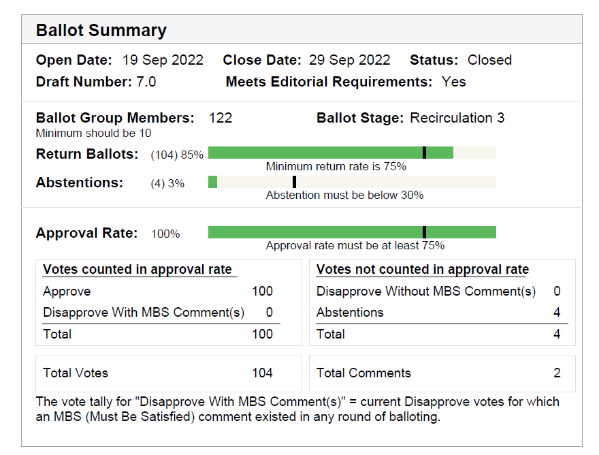
TGaz Next Generation Positioning
Status and Work completed since Sep. meeting:
  The IEEE-SA recirculation ballot closed on September 29, with 100% approval rate.
  EC approved TG report on approval to forward to draft to RevCom, submission 11-22-1511.
  All materials are with the IEEE Publishing editor.
  Draft 7.0 is on the RevCom Dec. 2nd agenda for approval.
Lots of thanks to all those who participated and contributed to the TG discussion.

Slide 15
TGaz Next Generation Positioning (con.)
320MHz Ranging (TGbk):
  PAR and CSD approved by WG and EC.
  PAR and CSD approval are on the NesCom agenda for the Dec. 2nd meeting.
  Will be reviewed by other IEEE WGs during this meeting week and feedback provided by 18:30 Tuesday .
  TGaz will review and response to feedback, as necessary, Tue. PM3 and Wed. AM1.
  In anticipation of TGbk formation January 2023, TGaz will sponsor meeting time to review technical presentations on 320MHz Ranging waveforms as time permits.

Slide 16
TGaz Next Generation Positioning
TG scheduled to meet for 3 meeting slots during the IEEE electronic meeting week:
  Nov. 15th Tue. AM2
  Nov. 15th Tue. PM3
  Nov. 16th Wed. AM1
Agenda document is submission: 11-22/1753, for latest revision use link.

Slide 17
802.11 TGbb – Light Communications
Progress since September 2022
  D4.1 Initial SA ballot completed with 90% approval rate and 41 comments received
    3 General
    26 Technical
    11 Editorial
Goals for November 2022 meeting (agenda in doc. 11-22/1718)
  Review and resolve comments against D4.1
  Move for D5.0 re-circulation
Meeting slots
  Mon., AM1 ; Tue., AM2, PM2 ;
  Wed., AM1 ; Thur., AM1, PM1

Slide 18
IEEE 802.11 TGbc
Broadcast Services
Chair: Marc Emmelmann
Progress since last meeting:
  1st SAB on D4.0 completed
    92% Approval rate
    7 disapprove votes with MBS comments
    173 comments received (72 technical, 101 editorial)
  802.11 WG Chair delegated responsibility of resolving P802.11bc SA Ballot series comments to Task Group bc
  TGbc held one telco: All comments assigned to volunteers to prepare suggested comment resolutions
Goal for this meeting:
  Discuss and approve comment resolutions

Slide 19
IEEE 802.11 TGbc
Broadcast Services
Chair: Marc Emmelmann
One ad-hoc slot Monday morning (AM1)
Two additional slots this week:
  Tue 08:00 – 10:00h (AM1)
  Thu 08:00 – 10:00h (AM1)
Agenda: 11-22/1721
Note – TGbc Telco Schedule
  Weekly 1-hour telcos
  Tuesdays 10:00h – 11:00h ET

Slide 20
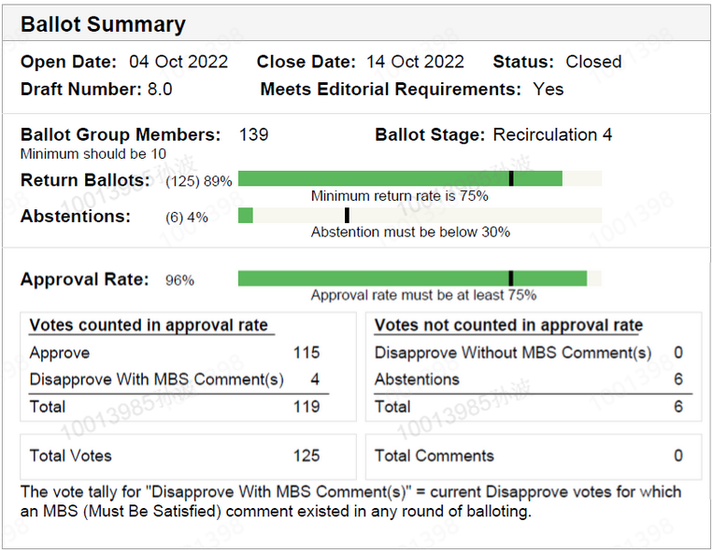
Snapshot of TGbd for Nov 2022 IEEE 802.11 Plenary
Since Sep 2022 IEEE 802.11 interim meeting
  One TC on Oct 3 was organized to proceed CR for D7.0, and approve the generation of D8.0 and new SA Ballot re-circulation.
  The 5th IEEE SA Ballot for D8.0 started on Oct 4 and closed on Oct 14, with approval rate 96% and no comment received.
  EC approved TG report (11-22/1521r4) on conditional approval to forward 11bd spec draft to RevCom; IEEE P802.11bd D8.0 meets the condition and is on the 2022 Dec RevCom/SASB agenda
  The minutes for Sep interim meeting and following TC are listed below:
    https://mentor.ieee.org/802.11/dcn/22/11-22-1640-00-00bd-ieee-802-11bd-september-2022-interim-meeting-minutes.docx
    https://mentor.ieee.org/802.11/dcn/22/11-22-1778-00-00bd-ieee-802-11bd-oct-2022-tc-meeting-minutes.docx

Slide 21
Plan for Nov Plenary Week
During the IEEE 802.11 Nov plenary week, 1 TGbd session is planned on
  Nov 15 (Tue) PM1, 13:30 – 15:30, Bangkok Local Time.
The TGbd agenda for Nov plenary week is included in the latest revision of 11-22/1706.

Slide 22
IEEE 802.11 TGbd Timeline
  PAR approved Dec 2018
  First TG meeting Jan 2019
  D0.1 Nov 2019
  D1.0 Letter Ballot Oct 2020
  D2.0 LB recirculation Jul 2021
  Form SA Ballot Pool Nov 1 to Nov 30, 2021
  D3.0 LB recirculation Dec 2021
  D4.0 LB recirculation Mar 2022
  Initial SA Ballot (D4.0) Apr 2022
  Final 802.11 WG approval Sep 2022
  802 EC approval Oct 2022
  RevCom and SASB approval Dec 2022

Slide 23
TGbe (Extremely High Throughput)
Since the September interim
  Delivered IEEE802.11be D2.2, available in the members area
  Held 10 teleconferences between September and November (11-22/657r16)
    2 Joint, 3 parallel MAC/PHY, and 5 MAC telcos
    ~310 comments resolved*
  Held a 2-day MAC ad-hoc in Bangkok, Thailand (11-22/840r9)
    ~250 comments resolved*
Latest CR status: ~70% of LB266 comments resolved*
  ~1250 remaining comments
  See figure for more details
*either motioned or ready for motion
Targets for November plenary
  Continue resolving comments that were received from LB266
  Discuss any technical presentations
Agenda is available in 11-22/1730
  Schedule is provided in the next slide
11%
73%
16%
PHY
MAC
JOINT
CID Distribution (~4120)

Slide 24
TGbe November F2F Schedule
 | Monday | Tuesday | Wednesday | Thursday
AM 1 | TGbe Ad-Hoc [MAC/PHY] | TGbe Ad-Hoc [MAC] | TGbe | TGbe
AM 2 |  | TGbe |  | TGbe Ad-Hoc [MAC/PHY]
PM 1 | TGbe | TGbe Ad-Hoc [MAC] |  | TGbe
PM 2 | TGbe Ad-Hoc [MAC/PHY] | TGbe Ad-Hoc [MAC/PHY] | TGbe Ad-Hoc [MAC/PHY]
EVE

Slide 25
TGbf (WLAN Sensing)– November 2022
Progress since September 2022 session
  19 teleconference calls were held
  Presentation of technical submissions (e.g., Comment resolution, PDT, technical contribution……)
  Comment resolution for D0.1 (802.11bf CC40 comments)
    Newly approved or marked as “ready for motion” the comment resolution for 187 CIDs after July Plenary
    Totally approved the comment resolution for 522 CIDs
    (522/912 =57.2% of all CC40 comments are now resolved)
    Totally 641 CIDs are resolved or marked as “ready for motion”
    (641/912 =~70.3% )
Goals for November 2022 session
  6 teleconference calls scheduled for TGbf (November 14 PM1, 15 AM1 & PM1, 16 AM1 & AM2, 17 AM1)
  Continue the Comment resolution and developing the Draft (Requested 3 calls per week)
  Considering add Ad-hoc meeting before January Interim session, in order to guarantee the hard deadline for D1.0 in January

Slide 26
TGbf Timeline (Updated)
Timeline (Comment collection for D0.1)
  PAR approved Sep 2020
  First TG meeting Oct 2020
  Comment Collection (D0.1) Jan 2022→Mar 2022
  → April 2022
  Initial Letter Ballot (D1.0) Jul 2022→ Sep 2022
  → Nov 2022
  → Jan 2023
  Recirculation LB (D2.0) Jan 2023 → March 2023
  Recirculation LB (D3.0) May 2023
  Recirculation LB (D4.0) July 2023
  Initial SA Ballot (D4.0) Sep 2023
  Final 802.11 WG approval July 2024
  802 EC approval July 2024
  RevCom and SASB approval Sep 2024
Early-mid May
  Identify topics, PoCs, and volunteers
May 20th
  Comment collection closes
Week of May 23rd
  Editor classifies comments and share them with TTTs
June 3rd
  Deadline for comment assignment
Sep 1, 2022
  TGbf decide to change the timeline for Initial Letter Ballot (D1.0) to November 2022
  SP Result: Unanimous consent
Nov 8, 2022
  TGbf decide to change the timeline for Initial Letter Ballot (D1.0) to January 2023 (Hard deadline)
  SP Result: Unanimous consent

Slide 27
Teleconference Times
  Confirmed
  November Plenary 2022 (November 13-18)
  (Daylight saving time end on Nov. 6)
    November 14 (Monday PM 1), 13:30-15:30 Thailand time
    November 15 (Tuesday AM 1), 08:00-10:00 Thailand time
    November 15 (Tuesday PM 1), 13:30-15:30 Thailand time
    November 16 (Wednesday AM 1), 08:00-10:00 Thailand time
    November 16 (Wednesday AM 2), 10:30-12:30 Thailand time
    November 17 (Thursday AM 1), 08:00-10:00 Thailand time
  ** Note:
  when conflict with CAC, the call will be changed
  (Sept - Nov 2022 CAC calls: October 10, 31 09:00 ET; November 13 06:00 ET)
  2. Thursday 23:00 - 01:00am ET (Thursday 20：00 – 22:00 PT, Friday 11am-13:00 in China, Friday 6am-8am in Israel, Friday 5am – 7am in Central Europe), and Sang Kim will help to take the minutes for these slots.
 | Thailand time | Beijing Time | Time Central Europe | Israel | Eastern Time | Pacific time
AM1 | 08:00-10:00 | 09:00-11:00 | 2:00-4:00 | 3:00-5:00 | 20:00-22:00 | 17:00-19:00
AM2 | 10:30-12:30 | 11:30-13:30 | 4:30-6:30 | 5:30-7:30 | 22:30-00:30 | 19:30-21:30
PM1 | 13:30-15:30 | 14:30-16:30 | 7:30-9:30 | 8:30-10:30 | 01:30-03:30 | 22:30-00:30
PM2 | 16:00-18:00 | 17:00-19:00 | 10:00-12:00 | 11:00-13:00 | 04:00-06:00 | 01:00-03:00
Evening 1 | 19:30-21:30 | 20:30-22:30 | 13:30-15:30 | 14:30-16:30 | 07:30-09:30 | 04:30-06:30

Slide 28
Teleconference Times
  Confirmed:
    November 21 (Monday), 09：00 - 11:00 ET (Too close to September interim)
    November 22 (Tuesday), 09：00 - 11:00 ET
    November 24 (Thursday), 22：00 - 00:00 ET – Thanks giving
    November 28 (Monday), 09：00 - 11:00 ET
    November 29 (Tuesday), 09：00 - 11:00 ET
    December 1 (Thursday), 22：00 - 00:00 ET
    December 5 (Monday), 09：00 - 11:00 ET
    December 6 (Tuesday), 09：00 - 11:00 ET
    December 8 (Thursday), 22：00 - 00:00 ET
    December 12 (Monday), 09：00 - 11:00 ET
    December 13 (Tuesday), 09：00 - 11:00 ET
    December 15 (Thursday), 22：00 - 00:00 ET - 1st Workshop on Wi-Fi Sensing (WiSe 1)
    December 19 (Monday), 09：00 - 11:00 ET
    December 20 (Tuesday), 09：00 - 11:00 ET
    December 22 (Thursday), 22：00 - 00:00 ET
    December 26 (Monday), 09：00 - 11:00 ET-- Holidays
    December 27 (Tuesday), 09：00 - 11:00 ET
    December 29 (Thursday), 22：00 - 00:00 ET
    January 2 (Monday), 09：00 - 11:00 ET
    January 3 (Tuesday), 09：00 - 11:00 ET
    January 5 (Thursday), 22：00 - 00:00 ET
    January 9 (Monday), 09：00 - 11:00 ET
    January 10 (Tuesday), 09：00 - 11:00 ET
    January 12 (Thursday), 22：00 - 00:00 ET
  To be Confirmed:
  January Interim 2023 (January 16-20)
    January 16 (Monday PM 1), 13:30-15:30 Baltimore time (ET)
    January 16 (Tuesday EV 1), 19:30-21:30 Baltimore time -- TBD
    January 17 (Tuesday AM 1), 08:00-10:00 Baltimore time
    January 17 (Tuesday PM 1), 13:30-15:30 Baltimore time
    January 17 (Tuesday EV 1), 19:30-21:30 Baltimore time -- TBD
    January 18 (Wednesday AM 1), 08:00-10:00 Baltimore time
    January 18 (Wednesday AM 2), 10:30-12:30 Baltimore time
    January 19 (Thursday AM 1), 08:00-10:00 Baltimore time
    January 18 (Thursday AM 2), 10:30-12:30 Baltimore time -- TBD
  ** Note:
  when conflict with CAC, the call will be changed
  (Sept - Nov 2022 CAC calls: October 10, 31 09:00 ET; November 13 06:00 ET)
  2. Thursday 23:00 - 01:00am ET (Thursday 20：00 – 22:00 PT, Friday 11am-13:00 in China, Friday 6am-8am in Israel, Friday 5am – 7am in Central Europe), and Sang Kim will help to take the minutes for these slots.
 | Baltimore time | Beijing Time | Time Central Europe | Israel | Eastern Time | Pacific time
AM1 | 08:00-10:00 | 21:00-23:00 | 14:00-16:00 | 15:00-17:00 | 08:00-10:00 | 05:00-07:00
AM2 | 10:30-12:30 | 23:30-01:30 | 16:30-18:30 | 17:30-19:30 | 10:30-12:30 | 07:30-09:30
PM1 | 13:30-15:30 | 02:30-04:30 | 19:30-21:30 | 20:30-22:30 | 13:30-15:30 | 10:30-12:30
PM2 | 16:00-18:00 | 05:00-07:00 | 22:00-00:00 | 23:00-01:00 | 16:00-18:00 | 13:00-15:00
Evening 1 | 19:30-21:30 | 08:30-10:30 | 01:30-03:30 | 02:30-04:30 | 19:30-21:30 | 16:30-18:30

Slide 29
TGbh (Random and Changing MAC Addresses) – Nov 2022
    D0.2 published, and Comment Collection 41 held
    Four teleconferences since Sept
    Considered additional solutions to be added to D0.2; general comment resolution
    Will have four meetings this session: Monday 8:00 ICT (ad hoc), Tuesday 13:30 ICT, Wednesday 8:00 ICT, Thursday 8:00 ICT
    Agenda topics (agenda is in 11-22/1704r1 and 11-22/1703r1):
    Contributions and technical discussions (see agenda slides)
      Review/resolve comments on CC41: 11-22/0973r13
    Approve material for D1.0, consider WG LB, update Timeline
    Discuss open issues in tracking document 11-21/0332r37 (11-22/0435r2)
    Respond to liaisons from WBA 11-21/0703r0, 11-21/1141r0, 11-22/0668r0, 11-22/0653r0

Slide 30
IEEE 802.11 TGbi – November 2022
TGbi is working on feature definition based on the approved requirements and text for those features.
There are 2 meetings in the November plenary for TGbi.
      Monday PM2
      Thursday AM2
We will discuss a timeline update during the Thursday meeting.
The agenda will be available as 802.11-22/1701.

Slide 31
Snapshot for Ultra High Reliability UHR SG
Status and Work completed since Sep. meeting:
  2 Conference calls: 9 contributions
  Minutes:
    September plenary: https://mentor.ieee.org/802.11/dcn/22/11-22-1612-02-0uhr-uhr-sg-september-2022-meeting-minutes.docx
    Teleconferences September-November: https://mentor.ieee.org/802.11/dcn/22/11-22-1656-01-0uhr-uhr-sg-september-october-2022-teleconference-minutes.docx
Goal for November session
  Continue with presentations on the different SG goals
  Initiate discussion on PAR and CSD

Slide 32
Snapshot for Ultra High Reliability UHR SG
SG scheduled to meet for 3 meeting slots during the session:
  Nov. 15th Tue. EVE
  Nov. 16th Wed. AM2
  Nov. 17th Thu. PM2
Agenda: 11-22/1720

Slide 33
IEEE 802.11 AIML TIG – November 2022
Artificial Intelligence and Machine Learning
Activities since September 2022:
  Teleconference on Oct 17 2022 cancelled:
    contribution is planned to be presented in the next teleconference
  Minutes for September 2022 Plenary: 11-22/1328r0
November meeting:
  Goals:
    Technical submissions and discussions:
      Use Cases for AIML
      Technical feasibility to support AIML in 802.11
      Technical report text

Slide 34
IEEE 802.11 AIML TIG – November 2022
Artificial Intelligence and Machine Learning
November meeting:
  2 Meeting slots:
    Monday PM2;
    Wednesday AM1
  Agenda: 11-22/1609
  802 Tutorial: Wireless Meets ML: Rethinking Next Generation Wi-Fi Networks
    Monday 7:30 pm – 8:50 pm (Bangkok time)

Slide 35
Snapshot of AMP TIG for Nov 2022 IEEE 802.11 Plenary
Since Sep 2022 IEEE 802.11 interim week:
One AMP TIG telecom was held on Oct 25 and 2 contributions were presented and discussed:
  11-22/1800, New use cases for AMP IoT devices smart-grid, Yinan Qi (OPPO)
  11-22/1799, On energy harvesting and the differentiation with RFID, Weijie Xu (OPPO)
The chair announced call for comments on the tech report draft (11-22/1562) in 802.11 reflector.
The minutes of AMP TIG meetings during Sep interim week and AMP TIG teleconference on Oct 25 are listed below:
  https://mentor.ieee.org/802.11/dcn/22/11-22-1623-01-0amp-amp-tig-session-minutes-of-sept22-802-11-mixed-mode.docx
  https://mentor.ieee.org/802.11/dcn/22/11-22-1814-00-0amp-ieee-802-11-amp-tig-teleconference-minutes-for-oct-2022.docx

Slide 36
Snapshot of AMP TIG for Nov 2022 IEEE 802.11 Plenary
2 AMP TIG meetings are planned during the IEEE 802.11 Nov plenary week:
  Nov 14th (Monday), 13:30 ~ 15:30, Bangkok local time
  Nov 17th (Thursday), 10:30 ~ 12:30, Bangkok local time
The AMP TIG agenda for Nov plenary week is included in the latest revision of 11-22/1707.
Goal for AMP TIG during IEEE 802.11 Nov plenary week:
  Contribution presentation
  Tech report draft development

Slide 37
802.11 ITU Liaison Ad Hoc (ITU AHG) – Nov 2022
    Had one meeting since September 2022 Interim on October 11, 2022
    ITU AHG completed development of contributions WP 5A Nov 2022 and approved the following two contributions as ITU AHG recommendations to 802.11 and 802.18.
  11-22-1598-05-0itu, Proposed modifications to ITU-R WP5A-C-0597!N17!
  11-22-1624-02-0itu, Proposed modifications to ITU-R M.1450-5
  Meeting Minutes:
    https://mentor.ieee.org/802.11/dcn/22/11-22-1951-00-0itu-itu-ahg-minutes-for-october-11-2022-meeting.docx
    No ITU AHG meeting during Nov 2022 session as we are still waiting for the result of WP 5A Nov meeting
    Next Steps: Working Party 5A Next Meeting Dates: Monday 2022-11-14 - Friday 2022-11-25
    Next ITU AHG Meeting: Dec 6, 2022, 7-8PM ET

