Slide 1
TGbc Closing Report
Date: 2022-11-17
Authors:

Slide 2
Abstract
Closing report for IEEE 802.11 TGbc (Broadcast Services) for November 2022.

Slide 3
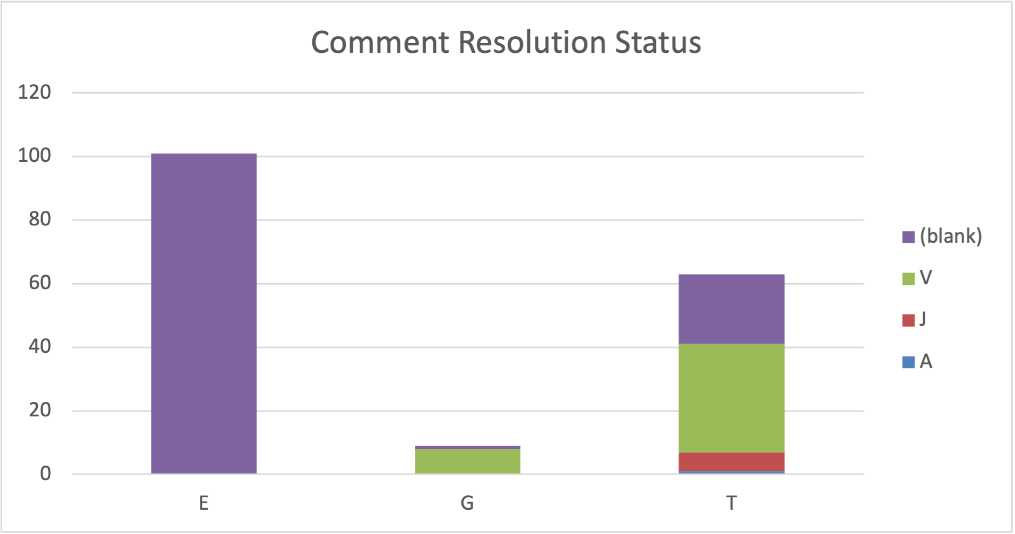
Meeting Goals & Accomplishments of the week
Goals for the week:
Resolve comments received from SAB
Accomplishments
Resolved and approved 49 technical comments
124 comments open
23 technical
101 editorial
Reviewed timeline (unchanged)
Comment database: 11-22/1902

Slide 4
TGbc schedule (unchanged)
January 2019 First meeting as a task group
June 2020 Call for comments on D0.1
November 2020 Initial WGLB (D1.0)
September 2021 D2.0 WG Recirculation LB
March 2022 D3.0 WG Recirculation LB
May intermediate version D3.1
June Form SAB Pool
July Editorial reviews completed: MEC & MDR on D3.1
D4.0 WG Recirculation LB
September 2022 WG request EC for unconditional approval to forward
draft D4.0 to SA ballot
Oct 4th EC telco EC approval to go to SA Ballot (unconditional)
Oct. 6th 2022 Initial SA Ballot (D4.0), Start of
March 2023 Second SA Ballot
July 2023 Third SA Ballot
September 2023 EC approval to RevCom
December 2023 RevCom/SASB approval

Slide 5
Plans for Next Meeting & Upcoming Telcos
Continue comment resolution
Start 1st SAB Recirc before the January meeting
Telcos
Tuesdays, 10:00h – 11.00h ET (1 hours)
2022-11-29
2022-12-06
2022-12-13
2022-12-20
2023-01-03
2023-01-10
Have been announced via WG and TG mail reflector with 10-day notice

Slide 6
References
Agenda for this week: 11-22/1721
Meeting / Chair’s Slide Deck: 11-22/1722
Meeting minutes: 11-22/1891
Snapshot Slide: 11-22/1723
Closing report: 11-22/1724
TGbc Motion Booklet: 11-18/2123
TGbc Selection Procedure: 11-19/0135
TGbc Functional Requirements: 11-19/0151
TGbc UseCase Document: 11-19/268

