Slide 1
Bluetooth in 6 GHz [Part 1]
Date: 2022-11-15
Authors:
Notes:
September 2012

Slide 2
Abstract
Currently, over 5 billion Bluetooth enabled devices are sold each year. This success is large part due to continued performance enhancements made to Bluetooth technology over the last 20+ years. To continue those enhancements, Bluetooth needs to expand its operation beyond the 83.5 MHz of spectrum in the 2.4 GHz band. With between 480 and 1200 MHz of license-exempt/unlicensed shared spectrum in the 6 GHz band, this narrowband technology can coexist with IEEE 802.11 technologies to the benefit of both.
Notes:
September 2012
doc.: IEEE 802.11-09/0301r1
March 2009
Stephen McCann, RIM
Page 2

Slide 3
Agenda
The History of Bluetooth
Bluetooth Today
WAS/RLAN in 6 GHz
Bluetooth and IEEE 802.11 Coexistence
Sharing Makes Sense
Solutions is What We Do!

Slide 4
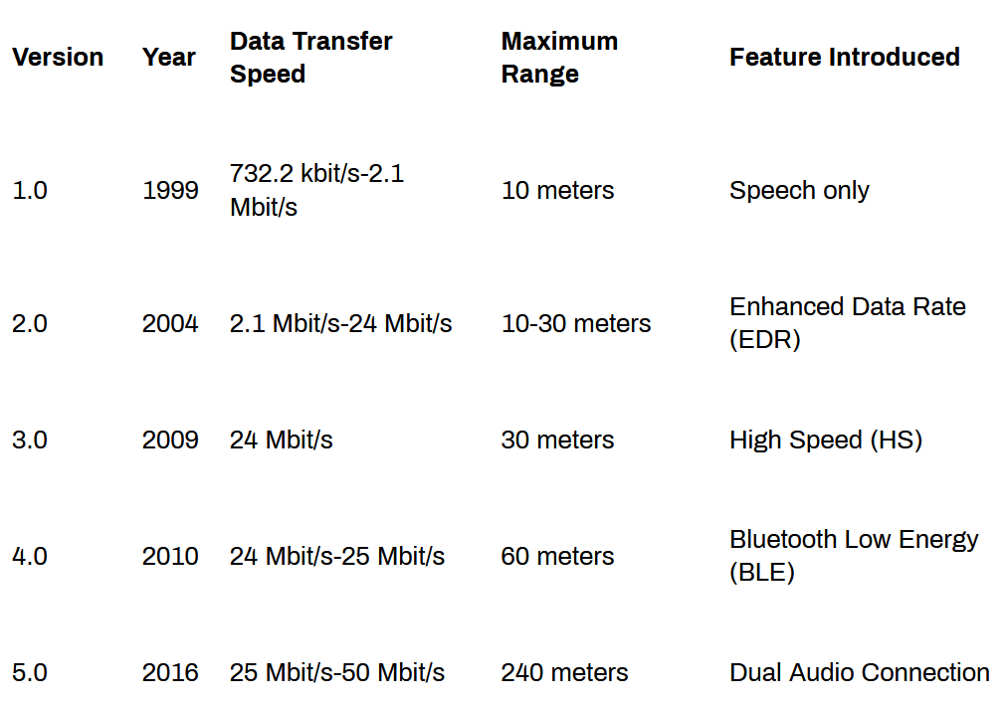
The History of Bluetooth
“Short-link” radio technology was initiated in 1989 by Nils Rydbeck, CTO at Ericsson Mobile in Lund, Sweden to enable wireless headsets
In 1997 by Jim Kardach of Intel proposed the name “Bluetooth” as a placeholder until a better name could be devised (RadioWire and PAN were rejected)
  Using the name of the 10th-century Danish king Harald Bluetooth
  Jim was one of the founders of the Bluetooth Special Interest Group
  The Bluetooth logo combines the runes ᚼ and ᛒ, which are Harald’s initials
Adalio Sanchez, then head of IBM ThinkPad product R&D, looked at incorporating a mobile phone in a ThinkPad
  Phone power requirements prompted another look, and Short-link was the answer
  Adalio and Nils decided it needed to become an open standard
In May 1998, the Bluetooth SIG was launched by IBM and Ericsson, and the specification was born, later to become a part of IEEE 802.15.1

Slide 5
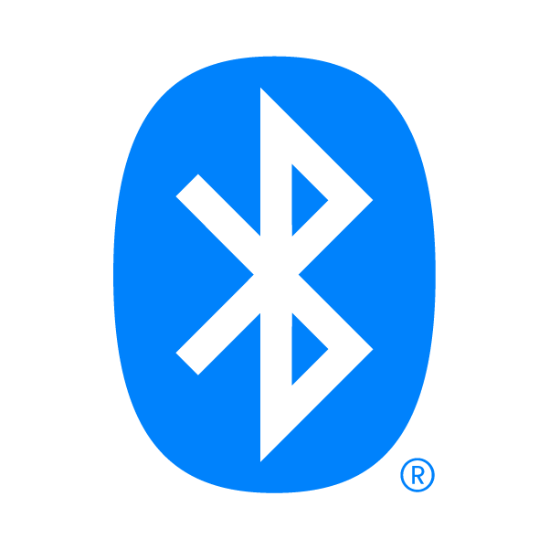
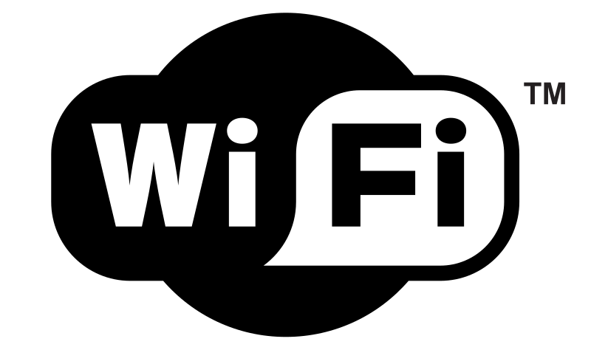

Bluetooth Today: The leading global wireless standard for device communications and positioning
billions
Annual Wireless Product Shipments
Sources: ABI Research, Bluetooth SIG, Inc.

Slide 6
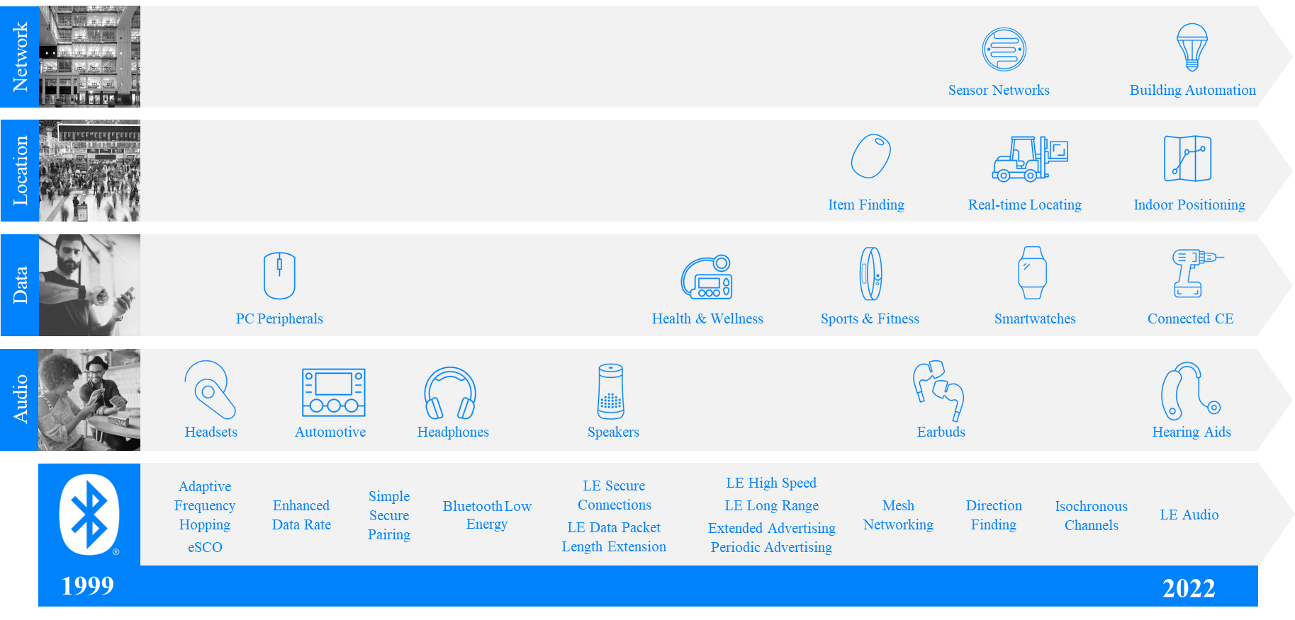
Bluetooth Today: >20-year track record of performance enhancements that have enabled massive new markets

Slide 7
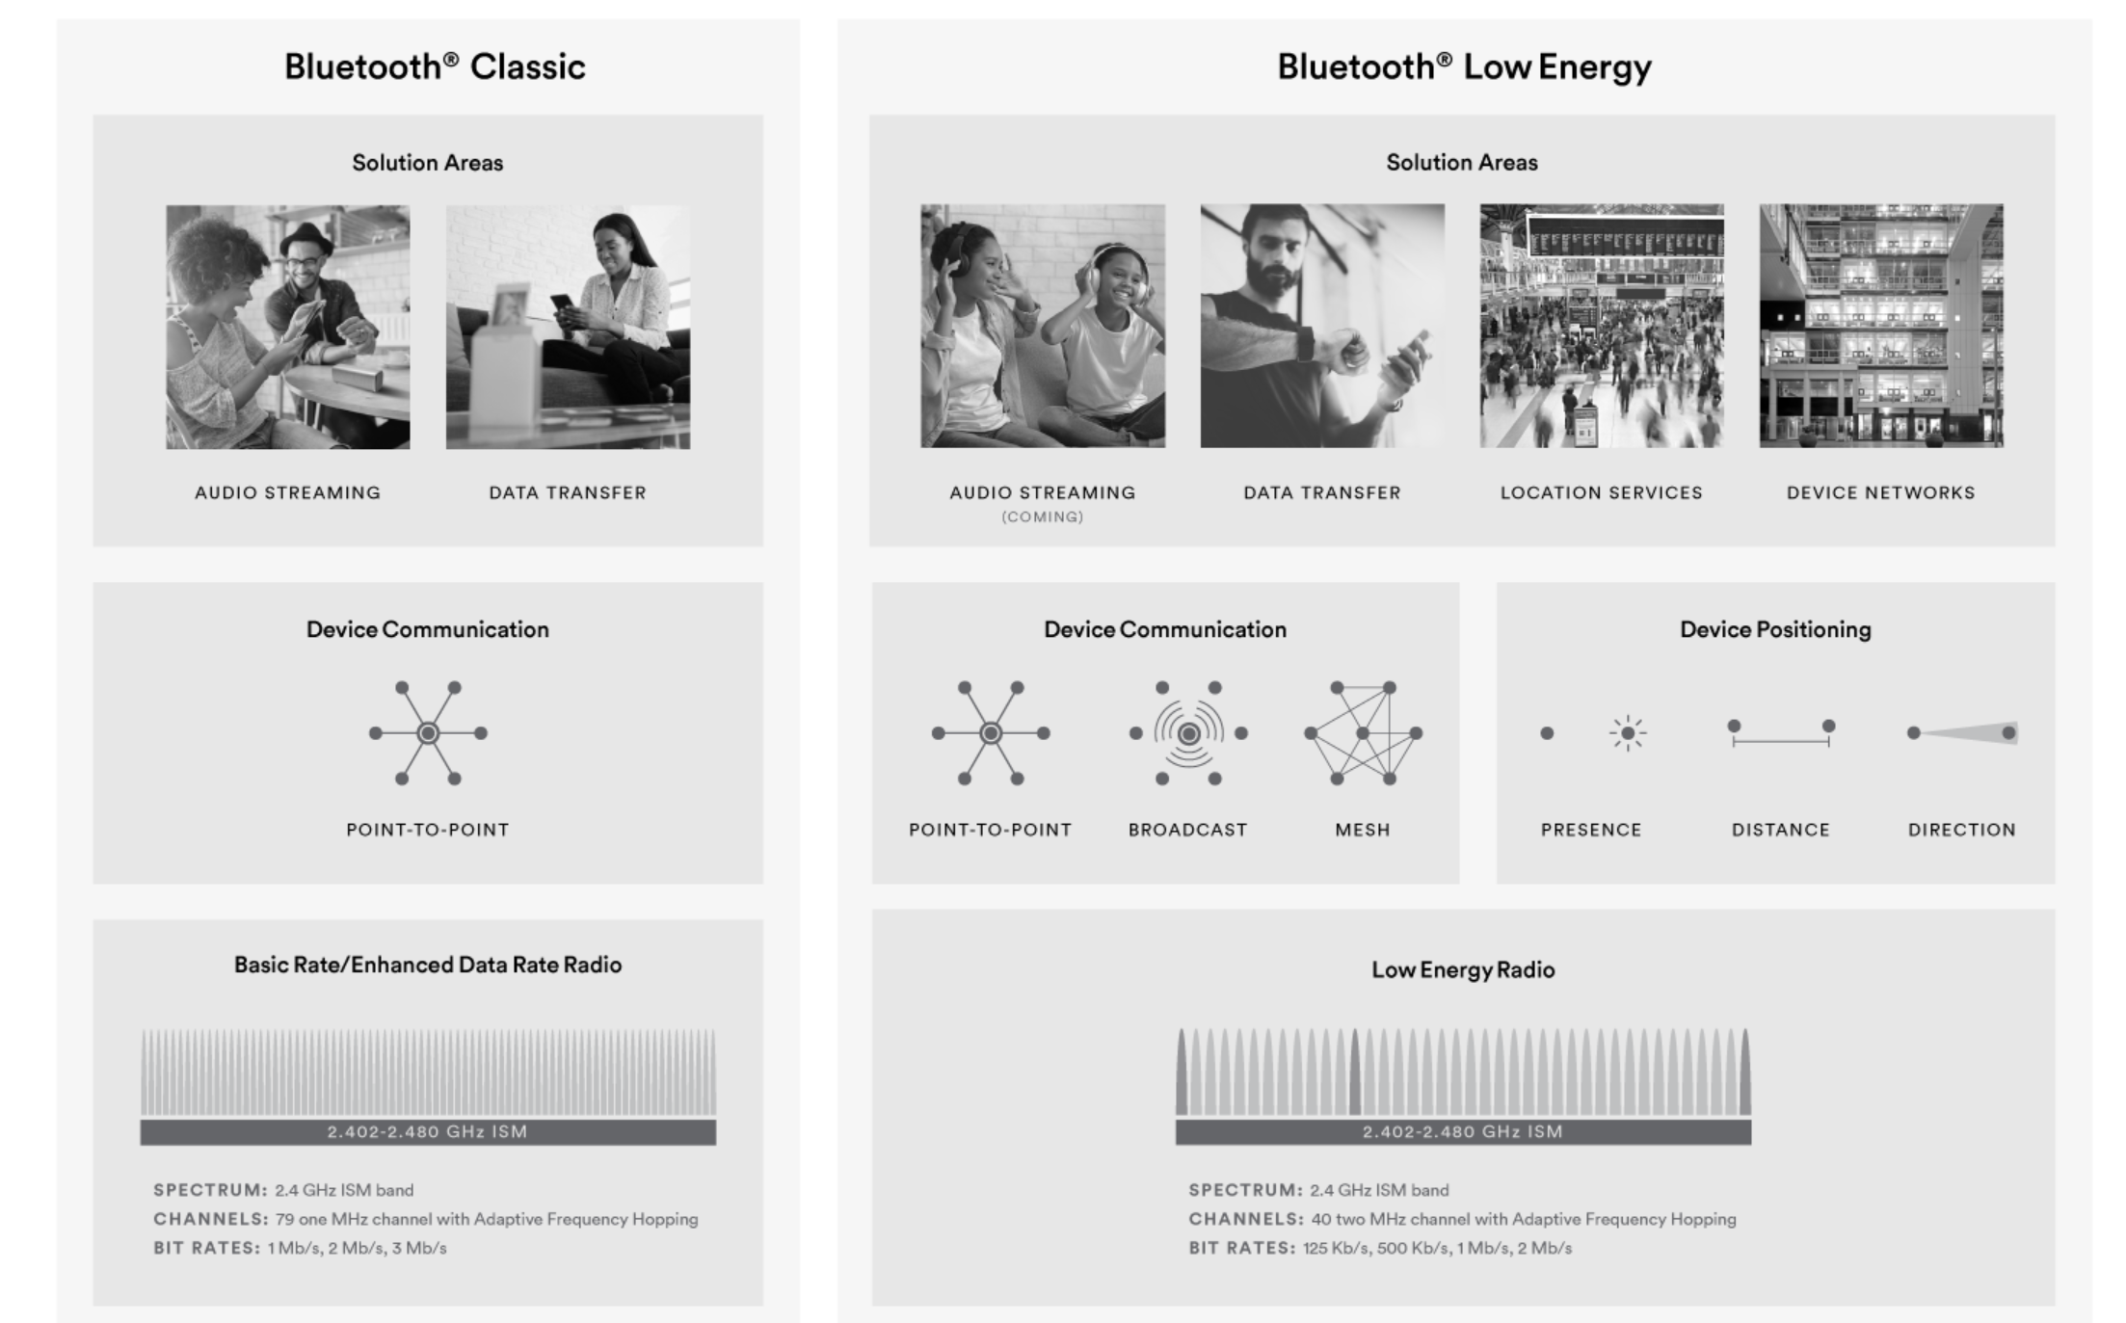
Bluetooth Today
Mid-Band Spectrum Expansion Project Aims to Enhance Performance of Bluetooth™ Technology
Bluetooth SIG has more than 38,000 members
Technologies
  Bluetooth Classic BR/EDR
    Basic Rate
    Enhanced Data Rate
    79 1MHz channels
    Point-to-Point connections
  Bluetooth LE
    Low Energy
    40 2MHz channels
    Multiple connection topologies
    Expanded applications

Slide 8
WAS/RLAN in 6 GHz
In 2017, a coalition of companies with an interest in expanding Wi-Fi to another frequency band to support innovation and to enable operation in less congested spectrum, requested ECC FM57 to consider the 6 GHz band
  Apple, Broadcom, Cisco, Facebook, Google, Hewlett-Packard Enterprise, Intel, MediaTek, Microsoft and Qualcomm
  The European Commission issued an Implementing Decision in June 2021 to make 5945 – 6425 MHz open for license-exempt sharing: [E]very EU member state must update their national frequency allocation plans to reflect the 6 GHz decision before December 1, 2021
The FCC started an NPRM in October of 2018: “Unlicensed Use of the 6 GHz Band” spun off from a proceeding on “Expanding Flexible Use in Mid-Band Spectrum Between 3.7 and 24 GHz”
  Supported by the same coalition, the FCC issued a first R&O in April 2020
Global* support is slowly become a reality
*WRC23 will decide if this band should be declared as IMT spectrum, the outcome of which countries such as China are waiting for.

Slide 9
Bluetooth and IEEE 802.11 Coexistence
Bluetooth sharing with Wi-Fi in 2.4 GHz
  e.g. Adaptive Frequency Hopping Spread Spectrum and in-device coordination
Sharing methods have been developed and enhanced over the years
  Innovation in both IEEE 802.11 and Bluetooth will adapt to new 6 GHz band uses “…to support innovation and to enable operation in less congested spectrum”
Both organizations have the experience and know-how to coexist in 6 GHz
Regulators have a responsibility to be technology neutral
  Collaboration between the two most prolific wireless technologies is essential

Slide 10
Sharing Makes Sense
IEEE 802.11 proponents took on the incumbents starting in 2017 to gain regulatory approval to share the 6 GHz band
  Significant industry support in an industry coalition to drive required regulatory changes
  Regulators world-wide recognized the need to support the growth of Wi-Fi based on how the limitations of the 2.4 and 5 GHz bands would stifle innovations
Bluetooth is currently shipping over 5 billion devices per year; 7 per year billion by 2026
  Congestion in the 83.5 MHz of spectrum in the 2.4 GHz band not only limits technology innovation but may eventually make critical application less reliable; reminiscent of the Wi-Fi story
Regulators will not favor one unlicensed/license-exempt technology over another
  ETSI has already begun the process of incorporating narrow band technology in the 6 GHz harmonized standard (EN 303 687)
For many years Bluetooth and Wi-Fi have successfully shared the 2.4 GHz band
  If we collaborate on this effort both technologies will win

Slide 11
Solutions Is What We Do!
The Bluetooth SIG is committed to sharing the 6 GHz band with minimal impact on Wi-Fi
Collaborating with both IEEE 802.11 and Wi-Fi Alliance we believe this will be a win-win
  Together at IEEE 802.11
  Together at ETSI BRAN
  Together at the FCC, etc.
Supporting the global growth of 6 GHz band unlicensed allocations together

Slide 12
References
COMMISSION IMPLEMENTING DECISION (EU) 2021/1067 of 17 June 2021 on the harmonised use of radio spectrum in the 5 945-6 425MHz frequency band for the implementation of wireless access systems including radio local area networks (WAS/RLANs)
  https://eur-lex.europa.eu/legal-content/EN/TXT/HTML/?uri=CELEX:32021D1067&from=EN

