Slide 1
Timing Problems of the Parallel Coordinated Monostatic DMG Sensing Instance
Date: 2022-10-31
Authors:
Name | Affiliation | Address | Phone | Email
Ning Gao | OPPO |  |  | gaoning1@oppo.com
Chaoming Luo |  |  |  | luochaoming@oppo.com
Pei Zhou |  |  |  | zhoupei1@oppo.com

Slide 2
Introduction
The Coordinated Monostatic DMG Sensing instance has two types: sequential and parallel.
In the contribution 22/1558r0, a timing problem of the Sequential Coordinated Monostatic DMG Sensing instance was shown and three solutions were proposed. The result of the SP is Option 1-A: 0, Option1-B: 1, Option 2: 16, Neither: 0, Abstain: 5.
In this contribution, several similar timing problems of the Parallel Coordinated Monostatic DMG Sensing instance are shown and possible solutions are proposed.

Slide 3
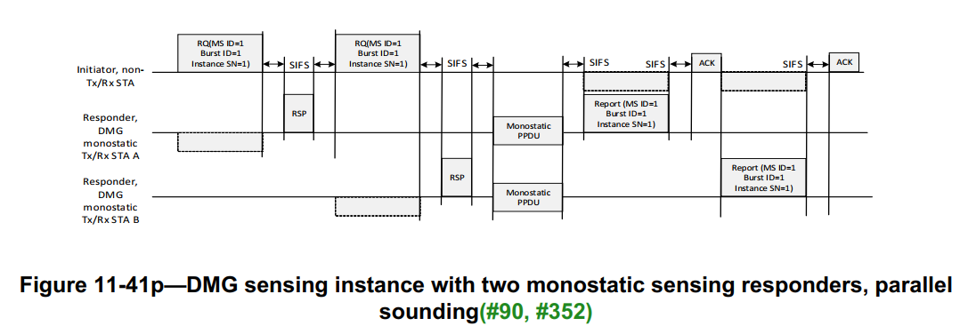
Recap
The Parallel Coordinated Monostatic DMG Sensing instance in 11bf D0.3
A Parallel Coordinated Monostatic DMG Sensing instance contains three phases:
In the initiation phase, the sensing initiator shake hands with sensing responders using DMG Sensing Request and DMG Sensing Response frames.
  In the sounding phase, the sensing responders (STA A and STA B) transmit the PPDU and receive the reflected signal in parallel.
  In the reporting phase, both sensing responders report results to the initiator.
However, due to the directional communication and the variety of PPDU types and MCSs, some timing problems may arise in this instance.

Slide 4
The Timing Problem of the STA B
The STA B does not know when to send the report frame.
  The STA B may not receive the Ack frame of the STA A for it is transmitted directionally.
  The STA B does not know the duration of the Report frame and the ACK frame of the STA A for different MCSs.
For Example:
When use non-EDMG SC mode PPDU and MCS 1, the maximum TXTIME_REPORT ≈ 5447.27μs.
When use non-EDMG SC mode PPDU and MCS 10, the maximum TXTIME_REPORT ≈ 838.11μs.
When use EDMG SC mode PPDU and MCS 1, the maximum TXTIME_REPORT ≈ 87157.70μs.
When use EDMG SC mode PPDU and MCS 10, the maximum TXTIME_REPORT ≈ 13411.67μs.
Notes:
The length of the Data field of the EDMG Control mode and the non-EDMG Control mode PPDU range from 14 to 1023 Octets.
The length of the Data field of the non-EDMG SC mode PPDU range from 1 to 262143 Octets.
The length of the Data field of the EDMG SC mode PPDU range from 1 to 4194303 Octets.

Slide 5
Solution
Add a rule to the 11bf Draft: In the Parallel Coordinated DMG Sensing instance, the sensing initiator shall poll each sensing responder for the report.

Slide 6
The Timing Problem of the STA A
The Report frame of STA A may overlap with the Monostatic PPDU of STA B for the duration of Monostatic PPDUs may be different.
Monostatic PPDUs of different STAs may have Date fields of different lengths.
Monostatic PPDUs of different STAs may use different PPDU types.
Monostatic PPDUs of different STAs may use the L/EDMG-CEF or TRN field for sensing.
For Example:
The TXTIME of Monostatic PPDUs(with shortest Data, without TRN) using different mode are as follow:
  The TXTIME_MONOSTATIC_PPDU using EDMG Control mode: 14.462μs.
  The TXTIME_MONOSTATIC_PPDU using EDMG SC mode: 3.377μs.
  The TXTIME_MONOSTATIC_PPDU using non-EDMG control mode: 13.153μs.
  The TXTIME_MONOSTATIC_PPDU using non-EDMG SC mode: 2.800μs
Notes:
The length of the Data field of the EDMG Control mode and the non-EDMG Control mode PPDU range from 14 to 1023 Octets.
The length of the Data field of the non-EDMG SC mode PPDU range from 1 to 262143 Octets.
The length of the Data field of the EDMG SC mode PPDU range from 1 to 4194303 Octets.

Slide 7
Solution
  Add a parameter(e.g. Duration of Monostatic PPDUs) into the DMG Sensing Response frame to inform the sensing initiator of the duration from the start of the first Monostatic PPDU to the end of the last Monostatic PPDU.
  Add a rule to the draft: The sensing initiator shall send the first DMG Sensing Poll frame after waiting the largest Duration of Monostatic PPDUs plus SIFS and BRPIFS time from the end of the last DMG Sensing Response frame.

Slide 8
SP 1
Do you support the following solutions?
In a Parallel Coordinated Monostatic DMG Sensing instance,
  Add a field(Duration of Monostatic PPDUs) into the TDD Beamforming Information field of the DMG Sensing Response frame to inform the sensing initiator of the duration from the start of the first Monostatic PPDU to the end of the last Monostatic PPDU.
  The sensing initiator shall poll each sensing responder for the report.
  The sensing initiator shall send the first DMG Sensing Poll frame after waiting the largest Duration of Monostatic PPDUs plus SIFS and BRPIFS time from the end of the last DMG Sensing Response frame.
  Yes/No/Abstain

