Slide 1
Timing Problems of the Parallel Coordinated Monostatic DMG Sensing Instance
Date: 2022-10-11
Authors:
Name | Affiliation | Address | Phone | Email
Ning Gao | OPPO |  |  | gaoning1@oppo.com
Chaoming Luo |  |  |  | luochaoming@oppo.com

Slide 2
Introduction
The Coordinated Monostatic DMG Sensing instance has two types: sequential and parallel.
In the contribution 22/1558r0, a timing problem of the Sequential Coordinated Monostatic DMG Sensing instance was shown and three solutions were proposed.
In this contribution, several similar timing problems of the Parallel Coordinated Monostatic DMG Sensing instance are shown and possible solutions are proposed.

Slide 3
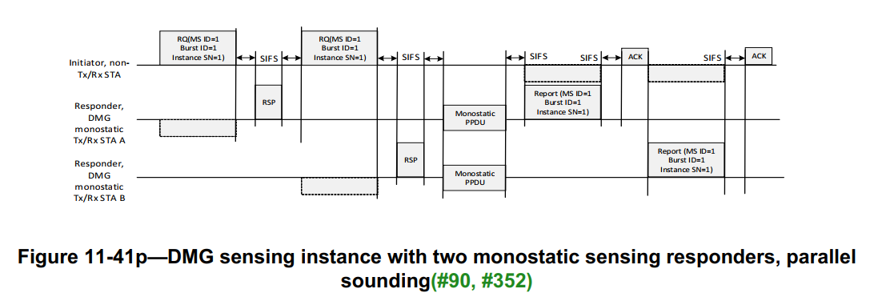
Recap
The Parallel Coordinated Monostatic DMG Sensing instance in 11bf D0.3
A Parallel Coordinated Monostatic DMG Sensing instance contains three phases:
In the initiation phase, the sensing initiator shake hands with sensing responders using DMG Sensing Request and DMG Sensing Response frames.
  In the sounding phase, the sensing responders (STA A and STA B) transmit the PPDU and receive the reflected signal in parallel.
  In the reporting phase, both sensing responders report results to the initiator.
However, due to the directional communication and the variety of PPDU types and MCSs, three timing problems may arise in this instance.

Slide 4
Problem 1
The STA A and STA B may not able to send Monostatic PPDUs at the same time.
The STA A dose not know the duration of the REQ and RSP frames of the STA B for different PPDU type and different MCSs.
The STA A may not receive the RSP frame of STA B for it is transmitted directionally.
For Example:
When use EDMG SC mode PPDU and MCS 1, TXTIME_RQ + TXTIME_RSP ≈ 7.627μs
When use EDMG SC mode PPDU and MCS 10, TXTIME_RQ + TXTIME_RSP ≈ 6.754μs
The TXTIME difference between the two STAs is 0.873μs, the maximum TXTIME difference can be 6.111μs when there are eight responder STAs (the first STA use MCS 10, left 7 STAs use MCS 1) which is bigger than SIFS(3μs).
Notes:
Note: All TXTIME calculation are based on 802.11REVme1.4, 28.12.3 TXTIME calculation. It is assumed that NUM_USERS = 1, NUM_STS = 1, EDMG_ADD_PPDU = NO-ADD-PPDU, GI_TYPE = Normal, CH_BANDWIDTH has a single bit set to 1.

Slide 5
Solutions for Problem 1
Option 1A
Add a rule to the 11bf Draft: In the Parallel Coordinated DMG Sensing instance, the sensing initiator and sensing responders shall send DMG Sensing Request frames and DMG Sensing Response frames with the same PPDU type (e.g. non-EDMG SC mode PPDU) and use the same MCS(e.g. MCS 1).
Option 1B
Use a modified EDMG Multistatic Sensing PPDU without TRN to trigger multiple sensing responders to send Monostatic PPDUs simultaneously.

Slide 6
Problem 2
The duration of the two Monostatic PPDUs may be different, so the Report frame of STA A may overlap with the Monostatic PPDU of STA B.
Monostatic PPDUs of different STAs may have Date fields of different lengths.
Monostatic PPDUs of different STAs may use different PPDU types of different lengths.
For Example:
The TXTIME of Monostatic PPDUs(with shortest Data, without TRN) using different mode are as follow:
  The TXTIME_Monostatic_PPDU using EDMG Control mode: 14.462μs.
  The TXTIME_Monostatic_PPDU using EDMG SC mode: 3.377μs.
  The TXTIME_Monostatic_PPDU using non-EDMG control mode: 13.153μs.
  The TXTIME_Monostatic_PPDU using non-EDMG SC mode: 2.800μs
Notes:
The length of the Data field of the EDMG Control mode and the non-EDMG Control mode PPDU range from 14 to 1023 Octets.
The length of the Data field of the non-EDMG SC mode PPDU range from 1 to 262143 Octets.
The length of the Data field of the EDMG SC mode PPDU range from 1 to 4194303 Octets.

Slide 7
Solution for Problem 2
Option 2
  Add a parameter (e.g. Maximum Duration of Monostatic PPDUs) into the DMG Measurement Setup element to restrict the duration of Monostatic PPDUs used by different responder STAs.

Slide 8
Problem 3
The STA B does not know when to send the Report frame.(Similar with the Problem 1)
  The STA B does not know the duration of the Report frame and the ACK frame of the STA A for different MCSs.
  The STA B may not receive the Ack frame of the STA A for it is transmitted directionally.
For Example:
When use non-EDMG SC mode PPDU and MCS 1, the maximum TXTIME_REPORT ≈ 5447.27μs.
When use non-EDMG SC mode PPDU and MCS 10, the maximum TXTIME_REPORT ≈ 838.11μs.
When use EDMG SC mode PPDU and MCS 1, the maximum TXTIME_REPORT ≈ 87157.70μs.
When use EDMG SC mode PPDU and MCS 10, the maximum TXTIME_REPORT ≈ 13411.67μs.
Notes:
The length of the Data field of the EDMG Control mode and the non-EDMG Control mode PPDU range from 14 to 1023 Octets.
The length of the Data field of the non-EDMG SC mode PPDU range from 1 to 262143 Octets.
The length of the Data field of the EDMG SC mode PPDU range from 1 to 4194303 Octets.

Slide 9
Solution for Problem 3
Option 3
Add a rule to the 11bf Draft: In the Parallel Coordinated DMG Sensing instance, the sensing initiator shall poll each sensing responder for the report.

Slide 10
Conclusion
In order to solve the mentioned three timing problems of the Parallel Coordinated Monostatic DMG Sensing instance, we provide two sets of solutions:
  Solution 1: Option 1A + Option 2 + Option 3
  Solution 2: Option 1B + Option 2 + Option 3

Slide 11
SP 1
In order to solve the three timing problems of the Parallel Coordinated Monostatic DMG Sensing instance, which one of the following solutions do you support?
  Solution 1: Option 1A + Option 2 + Option 3
  Solution 2: Option 1B + Option 2 + Option 3

