Slide 1
Harmonized Sensing NDPA
Date: 2022-09-28
Authors:
Name | Affiliation | Address | Phone | Email
Junghoon Suh | Huawei |  |  | junghoon.suh@huawei.com
Yan Xin |  |  |  | Yan.Xin@huawei.com
Osama AboulMagd |  |  |  | Osama.AboulMagd@huawei.com

Slide 2
Proposed Harmonized Sensing NDPA
B2
B7
Measurement Instance ID
SP 1
B0
(Ranging)
B1
(HE)
Sounding Dialog
Token Number
AID:
2045
I2R NDP
TX Power
R2I NDP
Target RSSI
Disambi-
guation
Measurement
Set-up ID
Bits
:
1 1 6
B0
B10
B11
B18
B19
B26
B27
B28
B31
Octets
:
4
4 4
4 4
MAC
Header
Sounding
Dialog
Token
Common Info Field 1
Common Info Field 2
……….
FCS
STA Info # 1
STA Info # n
1 0
SP 2
AID:
2042
BW of
NDPA
Punctured
Sub-channel
Disambi-
guation
Reserved
B0
B10
B11
B14
B15
B26
B27
B28
B31
SP 3
SP 4/5
SP 4/5
AID 11
Partial BW
Feedback
R2I N_STS
R2I Rep
I2R N_STS
Sensing
Disambi-
guation
I2R Rep
Sensing
B0
B10
B11
B16
B17
B19
B20
B22
B23
B25
B26
B27
B28
B30
B31

Slide 3
SP 1
Do you agree to indicate the Measurement Set-up ID in the Special STA Info Field of Sensing NDPA ?
B28 to B31 are used for the indication of Measurement Set-up ID
AID for Special STA Info Field is 2045
Yes
No
Abs

Slide 4
SP1-2
How many bits do you prefer for the Measurement Set-up ID?
Option 1: 3 bits
Option 2: 4 bits
Option 3: 1 byte
Abs
Option 1: 12
Option 2: 7
Option 3: 1
Abs: 7
No answer: 6

Slide 5
SP1-1
Do you agree to indicate the TX Power Control in the TB case of the Special STA Info Field with AID 2045 of Sensing NDPA ?
R2I NDP Target RSSI subfield is Reserved
Yes
No
Abs
Unanimously supported

Slide 6
SP1-3
Do you agree to indicate the Measurement Set-up ID and Sensing indications in the Special STA Info Field of Sensing NDPA ?
B28 to B30 are used for the indication of Measurement Set-up ID
B31 is used to indicate the Sensing NDPA
AID for Special STA Info Field is 2045
Yes
No
Abs

Slide 7
SP 2
Do you agree to indicate the BW and Preamble Puncturing Patterns of the Sensing NDPA in a subfield of the Common Info field 2?
AID for Common Info Field 2 is 2042
Yes
No
Abs

Slide 8
Partial BW FB provides more effective and flexible Preamble Puncturing than Static Puncturing Patterns
Non-OFDMA Preamble Puncturing Patterns in EHT NDP are not flexible and there are very few 40 MHz or 80 MHz non-contiguous preamble puncturing across 320 MHz
Partial BW FB effectively provides more flexible preamble Puncturing
Example
Even the STA in 80 MHz Operating Channel Width can participate in the 320 MHz sounding
The STA in 160 MHz Operating Channel Width can participate in the 320 MHz sounding and with the second 40 MHz and the fourth 40 MHz preambles punctured → 40 MHz non-contiguous preamble puncturing is not possible in the Static Preamble Puncturing (non-OFDMA Preamble Puncturing)

Slide 9
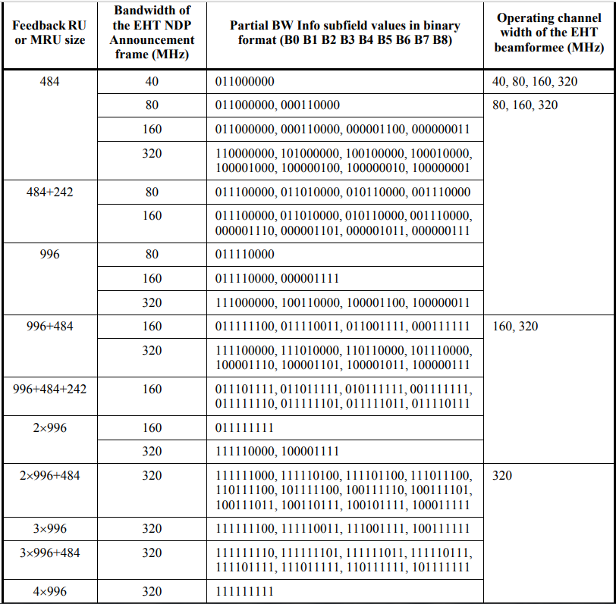
Partial BW FB in EHT NDPA

Slide 10
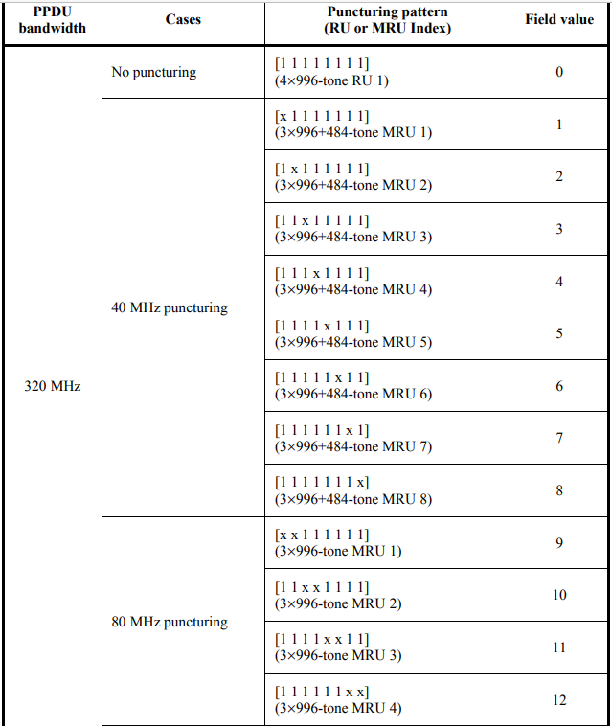
Punctured Sub-channel (Non-OFDMA Preamble Puncturing) in EHT NDP

Slide 11
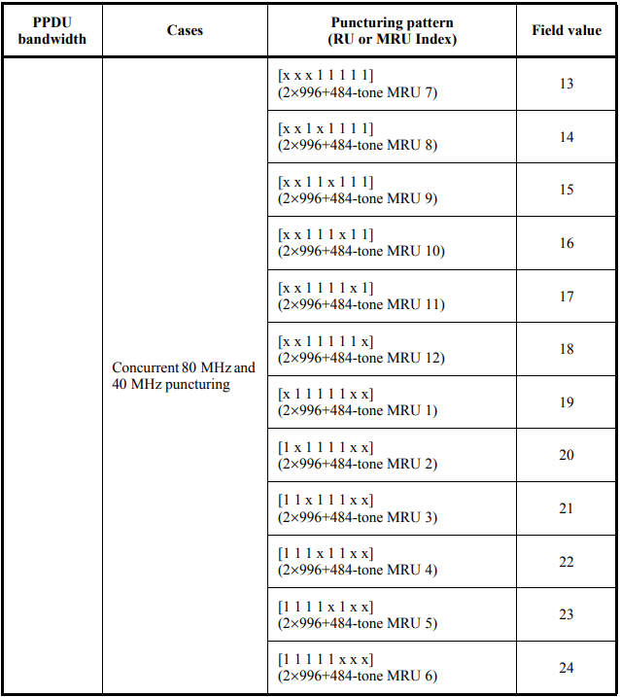

Slide 12
SP 3
Which one of the followings do you prefer?
Option 1: Disallow the Partial BW Feedback in the Sensing NDPA
The Operation BW of each responder should be aligned with the BW of EHT NDP PPDU (which is 320 MHz)
LTF Offset subfield of Ranging NDPA shall be set to “Reserved”
Option 2: Allow only the same Partial BW Feedback patterns for 320 MHz of the EHT NDPA in the Sensing NDPA
LTF Offset subfield of Ranging NDPA shall be repurposed for the Partial BW Feedback
B11 to B16 of the STA Info Field are used for this indication
Option 1
Option 2
Abs

Slide 13
SP 4
Which one of the followings do you prefer ?
Option 1: The following Sensing NDP PPDU type can be implied through the BW indication in the SERVICE field of NDPA
Option 2: The following Sensing NDP PPDU type may be explicitly indicated in the NDPA
Option 1
Option 2
Abs

Slide 14
SP 5
Which one of the following do you prefer to indicate the Sensing NDPA in the STA Info Field in order to distinguish from the Ranging NDPA?
Option 1: Both B26 and B31 shall be used for this indication
Option 2: B26 is the Sensing subfield and B31 is set to “Reserved”
Option 3: B31 is the Sensing subfield and B26 is set to “Reserved”
Option 1
Option 2
Option 3
Abs

