Slide 1
A briefing of coexistence issues for IEEE 802.11 WG in September 2022
14 September 2022
Authors:
Name | Company | Phone | email
Andrew Myles | Cisco | +61 418 656587 | amyles@cisco.com

Slide 2
Executive summary: various coex issues have not yet been resolved … and assistance is requested
Ensuring equitable access for Wi-Fi is a complex multi-dimensional problem with many trade-offs
Coexistence related activities across the Wi-Fi industry have been broadly successful … but not universally so
Situation
Despite best efforts it appears there will be poor coex between LAA/NR-U & Wi-Fi in practice
More work is required to understand the issue & find mitigations
802.11be may have less performance that 802.11ax in 5 GHz in Europe
More work is required to understand the risk of 802.11ax/be coex issues in Europe
Issue 1
Issue 2
Next
The Coex SC has many questions (more than just those above) & not enough answers … please help!

Slide 3
Ensuring equitable access for Wi-Fi is a complex multi-dimensional problem with many trade-offs
The Coex SC’s goal (from its scope) is to:
… promote, within the 802.11 WG and externally, an environment that enables IEEE 802.11 technologies to have equitable access to unlicensed spectrum globally
This is a complex task with many dimensions, encompassing a variety of stakeholders, not all fans of Wi-Fi technology:
Availability: politicians/regulators determine availability of unlicensed spectrum with an impact on need for coexistence & mitigation of coexistence issues
Rules: regulators, ETSI BRAN, … imposed rules influence coexistence issues
SDOs: standards developed by IEEE 802.11 WG, 3GPP, LTE-U Forum (all with self interest at top of mind) all have an impact on coexistence
IPR owners: some perceive more value in cellular technology used in both licensed & unlicenced spectrum
SPs: some perceive more value in licensed spectrum (that they own)
Any solution focusing on equitable access will be a trade-off …

Slide 4
Coexistence related activities across the Wi-Fi industry have been broadly successful … but not universally so
Successes … and non successes
LTE-U was an early threat to equitable access that has now gone away, mostly due to Wi-Fi industry efforts
Wi-Fi industry has gained access to 1200 MHz in 6 GHz band in mostly in America’s … but is still struggling in other countries in face of a well funded & very professional lobbying effort by GSMA and others
1200 MHz helps meet user needs … and both causes & mitigates coex issues
500 MHz does not meet user needs … but may result in less coex issues
Debates driven by Wi-Fi industry in 3GPP & ETSI BRAN have resulted in adoption of EDCA-like access for LAA/NR-U … but without the sophisticated multi-level listening mechanisms refined by 802.11 over many years
PD/ED + NAV as used by Wi-Fi is not perfect … but it works in practice
ED-only as used by LAA/NR-U works on average in sims … but not in practice

Slide 5
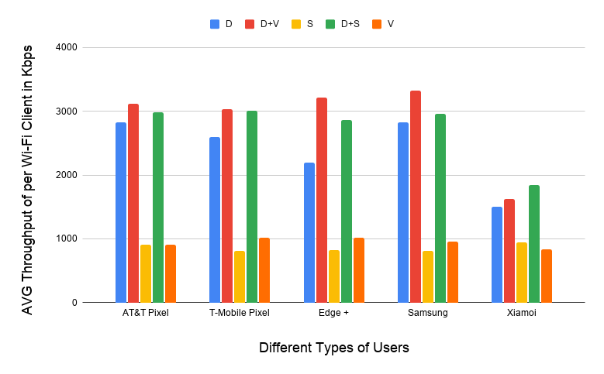
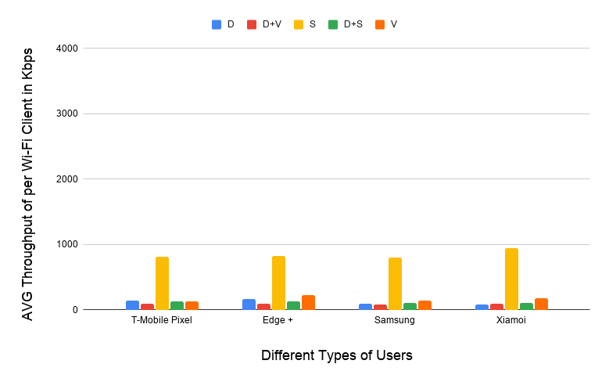
Issue 1: despite best efforts it appears there will be poor coex between LAA/NR-U & Wi-Fi in practice
Uni of Chicago studies (11-20-1973 et al) showed that LAA causes significant interference to data traffic
Probably because LAA is using ED @ -72 dBm rather than PD @ - 82 dBm
Also because Wi-Fi’s hidden station mitigation mechanisms based on RTS/CTS have no effect on LAA
This will probably be true for NR-U too
5 Wi-Fi APs on one channel, no LAA
5 Wi-Fi APs on one channel, one LAA
11-20-1973 slide 16
All client close to Wi-Fi APs
Addition of LAA caused all Wi-Fi traffic to collapse …
… except streaming because LAA used licensed for streaming

Slide 6
Next steps 1: more work is required to understand the issue & find mitigations
Lots of questions on LAA/NR-U/Wi-Fi coex … your help is needed!
It seems likely we have a coex problem if LAA/NR-U deployed …
Is there any counter evidence from deployment measurements?
Is it reasonable to apply the LAA based measurements to NR-U too?
We are not yet sure if LAA/NR-U will be widely deployed …
Is extensive LAA/NR-U deployment expected in any significant markets?
Will there be less LAA/NR-U if more 6 GHz spectrum licensed?
It seems that there are few ways to deal with the coex issues …
Are there any obvious technical mitigations? None so far
Can we rely on avoidance as a mitigation, esp with 1200 MHz in 6 GHz band?
Can we persuade everyone to not bother with LAA/NR-U? They don’t seem to provide much value over Wi-Fi to the user and they cause much pain!
…

Slide 7
Issue 2: 802.11be may have less performance that 802.11ax in 5 GHz in Europe
EN 301 893 (5 GHz HS for Europe) has previously allowed Wi-Fi to use PD/ED @ -82/-62 dBm based listening for EDCA based sharing
European requirements were historically satisfied merely by operating in compliance with the 802.11 standards
This approach is now less acceptable in Europe because it was perceived by some people to be less technology neutral
… although it is also possible that some cellular stakeholders just want to make life difficult for Wi-Fi ☹
The result is that different Wi-Fi generations will operate under heterogenous rules in 5 GHz in Europe, with potential coex issues
802.11ax can use PD/ED @ -82/-62 dBm (historical approach)
802.11be must operate within ED @ -72 dBm constraint (new compromise)
At worst, 802.11be may have less performance that 802.11ax
Note: there is NOT consensus on the correctness of this claim

Slide 8
Next steps 2: more work is required to understand the risk of 802.11ax/be coex issues in Europe
Questions on 802.11ax/be coex in Europe … your help is needed!
It is unknown if we have 802.11ax/be coex issue in 5 GHz in Europe …
Is there consensus that there is a 802.11ax/be coex issue (or not)?
Can the issue be mitigated by operating 802.11be with PD/ED @ -72/-72 dBm?
The proposed mitigation of ED @ -62 dBm in EN 301 893 may be worse by allowing LAA/NR-U to operated with less constraints…
Is there consensus relating to some claims that LAA/NR-U operating with ED @ -62 dBm causes no harm? Note that these claims contradict original 3GPP simulations
Could a relaxed ED constraint encourage more LAA/NR-U deployment, thus causing more coex issues?
…

Slide 9
The Coex SC has many questions & not enough answers … please help!
The preceding slides have set up some of the key coex questions related to LAA/NR-U/Wi-Fi coex … but we need more answers!
The questions will be discussed in more detail in the next Coex SC session (in PM2 today) …
… with a hope we can generate/inspire some/more answers in Nov 2022 in Bangkok
In the meantime, there are new coex issues to consider across a range of technologies … and again your help is sought
SL-U
60 GHz
BT in 6 GHz
802.15.5ab UWB in 6 GHz
NB FH in 6 GHz
C2C

Slide 10
Appendix: 6 GHz spectrum is tied to coex … and is probably the key to avoiding the worst coex issues
Wi-Fi is the prime technology in unlicenced spectrum?
It is unclear whether NR-U will succeed;
LAA has not succeeded so far
Yes
No
All 1200 MHz in 6 GHz unlicensed?
All 1200 MHz in 6 GHz unlicensed?
Answer will vary by country
Yes
No
Yes
No
Wi-Fi has room to grow & thrive for benefit of all
Insufficient unlicensed spectrum for Wi-Fi to meet users’ needs!
Coex issue between Wi-Fi & LAA/NR-U, mitigated by possibility of using avoidance
Coex issue between Wi-Fi & LAA/NR-U, with no current known mitigations
1200 MHz of unlicensed is vital

