Slide 1
A perspective on proposed
Ultra-High Reliability (UHR) features for enterprise use cases
11 September 2022
Authors:
Name | Affiliation | Phone | email
Brian Hart | Cisco Systems |  | brianh@cisco.com
Pooya Monajemi | Cisco Systems |  | pmonajem@cisco.com
Andrew Myles | Cisco Systems
Juan Carlos Zuniga | Cisco Systems
Peter Ecclesine | Cisco Systems
Stephen Orr | Cisco Systems
Jerome Henry | Cisco Systems

Slide 2
Enterprise use cases suggest various next-gen 802.11 requirements^{[3]} … that are often applicable more broadly
Primary goals arising from enterprise
Reliability/availability
Security
Client scale/density
Network capacity
QoS with para-determinism
Visibility, supportability, serviceability, manageability
QoS with para-determinism
High reliability of packet delivery at low latency / jitter for teleconferencing, automation, evolving to AR/VR
Make before break aka hitless roaming
Infrastructure & client-to-client coordination for mutual benefit
  Next gen enterprise requirements are an evolution of those for various 802.11 amendments over the years …
  … but now with a greater emphasis on client scale & QoS with para-determinism^{[1]}
  Traditionally these more challenging enterprise requirements become valuable for all 802.11 use cases, including residential

Slide 3
Likely features in next-gen 802.11 seem to support the requirements of important enterprise use cases
Goals Features | Reliability/ availability | Security | Client scale/ density | Network capacity | QoS with para-Determinism^{[7]} | Visibility, supportability, troubleshootability, manageability
Multi-AP |  |  |  |  | 
Hitless Roaming |  |  |  |  | 
C2C Coordination |  |  |  |  | 
mmWave |  |  |  |  | 
Mandatory .1X support |  | 
AI/ML |  |  |  |  |  | 
Key:  Feature Strongly Supports Goal;  Feature Supports Goal

Slide 4
Multi-AP

Slide 5
Multi-AP is potentially the most valuable next gen feature for the support of enterprise use cases …
Outcomes of Multi-AP use:
  Increased reliability through better collision
  avoidance
    APs schedule medium time among themselves
    APs schedule their clients
    … so triggered access & r-TWT can scale to OBSS
  Higher and more predictable MCSs during
  spatial reuse
    Greater capacity & reliability
  Lower latency for critical traffic
    APs can identify among themselves who has
    the most important, most backlogged traffic,
    and ensure that it gets sent first
Planned SR TXOP
AP1
Client(s)
Planned TXOP
AP2
Client(s)
Planned SR TXOP
AP3
Client(s)
Most interesting/feasible
Multi-AP technologies
Coordinated TDMA/spatial reuse/OFDMA/beamforming
Macrodiversity
Joint TX/RX, etc
Hart et al (Cisco Systems)

Slide 6
… but Multi-AP must be flexible enough that it can operate in a way best suited to enterprise use cases (1/3)
A multi-AP protocol must …
  … operate when frequency reuse factor exceeds 1
    Frequency reuse in enterprise 5/6 GHz use cases is typically 6-12 & is unlikely to change much^{[4]}, except in
    2.4 GHz band & in multi-floor buildings
    CoSR/CoBF is competitive with JT/JR in this case
  … support wired AP2AP control traffic
    Sending extra wireless control traffic must be avoided where possible
    The preferred option is to send control traffic over Ethernet
  … handle large inter-AP delays
    Mainstream AP designs typically have 1-10 msec wired MAC-to-MAC delays due to intervening host
      100x more than cabling + switch delays
      Intra-TXOP coordination seems out of reach of wired Multi-AP
2.4 GHz
5/6 GHz
Linux interrupt delays
Switch
Host
Host
802.11 MAC/ Baseband
802.11 MAC/ Baseband
RF
RF

Slide 7
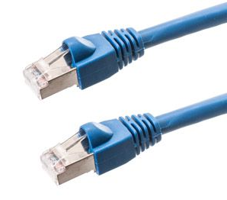
… but Multi-AP must be flexible enough that it can operate in a way best suited to enterprise use cases (2/3)
A multi-AP protocol must …
  … operate with realistic backhaul speeds
    Single or dual Cat6a twisted pair will provide 10-20 Gbps up + 10-20 Gbps down, shared with data traffic
  … reserve wireless coordination for late exceptions
    Traffic is bursty, MCSs & retries are unpredictable, so an AP might have reserved too little or too much medium time compared to what was needed
      So the AP can poll neighboring APs wirelessly to identify the greatest need
      ... and then grant a portion of the TXOP to the neediest
Planned TXOP
AP1
AP2AP Req
AP2AP Grant
Client(s)
Planned TXOP
AP2
AP2AP Resp
Refarmed
Client(s)
Interferer
Planned transmission not Acked
AP1’s QoS buffers emptied
AP2 has greatest need

Slide 8
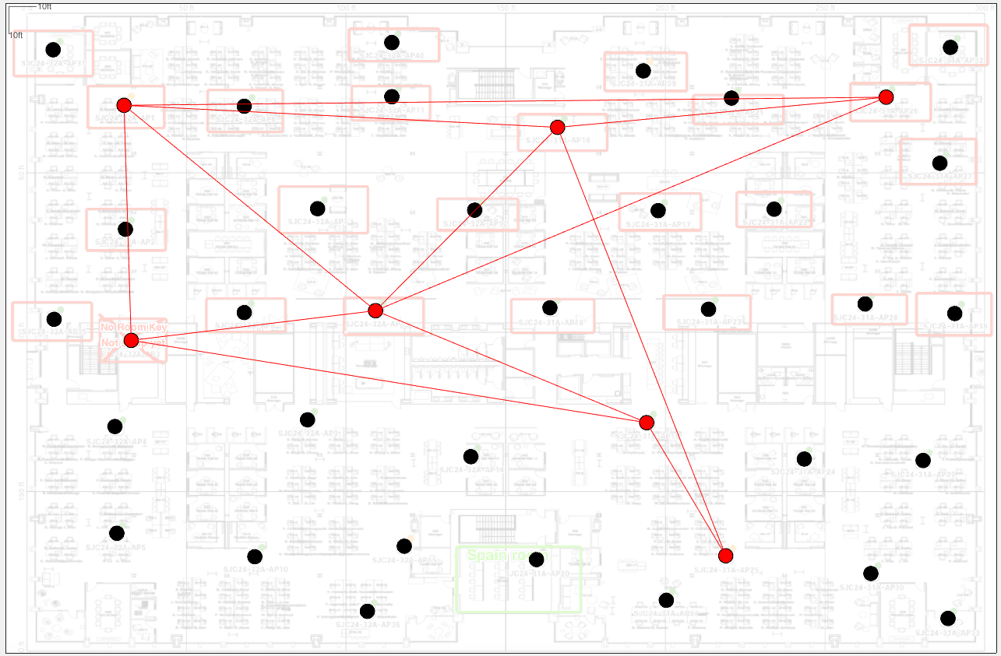
… but Multi-AP must be flexible enough that it can operate in a way best suited to enterprise use cases (3/3)
A multi-AP protocol must …
  … operate without direct wireless connectivity to a leader AP
    In a typical enterprise environment, considering an island of in-range co-channel APs, no one AP has 1-hop connectivity to every other AP in the island
    APs in an island are routinely 3 hops apart^{[8]}
  Dots = APs
  Red dots = cochannel APs
  Lines = in-range
  No one AP has direct connectivity to every other AP in the island
  Multi-floor (not shown) makes this connectivity island much more extensive

Slide 9


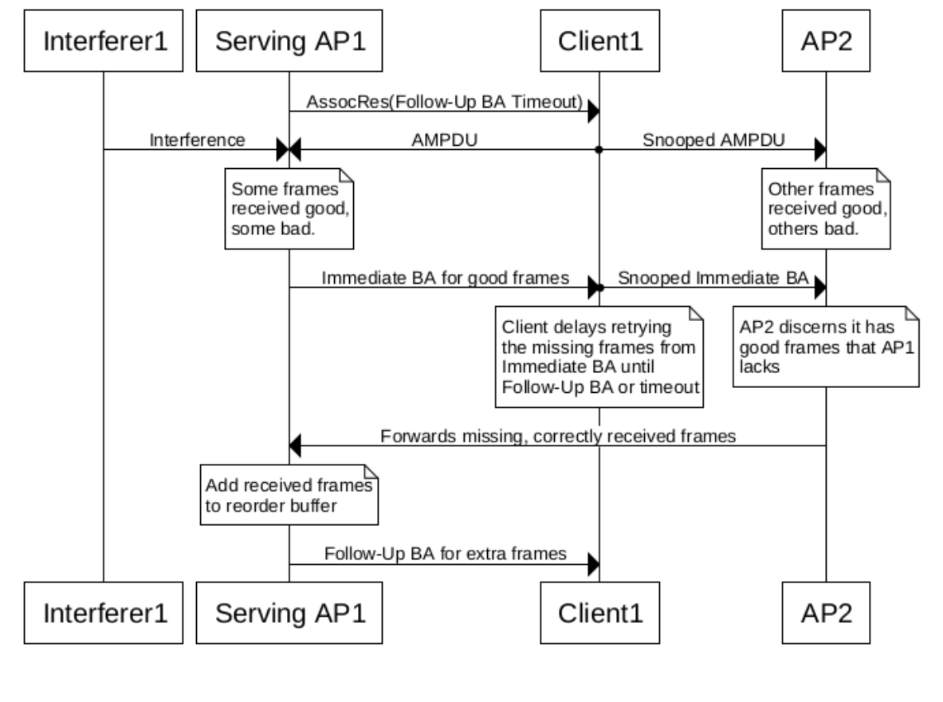
Macro-diversity using JR is required in the next gen of 802.11 to harden the UL, just as CoBF/JT hardens the DL
Macro-diversity
  Just as CoBF/JT assists DL reliability …
  … macro-diversity using JR by nearby co-channel
  APs can assist UL reliability
    A serving AP will sometimes not correctly receive an UL frame while a nearby AP does due to varying SINRs at different locations
    Retransmissions & further contention can be
    avoided by the nearby AP sending the frame to
    the serving AP via a wired link
    The challenge is ack’ing the frame because the
    serving AP will not be able to do so within SIFS
    given typical AP2AP latencies
    The solution is to define new Follow-Up BAs to
    belatedly acknowledge frames received by
    nearby APs on behalf of serving APs
      Follow-Up BAs need protection, to avoid a DoS
Serving AP misses UL transmission due to interference
Nearby AP can still receive UL transmission
Interference

Slide 10
mmWave (and more Multi-AP)

Slide 11
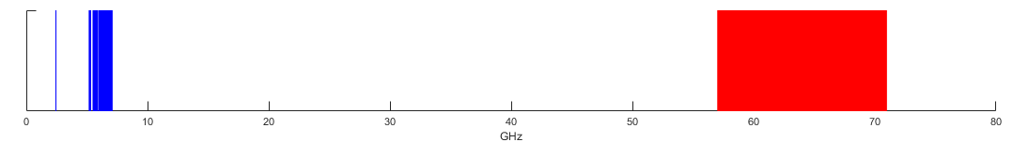
MLO & other mitigations provide new hope that clients will finally use mmWave
Infrastructure is ready to adopt mmWave when next-gen clients do
Opportunity: lots of spectrum
New hope: client issues are mitigated
The large amount of unlicensed & lightly licensed spectrum at >45/60-70 GHz worldwide presents significant opportunities to enhance client scale, system capacity & QoS
mmWave’s new hope is that many current client issues will be mitigated
mmWave’s range & reliability limitations can be masked by a high-density deployment & the use of MLO
mmWave surpasses classic 802.11 at MCS13 in terms of rate versus range
  MCS7 at 640 MHz in 65 GHz has the same data rate as MCS13 at 320 MHz in 6.5 GHz …
  … and has a 7-13dB better link budget, under various assumptions^{[5]}
mmWave power draw wrt 802.11ad can be reduced by reducing the signal bandwidth from 2.16 GHz to something closer to classic 802.11 (e.g., 320 or 640 MHz)
Classic 802.11 spectrum
mmWave spectrum
Problem: few clients
Up until now, mmWave adoption by clients has been limited due to short range, low reliability, high power consumption & complexity issues
FCC

Slide 12
MCS13, mmWave & Multi-AP are synergistic
  Increased
  AP density
  causes co-channel APs to be closer together
  MCS13
  and mmWave drive increased AP density
  Ditto multi-floor buildings and wider channels
  Multi-AP improves
  efficiency and
  reliability even
  with high AP
  density
  More nearby
  co-channel APs
  increases value
  of Multi-AP

Slide 13
Hitless Roaming

Slide 14
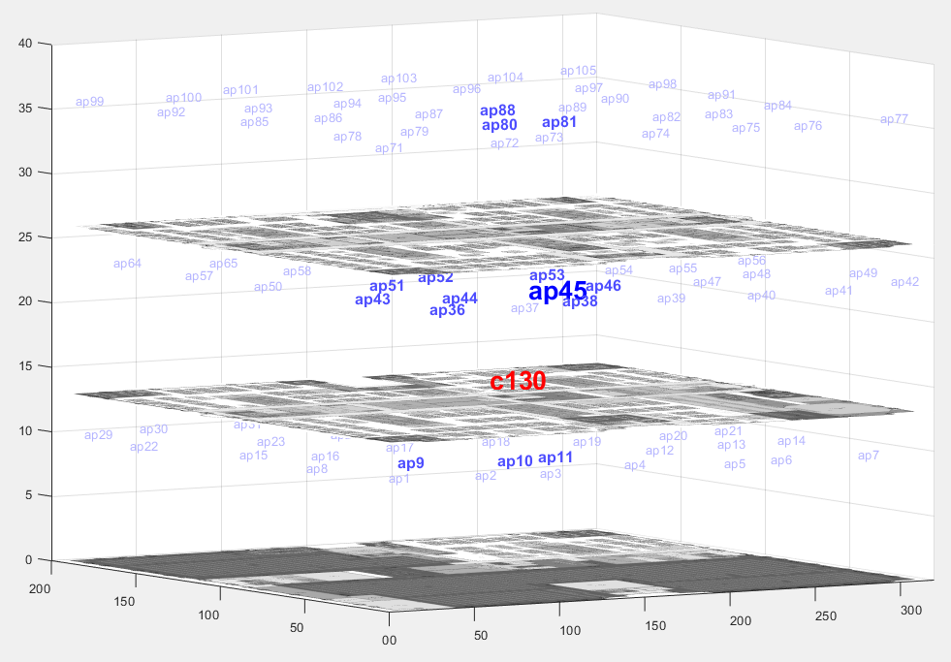
The infrastructure can support only modestly improved roaming times by using an enterprise mechanism …
  802.11r (fast roaming) enables break-before
  make, with no timing guarantees
    Implementation quality can vary (WFA topic)
  Constrained scanning is already used in the
  enterprise to achieve roaming of 5-10 ms …
  … so next-gen 802.11 could mandate:
    Whenever the AP detects that a client has a weak or
    weakening RSSI …
    … the AP requests a Neighbor Report from the client
    … the client responds with a Neighbor Report listing the APs in view
    … and the AP specifies preferred roaming candidates (e.g., adjacent & same floor) by sending a trimmed Neighbor Report to the client
  But we really want to reduce roaming times to 0 msec …

Slide 15
… and mechanisms to improve roaming based on MLO to multiple APs probably are ill advised
  An intriguing approach to faster roaming is a Roaming MLD^{[9]} that:
    Is connected to multiple nearby AP MLDs …
    … and enables the use of any AP link
  However, this is ill-advised because:
    the unavoidable buffers & communication delays within & between the Roaming MLD and AP MLDs means frames can get stuck for 1-2-5-10-20 ms
    implementing reorder buffers at the Roaming
    MLD is challenging in terms of scalability
  Also, there are some L3 challenges

Slide 16
… leaving multiple hot-standby security associations as an attractive middle ground
Hitless (aka Make Before Break) Roaming
  The idea is that a non-AP MLD is associated to and communicating via a serving AP MLD …
  … while also simultaneously maintaining hot-standby associations with other nearby AP MLDs within the same Roaming Domain
    With all security handshakes completed & keys available …
    … and QoS Characteristics and r-TWT requirements distributed
  When one of the nearby AP MLDs is better than the serving AP MLD …
    eg higher RSSI, lower congestion, etc
  ... the serving & nearby AP MLDs
  coordinate a roaming point
  … and the serving AP MLD
  transfers residual frames to the
  nearby AP MLD
  … achieving hitless switching

Slide 17
…with use it or lose it resource reservations
  A roaming non-AP MLD cannot reasonably reserve lots of resources at all nearby AP MLDs that it might roam to at some future time
    Which is why 11r didn’t take this path
  However, the roaming non-AP MLD can reasonably reserve resources at the most promising nearby AP MLD a short time before an expected roam …
    Agreements for BA, TWT, QoS Characteristics, r-TWT etc
  … with an expectation that the nearby AP MLD will auto-cancel the reserved resources if not used within a reasonable period
  … and an understanding that the nearby AP MLD may restrict the acceptance of future resource reservations if they are often auto-cancelled

Slide 18
Other

Slide 19
For users asking for better security, it is time to make enterprise class security available to all by making .1X support mandatory
PSK/Passphrase-based personal security has been problematic …
… PSK/Passphrase based security is inevitably limited …
… so it is now time to make .1X (~WPA3-Enterprise security) support mandatory
Personal security is using a single PSK/passphrase for all STAs in a BSS; SAE PWID adds “un+pw”
We have seen a multitude of attack vectors within a BSS
… which forces network admins to spend too much time fixing PSK/passphrase related security (& associated transition mode) issues
A compromised PSK allows over the air decryption
A compromised SAE passphrase doesn't allow over the air decryption, which is an improvement
… yet, a compromised SAE passphrase still allows access to the wired/physical infrastructure
.1X and thence WPA3-Enterprise is best in class security …
… using a username & password (usually vetted by a AAA server)
It is time to make enterprise class security support mandatory and available to all users…
… still leaving the option of other mechanisms

Slide 20
There are a few features with moderate-to-high priority for enterprise use cases
  Moderate-to-high priority for enterprise
  Improved link adaptation & improved buffer status reporting
    E.g., instead of MAC padding, send mgmt. frames to report RSSI / SINR / MCS headroom / buffer depth by AC/TID / time to live for frames at head of each buffer / statistics / etc
  Reduced CSI feedback
  Time-based MU on DL
    Send AMPDUs to multiple different RAs in the same RU; e.g., generalize the AID
  Secondary channel access
    Without loss of reliability
  Dynamic preamble puncturing & TB punctured PPDU

Slide 21
There are a few features with lower priority for enterprise use cases
  Lower priority for enterprise
  16KQAM
    mmWave with MLO will provide greater & more usable gains
  480 / 640 MHz in 6 GHz
    mmWave with MLO will provide greater & more usable gains
  A-PPDU
    Since 320 MHz is not a commonly-used bandwidth in enterprise use cases
  16 SS in a single AP
    The advent of 6 GHz has reduced the need for higher TX chain counts per band, and having 8 antennas per band still provides plenty of headroom^{[10]}
    16SS in a single link might be a feature more suitable for next-next-gen

Slide 22
Four features are very interesting from an enterprise perspective for the next gen and should be supported by the PAR & CSD
Feature | Commentary
Multi-AP | Increased reliability through better collision avoidance Higher & more predictable MCSs during spatial reuse Lower latency for critical traffic Some Multi-AP technologies seem more feasible than others
mmWave | Given the introduction of MLO, mmWave is now: synergistic with classic 802.11 superior to increasing the MCS or bandwidth of classic 802.11 The enterprise is ready to adopt mmWave when clients do
Hitless roaming | Quasi make-before-break
Enterprise class security | Mandating support for trusted 802.1X based security enables enterprise class security for all users … ... and makes more clients usable in enterprise use cases

Slide 23
Backup

Slide 24
References
  [1] Many presentations at WNG from January 2022 to July 2022 at https://mentor.ieee.org/802.11/documents?is_group=0wng
  [2] Brian Hart (Cisco Systems), “Candidate Technology Review”, https://mentor.ieee.org/802.11/dcn/18/11-18-1549-00-0eht-candidate-technology-review.pptx
  // For higher footnotes, see rest of Backup

Slide 25
[3] Enterprise Use Cases
Enterprise use cases include delivering the missions of:
Central Offices (e.g., headquarters)
Branch Offices (e.g., small office, coffee shop)
Hybrid Work From Home
Service Provider Networks
Managed Networks
Education (K-12, tertiary)
Hospitality (e.g., hotels)
Transit Hubs (e.g., airports)
Retail
Government
Healthcare
Manufacturing
Oil & Gas
Distribution Hubs
Sports and Entertainment
…

Slide 26
[4a] Multi-AP Must Be Optimizable for How it Should be Deployed in Enterprise Use Cases (1/2)
  Multi-AP needs to be designed and optimized given an understanding of how and why 802.11 is deployed in the enterprise, as follows …
    Highest priority is to use all the spectrum in a deployment, in order to maximize the available capacity.
    Then, the channel bandwidth is chosen to maximize capacity/QoE. Real world experience indicates greater capacity/QoE from narrow-ish channels than from the widest channels. E.g., at 5 GHz, the BSS width “popularity” is 40 MHz > 20 MHz ~ 80 MHz >> 160 MHz^{[4c]}. This seems to be due to many factors:
      Legacy clients only operate on a narrower bandwidth
      CSMA/CA has some corner-case issues with networks of overlapping BSSs (hidden/exposed nodes, slot asynch^{[11]}), so minimizing BSS overlap seems to be effective in practice
      With BSSs on narrower channels, there are fewer clients per channel contending and transmitting
      If there is a regular stream of “bad” behavior (e.g., from clients such as a client going to PS mode without advising its AP; or clients not randomly backing off correctly), then minimizing the affected resources reduces the number of clients impacted.
      Beacons, probe request/responses/20MHz-only STAs only operate on 20 MHz, so having a wider BSS wastes spectrum
      Wider bandwidth PPDUs involve some extra overheads – duplicated RTS/CTS, preambles are mostly duplicated, duplicated SIFS, duplicated Ack/BAs etc

Slide 27
[4b] Multi-AP Must Be Optimizable for How it Should be Deployed in Enterprise Use Cases (2/2)
    Triggered access in HE offers some hope for wider channels – but so far there has been too much legacy at 2.4 / 5 GHz. With 6 GHz, that is more of an open question but with supply chain issues etc there have not been enough devices in the field to commit to a new paradigm
    Bottom-line, today the enterprise is comfortable with a freq reuse factor of 6-12 for 5 GHz (and higher in stadia); and likely the same for 6 GHz, and for some time to come. This should be the default model for Multi-AP in 5/6 GHz in the enterprise
    This doesn’t preclude choosing to have a cluster of multiple cochannel APs in a home mesh. All the advanced Multi-AP PHY technologies (JT, CoBF etc) might help here. However, this is not mainstream in the enterprise due to 1).
    Co-channel APs are closer in multi-floor buildings, for all bands
    Despite 1)-4) in 5/6 GHz, Multi-AP remains valuable since there is usually deferral/collisions between cochannel BSSs. Multi-AP can be used to ensure the highest priority traffic across all nearby BSSs gets sent first, collisions are avoided, and reliable coordinated spatial reuse (at an appropriate, usually lower MCS) can occur. CoBF and/or JT can help to increase the MCS during SR

Slide 28
[4c] Channel Usage in Enterprise Use Cases
Some enterprise customers elect to share their WLAN configs with their vendor for help on optimizing / troubleshooting their deployments
To illustrate the relative usage of different channel widths and trends, anonymous 2018^{[2]} and 2022 elective data for 5 GHz is presented:
Year | Selection | 20 MHz | 40 MHz | 80 MHz | 160 MHz
2018 (~1 million 5 GHz radios) | Human Expert | 25% | 64% | 11% | 0.02%
 | Human+Auto Total | 23% | 59% | 17% | 0.02%
2022 (~7 million 5 GHz radios) | Human Expert | 25% | 64% | 11% | 0.1%
 | Human+Auto Total | 15% | 68% | 17% | 0.06%
Over time, we see humans are conservative at 20/40/80 MHz while automated channel selection tends to move some 20 MHz usage to 40 MHz. Human selection has caused 160 MHz usage to increase rapidly (but it remains low in absolute terms). 80 MHz usage is holding steady but is now in second place.

Slide 29
[5] mmWave Range is Commensurate with MCS13 in classic 802.11
  MCS9/11/13 are increasing short range technologies
  In fact, given 15dB conducted, reasonable 6&0dBi beamforming gains, 6.5GHz, [160 320] MHz, LOS, 8dBNF, MCS13~40dB SNR, range is [6.4 4.5] meters [Notes3b]
  Accordingly, AP densities have steadily evolved from one AP / 10000ft² to 5000ft² to 2500ft² to 1500ft², and we even have deployments in the 1000-800ft² ballpark. Assuming hex BSAs and a 7ft vantage, all clients are within [19 14 10 8 6.9 5.7]m of an AP, respectively. [Notes1]
  Although mmWave has a 5 dB worse link budget than 6.5 GHz for the same data rate without beamforming, almost any beamforming at 65 GHz turns this around and we even see mmWave reaching up to a 13 dB better link budget.
  Comparing the same data rate and typical 12&6dB beamforming gains, at 65 GHz, for [320 640]MHz and MCS7~22dB SNR, then the range is better at [14.3 10.2] meters [Notes3a].
Parameter | 6.5 GHz |  | 65 GHz
Pathloss (dB) | 0 dB |  | -20 dB
MCS | 13 (4KQ5/6) |  | 7 (64Q5/6)
Delta-SNR | 0 dB |  | 18 dB
Bandwidth | 160 / 320 MHz |  | 320 / 640 MHz
Delta-SNR | 0 dB |  | -3 dB
Interim Total (same data rate) | 0 dB |  | -5dB
Antenna elements used for UL BFing at AP / non-AP | Typ 4 / 1 | Max 8 / 1 | Typ 16 / 4 | Max 64 / 8
UL Beamforming Gain relative to 6.5 GHz | 6+0-6 dB | 9+0-9 dB | 12+6-6 dB | 18+9-9 dB
Max Total (same data rate) | 0 dB | 0 dB | +7 dB | +13 dB
Without beamforming the 65 GHz link budget is 5dB worse than the 6.5 GHz link budget. With max beamforming, the 65 GHz link budget is 13dB better than the 6.5 GHz link budget
Notes:
[Notes1] maxRangeFactorHex = 1.5*sqrt(3); rangeMaxFt = sqrt(sqrt([10000 5000 2500 1500 1200 800]/maxRangeFactorHex).^2 + 7.^2), rangeMaxMeter = rangeMaxFt *12*0.0254
[Notes2] General link budget is:
TXP + Gtx – 20*log10(4*pi*distanceMeters* fcHz/cMetersPerSec) + Grx = 10*log10(k*tempK*bandwidthHz) + NF + SNR
[Notes2a] A mmWave link budget for MCS7~22dB with max reasonable beamforming gain of [18 9]dB and [320 640]MHz is:
15dBm + 18 - 20*log10(4*pi*distanceMeters * 65e9/3e8) + 9 = -173.9 dBm + 10*log10([320e6 640e6]) + 8 + 22 // 20degC
distanceMeters = 3e8/(4*pi*65e9) * 10.^((-173.9+[85.05 88.06]+8+22-15-18-9)/-20) = [40.5 28.6] meters
[Notes2b]
By comparison, a classic Wi-Fi link budget with max reasonable beamforming of [9 0]dB and MCS13~40dB and [160 320]MHz is:
distanceMeters = 3e8/(4*pi*6.5e9) * 10.^((-173.9+[82.04 85.05]+8+40-15-9-0)/-20) = [9.1 6.4] meters
[Notes3a] A mmWave link budget for MCS7~22dB with moderate beamforming gain of [12 6]dB and [320 640]MHz is:
distanceMeters = 3e8/(4*pi*65e9) * 10.^((-173.9+[85.05 88.06]+8+22-15-12-6)/-20) = [14.3 10.2] meters
[Notes3b]
By comparison, a classic Wi-Fi link budget with moderate beamforming of [6 0]dB and MCS13~40dB and [160 320]MHz is:
distanceMeters = 3e8/(4*pi*6.5e9) * 10.^((-173.9+[82.04 85.05]+8+40-15-6-0)/-20) = [6.4 4.5] meters

Slide 30
[6] Multi-AP and mmWave are Sufficiently Novel that Functional Requirements and Evaluation Methodology needed
  For validating Multi-AP techniques and mmWave against realistic scenarios, we recommend that UHR SG/TG develops something akin to the past “Functional Requirements and Evaluation Methodology” to reflect:
    Typical (and Multi-AP-optimized) enterprise AP channel selection policies
    Typical (and Multi-AP-optimized / mmWave-optimized) enterprise AP densities
    Comparable 2.4/5/6/mmWave propagation

Slide 31
[7] Para-Determinism / SLA is Hard
  1 msec or 0.1 msec latency needs to be achieved 99 or 99.99 or 99.9999% of the time
    Call this para-determinism or a Service Level Agreement (SLA)
  Para-determinism is hard; need to consider and solve:
Name | Problem | Mitigation
Primary Users of Spectrum | Can force a BSS off the channel it was occupying (e.g., DFS, AFC) | Seamless, well-tested channel switching
Non-Wi-Fi Interference | Can share badly (e.g., point-to-point TDMA, LAA/LTE-U/NR-U) | Physical controls where possible and respected. Manual frequency coordination where possible. Interference classification & hitless, well-tested channel switching.
Unmanaged OBSS | Can start a 10msec TXOP at AIFS~PIFS (e.g., neighboring tenants in the same building, mobile hotspots, etc., ) | Physical controls where possible and respected. Manual frequency coordination where possible. Hitless channel switching.
Managed OBSS | Can start a TXOP just before critical traffic was scheduled | Radio Resource Management and/or Multi-AP orthogonalizes resources across BSSs.
Legacy associated clients | Can start a TXOP just before critical traffic was scheduled (e.g., incapable of Triggered Access, r-TWT, etc) | AP has no SLAs on some radios and actively manages clients on radios offering SLAs. BSS Membership Selector.
Low capability or disinterested UHR associated clients | Can start a TXOP just before critical traffic was scheduled (might evade Triggered Access via UL MU Disable and/or not respect r-TWT service periods) | AP has no SLAs on some radios and actively manages clients on radios offering SLAs.

Slide 32
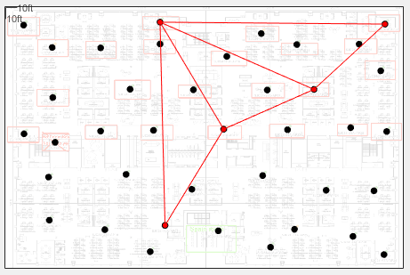
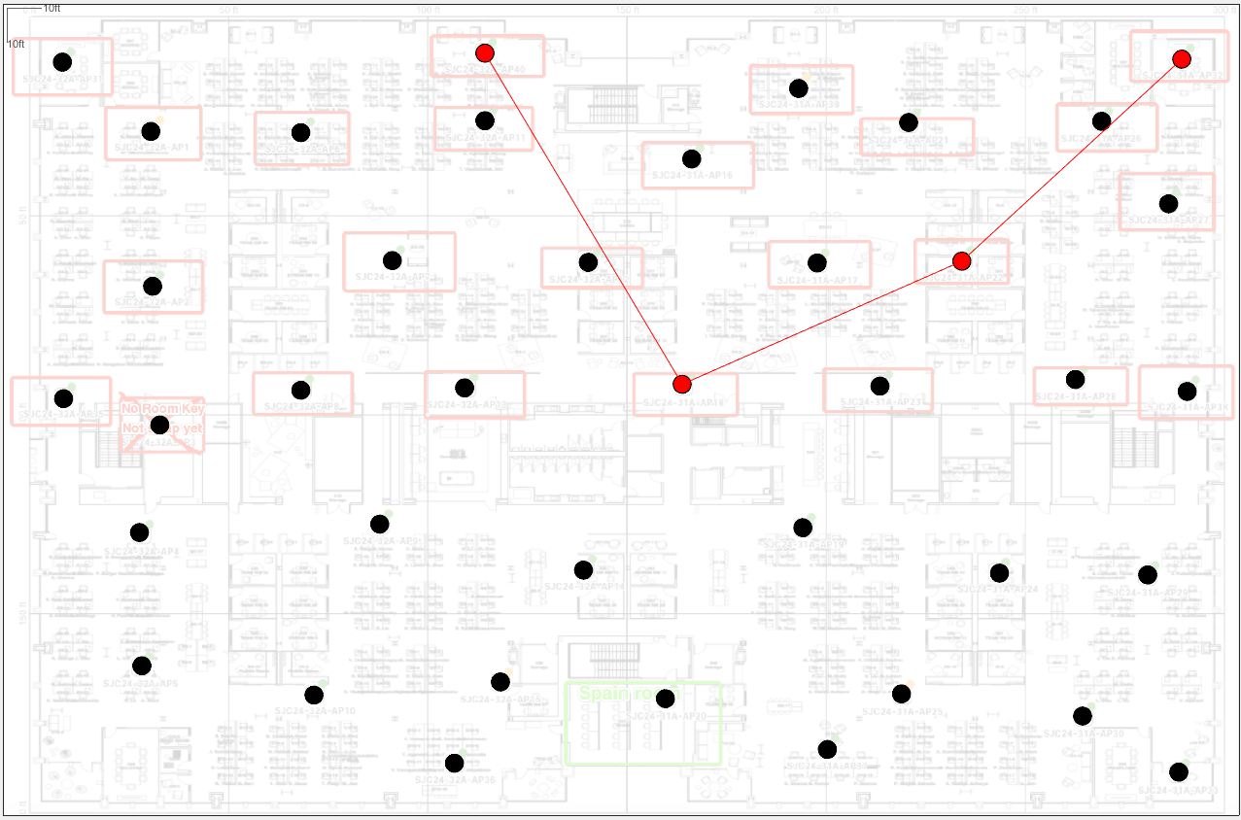
[8] A single leader model for Multi-AP is usually insufficient: connectivity is routinely 3 hops or more
On these floors, APs are routinely up to two hops from a central AP
Largest islands of co-channel APs within range of each other
40MHz, 20 dBm: 5 APs
(with a possible 1-hop leader)
80MHz, 20 dBm: 7 APs
(no 1-hop leader)
80 MHz, 5dBm: 4 APs
(no 1-hop leader)
Environment | AP Count | Square feet per AP
Open-plan corporate office with sporadic drywall meeting rooms and two internal concrete walls (with multiple breaks) in the middle left-to-right on these images) | 39 | 1540

Slide 33
[9a] Restatement of why adding Roaming MLDs to the architecture adds extra delays
  Bolded items can add latency versus a legacy AP MLD
    TX: Need to retrieve the frame and reforward (as shown, 3x network hops versus legacy)
    RX: if there are asymmetric path delays through the network, all frames tend to get delayed by the longest path delay
  Colored boxes represent typical box boundaries
  The Non-AP Roaming MLD and non-AP MLD sublayers collapse together in the non-AP STA “device”
AP Roaming MLD
TX: buffer, and send on one (or more) links; if the first try fails or retries persistently fail, retry on another AP MLD
RX: merge frames in reorder buffer and release de-duped & ordered frames
AP MLD
AP MLD
AP
AP
AP
AP
Non-AP
Non-AP
Non-AP
Non-AP
Non-AP MLD
Non-AP MLD
Non-AP Roaming MLD
TX
RX

Slide 34
[9b] … and the delays are worsened in a flattened architecture
  Bolded items are worse: as shown, now 5x network hops compared to legacy
AP Roaming MLD
TX: buffer, and send on one (or more) links; if the first try fails or retries persistently fail, retry on another link
RX: merge frames in reorder buffer and release de-duped & ordered frames
AP
AP
AP
AP
Non-AP
Non-AP
Non-AP
Non-AP
Non-AP Roaming MLD
TX
RX

Slide 35
[9c] … Meanwhile, AP Add/Delete also introduces extra delays
  Extra delay due to the UL traffic being tunneled to a single reordering buffer on a different AP MLD “box”
Switch
Switch
Switch
AP
MLD1
AP MLD2
AP MLD1
AP MLD2
AP MLD3
  Client moves to right;
  AP Add for AP MLD2’s link(s)
Reorder buffer
  Client moves more to right;
  AP Add for AP MLD3 & AP delete for AP MLD1
Reorder buffer
AP MLD1
AP
AP
AP
AP
AP
Non-AP
Non-AP
Non-AP
Non-AP
Non-AP
Non-AP MLD
Non-AP MLD
Non-AP MLD
  The reorder buffer (shown above) does not have to be pinned at AP MLD1 permanently
  Given coordination between all AP MLDs, an ApMld2ApMld reorder buffer transfer from AP MLD1 to (for instance) AP MLD2 can be performed

Slide 36
[10] Evolution of TX chain counts in an “AP box”
Amendment | Common enterprise TX chain counts (Total = 2.4+5+6 GHz)
802.11 | 1 = 1+0+0
802.11a/b/g | 2 = 1+1+0
802.11n | 4 = 2+2+0
802.11ac | 8 = 4+4+0
802.11ax | 12 = 4+8+0 or 4+4+4
802.11be | Likely less than 24 = 8+8+8
Next-gen | Likely less than 24 = 8+8+8

Slide 37
[11] Loss of Slot Synchronization in OBSS
  Fixing this perfectly requires PPDU TXTIME (T) + aSIFSTime to be a multiple of aSlotTime (should be considered for next-gen mmWave). As a workaround, CCA should be active for as much of each slot as possible.

