Slide 1
Coexistence of Narrowband Frequency Hopping (NB FH) systems and Wi-Fi
Date: 2022-09-13
Authors:

Slide 2
Recap
Document 11-22/998r0, ”Clear Channel Assessment (CCA) behavior of commercial Wi-Fi equipment”
  Presented in the July 2022 Meeting’s WNG session
  Analyze how commercial Wi-Fi products react to NB FH signals present in the same frequency channel
Methodology
  A 2 MHz band limited additive gaussian noise (BLAGN) signal is produced in baseband
  BLAGN signal transmitted into Wi-Fi channel
  Varying dwell times and duty cycles, emulating hopping in and out of the specified Wi-Fi channel

Slide 3
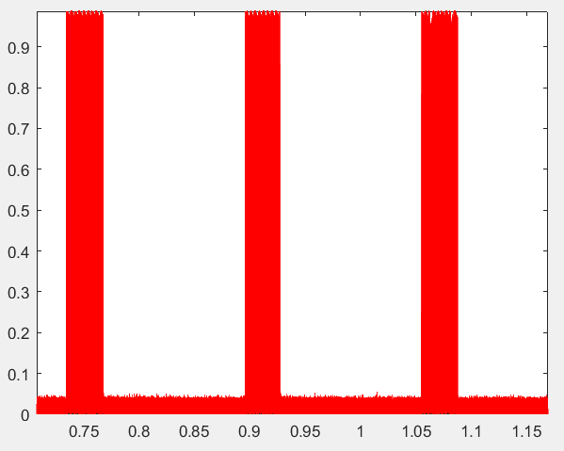
NB FH Signals in Time Domain
20 % Duty Cycle, 60 ms Dwell time NB FH Signal
Dwell Time
  Duration that signal is active
T
  Periodicity of the signal
Duty Cycle
  Ratio of dwell time to period
Dwell Time
Normalized absolute magnitude
T
Time (s)

Slide 4
Changes with respect to 11-22/998r0
20 % Duty Cycle, 60 ms Dwell time NB FH Signal
Very valuable feedback at IEEE 802.11 July meeting
  Highly appreciated, enormously helpful comments–thanks to all meeting participants!
  Resulted in improved measurement setup
  Fixed issue in dwell time duration calculation
Repeated all measurements with corrected signal generator
Dwell Time
Normalized absolute magnitude
T
Time (s)

Slide 5
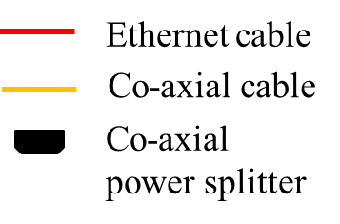
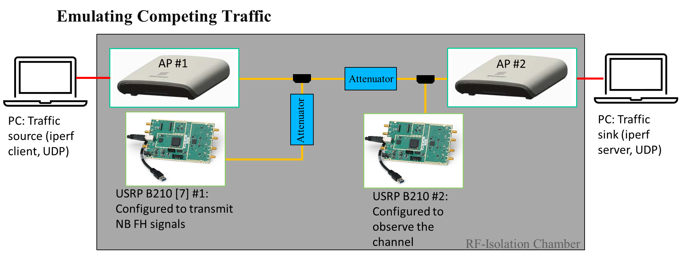
Test Setup (Diagram)
Signal strength reference point
If not stated otherwise, Wi-Fi signal strength is at 6 dB above NB FH signal strength (-49, -55 dBm respectively)

Slide 6
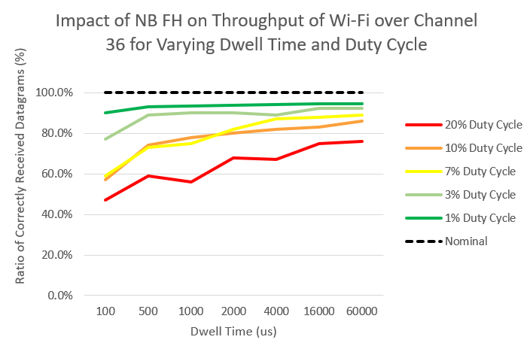
Impact of Duty Cycle & Dwell Time
Increased duty cycle results in decreased Wi-Fi throughput
Increased dwell time results in increased Wi-Fi throughput
  Across all duty cycles, short dwell time has largest impact on Wi-Fi throughput
  Less impact on Wi-Fi throughput at longer dwell times for each duty cycle tested
Worst case throughput less than 50 % of maximum Wi-Fi throughput

Slide 7
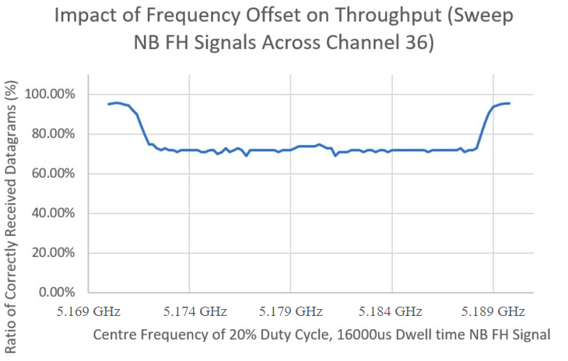
Impact of Frequency Offset
Swept NB FH signal Centre Frequency across Wi-Fi channel 36 at 200 kHz increments
The effect of NB FH signals on Wi-Fi throughput at frequency offsets less than ±7.6 MHz is approximately uniform
NB FH signals at frequency offsets greater than ±7.6 MHz have a reduced impact on Wi-Fi throughput
5.17 GHz
5.19 GHz
Wi-Fi Channel 36 (CF = 5.18 GHz, BW = 20 MHz)

Slide 8
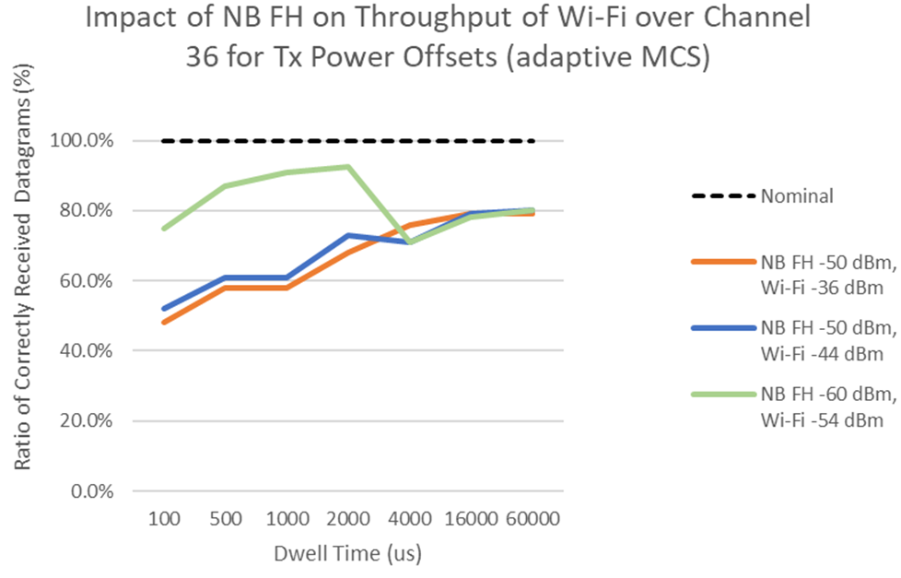
Impact of Relative Power
Three Test Cases:
1. NB FH = −50 dBm, Wi-Fi = −36 dBm
2. NB FH = −50 dBm, Wi-Fi = −44 dBm
3. NB FH = −60 dBm, Wi-Fi = −54 dBm
Lower absolute power NB FH signals have less impact on Wi-Fi throughput
Increasing power of Wi-Fi relative to NB FH does not significantly reduce the impact on Wi-Fi throughput.

Slide 9
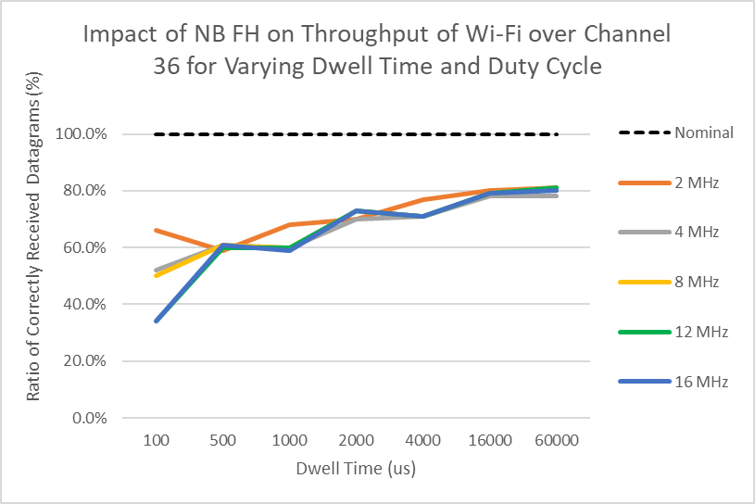
Impact of NB FH Signal Bandwidth
Changing Bandwidth of the NB FH signals (MHz):
2, 4, 8, 12, 16
Results Show:
Similar Wi-Fi throughput for each bandwidth NB FH signal
Except:
100 µs dwell time – Throughput decreases as bandwidth increases

Slide 10
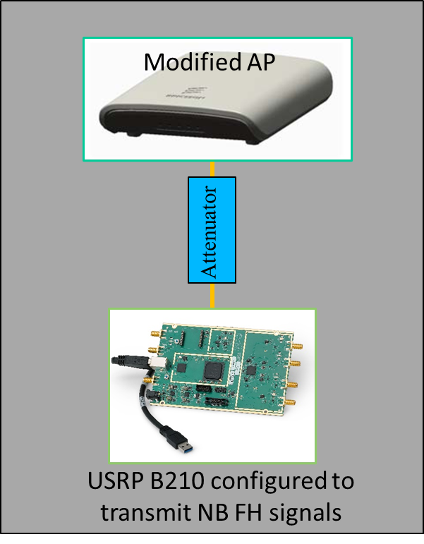
Observing CCA Mechanism’s Internal States
Modified access point
Capable of logging the internal state of CCA mechanism
Records duration that AP deems channel to be occupied
No Wi-Fi traffic (generation of beacons and all other management traffic disabled)
Pure passive monitoring
Compare
Known transmission duration
with
Channel occupation duration as determined by Wi-Fi CCA mechanism

Slide 11
Results: Detection Ratio
Duty Cycle 20 %, Dwell Time 16 ms
The Wi-Fi device can detect higher bandwidth signals more accurately than lower bandwidth signals
Bandwidth | EDT Occ. | Detection Ratio
2 MHz | 9.3 % | 46.9 %
4 MHz | 11.7 % | 58.3 %
5 MHz | 13.3 % | 66.4 %
6 MHz | 14.6 % | 73.2 %
8 MHz | 15.2 % | 76.2 %
12 MHz | 17.6 % | 87.8 %
16 MHz | 19.1 % | 95.3 %
20 MHz | 19.8 % | 99.2 %

Slide 12
Conclusions
After the Montreal meeting and presentation:
  Discussion from interested individuals led to review of experiment methodology and revealed issues which required addressing
  The issues were addressed, fixed, and subsequent re-experimentation took place.
Examined parameters impact on Wi-Fi throughput:
  Duty cycle shown to have clear impact
  Shorter dwell time demonstrated to have higher impact than longer – reducing the period of the NB FH signal
  Frequency offset has been observed to have a uniform impact over the portion of the channel where Wi-Fi is active
  Bandwidth has not been observed to independently impact Wi-Fi throughput

