Slide 1
C-OFDMA throughput analysis in various mesh backhaul scenarios
Date: 9/9/2022
Authors:

Slide 2
Abstract
We consider C-OFDMA added to (in-home) “mesh” network
We consider several backhaul scenarios
We evaluate possible throughput enhancement

Slide 3
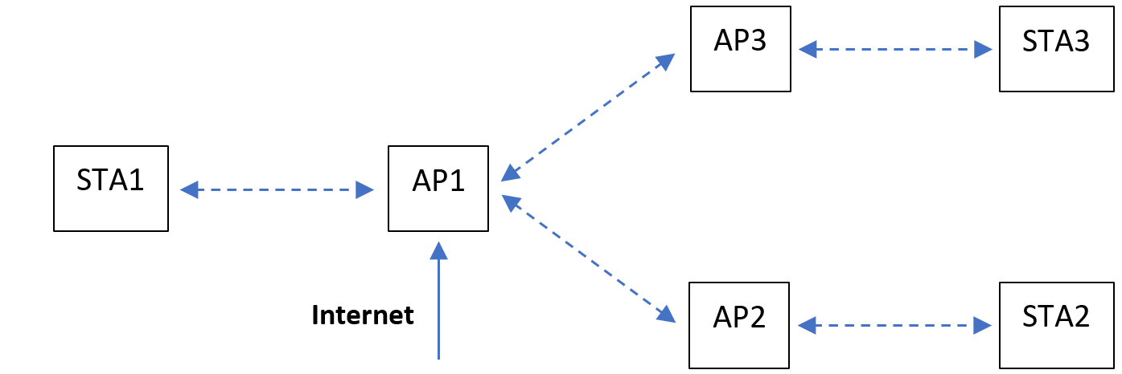
Introduction
Many residential deployments already use “mesh” topology
One “Main” AP connected to internet
Secondary AP(s) serve subset of STAs and forward traffic from the main AP
Goal of mesh topology is to extend range of data delivery
We consider addition of C-OFDMA to this scenario as a possible incremental improvement to overall throughput
“natural” evolution of mesh deployments
SR, nulling, … more appropriate for OBSS scenarios instead
We evaluate aggregate throughput of C-OFDMA vs. SU-only transmissions

Slide 4
Definitions
C-OFDMA
Form of Multi-AP coordination
One AP (“Sharing AP”) initiates channel access and inquires about requested resources from other APs (“Shared APs”)
Based on feedbacks from Shared APs, the Sharing AP allocates final resources among all participating APs
Allocations are in the frequency domain
All participating APs send concurrently occupying their allocated resources
Backhaul
Traffic from Sharing AP to Shared APs intended for connected STA(s)
Fronthaul
Traffic between an AP and its connected STA(s)

Slide 5
Why evaluate C-OFDMA throughput improvement?
OFDMA is not typically associated with throughput improvements in high-traffic scenarios
Resources are shared between multiple users, no new resources created
Only when MAC overhead dominates data (e.g., preponderance of short packets), some performance benefit is seen
Latency improvements may be of more interest
C-OFDMA has some inherent benefits relative to OFDMA that make throughput evaluation worthwhile:
Airtime benefit: Less contention/collisions compared to SU with hops
Single AP effectively controls all network access
Power benefit: Several APs can transmit simultaneously at full power
Higher MCS possible when using part of the band (i.e. when doing OFDMA)

Slide 6
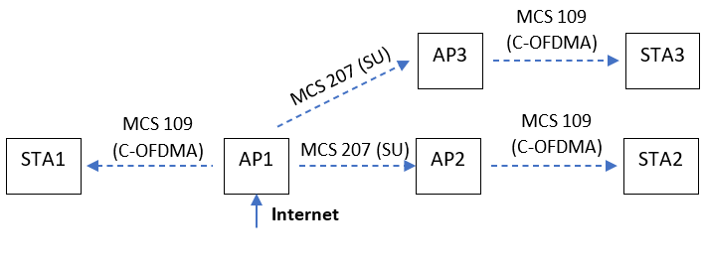
Simulation Scenarios
Single AP serves whole network
Two remote devices
Mesh topology - SU only
Two secondary mesh APs
SU for backhaul and AP-STA links
All transmissions on the same channel
Mesh topology with C-OFDMA
Higher MCS due to power gain
SU for Backhaul
Whenever possible, C-OFDMA for fronthaul links
AP1 initiates C-OFDMA
All transmissions on the same channel

Slide 7
Evaluation Methodology
Target: Maximize aggregate network throughput
Which configuration provides highest aggregate throughput?
As measured between traffic endpoints, i.e., excluding any backhaul traffic
Typical Methodology:
Full buffer scenario: pump high data rate to each of the STAs
Excess packets are dropped from Tx buffer
Aggregate performance determined by network conditions
This methodology does not work for C-OFDMA
Excess packets are delivered over the backhaul from the Sharing AP to the Shared APs and are only dropped from the Tx buffer of the Sharing AP
Airtime is spent transmitting backhaul packets that will not be sent from Sharing AP to its STA
This creates Backhaul inefficiency

Slide 8
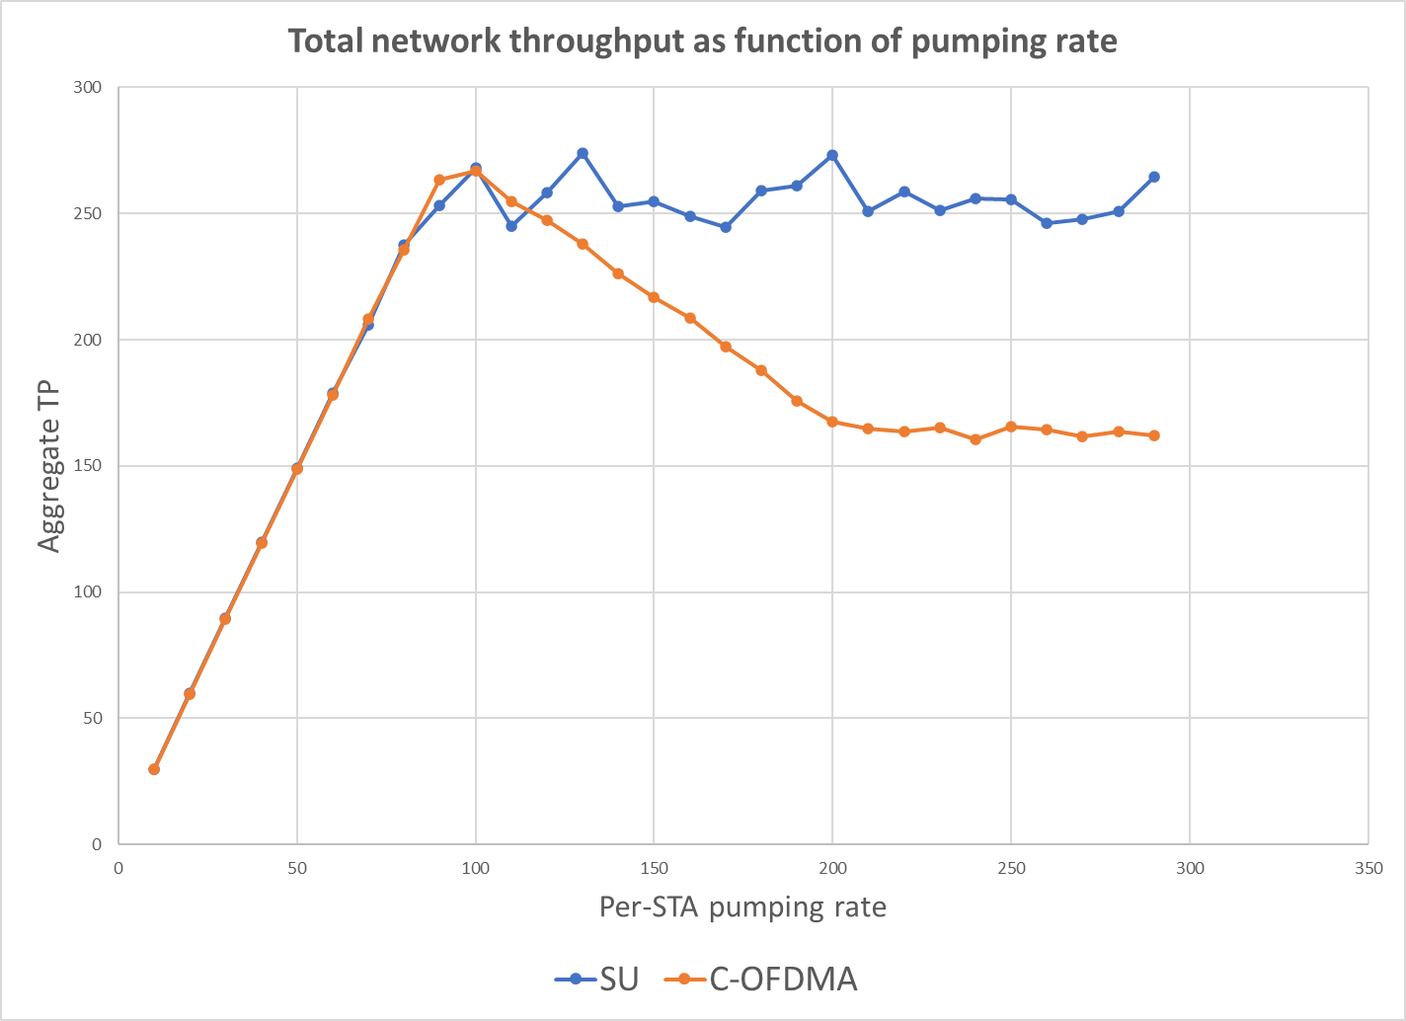
Backhaul inefficiency in C-OFDMA illustrated
SU operation independent of traffic rates
Backhaul delivers amount of traffic that matches AP-STA link capacity
Backhaul delivers more traffic than can be handled by the Sharing AP-STA link. “Wasted” airtime reduces overall network performance.
Non-full buffer scenario: all traffic delivered. No throughput difference between SU and C-OFDMA
Backhaul airtime usage maxes out. Further increases in data rate do not cause further reduction in airtime availability.

Slide 9
Backhaul inefficiency in C-OFDMA
Happens when Fronthaul and Backhaul share the same channel
Allows for simpler devices
Will evaluate alternative scenarios later
Hard to match backhaul transmissions to AP-STA link capacities without inefficiency
Either backhaul too high, leading to backhaul transmission of packets that will ultimately be dropped at the Sharing AP
Or backhaul traffic may be too low to fully utilize capacity of the Shared AP-STA link
Not just a testing/simulation issue:
If Shared AP-STA link is oversubscribed, it will impact overall network capacity because of excess airtime used by the backhaul
“excess” = backhaul delivers more data than final link can support

Slide 10
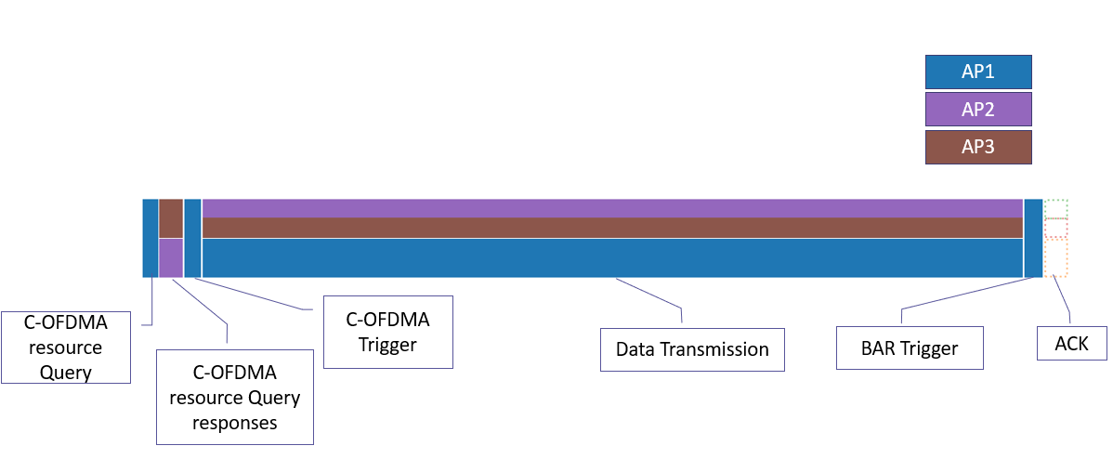
Simulation assumptions
To avoid the backhaul inefficiency in C-OFDMA, traffic rates for C-OFDMA scenario are gradually increased to find the optimum
Backhaul runs independently: no synchronization with C-OFDMA, always uses SU
Padding in C-OFDMA frames is minimized
Basic C-OFDMA protocol elements are accounted for

Slide 11
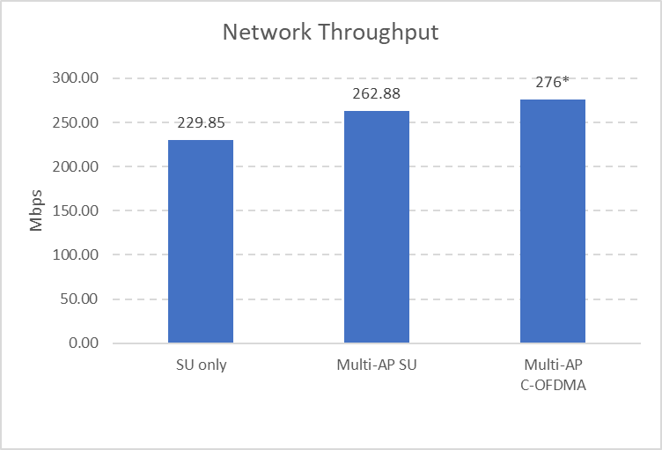
Simulation Results (3 AP scenario)
Minor performance improvement from C-OFDMA
Requires fine tuning of backhaul
C-OFDMA gains from:
Collision avoidance
Higher MCS
C-OFDMA overhead:
Additional protocol
Possible backhaul inefficiency

Slide 12
Alternative backhaul scenarios
Key issue in previous simulations is the Wireless Backhaul sharing the same medium as fronthaul data, which leads to inefficiencies
Alternatives include:
Off-channel wireless backhaul
“hides” the backhaul inefficiency issue
Increase in needed wireless resources
Wired backhaul
Especially in in-home deployment scenarios, a wired alternative may be available
Does not impact wireless spectrum availability
Packet forwarding can be done at higher layers

Slide 13
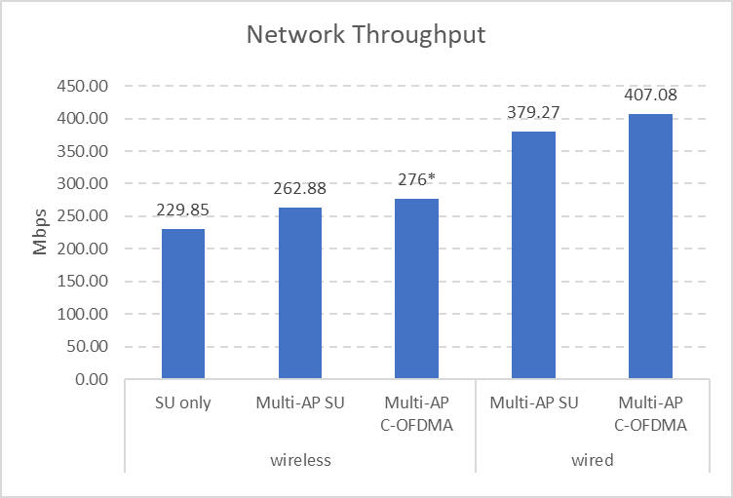
Simulation Results (3 AP scenario)
Throughput significantly higher for both SU and C-OFDMA
In-channel Wireless backhaul represents significant part of overall airtime consumption
Inefficiency avoided
Or rather, “hidden” off-channel
Some gain between SU and C-OFDMA

Slide 14
Conclusions
We have evaluated possible performance improvement of C-OFDMA over SU in an in-home scenario
Use of wireless backhaul in C-OFDMA on the same channel leads to several inefficiencies
Less airtime available to data
Inefficiency in matching backhaul to actual data requirement when using C-OFDMA
Wired backhaul or off-channel wireless backhaul eliminates both types of inefficiency in-channel
Extra resources are used off-channel
Backhaul inefficiency (backhaul/fronthaul mismatch) may still exist off-channel

Slide 15
Conclusions
C-OFMDA does provide some (minor) throughput gain over SU-only
Most gain from moving the backhaul off-channel
Latency remains to be evaluated
Backhaul and fronthaul need to be matched to avoid resource inefficiency
Multi-AP specification should be compatible with both wireless and wired backhaul scenarios
Coordinated operation can accommodate this easily
Joint operation may require explicit format definition

Slide 16
Back-up slides

Slide 17
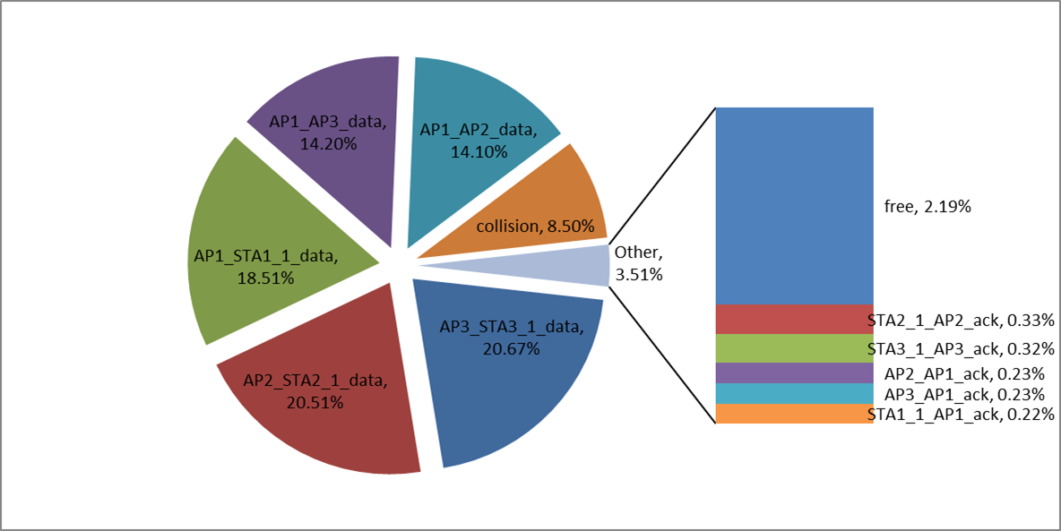
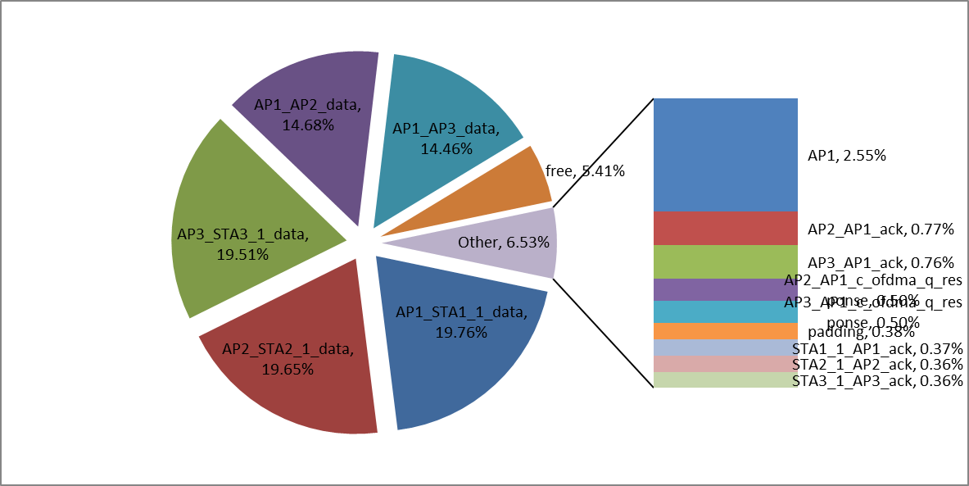
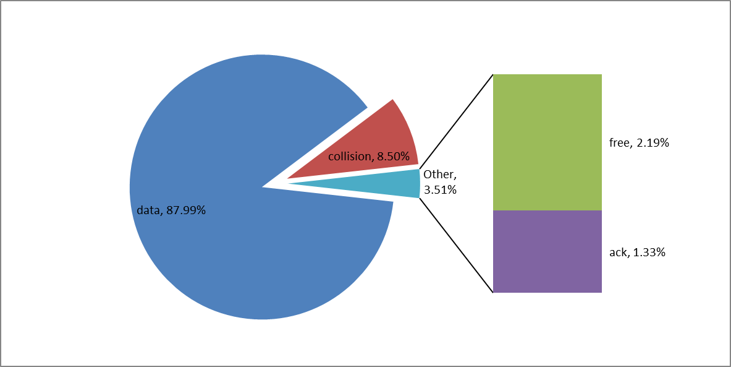
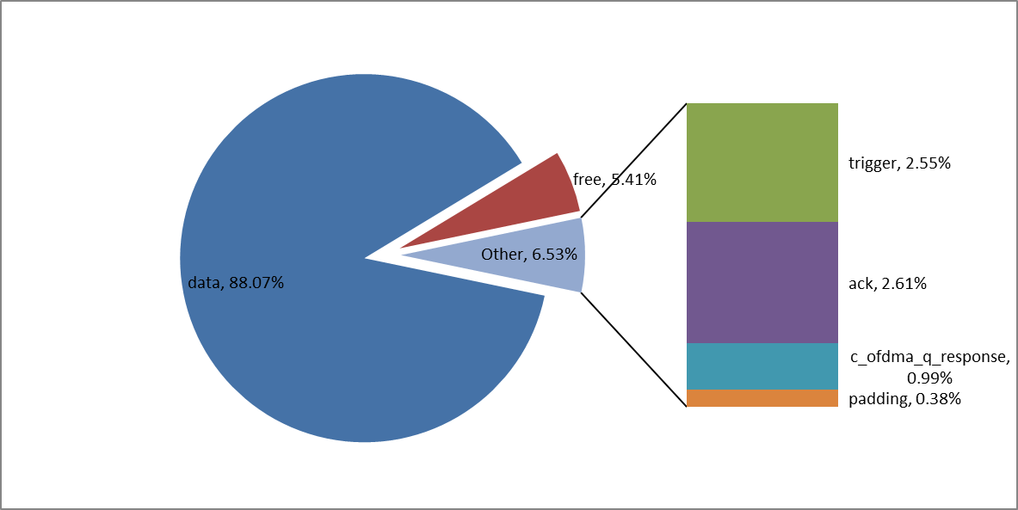
Airtime Usage Multi-AP without C-OFDMA
Airtime Usage Multi-AP with C-OFDMA (optimal backhaul)

Slide 18
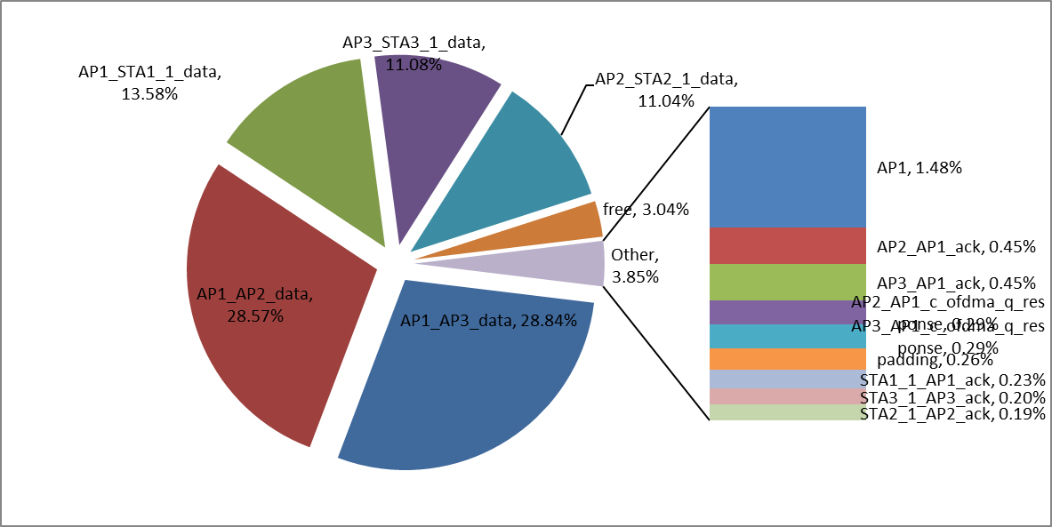
Backhaul
Backhaul
Airtime Usage Multi-AP with C-OFDMA (inefficient backhaul)
Airtime Usage Multi-AP with C-OFDMA (optimal backhaul)

