Slide 1
Further discussion on feasibility of supporting AMP IoT devices in WLAN
September 2022
Doc.: IEEE 802.11-22/1561r0
Date: 2022-09-08
Authors:
Name | Affiliation | Address | Phone | Email
Chuanfeng He | OPPO
Shengjiang Cui
Weijie Xu |  |  |  | xuweijie@oppo.com
Xiaoqing Tang | HuBei University |  |  | Tangxq@Hubu.edu.cn
Heng Pan | Finsiot |  |  | pan.heng@finsiot.com

Slide 2
Outline
September 2022
Doc.: IEEE 802.11-22/1561r0
Link budget at 2.4GHz for AMP IoT device
Carrier for backscattering
Prototype presentation
Summary
Reference

Slide 3
Link budget at 2.4GHz for AMP IoT device (1)
September 2022
Doc.: IEEE 802.11-22/1561r0
Link budget for AMP-only IoT device with backscatter transmitter. Three cases are evaluated: case1/2 (energy harvested from radio waves) and case 3 (energy harvested from light). Please note that the link budget for sub 1GHz has already been analyzed in [11], please see appendix for details.
 | Case1 | Case2 | Case3
Frequency (GHz) | 2.4 | 2.4 | 2.4
EIRP of AP (dBm) | 27 | 27 | 27
Receiver sensitivity of AP (dBm) | -95 (Note 1) | -95 | -95
Antenna gain of IoT device (dBi) | 2 | 2 | 2
Minimum receiving power for IoT device (dBm) | -20 (Note 2) | -30 (Note 2) | -45 (Note 3)
Maximum communication distance from AP to IoT device (m) | 2.8 | 8.87 | 49.85
Backscattering loss at IoT device (dB) | 5 | 5 | 5
Low Noise Amplifier factor (dB) | 0 | 0 | 30 (Note4)
Maximum communication distance from IoT device to AP (m) | 39.60 | 12.52 | 70.42
*Notes: Reuse the receiver sensitivity of 802.11 ah AP The minimum required signal power for an IoT device is -20dBm when the IoT device can’t store power itself. It can be -30dBm when the IoT device has the capability of power storage. -45 dBm is assumed as the sensitivity of ultra-low power receiver [1][2][3]. LNA with 30 dBm gain is assumed to boost the backscattering signal, it can have ultra-low power consumption [4][5].

Slide 4
Link budget at 2.4GHz for AMP IoT device (2)
September 2022
Doc.: IEEE 802.11-22/1561r0
Link budget for AMP-only IoT device with active transmitter
 | Case4
Frequency (GHz) | 2.4
EIRP of AP (dBm) | 27
Receiver sensitivity of AP (dBm) | -95
Antenna gain of IoT device (dBi) | 2
Minimum receiving power for IoT device (dBm) | -45
Maximum communication distance from AP to IoT device (m) | 49.85
Maximum transmission power of IoT device (dBm) | -15(Note 1)
Maximum communication distance from IoT device to AP (m) | 99.47
*Notes: Ultra-low power active transmitter is assumed[6][7][8].

Slide 5
Link budget at 2.4GHz for AMP IoT device (3)
September 2022
Doc.: IEEE 802.11-22/1561r0
Observations:
  With RF power harvesting, the communication distance of AMP-only IoT device is limited ( i.e., restricted by the DL distance of RF power transfer in case 1/2 ) if the device has no power storage.
  However, it still can achieve a medium coverage (e.g., up to 50 meters) if other power source(e.g., solar, heat etc.) can be utilized for AMP-only IoT devices and/or if the device has an active transmitter.

Slide 6
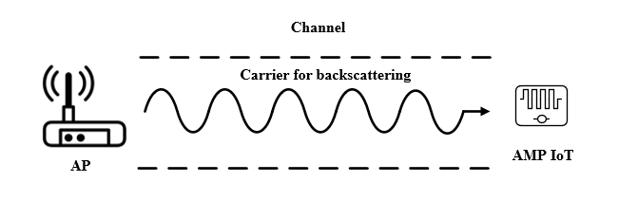
Carrier for backscattering (1)
September 2022
Doc.: IEEE 802.11-22/1561r0
  Backscattering would be a promising technique to achieve ultra-low power consumption and ultra-low complexity[9]. In typical system using backscattering, Continuous Wave, e.g., sine wave, is used as the carrier for backscattering.
  For AMP IoT, the carrier signal can be provided by a AP. If backscattering is introduced in WLAN, the following needs to be considered:
    The carrier shall be able to provide sufficient RF power to drive the IoT devices
      The higher the power, the longer the communication distance
    There is PSD restricted by regulation, e.g. 10 dBm/MHz or 17dBm(with high gain antenna in CN) at 2.4GHz.
    The maximum transmission power of WiFi devices, e.g. 20dBm or 27dBm
    Backward compatibility shall be maintaining as much as possible considering the impact of specification and implementation

Slide 7
Carrier for backscattering (2)
September 2022
Doc.: IEEE 802.11-22/1561r0
  There may be two potential carrier signals for AMP IoT devices.
    Signal carrier with narrower bandwidth
    Signal carrier spanning a wider bandwidth
  It seems that signal carrier spanning a wider bandwidth is more appropriate to serve as the carrier signal for backscattering.
    Produce high RF power with wider transmission bandwidth
    Try to reuse legacy wider bandwidth transmitter
    Improve the RF energy transfer (i.e., the diversity gain) and energy harvesting efficiency[10].
    Figure 1 Signal carrier spanning a wider bandwidth

Slide 8
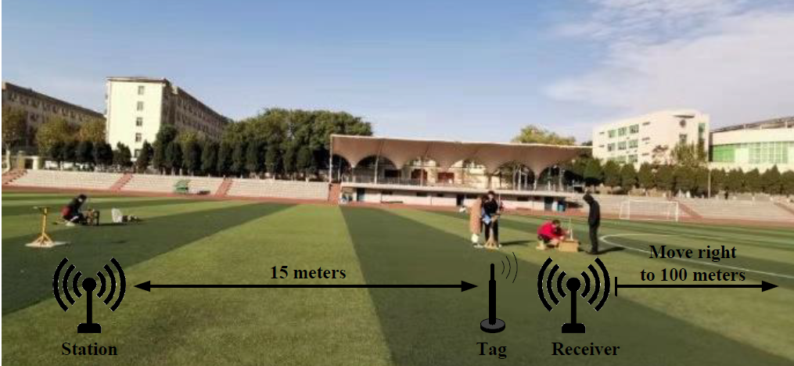
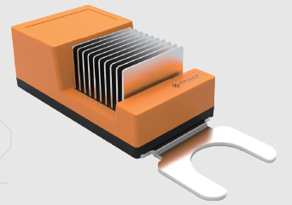
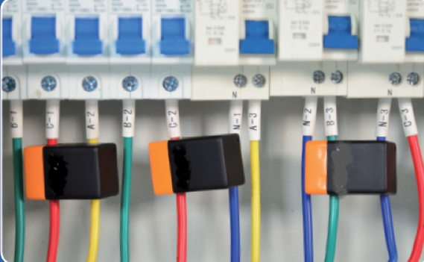
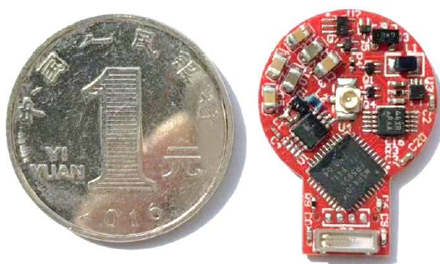
AMP IoT Prototype Presentation
September 2022
Doc.: IEEE 802.11-22/1561r0
  In order to verify the feasibility of AMP IoT, several prototypes are collected to show the potential communication techniques, the applicable ambient powers and the achieved performance.
    Prototype using RF power and backscattering
    (Figure 2)
    Prototype using thermal energy (Figure 3)
    Prototype using induced current (Figure 4)
    Figure 3 Figure 4
  The details of the prototype will be present in next meeting.
Figure 2

Slide 9
Summary
September 2022
Doc.: IEEE 802.11-22/1561r0
  This presentation discusses the feasibility of supporting AMP IoT devices in WLAN, focusing on the following aspects
  Link budget at 2.4GHz for AMP IoT device
  Carrier for backscattering
  Prototype presentation

Slide 10
Reference
September 2022
Doc.: IEEE 802.11-22/1561r0
  J. Im, H. -S. Kim and D. D. Wentzloff, "A 470µW −92.5dBm OOK/FSK Receiver for IEEE 802.11 WiFi LP-WUR," ESSCIRC 2018 - IEEE 44th European Solid State Circuits Conference (ESSCIRC), 2018, pp. 302-305, doi: 10.1109/ESSCIRC.2018.8494331.
  J. Im, H. Kim and D. D. Wentzloff, "A 217µW −82dBm IEEE 802.11 Wi-Fi LP-WUR using a 3rd- Harmonic Passive Mixer," 2018 IEEE Radio Frequency Integrated Circuits Symposium (RFIC), 2018, pp. 172-175, doi: 10.1109/RFIC.2018.8428988.
  R. Liu et al., "An 802.11ba-Based Wake-Up Radio Receiver With Wi-Fi Transceiver Integration," in IEEE Journal of Solid-State Circuits, vol. 55, no. 5, pp. 1151-1164, July 2020, doi: 10.1109/JSSC.2019.2957651.
  J. Kimionis, A. Georgiadis, Sangkil Kim, A. Collado, K. Niotaki and M. M. Tentzeris, "An enhanced-range RFID tag using an ambient energy powered reflection amplifier," 2014 IEEE MTT-S International Microwave Symposium (IMS2014), 2014, pp. 1-4, doi: 10.1109/MWSYM.2014.6848653.
  D Matos, R Correia,NB Carvalho, ”Dual-Band FET-Based Reflection Amplifier for Backscatter Modulator Performance Enhancement” URSI Radio Science Letters, 2021
  K. Tang et al., "A 75.3 pJ/b Ultra-Low Power MEMS-Based FSK Transmitter in ISM-915 MHz Band for Pico-IoT Applications," 2021 IEEE International Symposium on Circuits and Systems (ISCAS), 2021, pp. 1-4, doi: 10.1109/ISCAS51556.2021.9401715
  M. S. Jahan, J. Langford and J. Holleman, "A low-power FSK/OOK transmitter for 915 MHz ISM band," 2015 IEEE Radio Frequency Integrated Circuits Symposium (RFIC), 2015, pp. 163-166, doi: 10.1109/RFIC.2015.7337730.
  J. Bae and H. Yoo, "A low energy injection-locked FSK transceiver with frequency-to-amplitude conversion for body sensor applications," 2010 Symposium on VLSI Circuits, 2010, pp. 133-134, doi: 10.1109/VLSIC.2010.5560325.
  11-22-0962-00-0amp-potential-techniques-to-support-amp-iot-devices-in-wlan
  Clerckx B, Huang K, Varshney L R, et al. Wireless power transfer for future networks: Signal processing, machine learning, computing, and sensing[J]. IEEE Journal of Selected Topics in Signal Processing, 2021, 15(5): 1060-1094.
  11-22-0970-00-0amp-feasibility-of-supporting-amp-iot-devices-in-wlan

Slide 11
Appendix
September 2022
Doc.: IEEE 802.11-22/1561r0

Slide 12
Link budget at sub 1GHz for AMP IoT (1)
September 2022
Doc.: IEEE 802.11-22/1561r0
Link budget for AMP-only IoT device with backscatter transmitter
  Three cases are evaluated: case1/2 (energy harvested from radio waves) and case 3 (energy harvested from light).
 | Case1 | Case2 | Case3
Frequency (MHz) | 920 | 920 | 920
EIRP of AP (dBm) | 30 | 30 | 30
Receiver sensitivity of AP (dBm) | -95 (Note 1) | -95 | -95
Antenna gain of IoT device (dBi) | 2 | 2 | 2
Minimum receiving power for IoT device (dBm) | -20 (Note 2) | -30 (Note 3) | -45 (Note 4)
Maximum communication distance from AP to IoT device (m) | 10.33 | 32.67 | 183.71
Backscattering loss at IoT device (dB) | 5 | 5 | 5
Low Noise Amplifier factor (dB) | 0 | 0 | 30 (Note 3)
Maximum communication distance from IoT device to AP (m) | 103.31 | 32.67 | 183.71
*Notes: Reuse the receiver sensitivity of 802.11 ah AP The minimum required signal power for an IoT device is -20dBm when the IoT device can’t store power itself. It can be -30dBm when the IoT device has the capability of power storage. -45 dBm is assumed as the sensitivity of ultra-low power receiver [1][2][3]. LNA with 30 dBm gain is assumed to boost the backscattering signal, it can have ultra-low power consumption [4][5].

Slide 13
September 2022
Doc.: IEEE 802.11-22/1561r0
Link budget at sub 1GHz for AMP IoT (1)
Link budget for AMP-only IoT device with active transmitter
 | Case4
Frequency (MHz) | 920
EIRP of AP (dBm) | 30
Receiver sensitivity of AP (dBm) | -95
Antenna gain of IoT device (dBi) | 2
Minimum receiving power for IoT device (dBm) | -45
Maximum communication distance from AP to IoT device (m) | 183.71
Maximum transmission power of IoT device (dBm) | -15(Note 1)
Maximum communication distance from IoT device to AP (m) | 259.49
*Notes: Ultra-low power active transmitter is assumed[6][7][8].

