Slide 1
Ambient powers and energy storage
September 2022
Doc.: IEEE 802.11-22/1560r0
Date: 2022-09-09
Authors:
Name | Affiliation | Address | Phone | Email
Shengjiang Cui | OPPO
Rongyi Hu
Weijie Xu |  |  |  | xuweijie@oppo.com
Chuanfeng He
Zhisong Zuo |  |  |  | zuozhisong@oppo.com
Yinan Qi
Zhi Zhang

Slide 2
Outline
September 2022
Doc.: IEEE 802.11-22/1560r0
Ambient power and energy harvesting
Energy storage
Summary
Reference

Slide 3
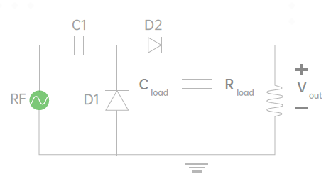
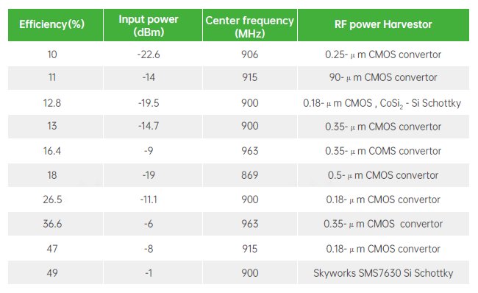
Ambient power (1) - RF energy
September 2022
Doc.: IEEE 802.11-22/1560r0
RF-based energy harvesting uses the transmission of radio waves ranging from 3 kHz to 300 GHz, it be accomplished using a single-stage or multistage converter. The amount of harvestable power depends on the source power, antenna gain, and the distance from the RF source.
Ambient RF energy has a relatively low energy density and the conversion efficiency depends on the received power level, as in Table 1.
The main advantage of RF-based energy harvesting is its availability in indoor environments and controllable (e.g., can send power with a transmitter). Potential applications include logistics/warehouse, manufacturing, smart homes, health monitoring, and environmental monitoring etc.
The minimum RF power can be harvested is around -30dB. [1][2]
Figure 1:Rectifier circuit for RF Energy
Table 1: Conversion efficiency for RF Energy [3]

Slide 4
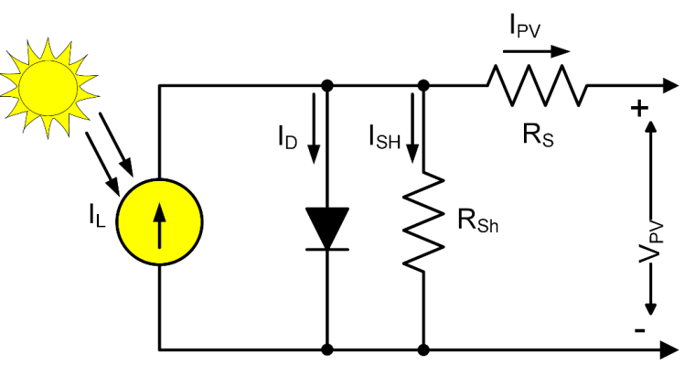
Ambient power (2) - Solar energy/light
September 2022
Doc.: IEEE 802.11-22/1560r0
Solar power/light can be transformed into electrical power using photovoltaic cells and it uses photovoltaic effect for energy harvesting with conversion efficiency of 10-40%[4].
Solar energy
For the outdoor case, solar energy is one of the most common ambient power, it can supply inexhaustible clean energy and has high power density of up to 100 mW/cm2[5].
Solar power is unstable, not constant and not continuous. It is highly dependent on the atmospheric condition, surrounding structures, etc. It is available during daylight hours. and inefficient on a cloudy day or at night.
Used for outdoor environmental monitoring, agriculture, husbandry, transportation etc..
Light
For the indoor cases, light from the Lighting Equipment can be used.
Although the power density is lower than solar, 100uw/cm2, it is much stable and controllable.
Used for manufacturing, indoor environmental monitoring etc.
Figure 2: The equivalent electrical circuit of
a single diode solar PV cell [6]

Slide 5
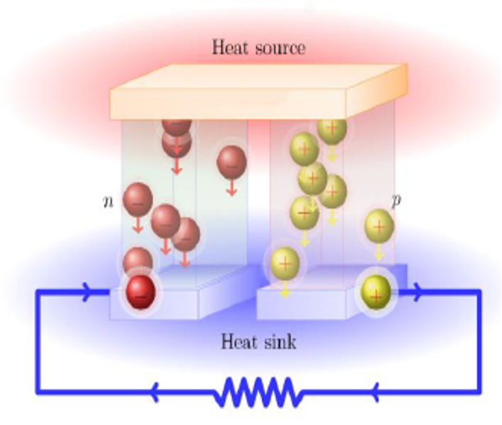
Ambient power (3) - Thermal energy
September 2022
Doc.: IEEE 802.11-22/1560r0
Thermal energy is another ambient power source that are available for lots of cases. Electrical power is directly generated by exploiting the temperature difference in thermoelectric devices taking advantage of thermoelectric effects, such as the Seebeck effect or the Thomson effect.
Thermoelectric generators have low efficiency (only about 5–6%) [7]. The power density is 25~1000uw/cm2 depending the environment condition.
Thermal energy can be used in many outdoor applications or indoor case, as long as temperature difference or temperature fluctuation can be expected in the environment. For example, outdoor environmental monitoring, agriculture, husbandry.
Figure 3: Seebeck effect

Slide 6
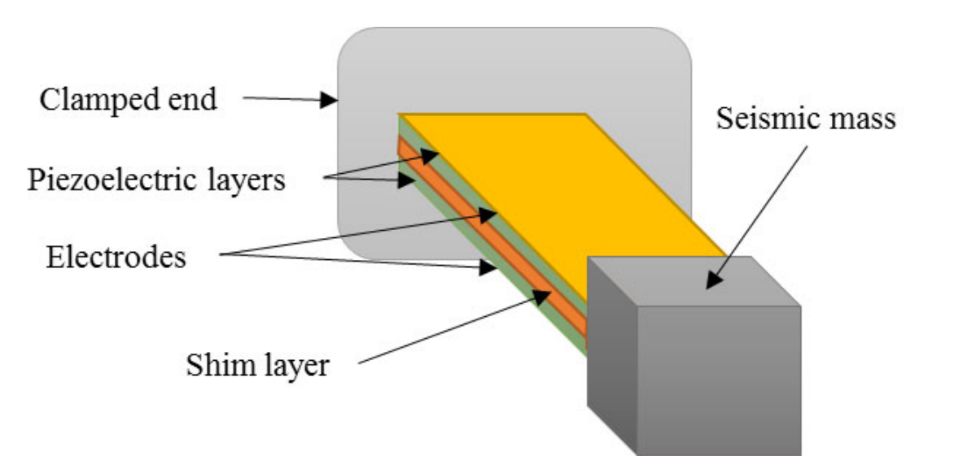
Ambient power (4) - Piezoelectric power
September 2022
Doc.: IEEE 802.11-22/1560r0
The piezoelectric effect generates electrical voltages or currents from mechanical strains, such as vibration or deformation.
Typical piezoelectric-based energy harvesters keep creating power when there is a continuous mechanical motion, such as acoustic noises and wind, or they sporadically generate power for intermittent strains, such as human motion (walking, clicking a button, etc.).
The volume of the piezoelectric power generators is relatively small and light and typical output power density values of usual piezoelectric materials are around 250 μW/cm3 but they can create more power when a motion or deformation is intense [8-9].
Figure 4: The piezoelectrochemical process that occurred at the surface/interface between the siloxene electrode and siloxene–PVDF piezofiber [10]
Figure 5: Piezoelectric energy harvesting generator[11]

Slide 7
Summary of ambient power
September 2022
Doc.: IEEE 802.11-22/1560r0
The typical power from ambient power source is summarized as in following table2:
Table 2. Energy harvesting sources [12-14].
Energy Source | Method | Power Density | Application Environment | Energy Conversion Factors | Feature | Advantages | Disadvantages
Radio Frequency | Antenna | 0.1–10 μW/cm² (Artificial) | (Semi-)urban environments; Dedicated transmitter setup; | Source transmission power; Distance from source; Antenna gain; Antenna design; | Partly controllable Partly predictable | Ambient or dedicated techniques; High conversion efficiency; Available anywhere; | Requires tuning to frequency bands; Energy availability limited by safety; Distance dependent; Low-power density
 |  | 0.001(WiFi)~0.1(GSM) μW/cm²
Solar | Photovolatic | 10~100 mW/cm² (Outdoor Sun Light) | Natural light; Brightly lit indoor spaces; | Light intensity; Temperature gradient; Material properties; | Uncontrollable Predictable | High voltage output； Predictable; Low fabrication costs | Long periods of natural absence; Natural prediction limited; Unavailable at night and non-controllable;
 |  | 10~100 μW/cm² (Indoor Art. Light)
Thermal | Thermoelectric | 20~60 μW/cm² | Industrial waste heat; Household water; Domestic heaters; Body heat; | Spatial temperature gradient; Temporal temperature gradient; Cycle frequency; | Uncontrollable Predictable | Long life due to stationary parts; High reliability; | Requires constant thermal gradient; Low conversion efficiency; Performs poorly on small gradients;
Mechanical Vibration | Electromagnetic | 300-800 μW/cm³ | Industrial machinery; transportation; Human activity; Roads and infrastructure; | Vibration frequency; Vibration acceleration; | Partly controllable | High-output currents; Robustness; Low-cost design; Controllable | Relatively large size; Unpredictable;
 | Electrostatic | 50-100 μW/cm³ |  |  |  | High-output voltage; Possibility to build low-cost devices | Requires bias voltage; Unpredictable
 | Piezoelectric | 4-250 μW/cm³ |  |  |  | High voltage output； High power density; Simplicity design and fabrication | Highly variable output; Unpredictable;
It can be observed the output power harvested from various power sources is very limited, e.g. from 1uW to 100mW(per cm²/cm³).
Notes:
这个表格可以替代

Slide 8
Energy storage for AMP IoT
September 2022
Doc.: IEEE 802.11-22/1560r0
Characteristics of ambient power
For typical ambient power, it can be observed the power harvested is very limited, e.g. from 1uW to 100mW(per cm²/cm³).
For some ambient power from artificial power source(e.g., light, RF waves), the power can be stable and constant.
But for some other kind of ambient power such as solar, heat or vibration, the ambient power will be unstable (intermittent, not constant). It is impossible to use the ambient power as a direct power source for electronic devices.
Energy storage element is needed for some AMP IoT devices
The energy storage element is able to stabilize and control the power output, smooth the fluctuation.
It is able to collect the weak harvested power (e.g., in the level of micro ampere or even nano ampere ) and provide the required peak discharge current for the AMP IoT devices.
Therefore, it make it possible to use more kinds of ambient power sources for AMP IoT by using the energy storage element.
Note: It is still necessary to have no power storage for some types of AMP IoT devices.

Slide 9
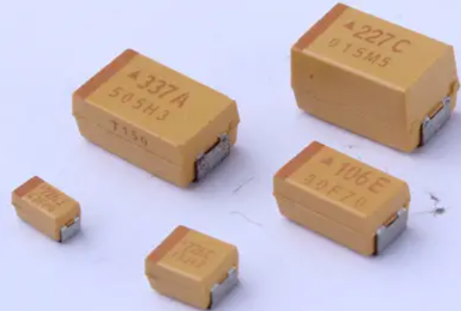
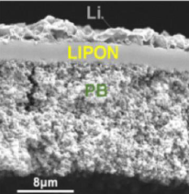
Possible Energy storage elements for AMP IoT
September 2022
Doc.: IEEE 802.11-22/1560r0
Capacitor and solid state battery can be considered as the possible energy storage elements for AMP IoT devices.
Limited but appropriate/sufficient power storage capacity for AMP IoT devices.
With a capacitor of 24uF, if it is fully charged, it can drive the AMP IoT devices for 3.6 seconds (1.5V and 10uA are assumed).
24uF*1.5V= 36uC = 36 uAs
With a solid state battery of 1uAh@1.5V, it can drive the AMP IoT devices for 6 minutes (1.5V and 10uA are assumed).
Good characteristics such as wide working temperature range, especially using solid state battery, as shown in Table 3.
Table 3 Comparison of capacitor, solid state battery and legacy coin battery
 | Legacy coin battery | Capacitor | Solid state battery
Capacity | 1~500mAh | 10uF~100uF | 0.05~5
Cycling Capacity | 500~1000 | >10000 | >1000
Temperature Range (℃) | -20 ~ +60 | -40 ~ +85 | -40 ~ +105
Self-discharging
Security
Notes:
添加几种储能介绍以及比较
计算可用的通信时长

Slide 10
Summary
September 2022
Doc.: IEEE 802.11-22/1560r0
In this contribution, we discuss the following on ambient power:
The possible ambient power sources
The power density and its characteristics of four typical ambient power
The example use cases for each ambient power
The necessity of power storage
Example energy storage elements for AMP IoT and the corresponding characteristics

Slide 11
4. Reference
September 2022
Doc.: IEEE 802.11-22/1560r0
[1] Noghabaei S M, Radin R L, Savaria Y, et al. A high-efficiency ultra-low-power CMOS rectifier for RF energy harvesting applications[C]//2018 IEEE International Symposium on Circuits and Systems (ISCAS). IEEE, 2018: 1-4
[2] Wu Z, Zhao Y, Sun Y, et al. A Self-Bias Rectifier with 27.6% PCE at-30dBm for RF Energy Harvesting[C]//2021 IEEE International Symposium on Circuits and Systems (ISCAS). IEEE, 2021: 1-5.
[3] Valenta C R, Durgin G D. Harvesting wireless power: Survey of energy-harvester conversion efficiency in far-field, wireless power transfer systems[J]. IEEE Mi crowave Magazine, 2014, 15(4): 108-120.
[4] Kim S, Vyas R, Bito J, et al. Ambient RF energy-harvesting technologies for self-sustainable standalone wireless sensor platforms[J]. Proceedings of the IEEE, 2014, 102(11): 1649-1666.
[5] Green M, Dunlop E, Hohl‐Ebinger J, et al. Solar cell efficiency tables (version 57)[J]. Progress in photovoltaics: research and applications, 2021, 29(1): 3-15.
[6] Mishu M K, Rokonuzzaman M, Pasupuleti J, et al. An adaptive TE-PV hybrid energy harvesting system for self-powered iot sensor applications[J]. Sensors, 2021, 21(8): 2604.
[7] Prauzek M, Konecny J, Borova M, et al. Energy harvesting sources, storage devices and system topologies for environmental wireless sensor networks: A review[J]. Sensors, 2018, 18(8): 2446.
[8] Kim S, Vyas R, Bito J, et al. Ambient RF energy-harvesting technologies for self-sustainable standalone wireless sensor platforms[J]. Proceedings of the IEEE, 2014, 102(11): 1649-1666.
[9] H. S. Kim, J. -H. Kim, and J. Kim, ‘‘A review of piezoelectric energy harvesting based on vibration,’’ Int. J. Precision Eng. Manuf., vol. 12, no. 6, pp. 1129–1141, Dec. 2011.
[10] Krishnamoorthy K, Pazhamalai P, Mariappan V K, et al. Probing the energy conversion process in piezoelectric-driven electrochemical self-charging supercapacitor power cell using piezoelectrochemical spectroscopy[J]. Nature communications, 2020, 11(1): 1-11.
[11] Hoang T, Ferin G, Bantignies C, et al. Aging assessment of piezoelectric energy harvester using electrical loads[C]//Journal of Physics: Conference Series. IOP Publishing, 2019, 1407(1): 012078.

Slide 12
4. Reference
September 2022
Doc.: IEEE 802.11-22/1560r0
[12] Williams A J, Torquato M F, Cameron I M, et al. Survey of energy harvesting technologies for wireless sensor networks[J]. IEEE Access, 2021, 9: 77493-77510.
[13] Mishu M K, Rokonuzzaman M, Pasupuleti J, et al. Prospective efficient ambient energy harvesting sources for iot-equipped sensor applications[J]. Electronics, 2020, 9(9): 1345.
[14] Sanislav T, Mois G D, Zeadally S, et al. Energy harvesting techniques for internet of things (IoT)[J]. IEEE Access, 2021, 9: 39530-39549.

