Slide 1
Updated Use Cases for AMP IoT Devices
September 2022
Doc.: IEEE 802.11-22/1559r0
Date: 2022-09-09
Authors:
Name | Affiliation | Address | Phone | Email
Yinan Qi | OPPO |  |  | v-qiyinan@oppo.com
Weijie Xu |  |  |  | xuweijie@oppo.com
Hongwei Wang | JD |  |  | wanghongwei10@jd.com
Jiazhi Ni | Tencent |  |  | andyni@tencent.com
Harry Wang |  |  |  | harryhwang@tencent.com
Wenhao Zhan | China Telecom |  |  | zhanwh@chinatelecom.cn

Slide 2
Background
September 2022
Doc.: IEEE 802.11-22/1559r0
Following use cases have been discussed in July meeting and the conference call
  Use case 1 Smart manufacturing: inventory/attendance check, real-time inspection and tracing, asset tracking/positioning, and industrial environment/production line sensing and monitoring [1]-[2]
  Use case 2 Data center: environmental monitoring, facility monitoring and asset management [3]
  Use case 3 Smart home: asset management, home environment monitoring and home security [1].
  Use case 4 Logistics and warehouse: goods tracking and inventory check [1]
  Use case 5 Smart agriculture: monitoring of soil moisture, soil fertility, temperature, wind speed, plant growth etc., and controlling of the agricultural facilities [1]

Slide 3
Background
September 2022
Doc.: IEEE 802.11-22/1559r0
Updated use case
  Use case 4 Logistics and warehouse: further details on functionalities and requirements
New use case
  Use case 6 Indoor positioning: positioning in giant shopping mall, factories, warehouses, etc.

Slide 4
Updated Use Case 4 Logistics and Warehouse
September 2022
Doc.: IEEE 802.11-22/1559r0

Slide 5
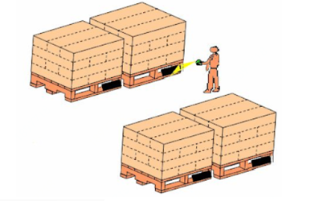
Logistics and Warehouse: Background
September 2022
Doc.: IEEE 802.11-22/1559r0
Inventory check
  Viewing all products and identifying any missing assets and discrepancies within inventory
  Goods are normally stored in containers such as cartons and a pile of cartons in a single storage location can be up to more than ten meters long and nearly five meters high and there could be hundreds of labels in a single storage location.
  It is inevitable that the labelling does not follow standard procedure, thus it is possible that not all labels face the same direction.
  State of the Art: manual scanning of labels of barcode or RFID tags (time consuming and inefficient)
  Expectation: fast and automatic label reading

Slide 6
Logistics and Warehousing: Background
September 2022
Doc.: IEEE 802.11-22/1559r0
Sorting
  Goods are categorized depending on their own characteristics, e.g., where they are from, where they need to be sent, etc.
  Goods are placed in the reusable containers and there are different container specifications
    Uniform specifications, e.g., regular constrainers such as cartons, wooden trays, etc.
    Non-uniform container specifications, e.g., irregular containers such as packing bags, etc.
  The target container can be easily misidentified with adjacent containers and labels on irregular containers are difficult to identify.
  State of the Art: Barcode, NFC or RFID tags attached to the containers.
  Expectation: fast and automatic label reading, environmental sensing for special goods, e.g., fresh food

Slide 7
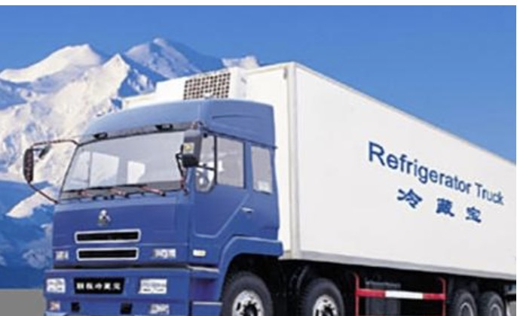
Example: Cold-Chain Transportation
September 2022
Doc.: IEEE 802.11-22/1559r0
Environmental monitoring in vehicles
  Fresh agricultural products such as meat, poultry, aquatic products, vegetables, and fruits are harvested from the place of origin and kept under low temperature control in product processing, storage, transportation, retail, etc.
  Certain temperature and humidity are needed to ensure product quality and safety to the greatest extent.
Required Services
  Fast identification: labels need to be identified, e.g., during loading and unloading procedure
  Environmental sensing: sensors within vehicles to sense temperature, humidity and other environmental parameters.

Slide 8
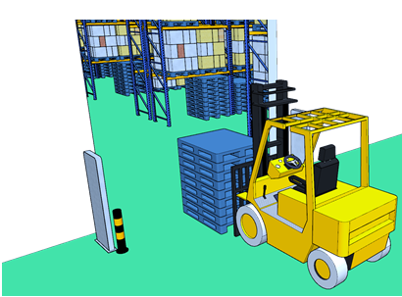
Use Case 4-1: Label Identification
September 2022
Doc.: IEEE 802.11-22/1559r0
Services and applicable scenarios
  Cartons are desired to be identified correctly with close to 100% accuracy.
  Inventory check needs to be completed in short time, thus manual operation is not preferred.
  High sensitivity and omni-directionality should be supported
Requirements
  Ultra-low cost and ultra-small size
  Maintenance-free and battery-less for long service time.
  99.5% identification accuracy even in case of high density deployment
  Coverage: 10-30 m for indoor case

Slide 9
Use Case 4-2: Sorting
September 2022
Doc.: IEEE 802.11-22/1559r0
Services and applicable scenarios
  Accurate label identification for closely adjacent items on the conveyor system.
  Fast label identification of the items on the conveyor belt that moves at a speed of 1.5-2 m/s on the sorting line;
  Real-time monitoring and related information acquisition for the items on the conveyor system
  Environmental monitoring for temperature, humidity, etc.
Requirements
  Ultra-low cost, ultra-small size and battery-less.
  99.5% identification accuracy
  Moving speed up to 2 m/s;
  Minimum distance to distinguish adjacent items: 0.5 m

Slide 10
New Use Case 6 Indoor Positioning
September 2022
Doc.: IEEE 802.11-22/1559r0

Slide 11
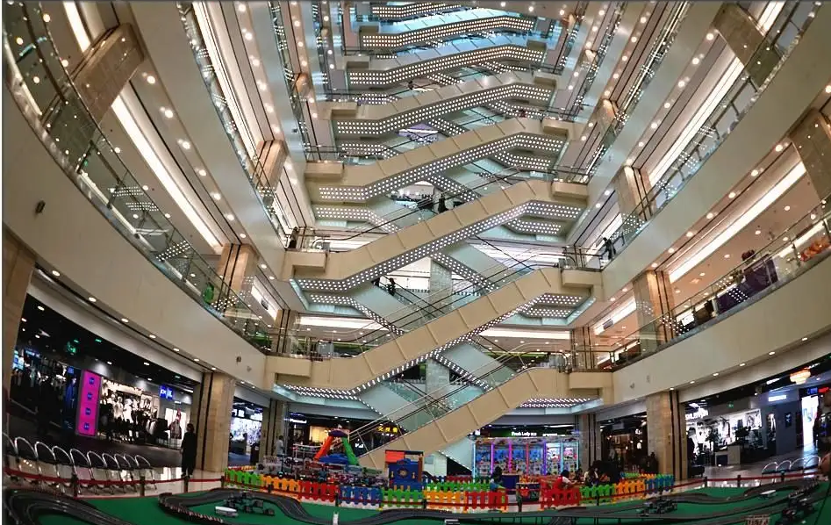
Indoor Positioning: Background
September 2022
Doc.: IEEE 802.11-22/1559r0
Shopping center
  A wide range of services and products and many giant shopping centres can occupy an area of tens to hundreds of thousands m², composed of one or multiple buildings, each of which has multiple storeys both over and underground.
Smart plant and warehouse
  Positioning is needed for items on the production line or conveyor system
Expectation
  Locating car or a vacant parking spot
  Locating a target shop and a target item in a supermarket/shop
  Locate items on the production line/conveyor system
  Locate items/personnel for inventory/attendance check

Slide 12
Indoor Positioning: Background
September 2022
Doc.: IEEE 802.11-22/1559r0
Potential market for indoor positioning
  The global Indoor Positioning and Navigation market was valued at $6.92 billion in 2020 and is projected to grow to $23.6 billion in 2025 at a CAGR of 27.9%[4].
  Unlike the outdoor use cases where Global Navigation Satellite System can be used, it calls for much more efficient indoor positioning and navigation technologies for indoor use cases.
    It shall be easily deployed
    The deployment cost shall be low enough
    It can be easily used by the verticals and individual customer

Slide 13
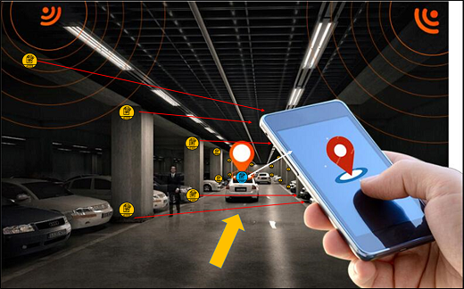
Use Case 5-1: Indoor Positioning for Parking
September 2022
Doc.: IEEE 802.11-22/1559r0
Services and applicable scenarios
  Reference tags can be deployed to build an indoor positioning and navigation system and these reference tags should last for long time without maintenance.
  High density deployment of reference tags (with known locations), e.g., evenly distributed with high density (e.g., 2-meter intervals) within the entire parking area
  Indoor positioning can be enabled by an AP in the car or a handheld device (e.g., smartphone), which can communicate with and position the reference tags.
Requirements
  Communication range: 10~30m
  Maintenance-free and battery-less for long service time, e.g., 10 years.
  Positioning accuracy: 1~3 m horizontal accuracy

Slide 14
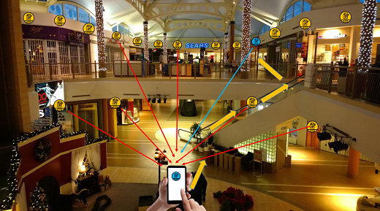
Use Case 5-2: Indoor Positioning for Shopping
September 2022
Doc.: IEEE 802.11-22/1559r0
Services and applicable scenarios
  Reference tags can be deployed to building an indoor positioning and navigation system to position a customer or guide the customer to a target place(e.g., a retail store or a restaurant ) within a giant shopping centre.
  High density deployment of reference tags, e.g., evenly distributed with high density (e.g., 2-meter intervals) within the entire shopping centre, in each floor and each room.
  Indoor positioning can be enabled by a handheld device (e.g., smartphone).
Requirements
  Communication range: 10~30m
  Maintenance-free and battery-less for long service time, e.g., 10 years.
  Positioning accuracy: 1~3 m horizontal accuracy and 2 m vertical accuracy

Slide 15
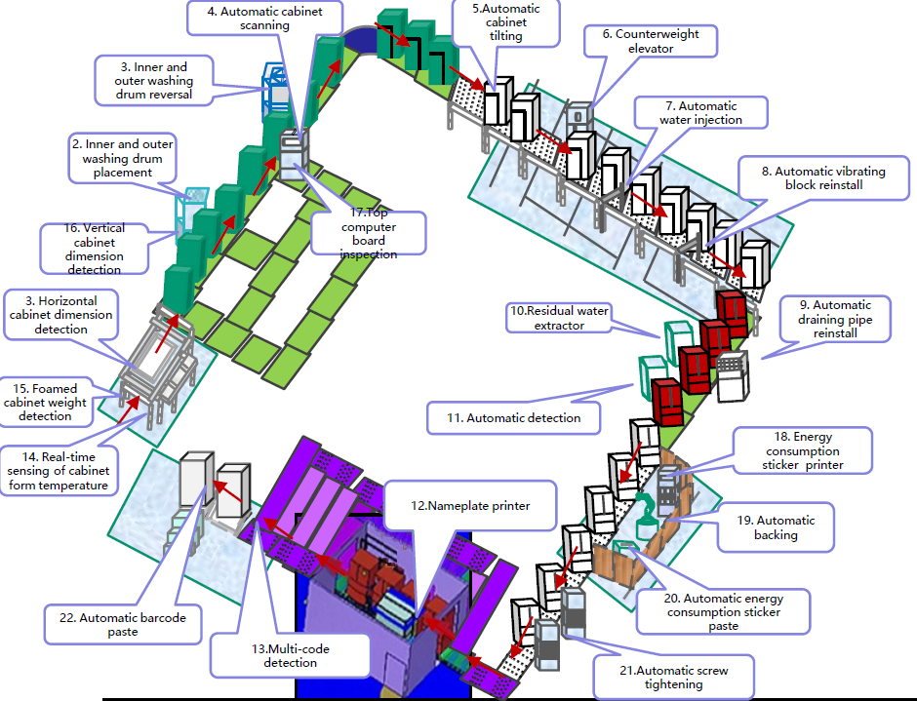
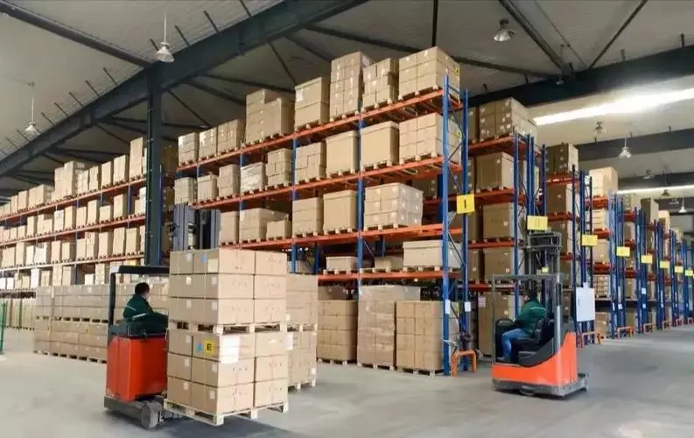
Use Case 5-3: Indoor Positioning for Smart Manufacturing and Warehouse
September 2022
Doc.: IEEE 802.11-22/1559r0
Services and applicable scenarios
  Positioning of a product in the production line
  Safety alarm to avoid dangerous zones in the industrial area
  Inventory and attendance check to locate an item and a personnel
Requirements
  Small size, maintenance-free, battery-free, and ultra-low-cost IoT devices
  Coverage: 10-30 meters for indoor (a product line has an area of 25 thousands m²)
  Positioning accuracy: 1~3 m horizontal accuracy and 1~2 m vertical accuracy
  Moving speed: 1.5-2 m/s

Slide 16
Summary
September 2022
Doc.: IEEE 802.11-22/1559r0
This submission presents
  Two use cases
    Updated use case of logistics and warehouse including label identification and sorting
    Additional use case which requires indoor positioning for shopping center, factories, and warehouse
  Current issues and expectation
  Services and applicable scenarios in both use cases
  Typical requirements for both use cases

Slide 17
Reference
September 2022
Doc.: IEEE 802.11-22/1559r0
IEEE 802.11-22/0963r0, Use Cases for AMP IoT Devices.
IEEE 802.1122/1339r0, Use Cases of smart manufacturing.
IEEE 802.1122/1341r1, Use Cases of Data Center Infrastructure Management.
https://www.researchandmarkets.com/reports/4531980/indoor-positioning-and-navigation-market

