Slide 1
Insights on the next generation WLAN: High Experiences
Date: 2022-11-08
Authors:
Name | Affiliations | Address | Phone | Email
Mao Yang | Northwestern Polytechnical University |  |  | yangmao@nwpu.edu.cn
Bo Li |  |  |  | libo.npu@nwpu.edu.cn
Zhongjiang Yan |  |  |  | zhjyan@nwpu.edu.cn

Slide 2
Introduction
In previous WNG meetings, several contributions focusing on the next generation WLAN were proposed.
D2.0 of IEEE 802.11be has been approved. It is the time to think about the next generation WLAN, and to start the NG SIG.
In this contribution, we analyze the problem of the current WLAN, and propose that the most important problem is low user experience.

Slide 3
Key Problem: poor QoE
Increasing various applications and services are emerging, such as meta universe, VR, AR, digital twin, ultra-high, online real-time games, leading to higher requirements and more severe challenges QoE [1-4].
Poor quality of experience (QoE) is the most obstinate problem of the current WLAN.

Slide 4
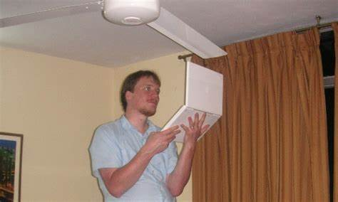
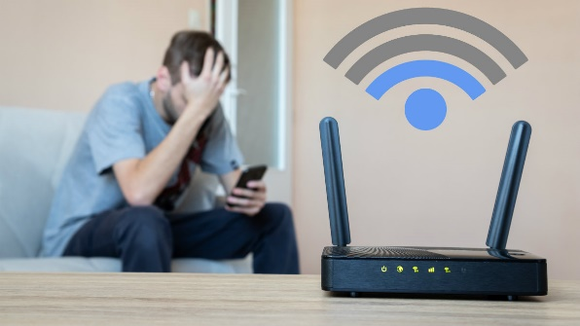
Key Problem: poor QoE
Our feelings about the QoE
In China, in many places, as long as the traffic usage fee of the cellular network is within the budget, people including us would rather choose 4G/5G than FREE WiFi.
The problem is not the peak performance, but the stability of performance. WiFi performance changes dramatically over time.
In my lecture, my students told me that almost the only reason to use WiFi was that it was cheap rather than experiences.
In practice, the claimed “very/extremely high throughput” can hardly be experienced.

Slide 5
Key Problem: poor QoE
Poor QoE is caused by several technical problems.
Network architecture: fully distributed networking architecture
Channel access: chaotic random access
Transmission: awkward “high capability”
QoS guarantee: coarse-grained QoS architecture
Interference management: ubiquitous and complicated interference
Network intelligence: “no place” for AI
Legacy dilemma: heavy burden of standard evolving

Slide 6
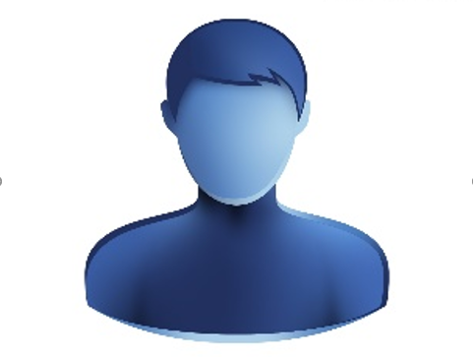
Key Problem: poor QoE
Poor QoE is caused by several technical problems.
Network architecture: fully distributed networking architecture
Network intelligence: “no place” for AI
Legacy dilemma: heavy burden of standard evolving
QoS guarantee: coarse-grained QoS architecture
Management: ubiquitous and complicated interference
Channel access: chaotic random access
Transmission: awkward “high capability”

Slide 7
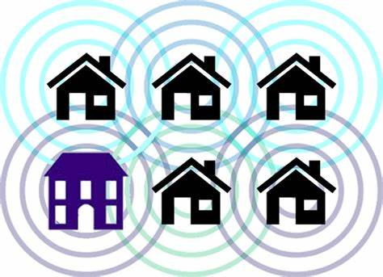
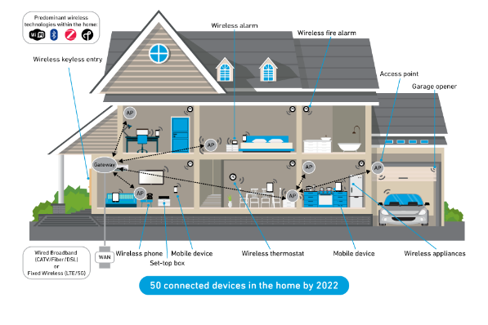
Fully distributed networking architecture
Definition: different from cellular network, WiFi adopts fully distributed network architecture. Distributed architecture has its advantages, but it usually leads to unordered network status, resulting in low QoE.
Example Scenarios
Within one BSS, the network is distributed although we have an AP
The coordination within ESS is still very limited
Even in deployed enterprise network, distributed feature also results in many problems such as starvation problem (flow-in-the-middle)[5]

Slide 8
Fully distributed networking architecture
Impact factors
Lack of overall and top-level architecture design
Fully distributed networking architecture for network management, control, and data transmission
The current ISM band is limited and environment complicated
Relationship with QoE
Fully distributed networking architecture makes the network low efficiency, resulting in low QoE.

Slide 9
Chaotic random access
Definition: the STAs including APs randomly contend the channel, resulting in chaotic channel access between STAs.
Example Scenarios
Radical channel access: consistently use the maximum TX power, set the duration as TXOP limit that is larger than actual demand, and etc.
For home and enterprise scenario, multiple BSSs or multiple STAs in one BSS are also “enemies” of each other in many places.
For r-TWT in 11be D2.0, the rule “Non-AP EHT STAs may behave as if overlapping quiet intervals do not exist” exacerbates random collision.
Once, a clean 6GHz band is ready for WiFi, but we make it random.

Slide 10
Chaotic random access
Impact factors
Deep-rooted random channel access
Rigid CCA and ED thresholds for diverse scenarios
Lack of clean designed channel access structure
The channel access rule for new band
Relationship with QoE
Chaotic random access significantly exacerbates the collision and ineffective access and transmission, which leads to low QoE.

Slide 11
Awkward “high capability”
Definition: MLO, 320MHz, 4096-QAM, 1024-aggregation, 16ss, and etc. sound attractive. However, the actual available performance is far from the capability.
Chinese archaism: chicken ribs —— not bad enough to leave, but not good enough to stay.
Example Scenarios
High-dense scenario and the complicated interference make it nearly impossible to achieve 320MHz. Maybe 20M and 40MHz is normal.
4096-QAM, even 1024-QAM, is difficult to use because of the unachievable SINR threshold. [Note]: 5G uses 256-QAM.
16ss is also challenging because of the inter-stream interference and complicated user grouping.
4096-QAM
320MHz
16ss…

Slide 12
Awkward “high capability”
Impact factors
Complicated channel environment and interference
Lack of mechanism to make these valuable technologies work in practice
Increasingly low efficiency
The higher the peak throughput, the lower the efficiency.
Maximum PPDU length will restrict the aggregation size.
160MHz+2ss+MCS13+4096-aggregation
Intended PPDU length: 11.368ms << maximum PPDU length 5.46ms
Relationship with QoE
A series of valuable technologies cannot be achieved in practice, thus high experiences are also unachievable.
Overhead 1: SIFS+BA | Overhead 1: BO+RTS/CTS+N*SIFS+BA | 1link+320MHz+4ss+MCS13+1024-aggregation | 1link+320MHz+4ss+MCS13+1024-aggregation | 1link+320MHz+4ss+MCS13+256-aggregation
60~100us | 200~400us | 710.52us | 355.26us | 88.81us

Slide 13
Coarse-grained QoS architecture
Definition: the current QoS architecture is traffic class based, eight TIDs and four ACs can not keep pace with the increasingly diverse services.
Example Scenarios
Increasingly diverse services require quite diverse and challenging QoS
VR, game, Metaverse, Digital twin, industry, remote medical, …
“Unsolvable” Low latency
Although low latency is one feature of 11be, there are little effective solutions till D2.0 such as r-TWT.
Several proposals discuss <1ms latency guarantee, which seems as an “unsolvable” objective for WiFi.
Instable resource acquisition results in unstable performance
Increasingly large bandwidth and other enablers are “unfriendly” to IoT.
Seamless WiFi roaming is challenging

Slide 14
Coarse-grained QoS architecture
Impact factors
QoS architecture with appropriate granularity
Fine scalability
Truly effective solution for low latency/jitter
Stable resource acquisition
Integrated wide band system and narrow band IoT
Seamless WiFi roaming
Relationship with QoE
QoS is the premise of QoE, and poor QoS will inevitably lead to poor QoE.

Slide 15
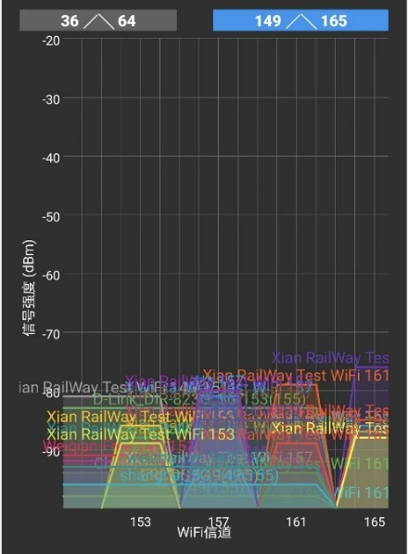
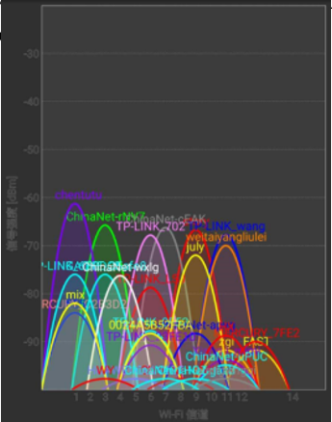
Ubiquitous and complicated interference
Definition: quite different from cellular network, the random interferences from OBSS, intra-BSS, and non-WiFi system are ubiquitous and complicated.
Example Scenarios
High-dense deployment scenario will be typical.
Devices made from different vendors adopt different implementations to select channels, bandwidth, access paras, and etc.
Cross-system interferences from LAA, LTE-u, and etc.
11ax introduces SR, which further increases interferences

Slide 16
Ubiquitous and complicated interference
Impact factors
Lack of inter-BSS coordination
Complicated ISM band interferences
Lack of explicit technical rules for the coexistence between WLAN and other systems
Lack of new band for WLAN
Relationship with QoE
Interference leads to poor network performance and, consequently, poor network performance leads to poor QoE.

Slide 17
“No place” for AI
Definition: user experience is subjective and complicated. Make network more intelligent is a natural and promising target, but it seems there is no place for AI in standardization.
Example Scenarios
Several proposals discuss the importance of AI for WLAN. But, it seems that ML, DL, and RL are usually considered as internal tools for each single device
Single device based AI obtain limited gain
Difficult to be standardized
Lots of AI models, training methods, and algorithms. Simply standardize specific one is unscalable.
AI
WLAN

Slide 18
“No place” for AI
Impact factors
What can AI do for WLAN?
What can the standardization do for AI?
Not simply model or algorithm
How to give full play to the advantages of AI in network interconnection?
What is the AI standardization architecture in IEEE 802.11?
Relationship with QoE
Network intelligence can help us to evaluate the complicated user experience, and help us to choose the optimal method to guarantee the QoE.

Slide 19
Heavy burden of standard evolving
Definition: …WiFi 4->WiFi 5->WiFi 6->WiFi 7, it seems that every time evolving has no choice but to coexist with many versions of legacy STAs.
Example Scenarios
Any new generation has to keep good backward compatibility, which is a “double-edged sword”. The innovation is in chains.
Compare: cellular network’s unfettered evolving: new band, new design, new frame format, and etc.
Once, a clean 6GHz band is ready for WiFi, but we simply summoned all the old technologies.
The frame format is continuously patched. With the evolution of the standard, the patch is in tatters.
EHT
HE
HT
VHT
non-HT
we

Slide 20
Heavy burden of standard evolving
Impact factors
Old versions and new version share the same band
The devices especially the APs installed with new standard have to serve all old versions
Frame format is full of patch, but still pay little attention to the scalable design or clean-sheet design
Relationship with QoE
Drop the heavy burden of legacy benefits to the technical innovation. It is easy for us to focus on and further guarantee the enhancement of the user experiences of the new generation standard.

Slide 21
Conclusions
Poor QoE is the most tricky problem affecting the evolving and user population of WLAN.
Several technical reasons are proposed
Feature | Problem | Threats | Importance
Network architecture | fully distributed networking architecture | Unordering
Channel access | chaotic random access | Unordering
Transmission | awkward “high capability” | Low efficiency
QoS guarantee | coarse-grained QoS architecture | Weak Adaptability
Interference management | ubiquitous and complicated interference | Unordering
Network intelligence | “no place” for AI | Weak Adaptability
Legacy dilemma | heavy burden of standard evolving | Hindering evolving

Slide 22
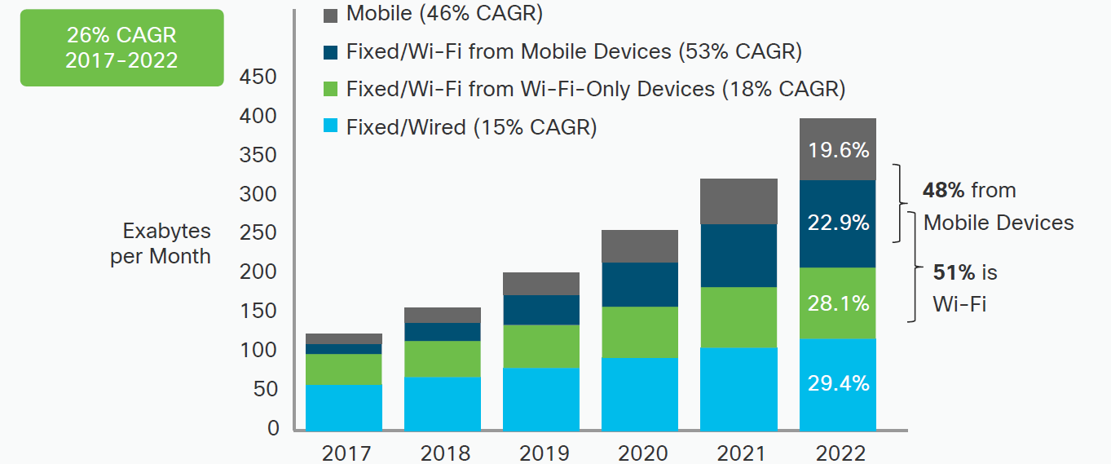
Conclusions (cont.)
The vision of wireless network is, in our opinion, to enable people to enjoy wireless and to enrich ubiquitous interconnection.
WLAN has achieved and is achieving great success.
Cisco Visual Networking Index

Slide 23
Conclusions (cont.)
It is the time for us to carefully think things from our god’s (i.e., users’) perspective. Therefore, to achieve high experiences (HEX) is highly suggested as the key objective of the next generation WLAN.
Keep curiosity and carry on.

Slide 24
Reference
[1] Dasari, Mallesham, et al. "Scalable Ground-Truth Annotation for Video QoE Modeling in Enterprise WiFi." 2018 IEEE/ACM 26th International Symposium on Quality of Service (IWQoS). IEEE, 2018.
[2] Ligata, Amir, Erma Perenda, and Haris Gacanin. "Quality of experience inference for video services in home WiFi networks." IEEE Communications Magazine 56.3 (2018): 187-193.
[3] Ligata, Amir, Erma Perenda, and Haris Gacanin. "Quality of experience inference for video services in home WiFi networks." IEEE Communications Magazine 56.3 (2018): 187-193.
[4] Laulajainen, Jukka-Pekka, et al. "Study of YouTube demand patterns in mixed public and campus WiFi network." 2014 International Wireless Communications and Mobile Computing Conference (IWCMC). IEEE, 2014.
[5] F: Shimizu H, Yin B, Yamamoto K, et al. Joint Channel Selection and Spatial Reuse for Starvation Mitigation in IEEE 802.11 ax WLANs[C]//2019 IEEE 90th Vehicular Technology Conference (VTC2019-Fall). IEEE, 2019: 1-6.

