Slide 1
Extra Normalization Before CSI Quantization
Date: 2022-08-25
Authors:
Name | Affiliation | Address | Phone | Email
Junghoon Suh | Huawei |  |  | junghoon.suh@huawei.com
Yan Xin |  |  |  | Yan.Xin@huawei.com
Mengshi Hu |  |  |  | humengshi@huawei.com

Slide 2
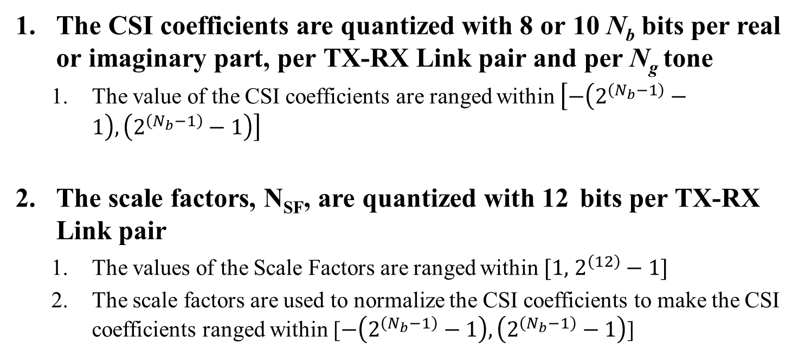
CSI Quantization in TGbf
The CSI coefficients are quantized with 8 or 10 N_{b} bits per real or imaginary part, per TX-RX Link pair and per N_{g} tone
  The value of the CSI coefficients are ranged within $\left[−\left(2^{\left(N_{b}−1\right)}−1\right),\left(2^{\left(N_{b}−1\right)}−1\right)\right]$
The scale factors, N_{SF}, are quantized with 12 bits per TX-RX Link pair
  The values of the Scale Factors are ranged within $[1,$ $2^{\left(12\right)}−1]$
  The scale factors are used to normalize the CSI coefficients to make the CSI coefficients ranged within [$−\left(2^{\left(N_{b}−1\right)}−1\right), \left(2^{\left(N_{b}−1\right)}−1\right)$]

Slide 3




Data Path Size Control
Round( $\frac{U}{M_{U}}\left(2^{N_{U}−1}−1\right)$ )
Round( $\frac{D}{M_{D}}\left(2^{N_{D}−1}−1\right)$ )
AGC
ADC
U
FFT
D
N_{U}
N_{D}
Maximum of the amplitude of U, M_{U}
Maximum of the amplitude of D, M_{D}
Maximum of the amplitude of H_{c}, M_{H}, where H_{c} is the channel estimation output
CSI
Quantization
H_{n}
Extra
Normalization
N_{P}
H_{c}
GI Removal and
Channel Estimation
$Hi=Round( \frac{H_{n}}{M_{n}}\left(2^{13−1}−1\right)$ )
$H=Round( \frac{H_{c}}{M_{H}}\left(2^{N_{P}−1}−1\right)$ )

Slide 4
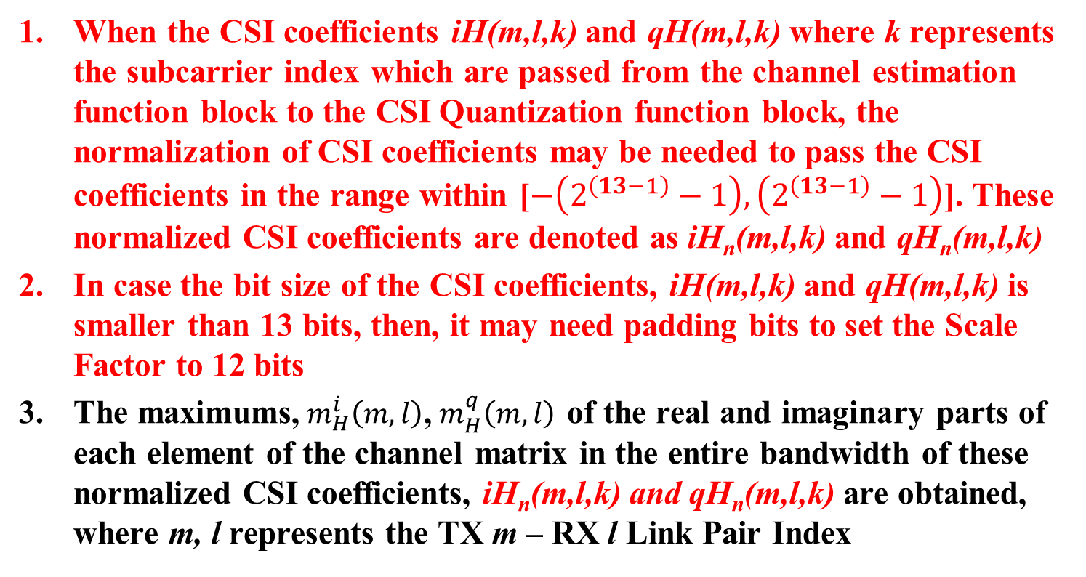
Proposed Detail of CSI Quantization: Responder Side
When the CSI coefficients iH(m,l,k) and qH(m,l,k) where k represents the subcarrier index which are passed from the channel estimation function block to the CSI Quantization function block, the normalization of CSI coefficients may be needed to pass the CSI coefficients in the range within [$−\left(2^{\left(13−1\right)}−1\right), \left(2^{\left(13−1\right)}−1\right)$]. These normalized CSI coefficients are denoted as iH_{n}(m,l,k) and qH_{n}(m,l,k)
In case the bit size of the CSI coefficients, iH(m,l,k) and qH(m,l,k) is smaller than 13 bits, then, it may need padding bits to set the Scale Factor to 12 bits
The maximums,${ m}_{H}^{i}\left(m,l\right)$,${ m}_{H}^{q}\left(m,l\right)$ of the real and imaginary parts of each element of the channel matrix in the entire bandwidth of these normalized CSI coefficients, iH_{n}(m,l,k) and qH_{n}(m,l,k) are obtained, where m, l represents the TX m – RX l Link Pair Index

Slide 5
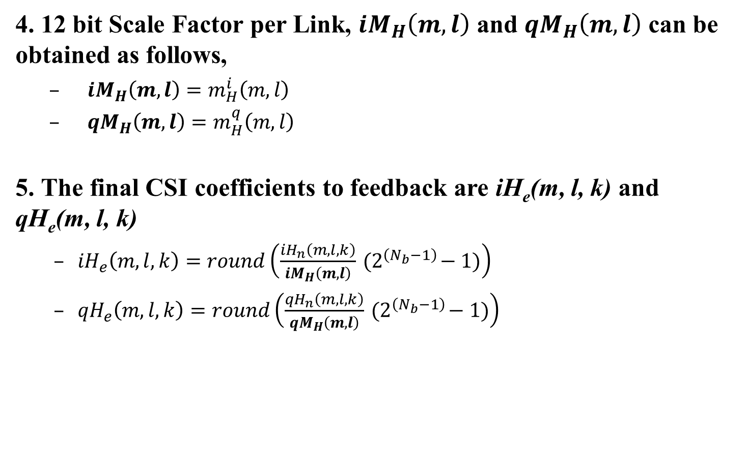
4. 12 bit Scale Factor per Link, ${iM}_{H}\left(m,l\right)$ and ${qM}_{H}\left(m,l\right)$ can be obtained as follows,
  ${iM}_{H}\left(m,l\right)=m_{H}^{i}\left(m,l\right)$
  ${qM}_{H}\left(m,l\right)=m_{H}^{q}\left(m,l\right)$
5. The final CSI coefficients to feedback are iH_{e}(m, l, k) and qH_{e}(m, l, k)
  ${iH}_{e}\left(m,l,k\right)=round\left(\frac{{iH}_{n}\left(m,l,k\right)}{{iM}_{H}\left(m,l\right)}{ (2}^{\left(N_{b}−1\right)}−1)\right)$
  ${qH}_{e}\left(m,l,k\right)=round\left(\frac{{qH}_{n}\left(m,l,k\right)}{{qM}_{H}\left(m,l\right)}{ (2}^{\left(N_{b}−1\right)}−1)\right)$

Slide 6
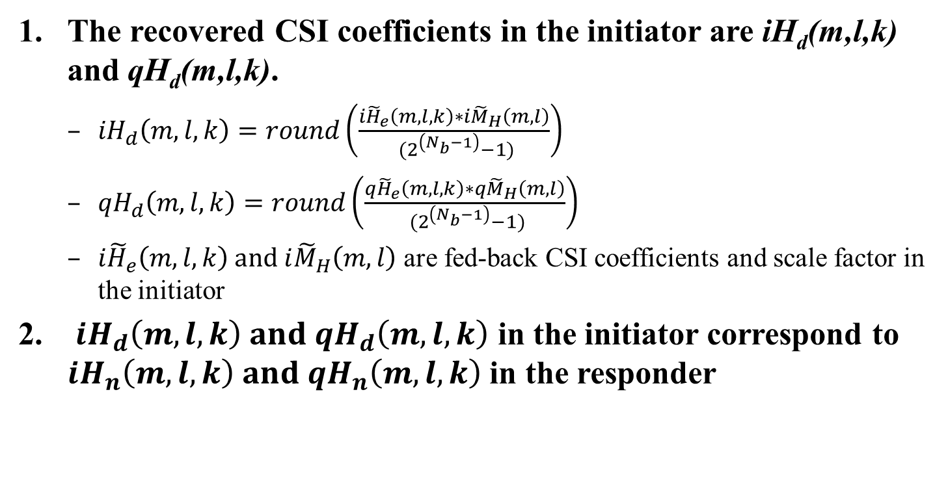
Proposed Detail of CSI Quantization: Initiator Side
The recovered CSI coefficients in the initiator are iH_{d}(m,l,k) and qH_{d}(m,l,k).
  ${iH}_{d}\left(m,l,k\right)=round\left(\frac{{i\tilde{H}}_{e}\left(m,l,k\right)∗{i\tilde{M}}_{H}\left(m,l\right)}{{ (2}^{\left(N_{b}−1\right)}−1)}\right)$
  ${qH}_{d}\left(m,l,k\right)=round\left(\frac{{q\tilde{H}}_{e}\left(m,l,k\right)∗{q\tilde{M}}_{H}\left(m,l\right)}{{ (2}^{\left(N_{b}−1\right)}−1)}\right)$
  ${i\tilde{H}}_{e}\left(m,l,k\right) and {i\tilde{M}}_{H}\left(m,l\right)$ are fed-back CSI coefficients and scale factor in the initiator
${iH}_{d}\left(m,l,k\right) and {qH}_{d}\left(m,l,k\right)$ in the initiator correspond to ${iH}_{n}\left(m,l,k\right) and {qH}_{n}\left(m,l,k\right)$ in the responder

Slide 7
Conclusions
It is implementation-specific on how to come up with the N_{b} sized CSI coefficients, and the N_{SF} sized Scale Factor
  However, we need to provide an example or two for the detail implementation from a guidance purpose
We may need an extra normalization for the Estimated CSI coefficients before the CSI Quantization for feedback
The step 1 & 2 in red color on slide 4 is not described in the Spec text and left as implementation-specific
  Do we need to introduce the extra normalization step into the Spec text?

Slide 8
SP 1
Do you agree to provide an example or two on the detail implementation of CSI Quantization and Feedback?
  Yes
  No
  Abstain

Slide 9
SP 2
Do you agree to add the following to the Spec text?
  There may be an additional normalization or padding for the channel estimation coefficients in the responder side to feedback the CSI coefficients in N_{b} bits and 12 bit Scale Factor

Slide 10
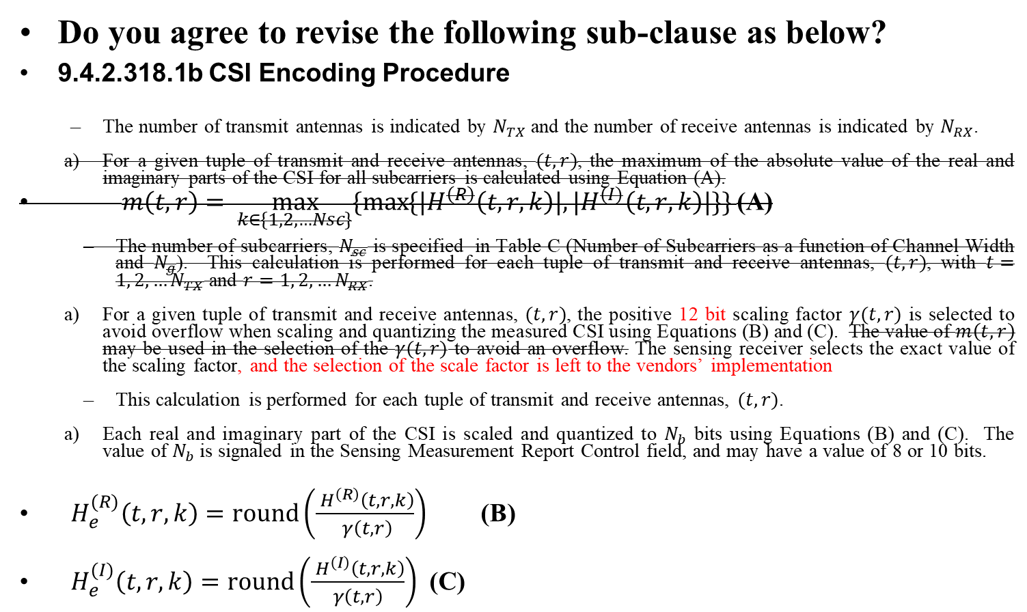
SP 3
Do you agree to revise the following sub-clause as below?
9.4.2.318.1b CSI Encoding Procedure
  The number of transmit antennas is indicated by $N_{TX}$ and the number of receive antennas is indicated by $N_{RX}$.
  For a given tuple of transmit and receive antennas, $(t, r)$, the maximum of the absolute value of the real and imaginary parts of the CSI for all subcarriers is calculated using Equation (A).
$m\left(t,r\right)= \max_{k∈\{1, 2, …Nsc\}}{\{\max{\{{|H}^{\left(R\right)}\left(t, r, k\right)|, |H^{(I)}\left(t, r, k\right)|\}\}} }$ (A)
  The number of subcarriers, $N_{sc}$ is specified in Table C (Number of Subcarriers as a function of Channel Width and $N_{g}$). This calculation is performed for each tuple of transmit and receive antennas, $(t, r)$, with $t=1, 2, …N_{TX}$ and $r=1, 2, …N_{RX}$.
  For a given tuple of transmit and receive antennas, $(t, r)$, the positive 12 bit scaling factor $γ(t, r)$ is selected to avoid overflow when scaling and quantizing the measured CSI using Equations (B) and (C). The value of $m\left(t,r\right)$ may be used in the selection of the $γ(t,r)$ to avoid an overflow. The sensing receiver selects the exact value of the scaling factor, and the selection of the scale factor is left to the vendors’ implementation
  This calculation is performed for each tuple of transmit and receive antennas, $(t, r)$.
  Each real and imaginary part of the CSI is scaled and quantized to $N_{b}$ bits using Equations (B) and (C). The value of $N_{b}$ is signaled in the Sensing Measurement Report Control field, and may have a value of 8 or 10 bits.
$H_{e}^{(R)}\left(t, r, k\right)=round\left(\frac{ H^{\left(R\right)}\left(t,r,k\right)}{ γ\left(t,r\right)}\right)$ (B)
$H_{e}^{(I)}\left(t,r, k\right)=round\left(\frac{ H^{\left(I\right)}\left(t,r,k\right)}{γ\left(t,r\right)}\right)$ (C)

