Slide 1
Extra Normalization Before CSI Quantization
Date: 2022-08-25
Authors:
Name | Affiliation | Address | Phone | Email
Junghoon Suh | Huawei |  |  | junghoon.suh@huawei.com
Yan Xin |  |  |  | Yan.Xin@huawei.com
Mengshi Hu |  |  |  | humengshi@huawei.com

Slide 2
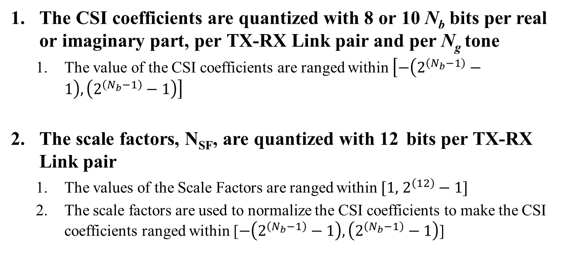
CSI Quantization in TGbf
The CSI coefficients are quantized with 8 or 10 N_{b} bits per real or imaginary part, per TX-RX Link pair and per N_{g} tone
  The value of the CSI coefficients are ranged within $\left[−\left(2^{\left(N_{b}−1\right)}−1\right),\left(2^{\left(N_{b}−1\right)}−1\right)\right]$
The scale factors, N_{SF}, are quantized with 12 bits per TX-RX Link pair
  The values of the Scale Factors are ranged within $[1,$ $2^{\left(12\right)}−1]$
  The scale factors are used to normalize the CSI coefficients to make the CSI coefficients ranged within [$−\left(2^{\left(N_{b}−1\right)}−1\right), \left(2^{\left(N_{b}−1\right)}−1\right)$]

Slide 3



Data Path Size Control
Round( $\frac{U}{M_{U}}\left(2^{N_{U}−1}−1\right)$ )
Round( $\frac{D}{M_{D}}\left(2^{N_{D}−1}−1\right)$ )
AGC
ADC
U
FFT
D
N_{U}
N_{D}
Maximum of the amplitude of U, M_{U}
Maximum of the amplitude of D, M_{D}
Maximum of the amplitude of H_{c}, M_{H}, where H_{c} is the channel estimation output
CSI
Quantization
H_{n}
Extra
Normalization
N_{P}
H_{c}
GI Removal and
Channel Estimation
$H=Round( \frac{H_{c}}{M_{H}}\left(2^{N_{P}−1}−1\right)$ )

Slide 4
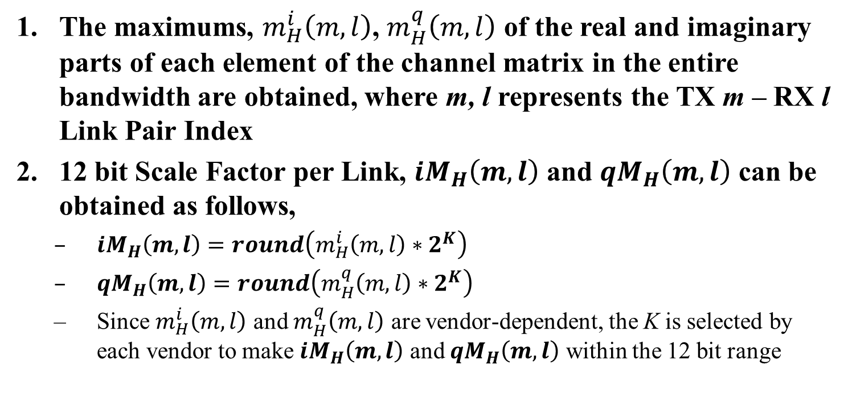
Proposed Detail of CSI Quantization: Responder Side
The maximums, $m_{H}^{i}\left(m,l\right)$, $m_{H}^{q}\left(m,l\right)$ of the real and imaginary parts of each element of the channel matrix in the entire bandwidth are obtained, where m, l represents the TX m – RX l Link Pair Index
12 bit Scale Factor per Link, ${iM}_{H}\left(m,l\right)$ and ${qM}_{H}\left(m,l\right)$ can be obtained as follows,
  ${iM}_{H}\left(m,l\right)=round\left(m_{H}^{i}\left(m,l\right)∗2^{K}\right)$
  ${qM}_{H}\left(m,l\right)=round\left(m_{H}^{q}\left(m,l\right)∗2^{K}\right)$
  Since $m_{H}^{i}\left(m,l\right)$ and $m_{H}^{q}\left(m,l\right)$ are vendor-dependent, the K is selected by each vendor to make ${iM}_{H}\left(m,l\right)$ and ${qM}_{H}\left(m,l\right)$ within the 12 bit range

Slide 5
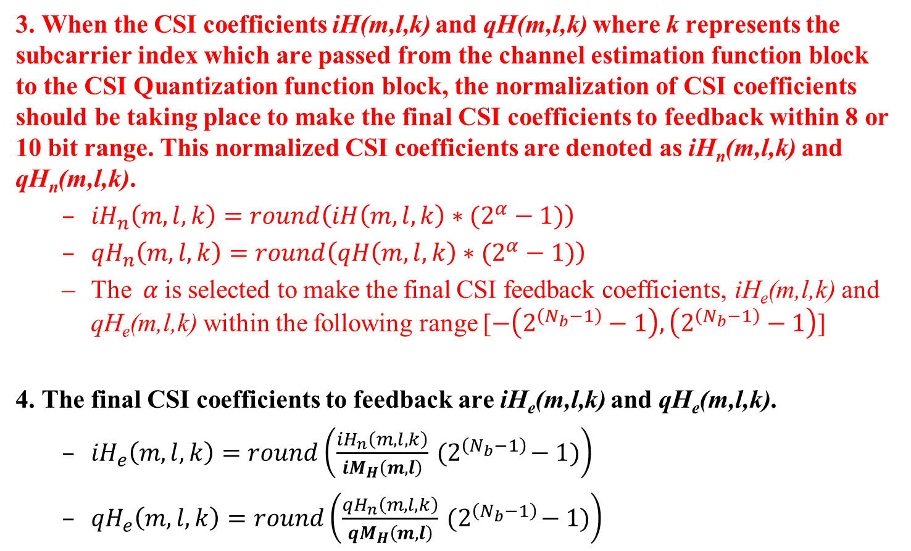
3. When the CSI coefficients iH(m,l,k) and qH(m,l,k) where k represents the subcarrier index which are passed from the channel estimation function block to the CSI Quantization function block, the normalization of CSI coefficients should be taking place to make the final CSI coefficients to feedback within 8 or 10 bit range. This normalized CSI coefficients are denoted as iH_{n}(m,l,k) and qH_{n}(m,l,k).
  ${iH}_{n}\left(m,l,k\right)=round\left({iH\left(m,l,k\right)∗(2}^{α}−1)\right)$
  ${qH}_{n}\left(m,l,k\right)=round\left({qH\left(m,l,k\right)∗(2}^{α}−1)\right)$
  The$α$ is selected to make the final CSI feedback coefficients, iH_{e}(m,l,k) and qH_{e}(m,l,k) within the following range [$−\left(2^{\left(N_{b}−1\right)}−1\right), \left(2^{\left(N_{b}−1\right)}−1\right)$]
4. The final CSI coefficients to feedback are iH_{e}(m,l,k) and qH_{e}(m,l,k).
  ${iH}_{e}\left(m,l,k\right)=round\left(\frac{{iH}_{n}\left(m,l,k\right)}{{iM}_{H}\left(m,l\right)}{ (2}^{\left(N_{b}−1\right)}−1)\right)$
  ${qH}_{e}\left(m,l,k\right)=round\left(\frac{{qH}_{n}\left(m,l,k\right)}{{qM}_{H}\left(m,l\right)}{ (2}^{\left(N_{b}−1\right)}−1)\right)$

Slide 6
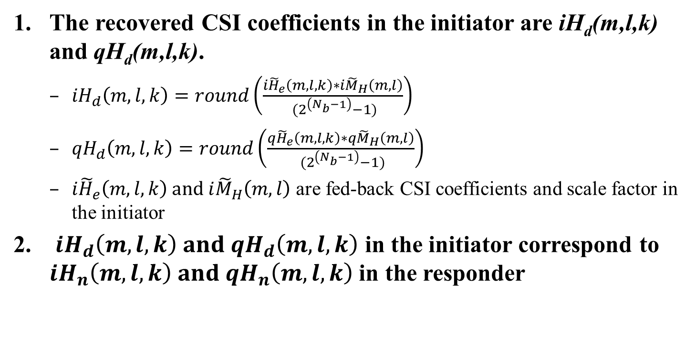
Proposed Detail of CSI Quantization: Initiator Side
The recovered CSI coefficients in the initiator are iH_{d}(m,l,k) and qH_{d}(m,l,k).
  ${iH}_{d}\left(m,l,k\right)=round\left(\frac{{i\tilde{H}}_{e}\left(m,l,k\right)∗{i\tilde{M}}_{H}\left(m,l\right)}{{ (2}^{\left(N_{b}−1\right)}−1)}\right)$
  ${qH}_{d}\left(m,l,k\right)=round\left(\frac{{q\tilde{H}}_{e}\left(m,l,k\right)∗{q\tilde{M}}_{H}\left(m,l\right)}{{ (2}^{\left(N_{b}−1\right)}−1)}\right)$
  ${i\tilde{H}}_{e}\left(m,l,k\right) and {i\tilde{M}}_{H}\left(m,l\right)$ are fed-back CSI coefficients and scale factor in the initiator
${iH}_{d}\left(m,l,k\right) and {qH}_{d}\left(m,l,k\right)$ in the initiator correspond to ${iH}_{n}\left(m,l,k\right) and {qH}_{n}\left(m,l,k\right)$ in the responder

Slide 7
Conclusions
It is implementation-specific on how to come up with the N_{b} sized CSI coefficients, and the N_{SF} sized Scale Factor
  However, we need to provide an example or two for the detail implementation from a guidance purpose
We may need an extra normalization for the Estimated CSI coefficients before the CSI Quantization for feedback
The step 3 in red color on slide 5 is not described in the Spec text and left as implementation-specific
  Do we need to introduce the extra normalization step into the Spec text?

Slide 8
SP 1
Do you agree to provide an example or two on the detail implementation of CSI Quantization and Feedback?
  Yes
  No
  Abstain

Slide 9
SP 2
Do you agree to add the following to the Spec text?
  There may be an additional normalization for the channel estimation coefficients in the responder side to feedback the CSI coefficients in N_{b} bits

