Slide 1
Requirements of Low Latency in UHR
Date: 2022-09-xx
Authors:

Slide 2
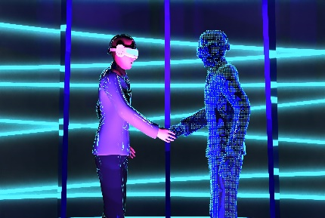

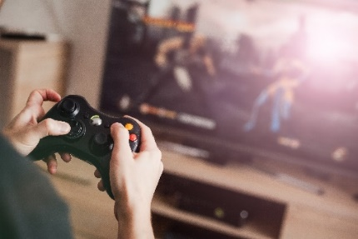
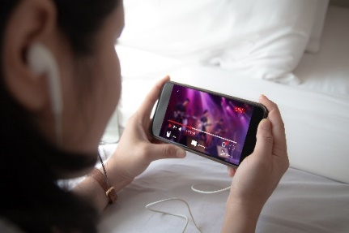
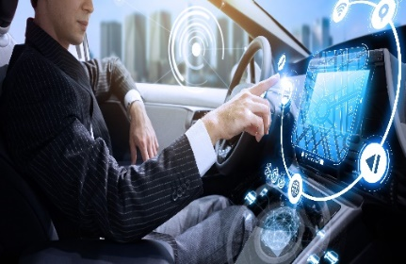

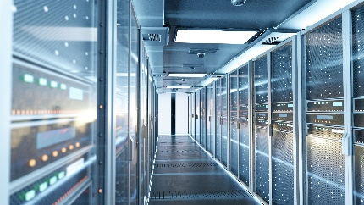

Use Cases of Low Latency
Low latency use cases have been discussed in [1]:
  Metaverse
  VR/AR
  Cloud gaming
  Real-time video streaming
  In-vehicle infotainment
  Tactile signals
  Industrial PLC control
  P2P links(distributed sharing/operation between devices)

Slide 3
Use Cases of Low Latency
Latency requirements of some use cases:
Use Cases | Equipment | Application Specification | Delay Requirement | Bandwidth
Real-time Video Streaming | Sink:PC/Pad/Avatar/Large Screen/Car Source: Phone/Pad/PC | P2P Screen Sharing Cloud-based Gaming Web Conference | <10ms@95% <100ms@99.99% | ~25Mbps@2K ~50Mbps@4K
Real-time Control Messaging | P2P Hardware Control (Keyboard/Mouse sharing) | Reverse haptic control | <4ms@95% <40ms@99.99% | ~2Mbps
 |  | Keyboard and mouse feedback | <4ms@95% <40ms@99.99% | ~400Kbps
V2X | Vehicle | Autonomous driving/Traffic safety control | 10ms-20ms^{[23]} | /

Slide 4
Current Methods to Reduce Latency
  Increasing contention opportunity
  Multi-link operation(MLO), optimized CSMA/CA [2] or EDCA parameters [3] and restricted TWT [4]
  Traffic shaping: prioritize critical applications while delaying less significant data packets [5]
  Reducing number of contentions among STAs
  parallel transmission (OFDMA, MU-MIMO, Spatial reuse [6])
  subgrouping: break the network down into smaller, more frequently communicated groups
  load balancing: distribute incoming network traffic over several servers on the backend [7]

Slide 5
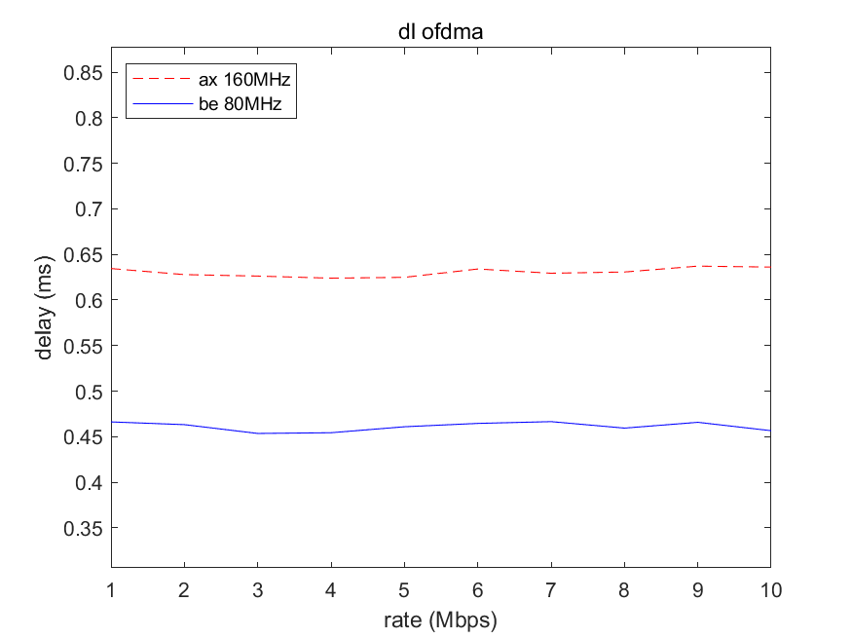
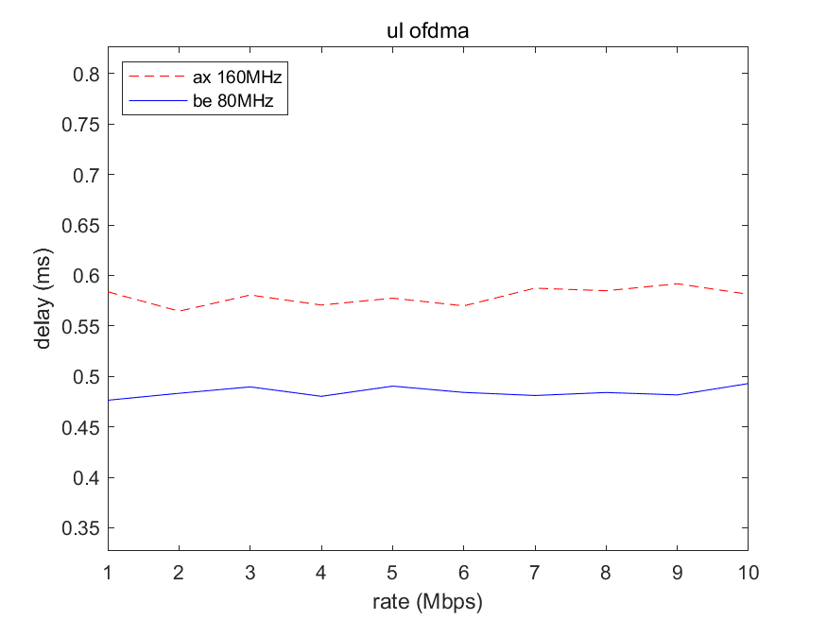
Current Methods to Reduce Latency
Take MLO for an example, it is promising way to improve latency performance [8]
The simulation setup assumes 5 BSSs are using the same channel, where there is 1 AP or AP MLD within each BSS. In 11ax, each AP is associated with 4 STAs, while in 11be, each AP MLD is associated with 4 non-AP MLDs.
The simulation results show that the latency of 11be is reduced around 32% compared to that of 11ax.
Our
Downlink OFDMA
Uplink OFDMA

Slide 6
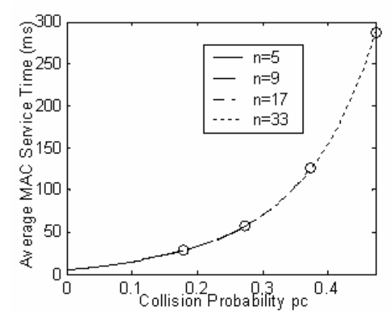
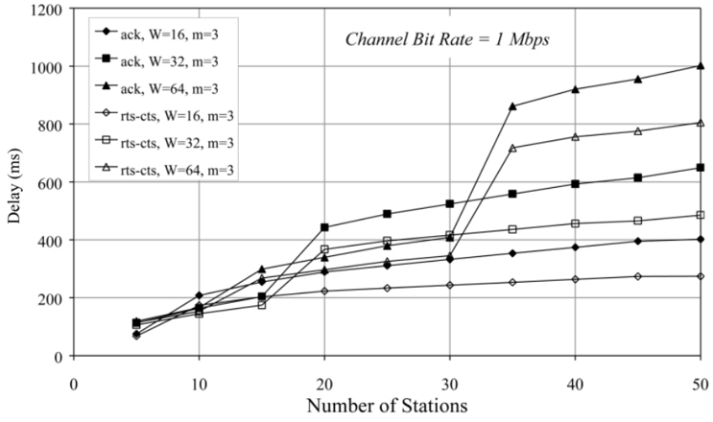
Analysis of WLAN latency
  However, all of current methods can’t address the delay issue resulted from channel access
  Channel access become the bottleneck of latency performance improvement
  Delay due to Channel access/collision
    Packets may be sent at irregular intervals due to the fact that multiple users are accessing the channel simultaneously and collision happens
    A higher collision probability will likely result in a higher average delay [9][10]
    The delay is highly affected by the CSMA/CA scheme with different mechanisms [11]
An increased number of users results in a higher collision probability and delay
When the traffic is saturated, the delay is highly affected by initial window size, maximum number of backoff, and the CSMA w/ or w/o RTC-CTS

Slide 7
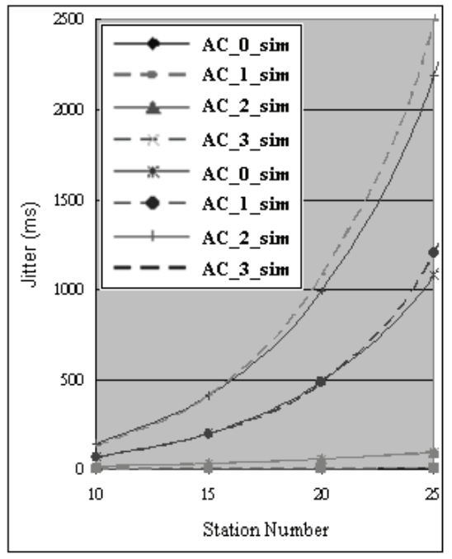
Analysis of WLAN latency
Jitter due to Channel access/collision
  As discussed in [12], the channel access scheme has an overwhelming impact on the jitter.
  Theoretically, jitter can be derived as the function of contention window, station number and packet length [13].
  The minimum jitter can be obtained by tuning the contention window for given network size and packet length.
  It implies that the jitter cannot be lower than certain value via any optimization w.r.t. CSMA/CA parameters.
The jitter increases as the station number increases given different initial window size and maximum number of backoff

Slide 8
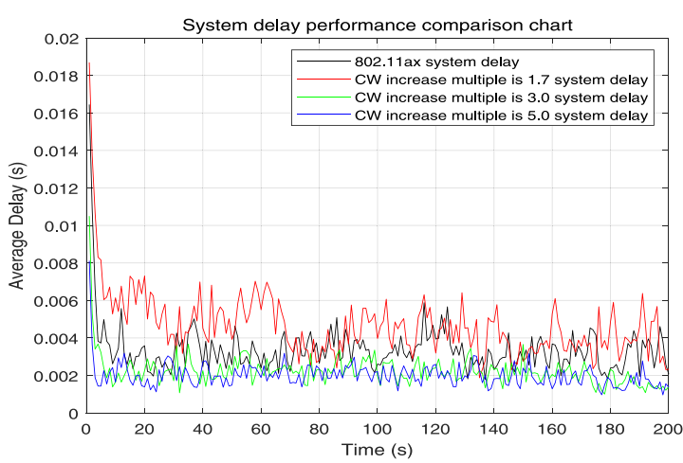
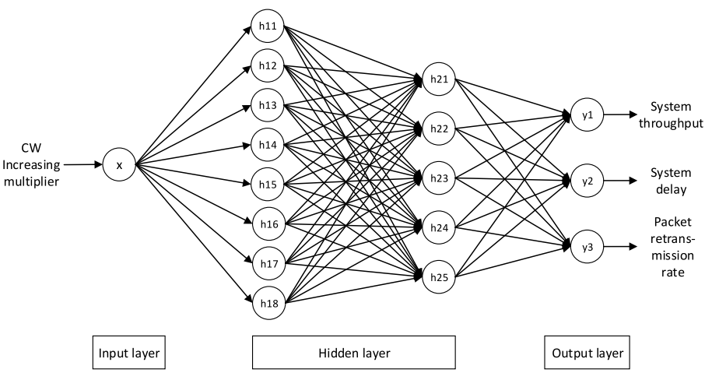
Latency Performance Improvement with AI/ML
Deep reinforcement learning(DRL) for optimizing contention window [14][15]
This deep learning scheme could always find the optimal CW adjustment multiple by adaptively perceiving the channel competition status. The finalized performance of the model has been significantly improved in terms of system throughput, average transmission delay, and packet retransmission rate

Slide 9
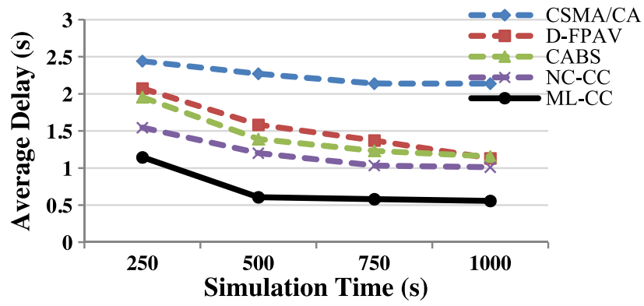
Latency Performance Improvement with AI/ML
Machine learning based congestion control strategy for reducing latency [16]
Based on the proposed DNN model, this contention window adaptation algorithm is able to deliver consistently higher average throughput, lower end-to-end delay, as well as improved fairness

Slide 10
Conclusion
Lots of works have been done to improve latency while CSMA/CA is still the bottleneck of the latency performance
Machine learning techniques have shown effectiveness in reducing latency by studying the dynamic characteristics of the WLAN
We propose to use AI/ML techniques to further improve the latency performance

Slide 11
References
[1] 11-22-0723-00-0wng-further-discussion-on-next-generation-wlan
[2] 11-22-0979-01-aiml-applying-ml-to-802-11-current-research-and-emerging-use-cases
[3] Serrano P, Banchs A, Patras P, et al. Optimal configuration of 802.11 e EDCA for real-time and data traffic[J]. IEEE Transactions on Vehicular Technology, 2010, 59(5): 2511-2528.
[4] Adame T, Carrascosa-Zamacois M, Bellalta B. Time-sensitive networking in IEEE 802.11 be: On the way to low-latency WiFi 7[J]. Sensors, 2021, 21(15): 4954.
[5] Georgiadis L, Guérin R, Peris V, et al. Efficient network QoS provisioning based on per node traffic shaping[J]. IEEE/ACM transactions on networking, 1996, 4(4): 482-501
[6] de Carvalho Rodrigues E, Garcia-Rodriguez A, Giordano L G, et al. On the Latency of IEEE 802.11 ax WLANs with Parameterized Spatial Reuse[C]//GLOBECOM 2020-2020 IEEE Global Communications Conference. IEEE, 2020: 1-6.
[7] Dhakal S, Hayat M M, Pezoa J E, et al. Dynamic load balancing in distributed systems in the presence of delays: A regeneration-theory approach[J]. IEEE transactions on parallel and distributed systems, 2007, 18(4): 485-497.
[8] 11-22-1348-00-00be-lb266-cr-for-par-verification-low-latency
[9] Tickoo, Omesh, and Biplab Sikdar. "Modeling queueing and channel access delay in unsaturated IEEE 802.11 random access MAC based wireless networks." IEEE/ACM transactions on networking 16.4 (2008): 878-891.
[10] Zhai, Hongqiang, Younggoo Kwon, and Yuguang Fang. "Performance analysis of IEEE 802.11 MAC protocols in wireless LANs." Wireless communications and mobile computing 4.8 (2004): 917-931.
[11] Ziouva, Eustathia, and Theodore Antonakopoulos. "CSMA/CA performance under high traffic conditions: throughput and delay analysis." Computer communications 25.3 (2002): 313-321.
[12] Huang, Ching-Ling, and Wanjiun Liao. "Throughput and delay performance of IEEE 802.11 e enhanced distributed channel access (EDCA) under saturation condition." IEEE Transactions on wireless communications 6.1 (2007): 136-145.
[13] Dai L, Sun X., “A Unified Analysis of IEEE 802.11 DCF Networks: Stability, Throughput, and Delay”, IEEE Transactions on Mobile Computing, Vol. 12, No. 8, 2013

Slide 12
References(cont’d)
[14] Chen C, Li J, Balasubramaniam V, et al. Contention resolution in Wi-Fi 6-enabled internet of things based on deep learning[J]. IEEE Internet of Things Journal, 2020, 8(7): 5309-5320.
[15] Edalat Y, Obraczka K. Dynamically Tuning IEEE 802.11's Contention Window Using Machine Learning[C]//Proceedings of the 22nd International ACM Conference on Modeling, Analysis and Simulation of Wireless and Mobile Systems. 2019: 19-26.
[16] Taherkhani, Nasrin, and Samuel Pierre. "Centralized and localized data congestion control strategy for vehicular ad hoc networks using a machine learning clustering algorithm." IEEE Transactions on Intelligent Transportation Systems 17.11 (2016): 3275-3285.

