Slide 1
A candidate feature: Multi-AP
Date: 2022-09-13
Authors:
Name | Affiliation | Address | Phone | Email
Jinyoung Chun | LG Electronics | 19, Yangjae-daero 11gil, Seocho-gu, Seoul 137-130, Korea |  | jiny.chun@lge.com
Dongguk Lim |  |  |  | dongguk.lim@lge.com
Eunsung Park |  |  |  | esung.park@lge.com
Insik Jung |  |  |  | insik0618.jung@lge.com
Insun Jang |  |  |  | insun.jang@lge.com
Sunhee Baek |  |  |  | sunhee.baek@lge.com
Jinsoo Choi |  |  |  | js.choi@lge.com

Slide 2
Introduction
In the last plenary session, UHR SG is formatted. The Study Group will investigate technology which may improve reliability of WLAN connectivity, reduce latencies, increase manageability, increase throughput including at different SNR levels, and reduce device level power consumption [1].
In this document, we’ll introduce the necessity, check the feasibility of multi-AP schemes as one candidate feature for improving reliability of WLAN connectivity, and find out the PHY/MAC techniques to be developed.

Slide 3
Needs of Multi-AP in IEEE (1/2)
At Home, an AP is not enough to support signaling in the whole rooms due to obstacles like wall. So we can set several APs but it makes conflict signaling between APs. For this reason, multi-AP schemes can be a good solution.
Easy Mesh from WFA(originally named by Multi-AP) is already used but it’s focused on AP selection without PHY and MAC change. In IEEE, we can make multi-AP techniques by enhancing PHY and MAC features for coordination and sharing in frequency, time, and spatial domain (e.g. RU selection, Joint transmission, or Nulling).
< Easy Mesh deployment example >
refer to Wi-Fi_EasyMesh_Specification_DRAFT_R5)

Slide 4
Needs of Multi-AP in IEEE (2/2)
An use case
  We can consider Home Appliances like TV, refrigerator that equips Wi-Fi connectivity. Currently, home appliances operate as one of WiFi device like Smart Home IoT Service. In the future, the home appliances can be used as Shared AP connected with Sharing AP by using IEEE WiFi Multi-AP techniques.
  Some of devices can get signals jointly from Sharing AP and Shared AP, and some can get signals from an AP avoiding other AP’s interference.

Slide 5
Multi-AP techniques (1/2)
Many multi-AP schemes were introduced from EHT TIG/SG to 11be TG [2-15] and can be categorized as below:
  Coordinated Transmission (C-TX)
    APs transmit data signals
      by splitting the spectrum (Coordinated OFDMA),
      by coordinating the spatial resource (Coordinated SR),
      by limiting interference from other APs (Coordinated Beamforming/Nulling),
      selectively(AP selection),
      etc.
    The techniques can be used jointly.
    Information sharing and scheduling between APs are needed.
    It helps improving the reliability of WLAN connectivity and reducing the latency.

Slide 6
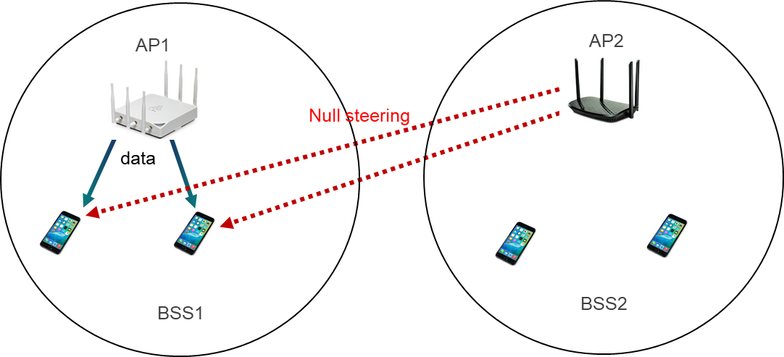
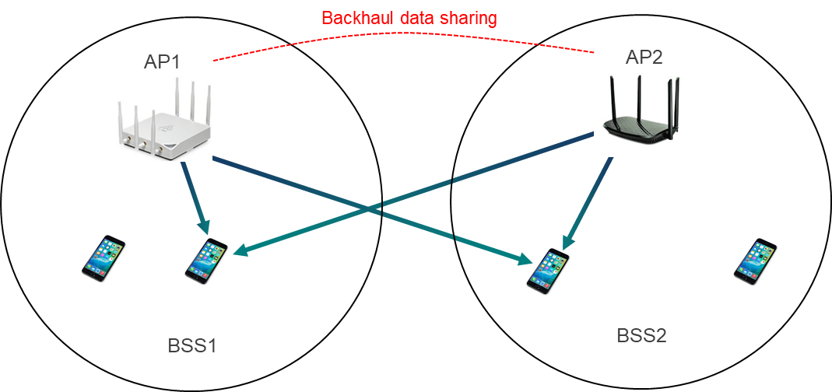
Multi-AP techniques (2/2)
  Joint Transmission (J-TX)
    APs transmit data signals jointly.
      to a STA simultaneously (Joint Beamforming)
      to multiple STAs simultaneously (Joint MU-MIMO)
    Not only Information sharing and scheduling (like C-TX) but also Data sharing between APs are needed.
    It helps improving the reliability of WLAN connectivity and increasing edge user throughput.
< An example of Coordinated beamforming/nulling >
< An example of Joint MU-MIMO >

Slide 7
The performance and the overhead of Multi-AP techniques
The performance of Multi-AP techniques
  Generally, C-TX has better performance than S-TX(single transmission), and J-TX has better performance than C-TX.
    [7] said, comparing with EDCA and SR, Coordinated SR has about 20~40% throughput gain when the number of Shared APs is more than 1 in both of Downlink and Uplink.
    [11] said, in the interference limited region, C-TX has a better performance than S-TX (single transmission) but its performance couldn’t reach that of J-TX. And in the noise limited region, S-TX offers a good performance but it is hard to always guarantee a low interference level favorable to S-TX especially in a dense environment.
The overhead of Multi-AP techniques
  Multi-AP operation can bring some overhead
    Wireless backhaul (AP-to-AP) negotiation signaling for information sharing between APs
    Channel status report of OBSS AP
  In addition, J-TX needs more overhead like [12]
    Wireless backhaul (AP-to-AP) data sharing for transmitting jointly
    OBSS NDP sounding for making beamforming matrix jointly

Slide 8
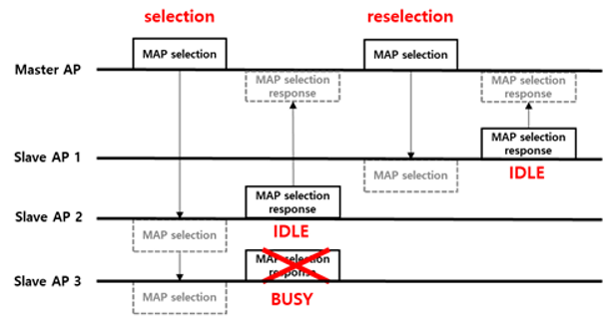
The required PHY/MAC features (1/4)
For preparing Multi-AP operation,
  Sharing AP has to know shared APs’ status.
    AP’s status means Multi-AP capabilities, channel status, buffer status of Shared APs and STAs operated in the Shared AP, etc.
    It can be done for sharing AP by overhearing the enhanced management frame or by requesting the information directly (e.g. defining new trigger frame to trigger OBSS APs’ reporting) to shared APs.
  AP selection and re-selection procedure is needed [14].
    Sharing AP and shared APs have to be selected based on the above information.
    And Sharing AP needs to recognize whether the selected Shared APs can participate.
Sharing AP
Shared AP1
Shared AP2
Shared AP3

Slide 9
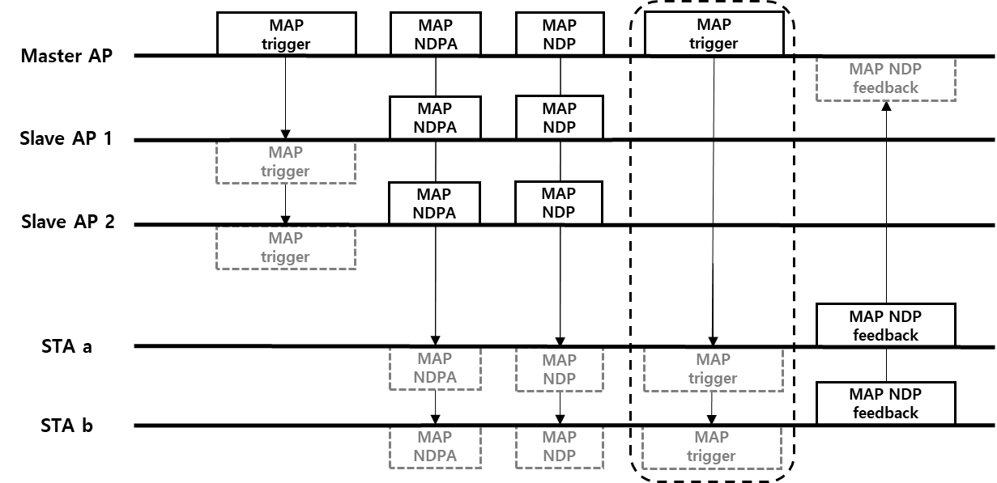
The required PHY/MAC features (2/4)
  OBSS channel status report or OBSS NDP sounding are needed.
    For Multi-AP operation, STAs have to report OBSS AP’s channel status. It can be done by listening on-going packet of OBSS AP or by doing NDP sounding with OBSS AP.
    Especially for J-TX, joint NDP sounding between sharing AP and shared APs shall be needed. And the details are also related to the maximum number of total spatial stream allowed for Multi-AP operation, and an example of procedure is as below [13].
  Wireless backhaul data sharing is needed.
    APs have to share data transmitted to STA(s) each other. It’s for J-TX only.
Sharing AP
Shared AP1
Shared AP2

Slide 10
The required PHY/MAC features (3/4)
For transmitting Multi-AP data,
  Sharing AP triggers Multi-AP operation to shared APs.
    New Multi-AP trigger frame can be defined [15] with the information including:
      Multi-AP types like C-OFDMA, C-SR, Joint Beamforming, etc
      Participated Shared APs’ information and STAs’ information
      Operation and allocation method like, for example, channel/RU allocation for C-OFDMA*, SR information for C-SR**, beamforming matrix information for J-TX***. It can be differed by Multi-AP types.
      * The minimum allocation unit per APs has to be defined for C-OFDMA operation.
      ** It needs to study which combination of DL/UL of Sharing AP/Shared AP are allowed/possible [10].
      *** The maximum number of total spatial streams of APs shall be defined. New beamforming matrix design can be needed for supporting over 8 streams.

Slide 11
The required PHY/MAC features (4/4)
  And the Shared APs/Sharing AP transmit data to each STA(s).
    New PPDU format may be needed including preamble design.
      For example of DL C-OFDMA, the data can be transmitted with joint preamble or discrete preamble.
        PPDU format with joint preamble: U-SIG can be transmitted identically with the same information including all information of Sharing AP and Shared APs through whole bandwidth.
        PPDU format with discrete preamble: U-SIG can be transmitted with own AP’s information in own allocated bandwidth.
        * STF/LTF design can be changed depending on the PPDU format. And 2nd method may be studied with primary channel rule.
      For example of Joint Beamforming, shared APs can transmit data like UL MU-MIMO in 11be. (but it’s transmitted from shared AP, not from STA like in 11be).
< An example of data transmission procedure of DL C-OFDMA >

Slide 12
Summary
We reviewed Multi-AP techniques and studied the performance, overhead and required PHY/MAC changes.
  Multi-AP techniques have better performance than S-TX generally and we can consider Multi-AP as one of candidate features in UHR SG to help improving reliability of WLAN connectivity.
  But Multi-AP techniques also have more overhead. Especially J-TX needs data sharing between APs and OBSS NDP sounding, etc.
  Therefore we need to check the feasibility and the benefit carefully.

Slide 13
Reference
[1] 11-22/0708r3, ‘Beyond be – Proposed Next Step’, Rolf de Vegt
[2] 11-20/1934r66, ‘Compendium of straw polls and
potential changes to the Specification Framework Document’, Edward Au
[3] 11-18/1926r2, ‘Terminology for AP Coordination’, Sameer Vermani
[4] 11-18/1576r1, ‘Considerations on AP Coordination’, Yang Bo, Roger Marks, Lyu Yunping, Yuchen Guo
[5] 11-18/1547r0, ‘Technology Features for 802.11 EHT’, Kome Oteri
[6] 11-19/0638r0, ‘Nulling and coordinated beamforming’, Sigurd Schelstraete
[7] 11-19/0801r0, ‘AP Coordination in EHT’, Jason Yuchen Guo
[8] 11-19/1594r2, Coordinated Beamforming/Null Steering Protocol in 802.11be, David Lopez-Perez
[9] 11-20/410r0, ‘Coordinated Spatial Reuse Procedure’, Sungjin Park
[10] 11-20/1040r0, ‘Coordinated SR for Uplink’, Jonghun Han
[11] 11-19/0779r1, ‘Performance Investigation on Multi-AP Transmission’, Eunsung Park
[12] 11-19/1089r0, ‘Joint Transmissions: Backhaul and Gain State Issues’, Sameer Vermani
[13] 11-19/1895r2, ‘Setup for Multi-AP coordination’, Sungjin Park
[14] 11-19/1143r3, ‘Efficient Operation for Multi-AP Coordination’, Sungjin Park
[15] 11-20/0560r0, ‘Multi-AP Configuration and Resource Allocation’, Po-Kai Huang

