Slide 1
Non-zero backoff
Date: 2021-05-18
Authors:
Name | Company | Address | Phone | Email
Liangxiao Xin | Sony Corporation |  |  | Liangxiao.Xin@sony.com
Li-Hsiang Sun |  |  |  | Li-Hsiang.Sun@sony.com

Slide 2
Related Comments
CID | Commenter | Clause Number(C) | Comment | Proposed Change | Resolution
10702 | Liangxiao Xin | 35.17.3.2 | It is not clear how to provide prioritized access for EPCS traffic using EPCS EDCA parameters. How EPCS EDCA parameters gives higher priority than regular EDCA parameter of AC_VO? | Commenter will bring a contribution for the resolution of this CID. | Revised Agree with the commenter. Provide non-zero backoff procedure with AIFSN=1 to have higher priority than AC_VO
10697 | Liangxiao Xin | 35.9.4 | Should give higher priority of member STAs and scheduling AP to gain the channel access during R-TWT SP compared with OBSS STAs. | A backoff procedure with higher priority needs to be added. Commenter will bring a contribution for the resolution of this CID | Revised Agree with the commenter. Provide non-zero backoff procedure with AIFSN=1 to have higher priority than AC_VO

Slide 3
Introduction
TGbe defines latency sensitive traffic and EPCS traffic which require higher priority than regular traffic.
However, those two types of traffic still use regular EDCA for channel contention, which makes it vulnerable to the OBSS channel contention.
  Channel access mechanisms for latency sensitive traffic and EPCS traffic only take effect inside BSS.
  OBSS, especially legacy OBSS, can still use EDCAF of AC_VO to contend the channel and ignore the existence of the mechanisms for latency sensitive traffic and EPCS traffic.
In order to provide higher priority to latency sensitive traffic and EPCS traffic, a channel access mechanism with higher priority than AC_VO is needed.
We propose a non-zero backoff procedure to bound the contention time and have higher priority than legacy backoff procedure, such as AC_VO.

Slide 4
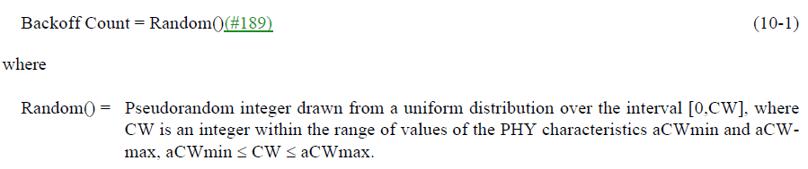
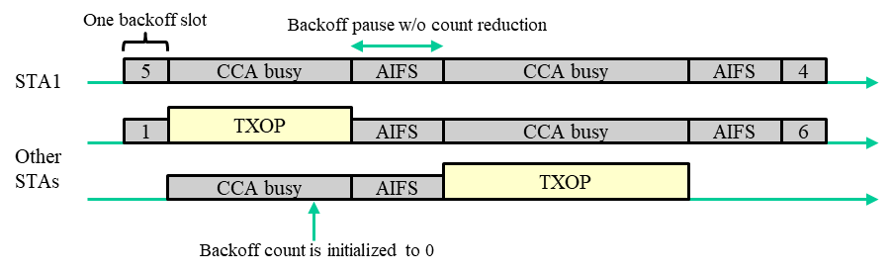
Problem of legacy backoff procedure
Contention time has significant impact on the worst-case latency.
  Contention time is denoted as the time from starting backoff until access the channel
  The number of backoff slots during contention time is randomized due to the CW.
  The contention time is not bounded because there are cases that the backoff counters do not count down between two consecutive TXOPs of other STAs.
The problem occurs because the backoff count can be initialized to be 0
  For the same EDCAF, if another STA initializes its backoff count = 0, it gains the channel access and transmits first. Then, STA 1 enters CCA busy without counting down its backoff counter.

Slide 5
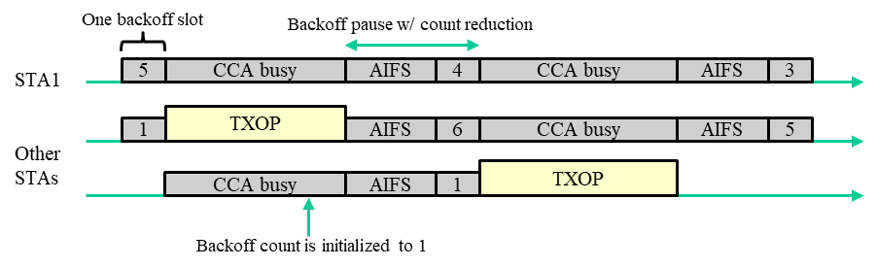
Non-zero backoff
When setting the backoff counter, the number of backoff slots is always greater than 0.
  STA1 counts down backoff counter at least by 1 between two consecutive TXOPs of other STAs.
  The contention time is bounded by # backoff slots * (TXOP_limit + aAIFSTime + aSlotTime)

Slide 6
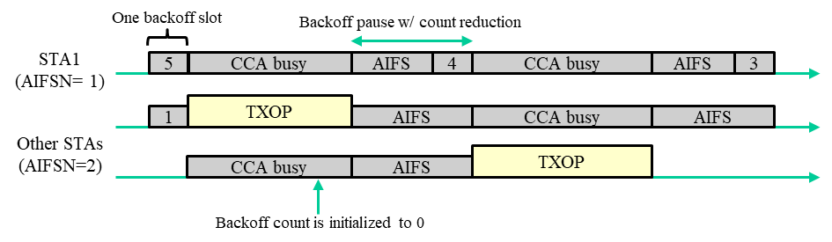
Non-zero backoff
The non-zero backoff procedure can set its AIFSN = 1.
  For legacy backoff, AIFSN >=2 because its AIFS time has to be greater than PIFS.
  In non-zero backoff, AIFSN = 1 is possible because AIFS is always followed by at least one backoff slot.
    Min non-zero backoff time = aAIFSTime(AIFSN=1) + aSlotTime = aAIFSTime(AIFSN=2) = Min legacy backoff time of AC_VO > aPIFSTime

Slide 7
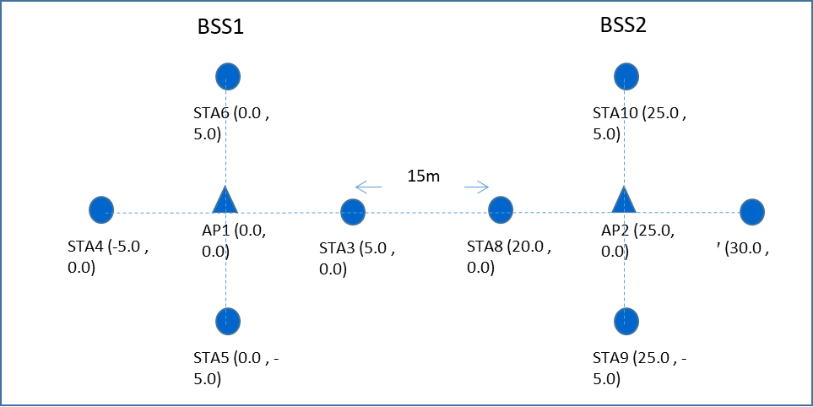
Simulation
Simulation Setting
  Two BSSs, each BSS has one AP and four STAs
  STAs in BSS1 and BSS2 transmits AC_VO traffic to AP1, AP2, respectively.
    Packet size = 1000 bytes
    MCS = 64QAM_5/6
    Channel bandwidth = 80MHz
  Non-zero backoff: the backoff count is set between [1, CW[AC_VO]+1]
  Legacy backoff: the backoff count is set between [0, CW[AC_VO]]
  TXOP limit = 3ms

Slide 8
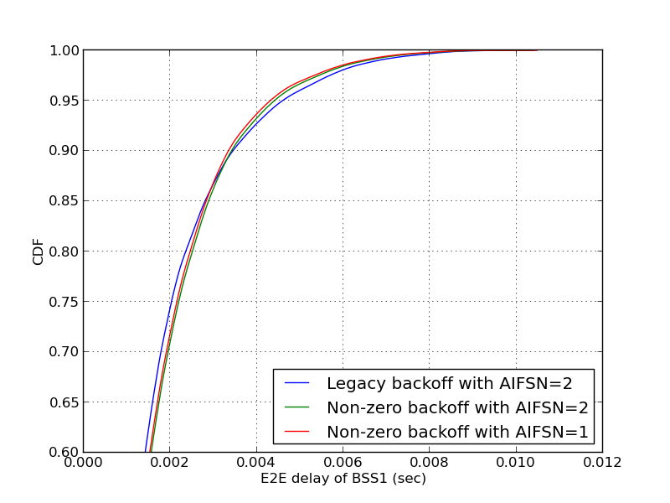
Simulation Result 1
Each STA of BSS1 and BSS2 generates 30 pkts burst traffic every 0.012s
We repeated simulation for 100 times. In each simulation,
  The traffic start time of each STA is randomly distributed
The simulation result shows non-zero backoff with AIFSN=1 can improve the 95-pc latency and jitter of the network.
 | legacy backoff with AIFSN=2 | non-zero backoff with AIFSN=2 | non-zero backoff with AIFSN=1
95-pc latency | 5.44 ms | 5.16 ms | 5.04 ms
Avg latency | 1.61 ms | 1.68 ms | 1.65 ms
Jitter (SD) | 1.39 ms | 1.33 ms | 1.31 ms
95-pc latency of non-zero backoff with AIFSN=1 is 7.4% shorter

Slide 9
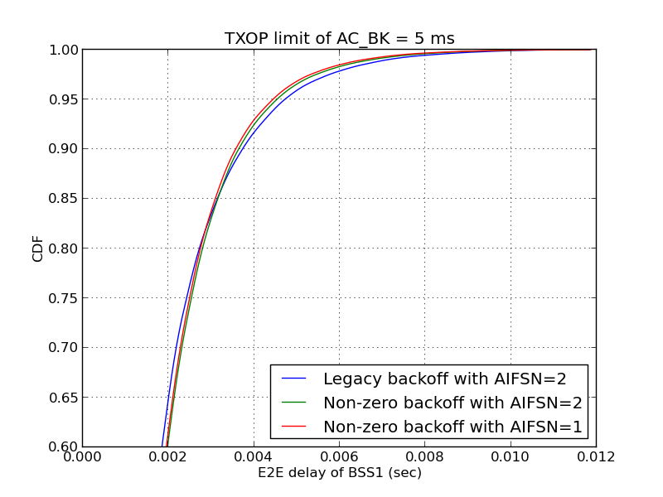
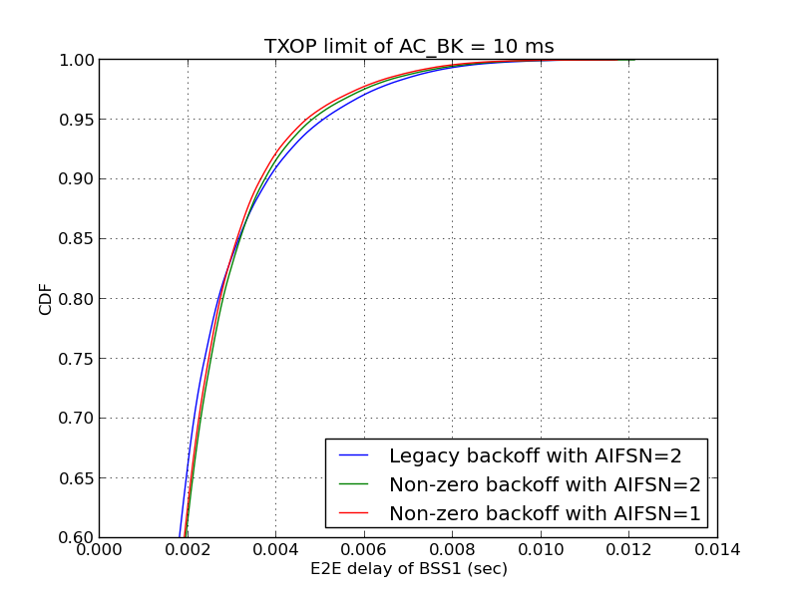
Simulation Result 2
Each STA of BSS1 and BSS2 generates 30 pkts burst traffic every 0.015s
Besides, there is one more node transmit saturated AC_BK traffic to AP2.
95-pc latency of non-zero backoff with AIFSN=1 is 5.7% shorter
95-pc latency of non-zero backoff with AIFSN=1 is 7.5% shorter
 | legacy backoff with AIFSN=2 | non-zero backoff with AIFSN=2 | non-zero backoff with AIFSN=1
95-pc latency (TXOP limit of AC_BK = 5 ms) | 4.71 ms | 4.53 ms | 4.44 ms
95-pc latency (TXOP limit of AC_BK = 10 ms) | 5.05 ms | 4.80 ms | 4.67 ms

Slide 10
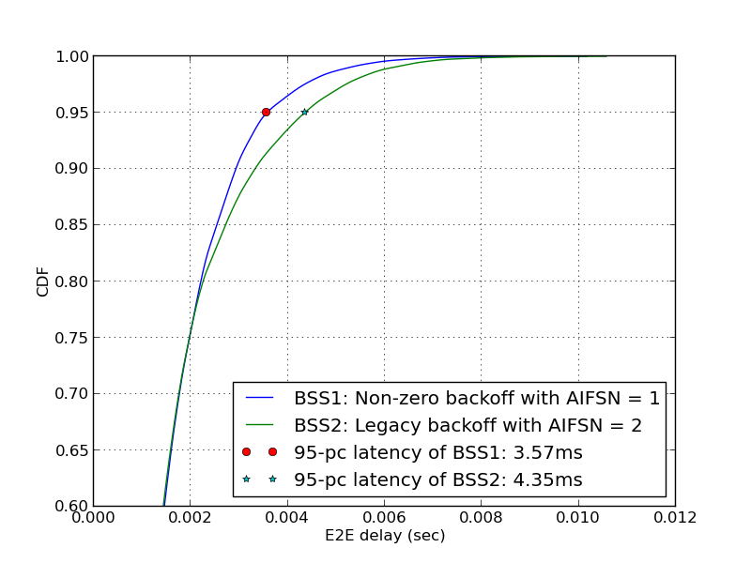
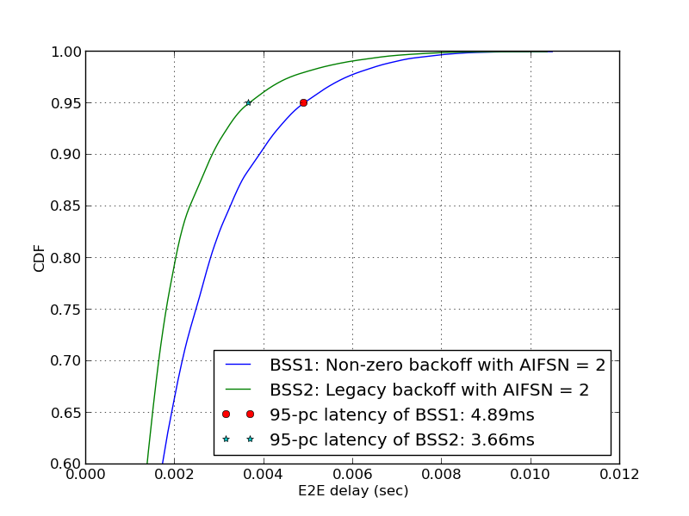
Simulation 3
Each STA of BSS1 and BSS2 generates 30 pkts burst traffic every 0.012s
  LHS figure: STAs of BSS1 use non-zero backoff with AIFSN=1 while STAs of BSS2 use legacy backoff with AIFSN=2.
  RHS figure: STAs of BSS1 use non-zero backoff with AIFSN=2 while STAs of BSS2 use legacy backoff with AIFSN=2.
The simulation results show that the non-zero backoff with AIFSN =1 has higher priority than legacy backoff (AC_VO).
95-pc latency of non-zero backoff with AIFSN=1 is 17.9% shorter
Non-zero backoff with AIFSN=2 has lower priority than legacy backoff with AIFSN=2

Slide 11
Summary
Non-zero backoff has the bounded contention time
  Max contention time = # backoff slots * (TXOP_limit + aAIFSTime + aSlotTime) according to theoretical analysis
  Worst-case latency and jitter are reduced compared with legacy backoff according to simulation results
Non-zero backoff can set AIFSN = 1 to prioritize the latency sensitive traffic and EPCS traffic
  Give the higher priority of channel access compared with legacy traffic (e.g., AC_VO)
  No scheduling is required and can be used in any network scenarios including OBSS interference
  Compliant with the legacy EDCA mechanism.

Slide 12
SP
Do you agree to add non-zero backoff to the spec?

Slide 13
backup

Slide 14
Test 3: Throughput of the network (saturation throughput of the network)
Number of Nodes | Legacy bakcoff with AIFSN =2 | Non-zero backoff with AIFSN = 1
8 | 206.54 Mbps | 206.31 Mbps
16 | 203.48 Mbps | 198.14 Mbps
24 | 211.69 Mbps | 208.81 Mbps

