Slide 1
Clause 6.3 re-write
Date: 2022-09
Authors:
Name | Company | Address | Phone | email
Graham Smith | SRT Group | Sunrise , FL |  | gsmith@srtrl.com

Slide 2
Background:
In writing some proposed new text for a number of request / response exchanges, I was informed that I needed to add text to Clause 6. I then went through the routine of writing descriptions for each request, plus the response, plus the indication plus the confirm. 10 pages later I started to think.
Clause 6 consumes 434 pages
MORE THAN Clause 11 (398 pages) !!!
Boy, this must be good stuff, thinks I… then I realized that what I am adding, in fact, was obvious from the text and frames, i.e., “boilerplate”
A presentation 21/1822 was originally made in ARC
ARC members indicated strong support to do something

Slide 3
Situation
TGme has motioned these changes and they are approved for the next Draft 1.5.
Hence
TGs should now start to look at any 6.3 additions/edits in the light that 6.3 has been completely revised.

Slide 4
RECAP
6.3 MLME SAP interface
“These services are described in an abstract way…and do not imply any particular implementation….”
MLME SAP primitives are of the general form
  ACTION.request primitive,
    Initiates request for a procedure
  ACTION.confirm primitive (for an exchange initiated by the SAP client)
    Reports result of request (success?)
  ACTION.indication primitive
    Result of receipt of request for procedure
  ACTION.response primitive (for an exchange initiated by the MLME)
    Initiate transmission of the requested procedure
There are 7 different “types”

Slide 5
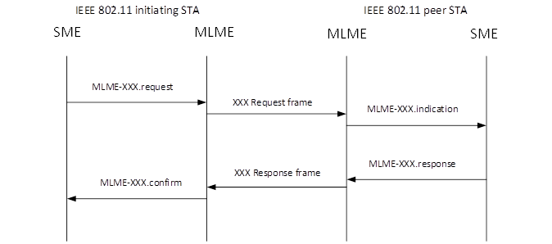
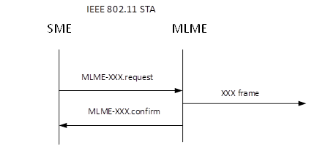
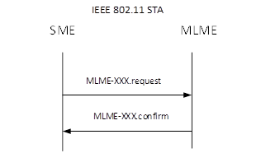
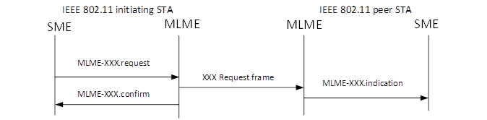
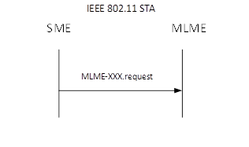
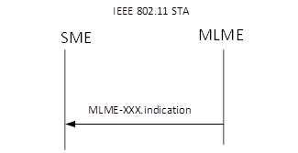
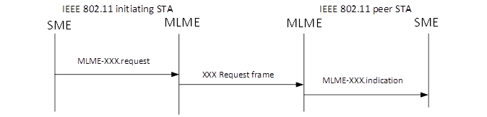
MLME-SAP Types
Type 1 – request/response
Type 4 – send a frame (Only 1, TPC request)
Type 2 – request only with confirm
e.g., disassociate, channel measurement
Type 5 – perform a process
e.g., activate power save,
get TSF
Type 3 – request only
Type 6 – perform a process
e.g., set protection
QMF policy set
Type 7 – indicate an event
e.g., MIC Failure
Often two type 3 used rather than one Type 1

Slide 6
In the vast majority of cases the primitives were simply boiler-plate and did not need to be spelled out in all their glory.
  Straightforward to construct the primitives based upon the descriptions and action frames.
  BUT
Some primitives are not obvious and describe actions that are basic. These tend to be the first ones in 6.3 such as: Authenticate, Associate, Start, Stop, Spectrum management/measurement, SetKeys, Set Protection, Event, DMG Beamforming, Update, etc.

Slide 7
Work in ARC
The work was carried out in the ARC SC over several months and thanks must be made to the participation and contributions of the members, with special mention to
  Joe Levy
  Mark Hamilton
  Journi Malinen

Slide 8
Adopted method
The following ‘Way Forward’ was adopted
  Identify the different ‘Types’.
  Constructed a table that provides the MLME-XXX name, Type and gives references. (New Clause 6.4)
  Identify MLME SAP primitives that are not “obvious” or have specific content that is not covered well by text.
    Keep these in full (moved to new Clause 6.5)
  did not correct or improve the primitives
    This is important. As each was examined in detail, the choices of the Type(s) used, and content details were found to be arbitrary.
      Hence, at this stage do not “Repair” what was 6.3
    Changes and comments could be accepted in future ballots.
    (However, some details in 6.3 that were not, for some reason, in main text, were inserted into the main text where the SG thought important not to lose the Figure or reference.)

Slide 9
Excerpt from proposed Table 6.4

Slide 10
New Text in 22/0916r9
Estimated reduction in pages: 300+
Suggested that “experts” should look at the primitives in their area(s) and confirm that
  they are content that the new format works for them.
  Also, check that the references in the Table are corr

Slide 11
New Amendments
New amendments can simply add a line to the Table in 6.4 for each service
  Include the correct text references
  Include references to the primitives in text plus how to and when to use them (no difference to previous)
OR
They can add to the Table in 6.4 AND insert the full primitives, in all their glory, in 6.5
This change will reduce the work of every TG

