Slide 1
TGme
Clause 6.3 re-write
Date: 2022-09
Authors:
Name | Company | Address | Phone | email
Graham Smith | SRT Group | Sunrise , FL |  | gsmith@srtrl.com

Slide 2
Background:
In writing some proposed new text for a number of request / response exchanges, I was informed that I needed to add text to Clause 6. I then went through the routine of writing descriptions for each request, plus the response, plus the indication plus the confirm. 10 pages later I started to think.
Clause 6 consumes 434 pages
MORE THAN Clause 11 (398 pages) !!!
Boy, this must be good stuff, thinks I… then I realized that what I am adding, in fact, was obvious from the text and frames, i.e., “boilerplate”
A presentation 21/1822 was originally made in ARC prior to the comment.
ARC members indicated strong support to do something hence a comment was subsequently submitted to TGme

Slide 3
6.3 MLME SAP interface
“These services are described in an abstract way…and do not imply any particular implementation….”
MLME SAP primitives are of the general form
  ACTION.request primitive,
    Initiates request for a procedure
  ACTION.confirm primitive (for an exchange initiated by the SAP client)
    Reports result of request (success?)
  ACTION.indication primitive
    Result of receipt of request for procedure
  ACTION.response primitive (for an exchange initiated by the MLME)
    Initiate transmission of the requested procedure
BUT on investigation I found there are 7 different “types”

Slide 4
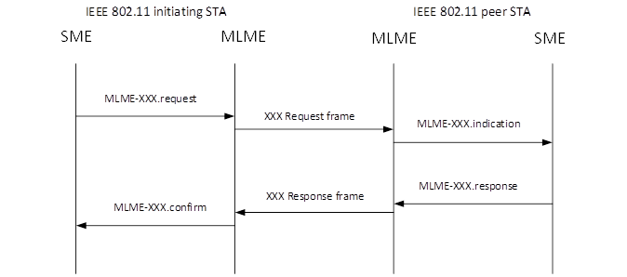
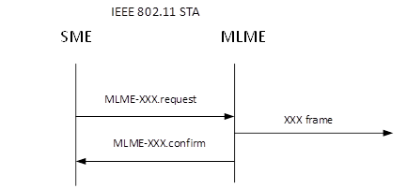
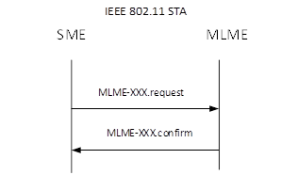
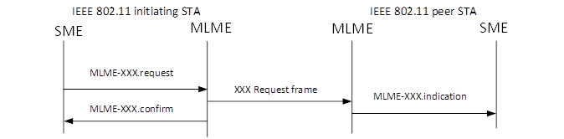
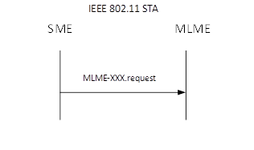
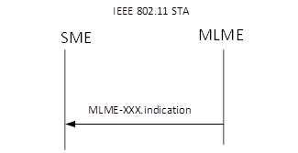
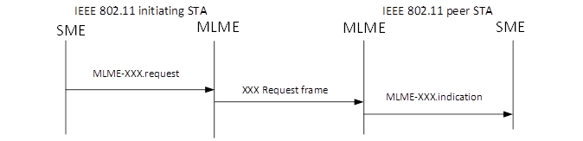
MLME-SAP Types
Type 1 – request/response
Type 4 – send a frame (Only 1, TPC request)
Type 2 – request only with confirm
e.g., disassociate, channel measurement
Type 5 – perform a process
e.g., activate power save,
get TSF
Type 3 – request only
Type 6 – perform a process
e.g., set protection
QMF policy set
Type 7 – indicate an event
e.g., MIC Failure
Often two type 3 used rather than one Type 1

Slide 5
In the vast majority of cases the primitives are simply boiler-plate and do not need to be spelled out in all their glory.
  Straightforward to construct the primitives based upon the descriptions and action frames.
  BUT
Some primitives are not obvious and describe actions that are basic. These tend to be the first ones in 6.3 such as: Authenticate, Associate, Start, Stop, Spectrum management/measurement, SetKeys, Set Protection, Event, DMG Beamforming, Update, etc.

Slide 6
Work in ARC
The work was carried out in the ARC SC over several months and thanks must be made to the participation and contributions of the members, with special mention to
  Joe Levy
  Mark Hamilton
  Journi Malinen

Slide 7
Way Forward
The following basic Way Forward was adopted
  Identify the different ‘Types’.
  Construct a table that provides the MLME-XXX name, Type and gives references. (New Clause 6.4)
  Identify MLME SAP primitives that are not “obvious” or have specific content that it not covered well by text.
    Keep these in full (moved to new Clause 6.5)
  try not to correct or improve the primitives
    This is important. As each was examined in detail, the choices of the Type(s) used, and content details were found to be arbitrary.
      Hence, at this stage do not “Repair” what was 6.3
    Changes and comments could be accepted in future ballots.
    (However, some details in 6.3 that were not, for some reason, in main text, were inserted into the main text where the SG thought important not to lose the Figure or reference.)

Slide 8
Excerpt from proposed Table 6.4

Slide 9
New Amendments
New amendments can simply add line to the Table in 6.4
  And ensure the text references are correct
OR
They can add to the Table in 6.4 AND insert the full primitives, in all their glory, in 6.5

Slide 10
Proposed Change Text in 22/0916r6
Estimated reduction in pages: 300+
Suggested strategy is that “experts” should look at the primitives in their area(s) and confirm that they are content that the new format works for them.

