Slide 1
Use Cases for Wi-Fi Business Solutions in UHR
Date: 2022-09-DD
Authors:

Slide 2
Introduction
This contribution introduces some use cases for Wi-Fi business solutions that require high reliability.
These use cases will expand the Wi-Fi market in addition to existing use cases for customer services, such as providing internet services at homes, offices, and stations.
UHR SG/TG will enhance those use cases by raising the reliability of Wi-Fi, which can promote Wi-Fi as essential access to network services.

Slide 3
Needs for Wi-Fi business solutions
Wi-Fi will be more important not only for customer services, such as providing internet services but also for business solutions [1].
Though mobile access has been utilized for network services with mission-critical applications previously, Wi-Fi could be used for these network services as Wi-Fi business solutions by enhancing the reliability of Wi-Fi.
To realize the fundamental digital formation (DX) of industry, it is necessary not only to provide best-effort communication but also to provide reliable connections in all industries via Wi-Fi.
The motion of the foundation of UHR SG [2] aims to improve WLAN's reliability and meets this direction.

Slide 4
Examples of Wi-Fi business solutions
The following slides show example use cases for Wi-Fi business solutions.
Applications of these use cases are categorized according to the magnitude of a problem that occurs if the Wi-Fi cannot operate with anticipated reliability.
Tier 1 (Mission critical): machine control, remote control, haptics, and control for autonomous robots.
Tier 2 (Service interruption): video streaming, monitoring, image diagnosis
Tier 3 (Quality of service degradation): data collection, internet access
Use cases introduced in the following slides include several applications and are categorized according to the magnitude of these factors.

Slide 5
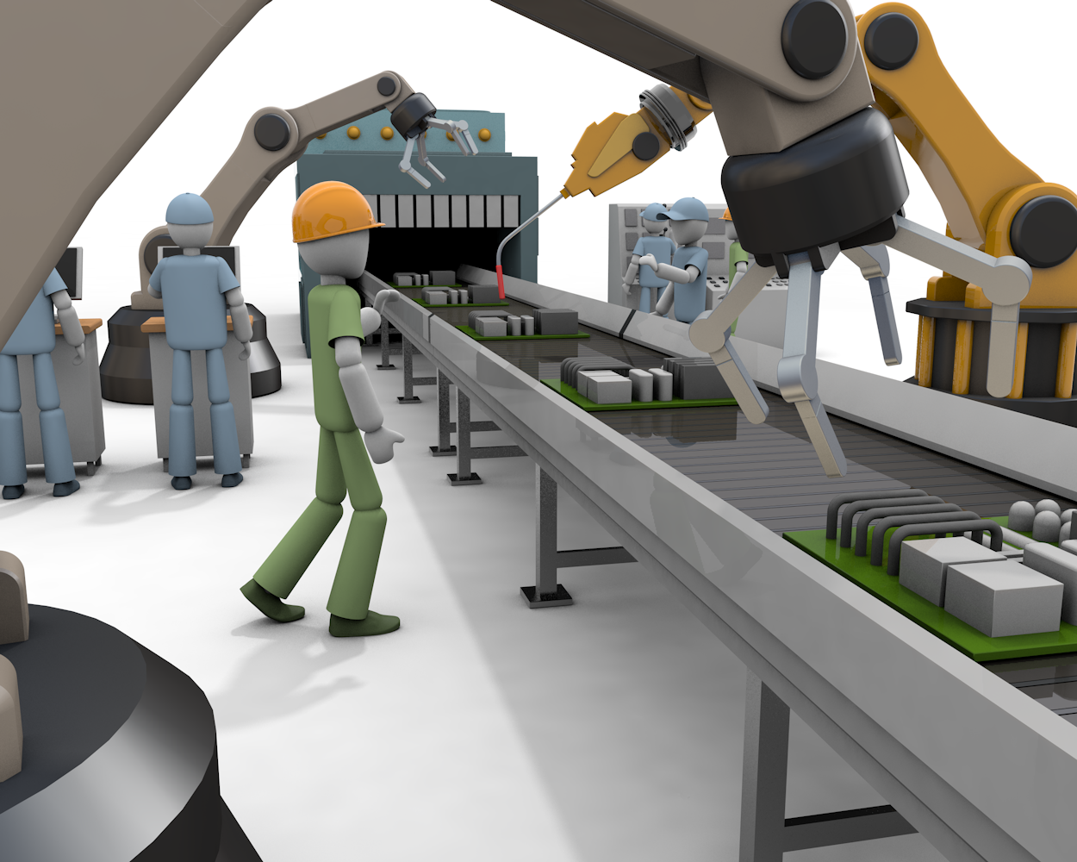
Example use case 1: Industrial IoT (Tier 1)
Characteristic
Machine control, remote control, image diagnosis, and precise machining operation such as haptics are target applications in the Industrial IoT.
Reliable data collection and secure control of machines should be required.
Issues:
Enhancement of reliability for machine control.
Lower latency and jitter for scheduled traffic.
Interference from unmanaged networks.
Realization of stable area handover.

Slide 6
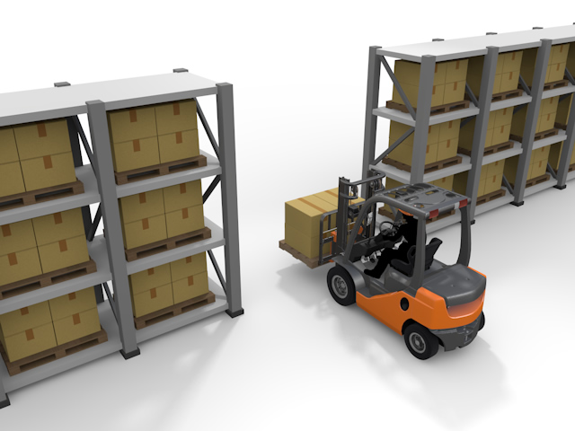
Example use case 2: Logistics (Tier 1 and 3)
Characteristic
Goods management is mainly controlled by scanning RFID tags equipped for storage.
Automatic Guided Vehicles (AGVs) controlled by Wi-Fi will be used for carrying goods or storage.
Scanning RFID tags will be realized using autonomous robots, manned/uncrewed vehicles, and logistics staff, and information on goods/storage will be transferred to the networks via Wi-Fi.
Reliable data collection, sufficient coverage of Wi-Fi, a countermeasure for NLOS, and control for autonomous robots are required.
Issues:
Received power fading due to propagation change or NLOS created by storage in warehouses.
Unstable connectivity according to narrow coverage of Wi-Fi AP by NLOS and frequent handover.
Realization of stable area handover.
Enhancement of reliability for control of autonomous robots or AGVs.

Slide 7
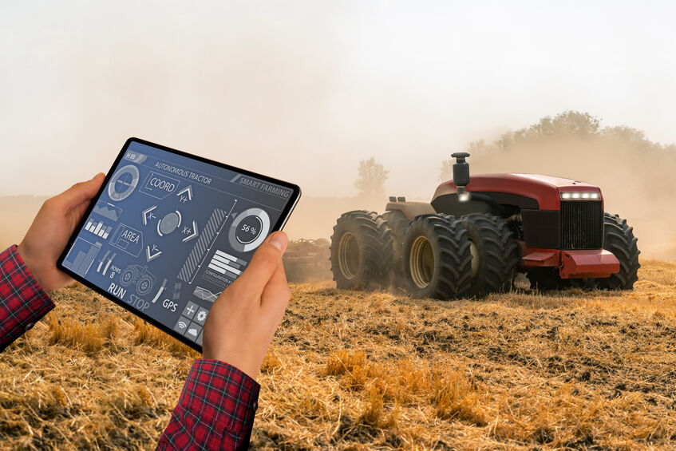
Example use case 3: Smart Agriculture (Tier 1 and 2)
Characteristic
Wi-Fi will be utilized for autonomous control of agricultural machines, monitoring for growing conditions of crops, and general network access, including access to the internet.
Radio propagation might change according to crops' growing conditions in the case of a plastic greenhouse.
Comprehensive area coverage and follow-up control for agricultural and farm machinery are needed.
Issues:
Virtual extension of the coverage area of Wi-Fi.
Realization of stable area handover.

Slide 8
Example use case 4: Stadium Wi-Fi (Tier 2 and 3)
Characteristic
Tens of thousands of audiences have smartphones and will get live streaming and utilize SNS services and/or mobile orders.
Wi-Fi APs are deployed under seats in an equidistant manner.
Countermeasures of the dense environment should be required.
Issues:
Interference between APs or STAs
Optimization of associating AP
Proper frequency resource allocation

Slide 9
Aspects of reliability for Wi-Fi business solution use cases
These use cases require "reliability," but these are several aspects of "reliability," as shown below.
To consider KPIs that UHR SG/TG should focus on, discussion for enhancement of these factors will be required.
Lower latency and jitter
Support for latency sensitive traffic
Live video streaming
Support for mobility, movement of STAs
Stable handover
Extensive area coverage
Manageability enhancement for quality of services
Interference mitigation
Countermeasure of the dense environment
Compensate for received power fading
Improvement of connectivity
Optimization of associating AP
Frequency resource allocation

Slide 10
Requirement of reliability factors for application for Wi-Fi business solution
KPI | Factors | Use Cases
 |  | Tier 1 (Mission Critical) | Tier 2 (Service Interruption) | Tier 3 (QoS Degradation)
Latency / Jitter | Support for Latency Sensitive Traffic | ✓
 | Live Video Streaming | ✓ | ✓ | ✓
Mobility /Coverage | Stable Handover | ✓ | ✓
 | Extensive Area Coverage | ✓ | ✓ | ✓
Manageability | Interference Mitigation | ✓
 | Countermeasure of the Dense Environment | ✓ | ✓ | ✓
 | Compensate for Received Power Fading | ✓ | ✓
Connectivity | Optimization of Associating AP | ✓ | ✓ | ✓
 | Frequency Resource Allocation | ✓ | ✓ | ✓

Slide 11
Summary
In this contribution, applications for Wi-Fi business solutions are categorized into 3 tiers and examples of use cases that include those tiers are introduced.
There are several factors of WLAN’s reliability, and discussion for enhancement of these factors will be required to consider KPIs that UHR SG/TG should focus on.

Slide 12
SP 1
Do you agree that example use cases for Wi-Fi business solutions shown in slides 5-8 are important and should be discussed to include PAR&CSD towards the UHR TG?
-Yes
-No
-Need More Discussion
-Abstain

Slide 13
SP 2
Do you agree that factors of reliability shown in slide 10 are important and should be discussed to include PAR&CSD towards the UHR TG?
-Yes
-No
-Need More Discussion
-Abstain

Slide 14
References
[1] 11-22-0961-00-0wng-network-operator-s-perspective-on-next-generation-wlan
[2] 11-22-0708-03-0wng-beyond-be-next-step

