Slide 1
R-TWT Schedule Suspension and Resumption
Date: 2021-07-15
Name | Affiliations | Address | Phone | email
M. Kumail Haider | Meta | 1180 Discovery Wy, Sunnyvale, CA |  | haiderkumail@fb.com
Chunyu Hu
Chitto Ghosh
Binita Gupta
Morteza Mehrnoush

Slide 2
Abstract
For supporting latency sensitive traffic, R-TWT is defined in 11be. R-TWT membership is associated with a set of R-TWT DL/UL TIDs.
TWT scheduled STAs can suspend bTWT schedules using TWT Information frames, to be resumed at a later time. A STA may suspend schedules due to PS, “pause” in application using SP etc.
In this contribution, we discuss existing signaling for TWT suspension/resumption when extended to R-TWT operation, gap analysis and proposals to enhance the signaling
Related LB-266 CIDs:
10733, 12074, 13015, 13057, 13240, 13311, 13312, 13738, 13657, 13658, 13659, 13661

Slide 3
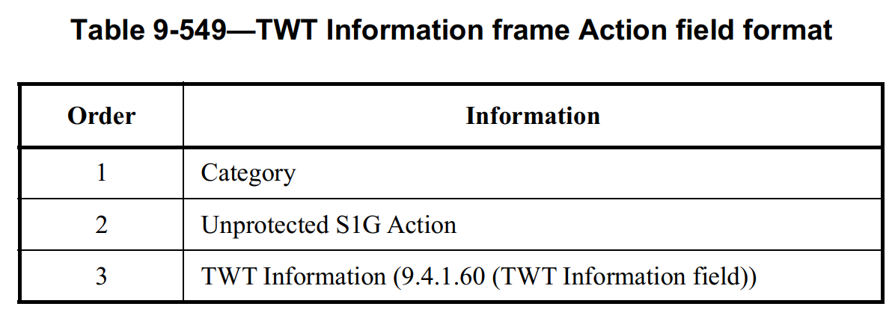
Background: TWT Suspension/Resumption
802.11ax defines procedure to suspend TWT schedules (indefinitely or until some specified later time), and to resume suspended schedule(s), via TWT Information Frame (26.8.4)
Applicable for both individual (iTWT) and broadcast (bTWT) schedules
TWT information frame carries the TWT information field
This subfield, if present, specifies when the schedule(s) resume. If absent, schedule(s) are suspended indefinitely
Identifies an iTWT schedule
If true, suspension/resumption applies to all iTWT/bTWT schedules

Slide 4
Extension to R-TWT: Gap Analysis
TWT Information field cannot specify a bTWT schedule (doesn’t have bTWT ID)
To suspend/resume a particular bTWT schedule (26.8.4.3):
“﻿A TWT scheduled STA that is in PS mode and that transmits a TWT Information frame to a TWT scheduling AP shall suspend the corresponding broadcast TWT schedule and may transition to doze state after receiving the acknowledgment, even if it has previously transmitted a PS-Poll or U-APSD trigger frame and has not yet received the expected frames from the TWT scheduling AP in response.”
STA needs to send a TWT Information frame during on-going SP of the corresponding schedule
STA needs to be in PS mode
r-TWT scheduled STA cannot suspend/resume a schedule if outside the SP and/or in Active Mode
STA may use All TWT outside the SP. However;
It suspends all iTWT+bTWT schedules followed by the STA
Defining “All R-TWT” subfield may be helpful; STA can suspend all R-TWT schedules without affecting other bTWT/iTWT schedules
Adding bTWT ID is needed to suspend a particular (or a subset of) R-TWT schedule(s); however, will need adding new subfields to TWT Information frame.

Slide 5
Solutions using Existing Signaling
9.4.1.60: TWT Flow Identifier is reserved when All TWT is set to 1
Option 1 – Part a:
When All TWT is 1, (B0-B2) of the TWT Information field (corresponding to TWT Flow Identifier) are defined as follows:
B0-B1 value | Types of schedules the TWT Information field applies to
0 | All bTWT schedules that the TWT scheduled STA is member of
1 | All R-TWT schedules that the R-TWT scheduled STA is member of
2 | All bTWT schedules which are not R-TWT schedules, that the TWT scheduled STA is member of
3 | Reserved

Slide 6
Solutions using Existing Signaling
Part b: Add the following rule to 35.9:
﻿An R-TWT scheduled STA that transmits a TWT Information frame to an R-TWT scheduling AP during an on-going R-TWT SP shall suspend the corresponding R-TWT schedule. If the STA is in PS mode, it shall follow the additional rules defined in 26.8.4.3 (﻿TWT Information frame exchange for broadcast TWT). The STA shall resume R-TWT operation for the corresponding R-TWT schedule at the specified TWT indicated (if any) in the TWT Information frame.
Same as baseline in 26.8.4.3, except that it removes the additional condition that the STA needs to be in PS mode when transmitting the TWT Information frame.
Remaining gaps:
TWT Information field still can’t identify a particular bTWT/R-TWT schedule
We propose some possible signaling extensions to address this gap

Slide 7
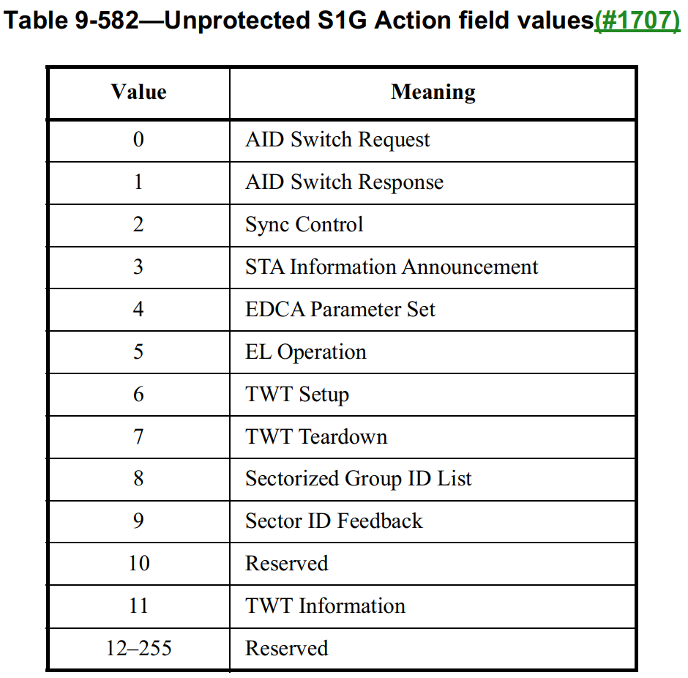
Option 2: Define Extended TWT Information frame
Extended TWT Information frame Action field format is defined below (similar to TWT Information frame (9.6.24.12)
#1 defined in ﻿9.4.1.11 (Action field)
#2 defined as next available Unprotected S1G Action field value in ﻿9.6.24.1 (Unprotected S1G Action field)
#3 Extended TWT Information field is defined as a new field in 9.4.1 (Fields that are not elements) (next slide)
Extended TWT Information (Extended TWT Information field)
Extended TWT Information
13-255

Slide 8
Option 2: Define Extended TWT Information frame
Extended TWT Information field definition
Some subfields defined similarly to existing TWT Information field
ID specification is expanded to include bTWT ID
Added All R-TWT subfield
Extended TWT Information (Extended TWT Information field)
Can define a separate All R-TWT subfield
If ID Type=0, bits B1-B2 are set to 0 and B3-B5 indicate TWT Flow Identifier.
If ID Type=1, TWT ID indicates bTWT ID

Slide 9
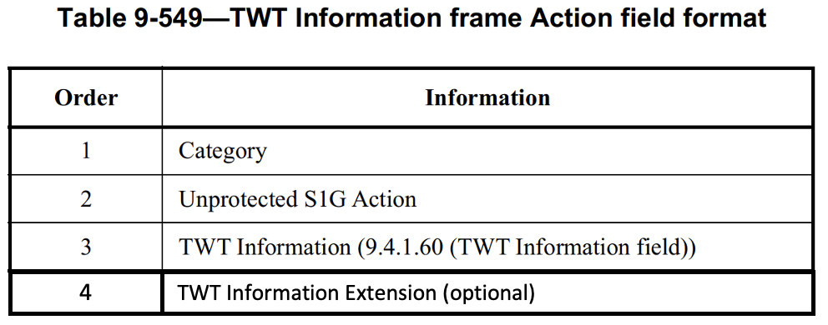
Option 3: bTWT ID in TWT Information frame
Append a new “TWT Information Extension” field to TWT Information Frame
﻿Optionally present in a TWT Information frame when transmitted by an EHT STA
The TWT Information frame, when transmitted by an EHT STA, has the following format
1 bit All R-TWT subfield, suspends all R-TWT schedules only
5 bits bTWT ID subfield
When TWT Information Extension field is present, the TWT Identifier subfield in the TWT Information field is reserved
B0 B1 B5 B6 B7
All R-TWT
bTWT ID
Reserved
Bits
1 5 2
TWT Information Extension field

Slide 10
Summary
Discuss TWT suspension/resumption in context of R-TWT, signaling gap analysis
Propose modifications to existing signaling and new signaling to cater to R-TWT operation requirements.

Slide 11
Straw polls

Slide 12
Backup Slides

