Slide 1
Potential PHY Features for UHR
Date: 2022-09-07
Authors:
Name | Affiliation | Address | Phone | Email
Eunsung Park | LG Electronics | 19, Yangjae-daero 11gil, Seocho-gu, Seoul 137-130, Korea |  | esung.park@lge.com
Dongguk Lim |  |  |  | dongguk.lim@lge.com
Jinyoung Chun |  |  |  | jiny.chun@lge.com
Insik Jung |  |  |  | insik0618.jung@lge.com
Insun Jang |  |  |  | insun.jang@lge.com
Sunhee Baek |  |  |  | sunhee.baek@lge.com
Jinsoo Choi |  |  |  | js.choi@lge.com

Slide 2


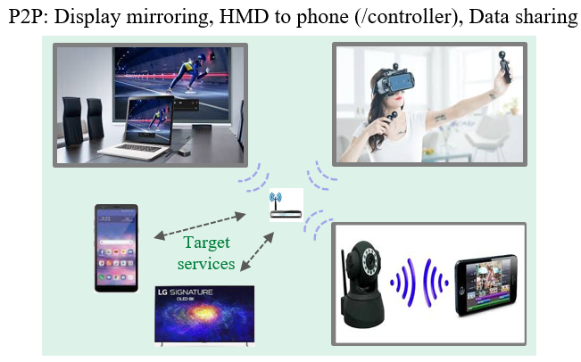
Introduction (1/2)
Various objectives have been discussed for the next Wi-Fi system (UHR) considering possible future use cases [1]-[19]
  In [7], we showed our initial view on use cases and their requirements
High throughput &
Low latency
High throughput
& Reliable Connectivity
High manageability

Slide 3
Introduction (2/2)
In this presentation, we further present our view on potential PHY features which can achieve some of the objectives for UHR
  Wider bandwidth
    Increased throughput (peak throughput in particular)
  A-PPDU
    Improved efficiency & average throughput / reduced latency

Slide 4
Wider Bandwidth (1/4)
Advantages
  Wider bandwidth can increase the peak throughput basically
  It can also help improve average throughput, efficiency, and so on, in conjunction with other features such as A-PPDU, SST, RU allocation, MRU, preamble puncturing, etc.

Slide 5
Wider Bandwidth (2/4)
Issues
  There are several alternatives for peak throughput enhancement
    Increased spatial streams: limited by the number of equipped antennas
    Higher modulation (e.g., 16K QAM): narrow available range due to low maximum input power level (-30 dB at 6 GHz) and high required receiver minimum input sensitivity level (higher than -40 dB at 80 MHz)
    Multi-link operation: limited by the number of equipped antennas and available links
    Given pros and cons in each method, it would be better to consider different types of methods for flexible implementation
    We especially focus on wider bandwidth since it is straightforward and can be easily expanded to cover more use cases by combining with other features
  Incumbent issues should be handled carefully in 6 GHz
    To mitigate the interference effect to / from incumbents, MRU / preamble puncturing designs applicable to wider bandwidth should be considered

Slide 6
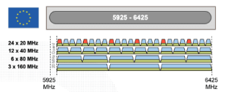
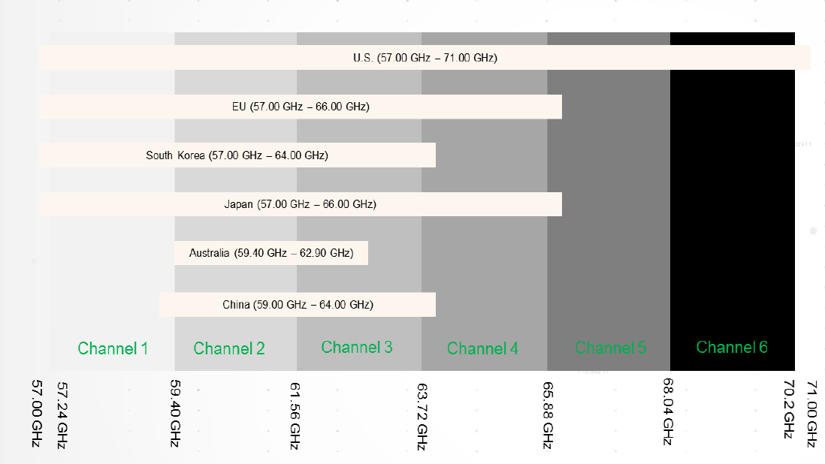
Wider Bandwidth (3/4)
Issues (cont.)
  In [13], 480 / 640 MHz channels were proposed in 6 GHz, but in some regions those channels are not available
    Wider bandwidth can be considered in a mmwave band as well where an extremely wide bandwidth can be exploited

Slide 7
Wider Bandwidth (4/4)
Issues (cont.)
  For a transmission in a mmwave band, short coverage and hardware complexity / cost issues need to be factored in carefully
    Efficient sector sweep / beam pairing procedure can be considered similar to 11ay
    Limited set of bandwidths can be considered (e.g., only some wide bandwidths)
    In order to balance between complexity/cost and performance (such as peak throughput), a proper up-clocked factor for bandwidth can be considered
Potential features
  480 / 640 MHz bandwidth with MRU and preamble puncturing in 6 GHz and the same or its up-clocked version in a mmwave band
  Possible impacts on the spec
    Channelization, Tone plan, Phase rotation / STF / LTF sequence, Sector sweep / beam pairing procedure, mmwave PPDU format etc.

Slide 8
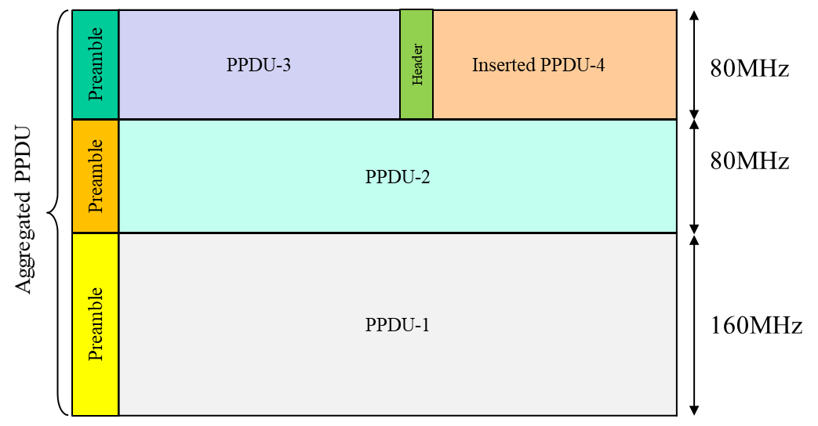
A-PPDU (1/4)
Advantages
  A-PPDU can improve the channel utilization and average throughput by aggregating different version PPDUs in a frequency domain
    It is possible to support UHR STAs with enhanced features of UHR while simultaneously transmitting previous version PPDUs
  Latency can be also reduced by applying the intercepted A-PPDU concept [15] or a dedicated channel in A-PPDU
    Intercepted A-PPDU in [15]

Slide 9
A-PPDU (2/4)
Issues
  It is important to balance between complexity and flexibility when aggregating different version PPDUs
    At least, UHR PPDU can be aggregated with EHT (or HE) PPDU
  Decoding issue of 320 MHz EHT STA should be addressed
    Wider bandwidth A-PPDU or SST can be considered
  Considering a restricted operating bandwidth of non-AP STA and the current SST which allows only P160 allocation, a proper channel allocation method is required
    Enhanced SST can be considered which allows additional S160 allocation
    To enable wider bandwidth A-PPDU, even S320 allocation can be considered
  To enable latency reduction features such as intercepted A-PPDU [15] or a dedicated channel in A-PPDU, it needs to be determined when and where the latency sensitive traffic can be transmitted in A-PPDU
    Specific channel and timing can be indicated ahead of A-PPDU transmission

Slide 10
A-PPDU (3/4)
Potential features
  EHT (or HE) PPDU + UHR PPDU with enhanced SST
    E.g., 640 MHz A-PPDU
Using conventional SST, EHT STAs can be assigned within P160
Using conventional/enhanced SST, UHR STAs can be assigned within P160
Using enhanced SST, UHR STAs can be assigned within S160
320 MHz EHT STA can participate in A-PPDU within P320 without SST
20/80/160 MHz EHT STA can participate in A-PPDU within P160 without SST
Using enhanced SST, UHR STAs can be assigned within S320

Slide 11
A-PPDU (4/4)
Potential features (cont.)
  A-PPDU header or Trigger-like frame based A-PPDU for latency sensitive traffic
  Possible impacts on the spec
    Enhanced SST, sub-PPDU channel resolution, A-PPDU preamble / format, UL A-PPDU & Trigger frame, Header / Trigger-like frame for latency sensitive traffic, etc.
We focus on the downlink case only.
Uplink is much more complicated since it may be hard to schedule all of the STAs trying to transmit latency sensitive traffic within a predefined channel whenever it arrives.
Intercepted A-PPDU
Channel indication
Dedicated channel in A-PPDU

Slide 12
Discussion
The two PHY features can complement each other
  A-PPDU enables EHT (and/or HE) STA to participate in a wider bandwidth transmission
  A-PPDU in conjunction with enhanced SST can reduce a resource waste in wider bandwidth even if operating bandwidths of non-AP STAs are limited
  Wider bandwidth can make A-PPDU much simpler by aggregating P320 EHT PPDU and S320 UHR PPDU

Slide 13
Summary
Some potential PHY features and their possible impacts on the spec have been discussed
  Wider bandwidth
    480 / 640 MHz bandwidth with MRU and preamble puncturing in 6 GHz
    480 / 640 MHz bandwidth or its up-clocked version in a mmwave band
  A-PPDU
    EHT (or HE) PPDU + UHR PPDU with enhanced SST
    A-PPDU header or Trigger-like frame for latency sensitive traffic

Slide 14
References
[1] 11-22-0030-01-0wng-look-ahead-to-next-generation
[2] 11-22-0032-00-0wng-next-gen-after-11be
[3] 11-22-0046-01-0wng-next-generation-after-802-11be
[4] 11-22-0059-00-0wng-beyond-be
[5] 11-22-0418-00-0wng-considerations-of-next-generation-beyond-11be
[6] 11-22-0458-01-0wng-looking-ahead-to-next-generation-follow-up
[7] 11-22-0685-00-0wng-discussion-on-next-generation-wi-fi
[8] 11-22-0694-00-0wng-thoughts-on-next-gen-wlan
[9] 11-22-0697-00-0wng-next-gen-wlan-and-xr
[10] 11-22-0708-03-0wng-beyond-be-next-step
[11] 11-22-0723-01-0wng-further-discussion-on-next-generation-wlan
[12] 11-22-0729-01-0wng-next-generation-after-802-11be-follow-up
[13] 11-22-0734-00-0wng-next-gen-after-11be-v2
[14] 11-22-0779-00-0wng-802-11bx-enabling-metaverse-metaverse-ar-vr-and-wearables
[15] 11-22-0932-00-0wng-thoughts-on-beyond-802-11be
[16] 11-22-0952-00-0wng-cloud-vr-use-case-and-requirements
[17] 11-22-0961-00-0wng-network-operator-s-perspective-on-next-generation-wlan
[18] 11-22-0965-01-0wng-view-on-beyond-be
[19] 11-22-1083-01-0wng-next-generation-sg-formation

