Slide 1
Wi-Fi Meets ML: Re-thinking Next-generation Wi-Fi Networks
Date: 2022-09-02
Authors:

Slide 2
Abstract
In this tutorial, we provide a brief and concise overview of standard ML techniques, as well as how they have been applied to Wi-Fi by the research community in the last years. Finally, we show what can be done by the WG to support ML in the 802.11 standard.

Slide 3

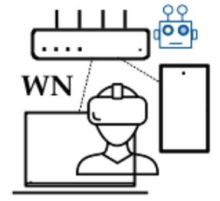
Boris Bellalta
Professor at UPF
Head of the Wireless Networking group
  Unlicensed bands, Wi-Fi
  XR Immersive Communications (over Wi-Fi)
ML interest: ‘intelligent’ adaptive systems; low-complexity RL agents; interplay between ML agents;
Contact: boris.bellalta@upf.edu

Slide 4

Szymon Szott
Associate professor at AGH University of Science and Technology, Kraków, Poland
Research interests
  Wireless local area networks
  Channel access
  Quality of service
  Security
  Inter-technology coexistence
ML interest: clever ways to improve performance
Contact:
  szott@agh.edu.pl
  https://szymonszott.github.io/

Slide 5
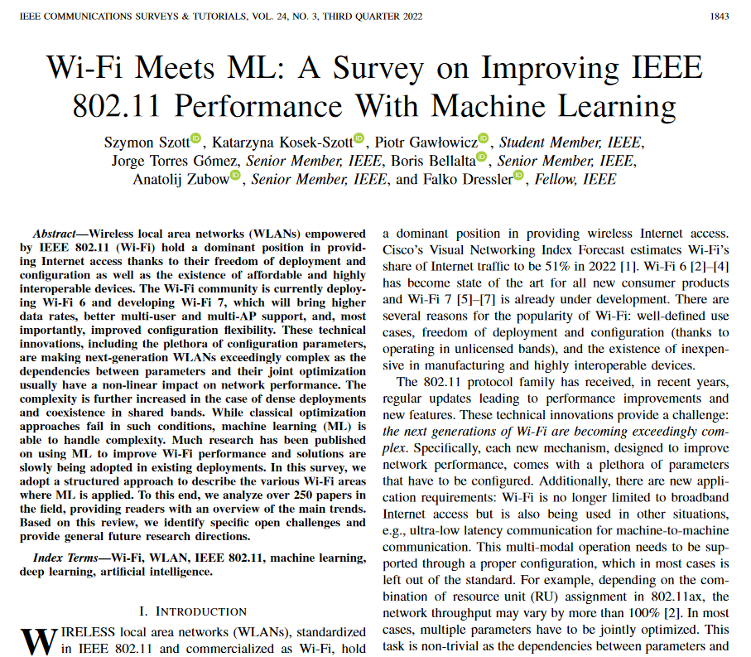

Acknowledgements
Katarzyna Kosek-Szott, Piotr Gawłowicz, Jorge Torres Gómez, Anatolij Zubow, Falko Dressler, co-authors of the survey paper “Wi-Fi Meets ML: A Survey on Improving IEEE 802.11 Performance with Machine Learning” in IEEE Communications Surveys & Tutorials, vol. 24, no. 3, pp. 1843-1893, third quarter 2022, doi: 10.1109/COMST.2022.3179242. [1]
From projects:
  WI-XR PID2021-123995NB-I00 & WINDMAL PGC2018-099959-BI00 (MCIU/AEI/FEDER,UE)
  National Science Centre, Poland, under Grant DEC-2020/39/I/ST7/01457

Slide 6
Outline
IEEE 802.11 Wi-Fi networks
Using ML to build models from data
  AI/ML definitions
  Overview of ML techniques: supervised, unsupervised, reinforcement learning
  Model training and deployment: centralized and distributed solutions
ML for improving IEEE 802.11 performance
  State of the art: what the research community is doing
  Examples
Open Challenges, missing pieces and summary

Slide 7
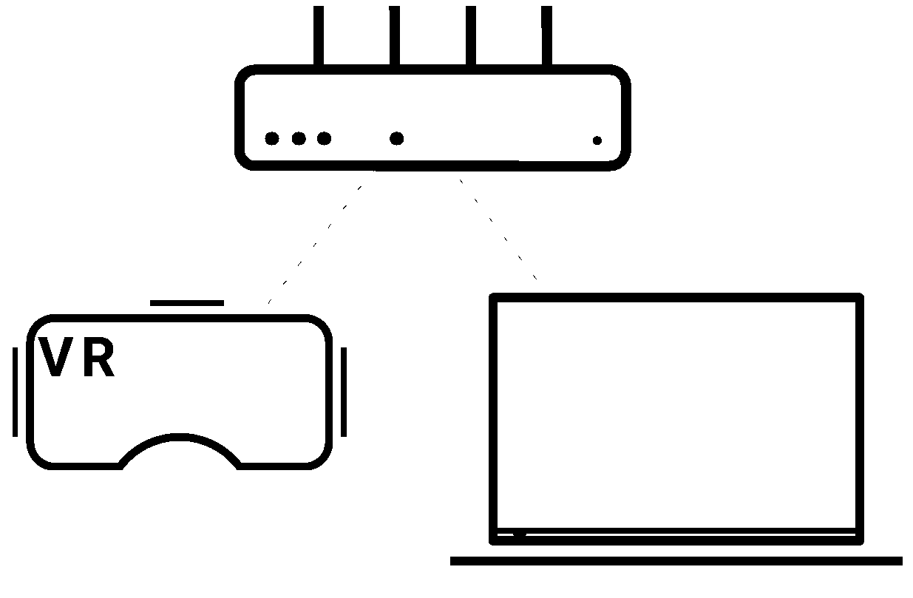
IEEE 802.11
PHY/MAC specs
  Data plane
  Management and Control
Operation in unlicensed bands
  Decentralized spectrum sharing
  Coexistence with other technologies
Scenarios
  Dense, dynamic, diverse and uncontrolled
  Wireless broadband access
  Real-time communication
Uncertainty

Slide 8
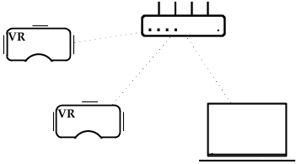
Wi-Fi Use-cases
Teleconference / video streaming, remote work and education
Cloud-supported productivity: Fast content/file exchange in collaborative environments
(Cloud) Gaming, VR/AR / Metaverse
System & plan control (machines, robots)
Requirements
Low-latency, high-throughput, high-reliability
Stable connectivity & predictable performance
XR streaming: Can we predict connection degradation enough in advance to perform preventive actions?

Slide 9
1. Using ML to build models from data

Slide 10
Outline
IEEE 802.11 Wi-Fi networks
Using ML to build models from data
  AI/ML definitions
  Overview of ML techniques: supervised, unsupervised, reinforcement learning
  Model training and deployment: centralized and distributed solutions
ML for improving IEEE 802.11 performance
  State of the art: what the research community is doing
  Examples
Open Challenges, missing pieces and summary

Slide 11


Artificial Intelligence and Machine Learning
Artificial Intelligence: collect/sense (get the data), reason (interpret the data), act (based on how the data is interpreted), enjoy (or not) the result, and self-correct / adapt.
  AI uses ML techniques to extract “knowledge” (learn) from the data
  Data + ML Algorithms + Reasoning + Actions→ (A)Intelligence
Machine Learning: Set of algorithms / techniques / mechanisms that are able to learn from data.
  Learn: map output to inputs, i.e., build the function f(.) that represents the ‘knowledge’
  General mechanisms, not explicitly programmed for a single family of functions f(.); In some cases, their performance/learning bounds are known
Deep Learning: Includes learning the relevant ‘features’ of the model.
Intelligent agent
AI
ML
DL

Slide 12

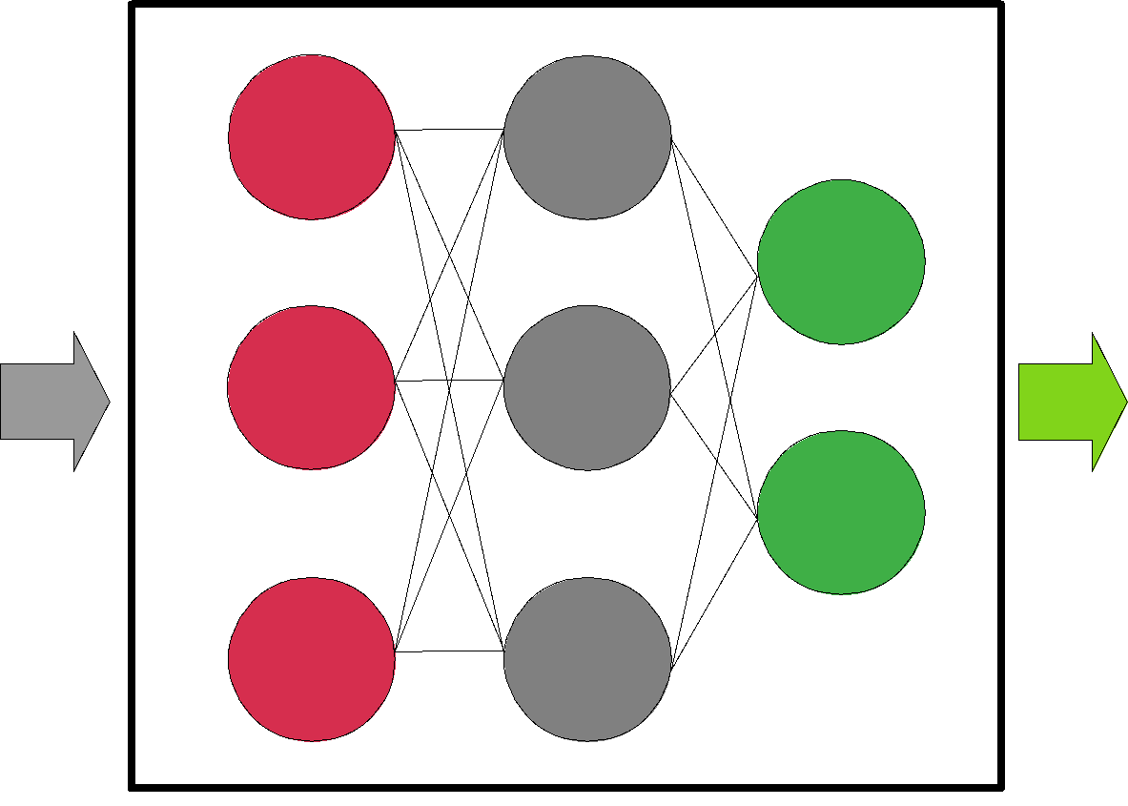
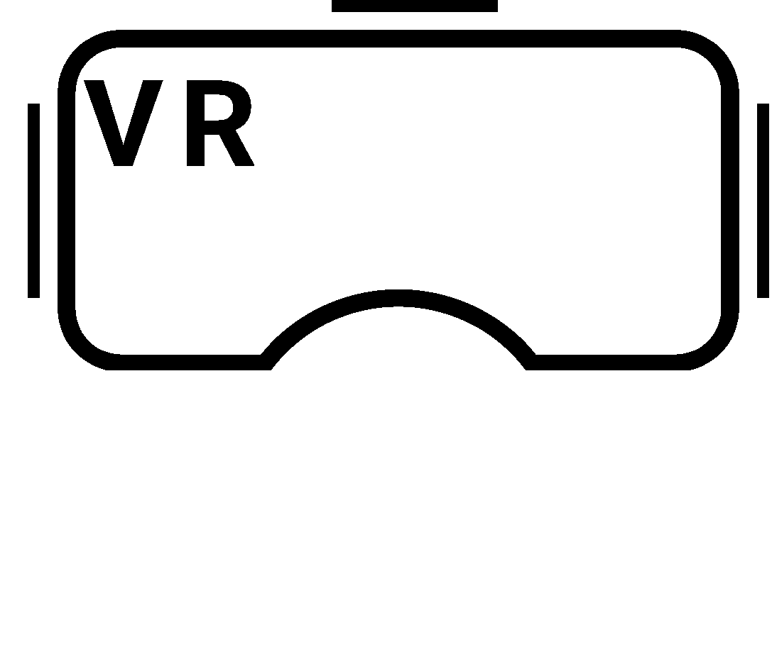

Building models
f(.) describes a system.
ML enables to model extremely complex systems by characterizing the hidden relationships between input parameters x (features) and outputs y (labels).
Example: To train a model able to suggest the best MCS to exchange data between the AP and laptop.
Features
- RSSI
- Throughput
- PER
- Coll. prob.
- SS
- Bandwidth
MCS?
MCS
Model

Slide 13
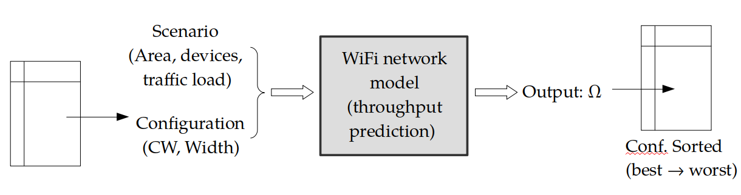
Why is having a model useful?
A model can give us some useful information before taking (better) decisions.
It can predict what will be the ‘performance’ (output) given a certain configuration (input).
Example: Given a certain scenario, we want to find the configuration that maximizes the throughput

Slide 14
Why is having a model useful?
A model can give us some useful information before taking (better) decisions.
It can predict what will be the ‘performance’ (output) given a certain configuration (input).
Example: After gathering data from different APs (load, number of associated clients, technology & capabilities, RSSI, etc. ) a STA can sequentially predict which is the best AP to associate.
A
B
good RSSI, 11ax, 80% busy
medium RSSI, 11n, 10% busy
?
B

Slide 15
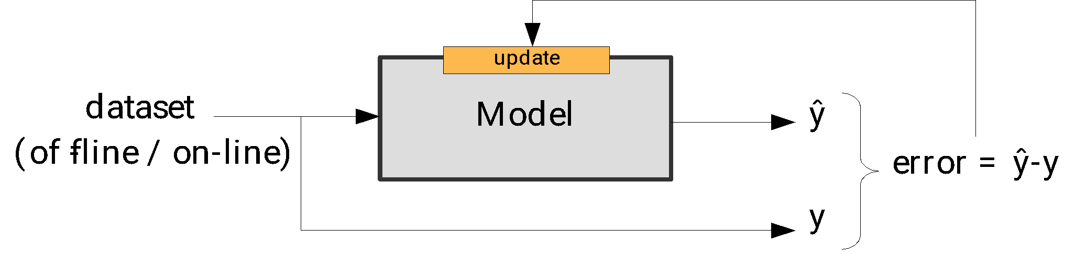
ML techniques build models from data (training)
Two training cases:
  Off-line: using a static dataset (present from the beginning).
  On-line: the dataset is created in real-time, so the model is updated as more data is collected.
Training is based on minimizing the error between what is known (in the dataset) and predicted (by the model) outputs.
Models should be as general as possible: the aim is not to exactly map inputs and outputs, but to learn the context behind any existing relationship (no overfitting).
A model can be first trained off-line, deployed and then improved with on-line training

Slide 16
Outline
IEEE 802.11 Wi-Fi networks
Using ML to build models from data
  AI/ML definitions
  Overview of ML techniques: supervised, unsupervised, reinforcement learning
  Model training and deployment: centralized and distributed solutions
ML for improving IEEE 802.11 performance
  State of the art: what the research community is doing
  Examples
Open Challenges, missing pieces and summary

Slide 17
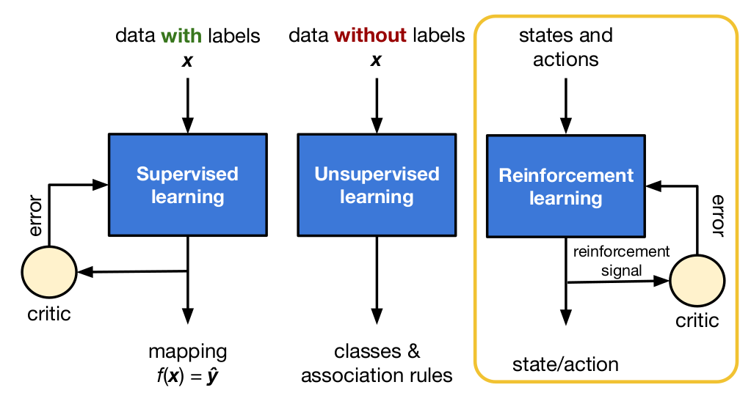
Taxonomy of ML models
Supervised Learning (SL)
Unsupervised Learning (UL)
Reinforcement Learning (RL)
How are these models trained?
  Centralized; Decentralized / Distributed
  Single player; Multiple players
Ex: Distributed Federated Learning

Slide 18
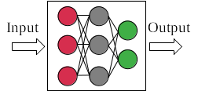
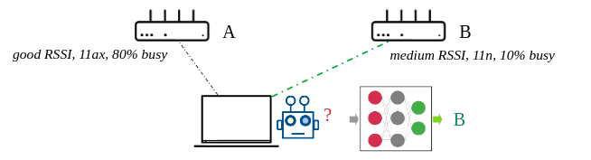
Supervised Learning
Goal: Training data includes x and y, so the goal is to learn f(.)
Dataset: We need a consolidated dataset to train the model, retraining it as the dataset updates
Techniques: Time series analysis, Regressions, Vector Machines, Decision Trees, Neural Networks, etc.
Main uses: Prediction (output is a real value), Classification (output is a label, e.g., 0 or 1)
Wi-Fi example: AP selection
  The STA uses a trained model that predicts which is the best AP to associate. The input of the model should consist of the info gathered by the STA for each AP.

Slide 19
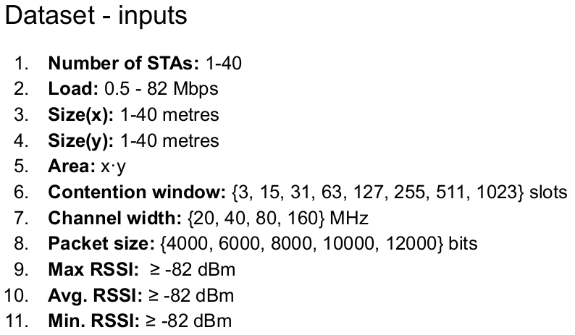
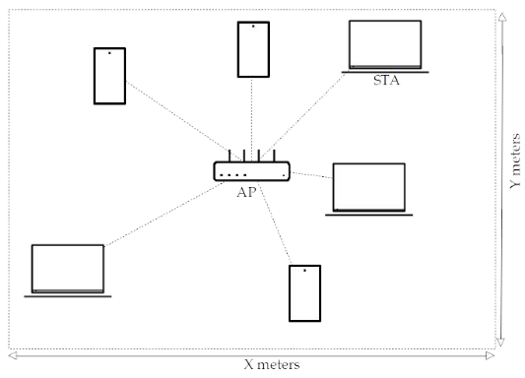
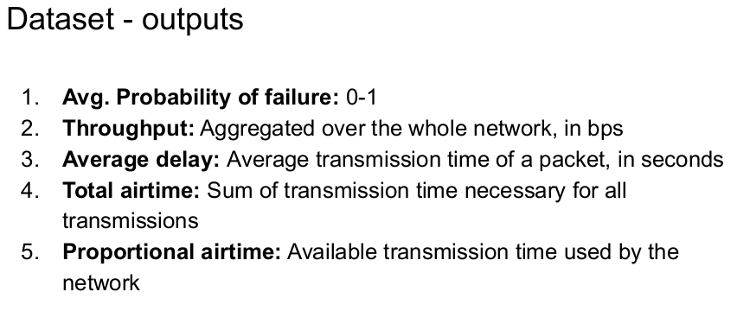
A Wi-Fi dataset
The dataset was created running 100,000 simulations with input parameters selected randomly.

Slide 20
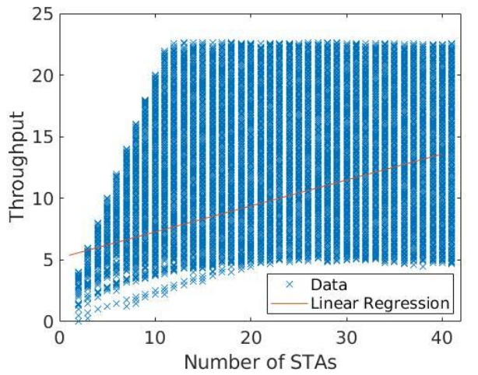
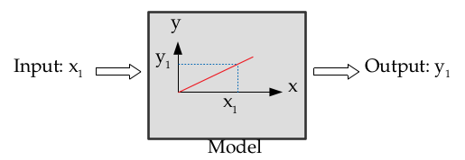
Example: Linear Regression
Results can be easily improved by using multivariate regression and a nonlinear model

Slide 21
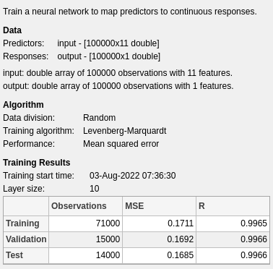
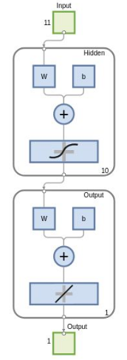
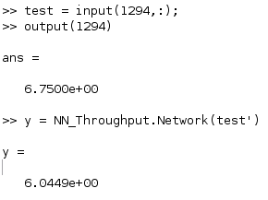
Example: Neural Network
Predicted Throughput
CW_{min}
Output layer
Real Value (Mbps)
Hidden layer
Matlab NN representation
Input layer
Prediction (Mbps)

Slide 22
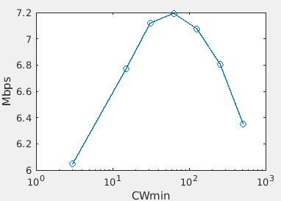
Example: Neural Network
We can use the NN model to try different CW_{min} values to see which is the best performing one.
Predicted Throughput
CW_{min}
Output layer
Hidden layer
Matlab NN representation
Input layer

Slide 23
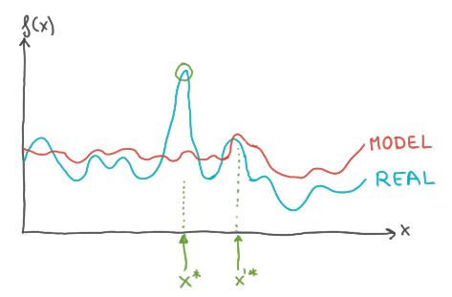
A problem (or not) of SL models
They provide accurate function approximation in general by minimizing the difference (mean squared error), but may fail to capture maximum / minimum values.
Not always useful for ‘optimization’ purposes.

Slide 24
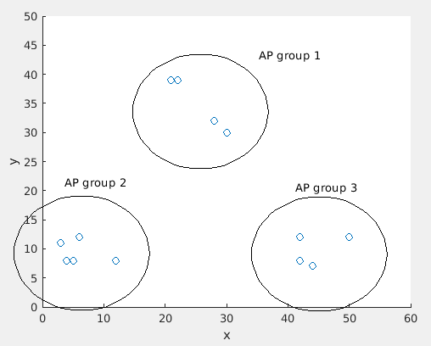
Unsupervised Learning
Goal: Find patterns/trends/similarities in a dataset when only the features are available
Dataset: We need a consolidated dataset to train the model, retraining it as the dataset updates
Techniques: K-means, Self-Organizing Maps (SOMs), hidden Markov model (HMM), Auto encoders (AEs), Principal Component Analysis (PCA), Restricted Boltzmann machine (RBM), fuzzy C-means etc
Main uses: Cluster the data in similar groups
Wi-Fi example
  AP selection from a dataset that contains only the features. Then, identifying which APs are similar may reduce the ‘testing’ phase by only requesting association to an AP of each representative ‘cluster’.

Slide 25
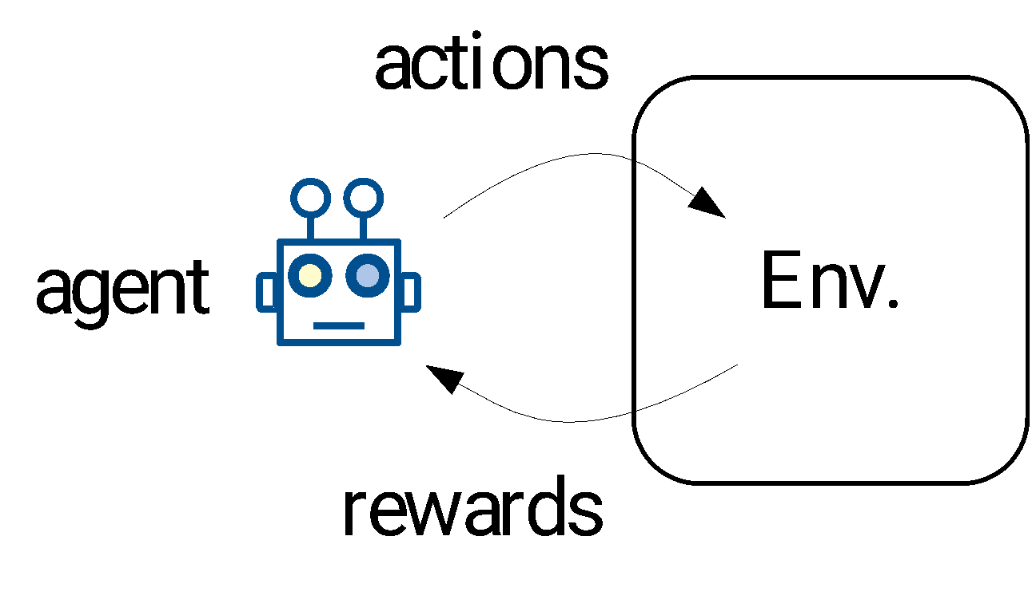
Reinforcement Learning
Goal: Learn from experience (relationship between actions and rewards)
Dataset: sequence of actions and rewards obtained
Techniques: Multi-armed Bandits, Q-learning, DQL
Main uses: Adaptive systems in dynamic environments
Wi-Fi examples: exploration – exploitation tradeoff
  AP selection by trying and rating different APs
  Dynamic channel selection: given a set of unknown channels, we need to find the best one (the empty one)
  Dynamic configuration of Tx Power and CCA to support Spatial Reuse
  etc.

Slide 26
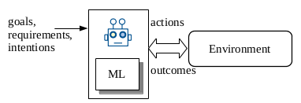
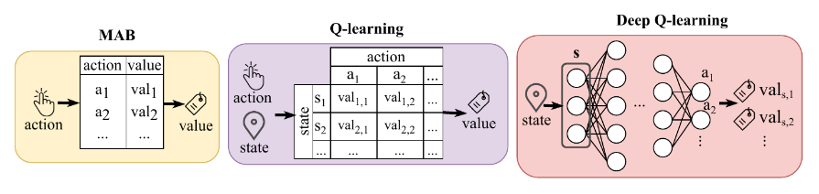
Reinforcement Learning
An ‘agent’ learns by interacting with the ‘environment’
  The agent can play different ‘actions’
  For each action, the agent receives a ‘reward’
  If possible, the agent may characterize the environment through a set of ‘states’
The ML algorithm tells the agent how to select the actions to maximize the reward

Slide 27
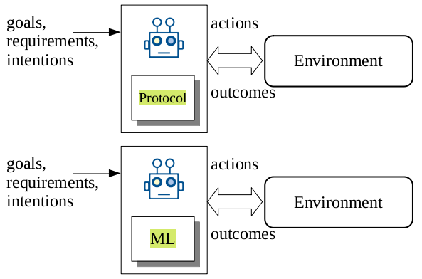
RL vs standard ‘rule-based’ protocols?
RL naturally adapts to different situations.
but…
  … requires time to learn.
  … higher computational resources.
The two approaches can be also combined.
Example: We can learn the protocol.
A
B
C
D
A
B
C
D
Pre-programmed
Learned

Slide 28
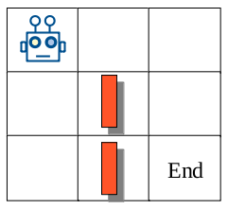
Actions, Rewards and States
Consider the case of a robot moving in a map.
Each position of the map is a ‘state’.
Actions: the movements that can be done in each state.
Rewards: how close is the robot to the End; and/or if there is an obstacle.
Moving results in a reward, but also moves the system to a new state.
It is not clear how to define states in Wi-Fi, as sometimes the state is equivalent to the ‘action’ (i.e., the selected AP or channel).
Wireless scenarios are hardly ‘static’, and so the same action may have different outcomes.

Slide 29
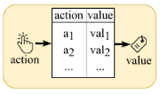
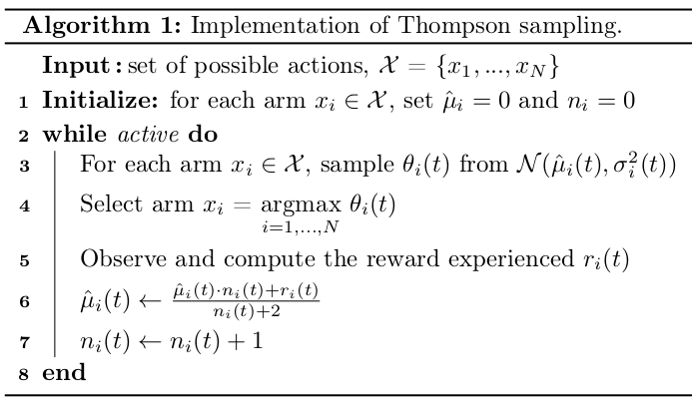
Multi-armed Bandits (MABs)
Sequential interaction between the ‘agent’ and the environment.
No states (or just a single state), only actions and rewards.
Exploration-exploitation trade-off. The agent:
  Explores: selects an action randomly
  Exploits: selects the action with higher reward from the table
Different approaches: simple, low-computing res.
  ε-greedy, Thompson Sampling, UCD, EXP3, etc.
Contextual MABs consider different situations:
  E.g. AP selection at home, at work
  Moving to a new ‘context’ may allow to reuse past info.

Slide 30
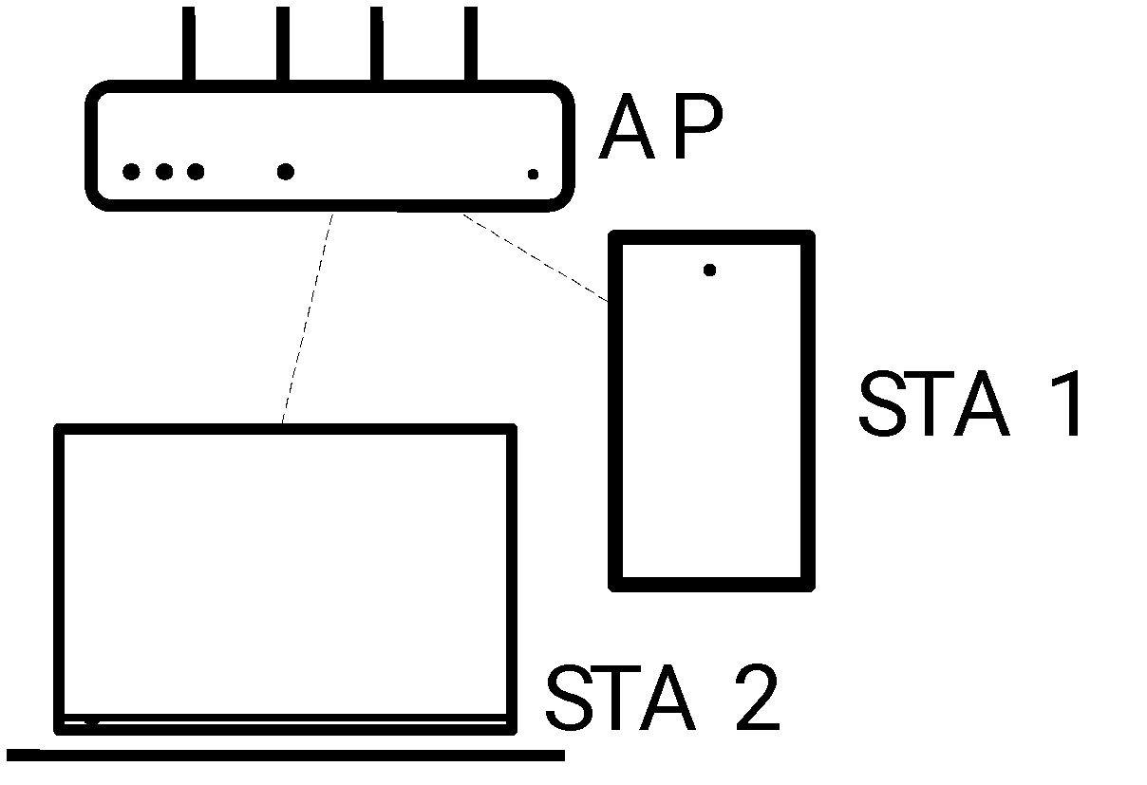
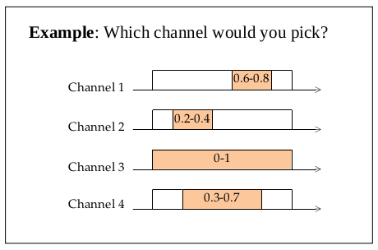
Example: Channel Selection (MABs)
channels
1
2
3
N
ρ(i) = Occupancy of channel i [0,1]
(measured every 1 second)
0
a_{i}
b_{i}
1
Smart AP
?
Reward using channel i: V(i) = 1-ρ(i)
Only the channel in use can be measured

Slide 31
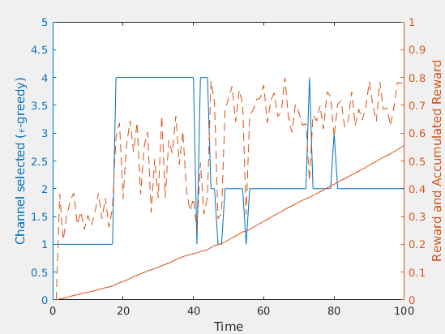
Example: Channel Selection (MABs)
channels
1
2
3
N
ρ(i) = Occupancy of channel i [0,1]
(measured every 1 second)
0
a_{i}
b_{i}
1
Smart AP
?
Reward using channel i: V(i) = 1-ρ(i)
Only the channel in use can be measured

Slide 32
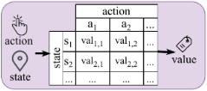

Q-learning
It requires states:
  Same or different actions depending on the state
  Actions can result in a ‘change’ of state
  Rewards depend on the state
We need a mechanism to explore the environment
  e.g., ε-greedy
We need a mechanism to update Q-table based on the obtained rewards (Bellman eq.)

Slide 33
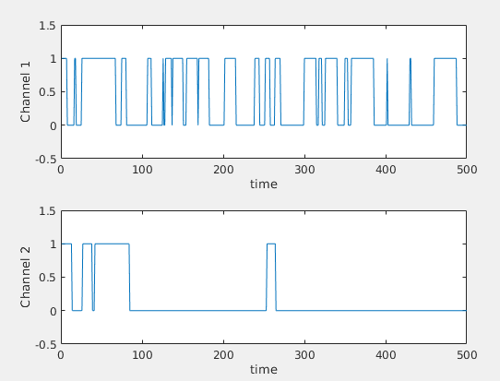
Example: Channel Selection (Q-learning)
remain
channels
1
2
Smart AP
?
change
A channel can be busy or empty
Actions: remain in the same channel; change channel
States: channel 1 and empty; channel 1 and busy; channel 2 and empty; channel 2 and busy

Slide 34
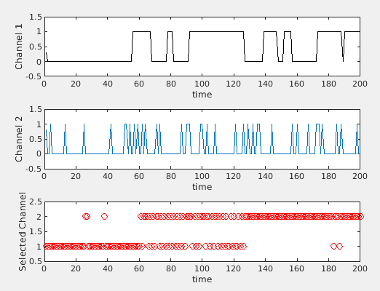
Example: Channel Selection (Q-learning)
channels
1
2
Smart AP
?

Slide 35
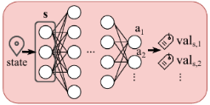
Deep Q-learning (DQN)
Problem: Accurate learning of the Q-table is difficult (or impossible) and time consuming when the number of states is large as the agent needs to go through all the different states and actions several times.
Solution: Model the Q-table response with a (Deep) Neural Network.
  If the system is in state ‘s’, the agent asks the (D)NN to predict the reward the agent will obtain if plays any of the available actions in state ‘s’.
  The agent selects the action with a higher predicted ‘reward’.
  DQN’s additional deep neural network allows for more efficient extrapolation of rewards for yet unseen states as compared to basic Q-learning.
Challenge: to train on-line the (D)NN, as it may require large CPU/GPU resources.

Slide 36
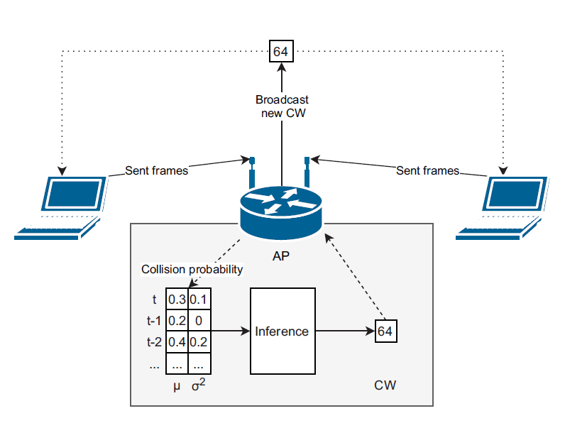
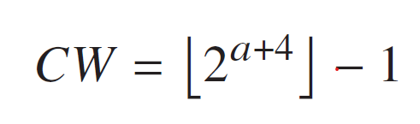

Example: DQN for CW optimization [2]
Agent - installed at the AP
State - status of all connected devices
Action - select CW (value of integer a)
Reward - network throughput
Observation - collision probability
DNN: 8 × 128 × 64
Exploration: random action w/ low probability

Slide 37
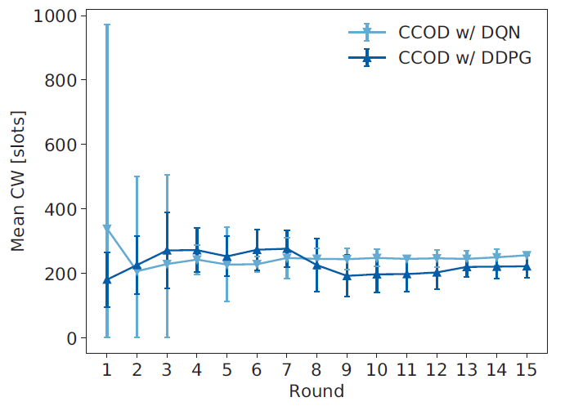
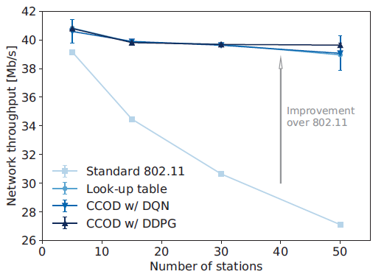
Example cont’d
DQN - Discrete action space
DDPG - Continuous action space
Mean selected CW in consecutive training rounds
(static scenario: 30 stations)
Throughput improvement over 802.11

Slide 38
Outline
IEEE 802.11 Wi-Fi networks
Using ML to build models from data
  AI/ML definitions
  Overview of ML techniques: supervised, unsupervised, reinforcement learning
  Model training and deployment: centralized and distributed solutions
ML for improving IEEE 802.11 performance
  State of the art: what the research community is doing
  Examples
Open Challenges, missing pieces and summary

Slide 39
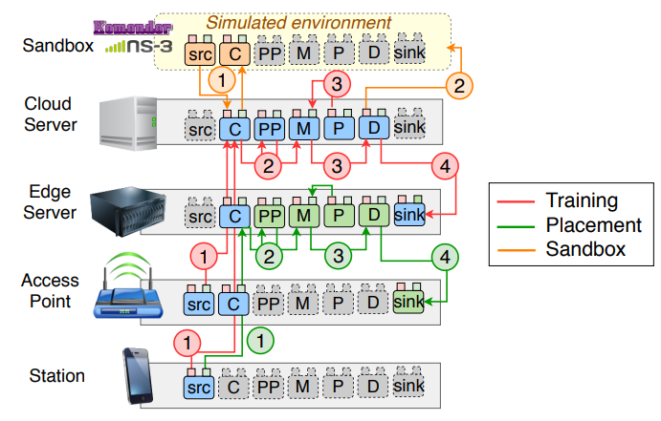
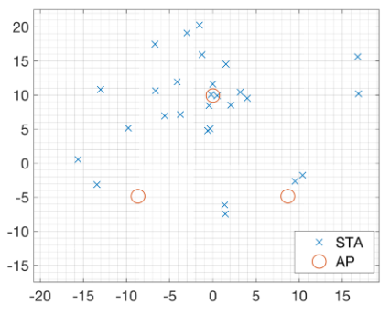
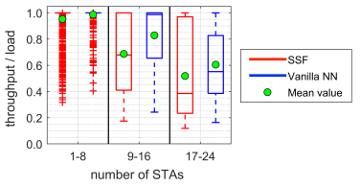
Training and deploying an ML model
Training: building the model from data.
Deployment: place where the model is used.
Example: Realization of the ITU’s ML architecture for IEEE 802.11 WLANs through a hybrid ML-based solution for AP (re)association and handover.
Francesc Wilhelmi, Sergio Barrachina-Muñoz, Boris Bellalta, Cristina Cano, Anders Jonsson, and Vishnu Ram. "A flexible machine-learning-aware architecture for future WLANs." IEEE Communications Magazine 58, no. 3 (2020): 25-31. [3]
SSF - Strongest signal first (802.11 baseline)

Slide 40
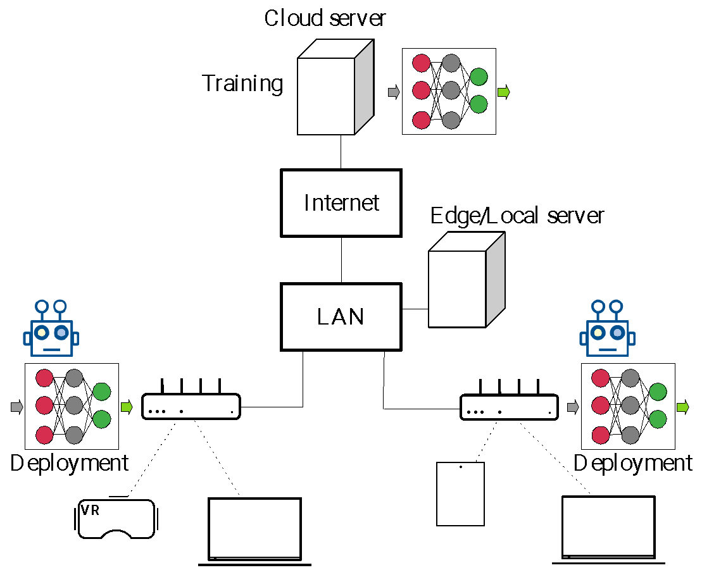
Training an ML model
Local models: Only the data available at a given device is used.
Global models: The data from multiple devices is used to build the model.
  Devices exchange the data to:
    A single point (centralized), where the ‘global’ model is trained using all data collected.
    Between them (distributed), each device is able to compute the ‘global’ model using all data collected.
  Devices share their ‘local’ models to:
    A single point (centralized), where the ‘global’ model is computed by combining the different ‘local’ models (distributed).
    Between them (distributed), each device is able to compute the ‘global’ model by combining the different ‘local’ models (distributed).

Slide 41
Deploying a (global) ML model
In the centralized case, the device training the ‘global’ model distributes it to the end devices.
In the distributed case, since all devices compute it, they already have it.
Pros and Cons
  Sharing the data:
    Large overheads
    Computing resources required to compute the model
    Accurate models can be built
  Sharing the model
    Less overheads (but depends on the model type)
    Loss of accuracy as the model is ‘averaged’
    Lower computing resources required
  Distributed vs centrallized

Slide 42
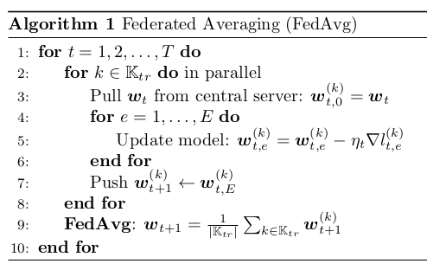
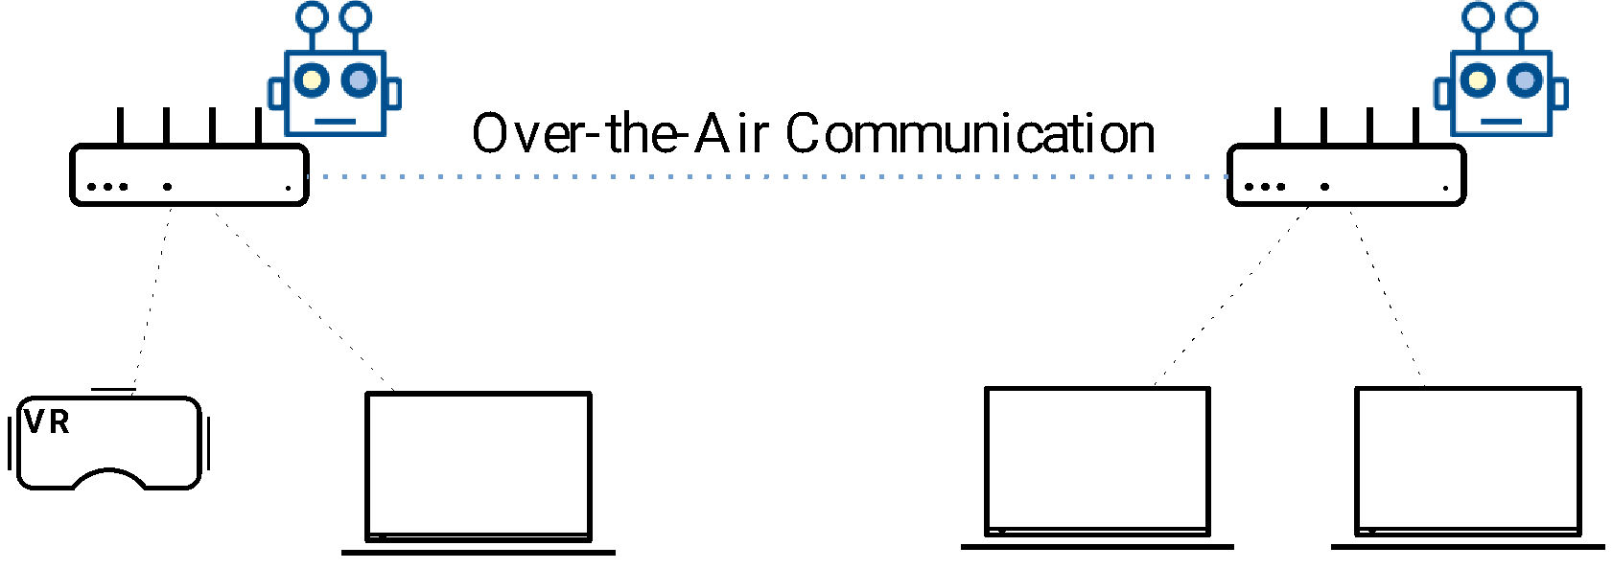
Training and deploying an ML model
Federated Learning: devices exchange their locally trained ‘global’ models.
  Centralized or distributed.
  The ‘global’ model is re-trained locally using the data gathered by each device.
  Only the ‘model’ is shared by participating devices.
    SL: the weights of a NN
    RL: Q-table, instantaneous rewards
  Could improve system stability in ‘adversarial’ situations
Example / Proposal
  To leverage the over the air MAPC framework to exchange local models to support DFL in next-gen. Wi-Fi networks

Slide 43
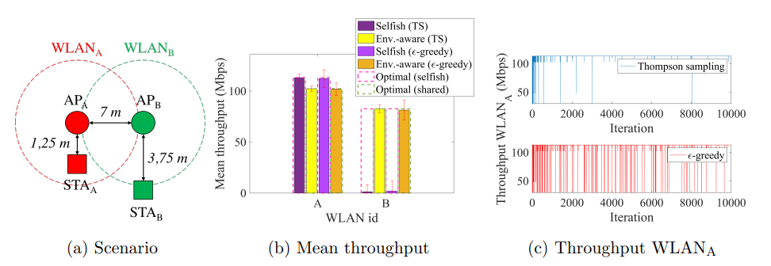
Example: ‘FL’ with MABs for SR [4]
AP A and B a) RL (2 local models); b) FRL (1 global model)
Wilhelmi, Francesc, Sergio Barrachina-Munoz, Boris Bellalta, Cristina Cano, Anders Jonsson, and Gergely Neu. "Potential and pitfalls of multi-armed bandits for decentralized spatial reuse in WLANs." Journal of Network and Computer Applications 127 (2019): 26-42.

Slide 44
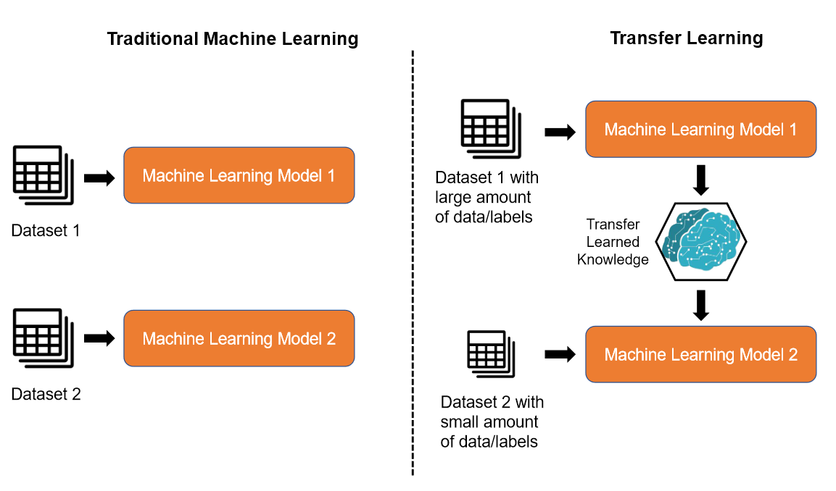
Transfer Learning
Transfer the already distilled ‘knowledge’ between different (but similar) ML tasks.
Motivation: reduce learning / training time.
Example: AP on/off switching scheme for energy saving
ML vs TL [7]

Slide 45
Re-cap
Machine Learning → techniques to create ‘models’ from data
  Supervised Learning: Make predictions, classify
  Unsupervised Learning: leverage similarity
  Reinforcement Learning: interact with the environment
Training and deploying models:
  Off-line vs On-line
  Centralized vs Distributed
Use-cases / Examples:
  Pre-trained SL models for AP selection (association)
  RL for CW/channel selection in dynamic environments
The capability of ML to go beyond rule of thumb strategies by automatically learning (and adapting) to (un)seen situations can cope with heterogeneous wireless network scenarios

Slide 46
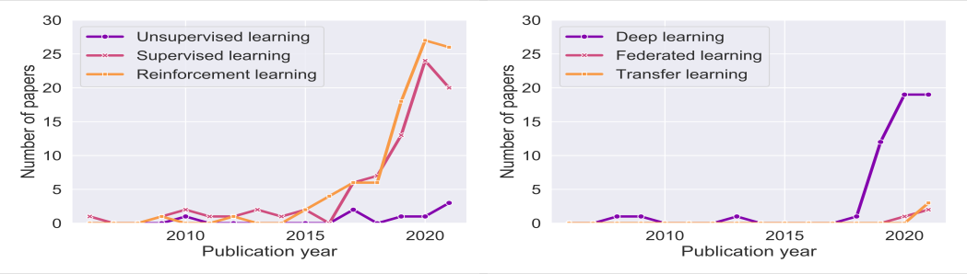
Related publications
SL and RL are frequently used, while UL is less popular.
The most often used ML mechanisms are Q-learning, multi-armed bandit, as well as different neural network types (mostly ANN, DNN, and CNN), usually implemented to optimize a constrained set of 802.11 parameters.
With the increase in available computing power, DL methods are gaining in popularity.
Federated learning and transfer learning are a recent introduction in the 802.11 domain.

Slide 47
2. ML for improving IEEE 802.11 performance

Slide 48
Outline
IEEE 802.11 Wi-Fi networks
Using ML to build models from data
  AI/ML definitions
  Overview of ML techniques: supervised, unsupervised, reinforcement learning
  Model training and deployment: centralized and distributed solutions
ML for improving IEEE 802.11 performance
  State of the art: what the research community is doing
  Examples
Open Challenges, missing pieces and summary

Slide 49
Augmented Wi-Fi with AI/ML
Should we expect that the use of ML techniques will…
  … improve raw ‘performance’ (i.e., throughput, delay and reliability)?
  … improve QoE in general (i.e., better AP selection)?
  … contribute to avoid BSS ‘starvation’ in dense scenarios?
  … contribute to reduce ‘overheads’ by reducing the amount of exchanged data?
  … contribute to improve the operation/performance of some functionalities?
  …
Any initial target? 4x gains? 10%? Only qualitative?
?

Slide 50
Research applications of ML to 802.11
802.11 Area | ML objective | ML methods | Improvement
Channel access | Select CW value, modify CW update rule | Mostly RL | Higher throughput
Link adaptation | Select transmission rate Predict link-layer throughput | Mostly RL SL | Higher throughput
PHY | Classify signal source, de-noise signals estimate interference | Mostly SL | Higher accuracy
Beamforming | Select beam sector, beamwidth, transmit power Predict channel characteristics | Mostly SL | Higher throughput, reduced exploration time
Multi-user | Select users, schedule RUs | SL and RL | Higher throughput
Spatial reuse, channel bonding | Select channel, transmit power, carrier sense threshold | Mostly RL | Higher throughput, lower latency

Slide 51
Examples
ML-enhanced Decentralized AP selection using MABs
  Carrascosa, Marc, and Boris Bellalta. "Multi-armed bandits for decentralized AP selection in enterprise WLANs." Computer Communications 159 (2020): 108-123.
ML-enhanced Decentralized channel selection (primary, width) using MABs, and Q-learning
  Barrachina-Muñoz, Sergio, Alessandro Chiumento, and Boris Bellalta. "Multi-Armed Bandits for Spectrum Allocation in Multi-Agent Channel Bonding WLANs." IEEE Access 9 (2021): 133472-133490.
Gap analysis on feasibility: from research to practical implementation

Slide 52
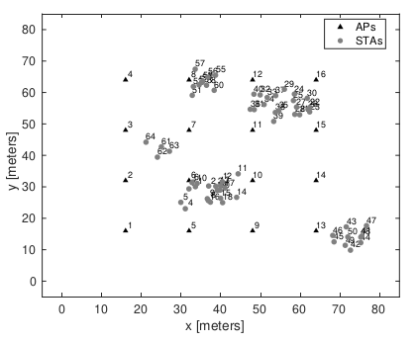
ML-enhanced Decentralized AP selection
Default AP selection is implemented considering only RSSI values
  A station associates to the ‘closest’ AP
This may cause that some APs are overloaded, while others are almost empty
ML solution: STAs use an ML agent to find an AP that is good enough to satisfy their traffic requirements.
The ML agent implements a MAB:
  Actions: APs in sight
  Reward: ratio Throughput/Load

Slide 53

ML-enhanced Decentralized AP selection
Default ε-greedy MAB is enhanced with ‘stickiness’.
Stickiness aims to improve stability by reducing the number of STAs switching APs simultaneously, or in a short time interval
Idea: STAs stick to the last AP that satisfied their requirements for several association rounds before switching

Slide 54


ML-enhanced Dec. AP sel.
Non overlapping channel allocation
16 APs, 64 STAs
Load STA: 4 Mbps

Slide 55

ML-enhanced Dec. AP sel.
Pros:
Easy to implement without any major update on 802.11 devices
All network devices benefit even if they are not ML-enhanced
Fully decentralized solution
Reactive, adapts to any environment
Cons:
Learning by interacting with the environment is required, implying periods of ‘low performance’ due to bad choices
AP switching overheads
Practical aspects:
Temporal window to assess throughput performance
It could be the used in combination with pre-trained SL models to boost AP selection performance, or with Wi-Fi mng. approaches

Slide 56


ML-enhanced Dec. AP sel. vs Load-aware AP sel.

Slide 57

ML-enhanced Decentralized Channel Selection
“Realistic” Wi-Fi simulation environment (Komondor)
  Path-loss, SNIR, Dyn. Bandwidth Access, etc.
Traffic load AP (only DL traffic): 50 Mbps
80 MHz available (shared by all 4 BSSs)
W=20, 40 and 80 MHz
12 different channels
  4 x 20 MHz channels (1 position for the primary)
  2 x 40 MHz channels (2 positions for the primary)
  1 x 80 MHz channels (4 positions for the primary)
The goal is to ‘learn’ a good channel allocation as fast as possible

Slide 58
ML-enhanced Decentralized Channel Selection
Multi-armed Bandits
Available actions correspond to the set of available channels
Rewards are computed taking into account the actual throughput during the simulation (in intervals of 5 s)
Channel switching time not considered (few ms)
Practical considerations:
Easy to implement on top of current 802.11 devices
Channel switching overheads need to be considered

Slide 59

ML-enhanced Decentralized Channel Selection
Unstable!
Only the simplest MAB algorithms perform well

Slide 60

ML-enhanced Decentralized Channel Selection
Can contexts or states aid learning?
  Two states (contexts) per BSS: satisfied (true) or not (false).
  Different actions can be selected taking the current state into account.
RL algorithms harnessing states or contexts do not boost the learning rate in short-term finite horizons like those studied in this work.

Slide 61

ML-enhanced Decentralized Channel Selection
Large deployments:
  20x20 m^2
  6, 10 and 16 BSSs
Random per BSS traffic loads: 50, 100, 150 Mbps
W = 20, 40, 80, 160 MHz
160 MHz available spectrum
  32 combinations of channels
Both exploration-first and e-greedy can learn even in high-density deployments, outperforming by far static configurations. Besides, while exploration-first performs worse than e-greedy at the early stages of the simulation, it reaches much better performance as the simulation progresses.

Slide 62
Wi-Fi 7 (IEEE 802.11be)
Is there any Wi-Fi 7 feature suitable to be enhanced with ML?
  New MCSs (4096-QAM)
  Up to 16 spatial streams
  320 MHz channels
  Wide-band channel access + OFDMA improvements (Multi-RUs per user)
  Multi-link Operation - new feature!
ML research done for similar features in previous amendments could be re-used & extended: improved symbol detection under ‘low’ SNR, beamforming, group selection for MU-MIMO transmissions, channel width selection and DBCA policies, etc.

Slide 63

Multi-link Operation
Several operation modes:
  MLSR, eMLSR
  MLMR-STR
  MLMR-NSTR
Improving MLO with AI/ML?
  Selection of the active links based on both traffic prediction and link occupancy (trade-off between power consumption and latency)
  Enhanced channel access schemes: predict when multiple links will be simultaneously available to improve link aggregation in NSTR.
  Learn optimum traffic allocation to different links
  …
Illustration of SLO, MLO-STR, and MLO-NSTR operations [8]

Slide 64
Re-cap
State of the art
  RL techniques are mostly used
  Features: CW adaptation, CCA and TX power adaptation, Link adaptation, Beamforming, Multi-user, Spatial reuse, Channel bonding, etc.
  Targets: Higher throughput (few works yet aiming to improve latency, fairness, reliability, …)
Examples:
  AP selection and channel allocation can be enhanced by applying simple ML strategies
  In dynamic environments, lightweight approaches could be the best ones in terms of the response delay-performance tradeoff
  ML agents operation must contribute to reduce the environment randomness
Gaps between lab settings and 802.11 deployments
  Decentralized methods require lengthy ‘throughput’ probes to determine reward

Slide 65
3. Open challenges, Missing Pieces, & Summary

Slide 66
Outline
IEEE 802.11 Wi-Fi networks
Using ML to build models from data
  AI/ML definitions
  Overview of ML techniques: supervised, unsupervised, reinforcement learning
  Model training and deployment: centralized and distributed solutions
ML for improving IEEE 802.11 performance
  State of the art: what the research community is doing
  Examples
Open challenges, missing pieces and summary

Slide 67
AI/ML for Wi-Fi - Open Challenges
More research is required!
New simulation / experimental tools
Assessment of AI/ML gains in practice
IEEE 802.11 contribution
  Architecture & interfaces
  New ‘components’ to support ML
  Reference scenarios
Real use-cases & practical use-cases required

Slide 68
Research
Optimizing new 802.11 features
  Not yet well-known how ML can improve the performance of existing features
  What about new ones? Multi-link operation, Multi-AP coordination
Joint parameter optimization
  Complex interplay between different features
  E.g., transmit power and carrier sensing threshold, channel/link selection
Distributed and Transfer learning; hierarchical learning
  Training and sharing/deploying models in a distributed way
  Reuse of knowledge between features

Slide 69

New simulation / experimental tools
Wi-Fi networks are becoming extremely complex, with many new features, and deployed in many different scenarios.
We need (new) evaluation tools (and metrics) to obtain reliable and reproducible performance results: analysis, simulations, testbeds.
  Include AI/ML support
The case of ns-3:
  Full TCP/IP stack, Wi-Fi, community validated
  Not all 11ax features yet implemented; some 11be ones in development
    Developing new features requires expertise and time
  AI/ML support:
    ns3-gym: OpenAI Gym integration

Slide 70
AI/ML in practice
Most of current results in the literature come from simulations:
  Many simplifying assumptions:
    Controlled (simple) scenarios, discrete time (iterations)
    Instantaneous and noise-free data: Ideal ‘devices’ (no need to calibrate data), no estimation errors, etc.
  The ‘gap’ with performance results from real implementations could be significant
Engineering effort to set-up and test AI/ML solutions in practice is still required
  When should AI/ML agents be triggered?
    Instability vs slow reaction;
    Should ‘thresholds’ be used to activate ML mechanisms?
  Suitable KPIs are required, including how to measure them
  Fairness issues between AI/ML-enabled devices and legacy devices

Slide 71
What is required from 802.11? (1)
802.11 architecture
  AI/ML models (agents)
    A single complex agent vs multiple simple agents cooperating
    Embedded vs external (edge / cloud)
  Interfaces to exchange ML agents (logic installation)
    Network controllers install logic at APs
    APs install logic at STAs
    Pre-trained vs online learning models
  Mechanisms to exchange data between stations, APs, and edge/cloud servers

Slide 72
What is required from 802.11? (2)
Extra components (processing capacity, interfaces) for ML
  Dedicated 802.11 interface to collect data without interrupting data communication
  Support for the ML control loop
      Observe/monitor network
      Select (quasi-static) values
      Use/disseminate new values
  Dedicated computing power to train models
Reference evaluation scenarios
  They should include non-stationary and changing conditions (i.e., sudden change in number of devices, changes in spectrum occupancy, etc).

Slide 73
Summary & take-home messages
ML is a set of general techniques to create models for making predictions. They can be used to empower autonomous ‘agents’ to find suitable configurations in particular scenarios.
Given the decentralized nature of Wi-Fi deployments, the use of RL techniques looks like the natural choice to improve several features such as channel selection, spatial reuse, channel access parameters, etc.
Performance gains in practice may not be so obvious. AI/ML enhanced Wi-Fi networks should improve user’s Quality of Experience by providing a fast response to challenging situations.
802.11 architecture should be updated to effectively support AI/ML

Slide 74
References
[1] S. Szott; K. Kosek-Szott; P. Gawłowicz; J. Torres Gómez; B. Bellalta; A. Zubow; F. Dressler, "Wi-Fi Meets ML: A Survey on Improving IEEE 802.11 Performance with Machine Learning," in IEEE Communications Surveys & Tutorials, doi: 10.1109/COMST.2022.3179242.
[2] Wydmański, Witold, and Szymon Szott. "Contention window optimization in IEEE 802.11 ax networks with deep reinforcement learning." In 2021 IEEE Wireless Communications and Networking Conference (WCNC), pp. 1-6. IEEE, 2021.
[3] Wilhelmi, Francesc, Sergio Barrachina-Muñoz, Boris Bellalta, Cristina Cano, Anders Jonsson, and Vishnu Ram. "A flexible machine-learning-aware architecture for future WLANs." IEEE Communications Magazine 58, no. 3 (2020): 25-31.
[4] Wilhelmi, Francesc, Sergio Barrachina-Munoz, Boris Bellalta, Cristina Cano, Anders Jonsson, and Gergely Neu. "Potential and pitfalls of multi-armed bandits for decentralized spatial reuse in WLANs." Journal of Network and Computer Applications 127 (2019): 26-42.
[5] Carrascosa, Marc, and Boris Bellalta. "Multi-armed bandits for decentralized AP selection in enterprise WLANs." Computer Communications 159 (2020): 108-123.
[6] Barrachina-Muñoz, Sergio, Alessandro Chiumento, and Boris Bellalta. "Multi-Armed Bandits for Spectrum Allocation in Multi-Agent Channel Bonding WLANs." IEEE Access 9 (2021): 133472-133490.
[7] Nguyen, Cong T., Nguyen Van Huynh, Nam H. Chu, Yuris Mulya Saputra, Dinh Thai Hoang, Diep N. Nguyen, Quoc-Viet Pham, Dusit Niyato, Eryk Dutkiewicz, and Won-Joo Hwang. "Transfer learning for future wireless networks: A comprehensive survey." arXiv preprint arXiv:2102.07572 (2021).
[8] M. Carrascosa, G. Geraci, E. Knightly and B. Bellalta, "An Experimental Study of Latency for IEEE 802.11be Multi-link Operation," ICC 2022 - IEEE International Conference on Communications, 2022, pp. 2507-2512, doi: 10.1109/ICC45855.2022.9838765.

