Slide 1
Discussion on SST and A-PPDU
Date: 2022-08-30
Authors:
Name | Affiliations | Address | Phone | email
Ross Jian Yu | Huawei |  |  | ross.yujian@huawei.com
Ming Gan
Shimi Shilo
Boyce Bo Yang
Lei Huang

Slide 2
Comments on SST and A-PPDU [1]
There are several comments regarding SST and A-PPDU.

Slide 3
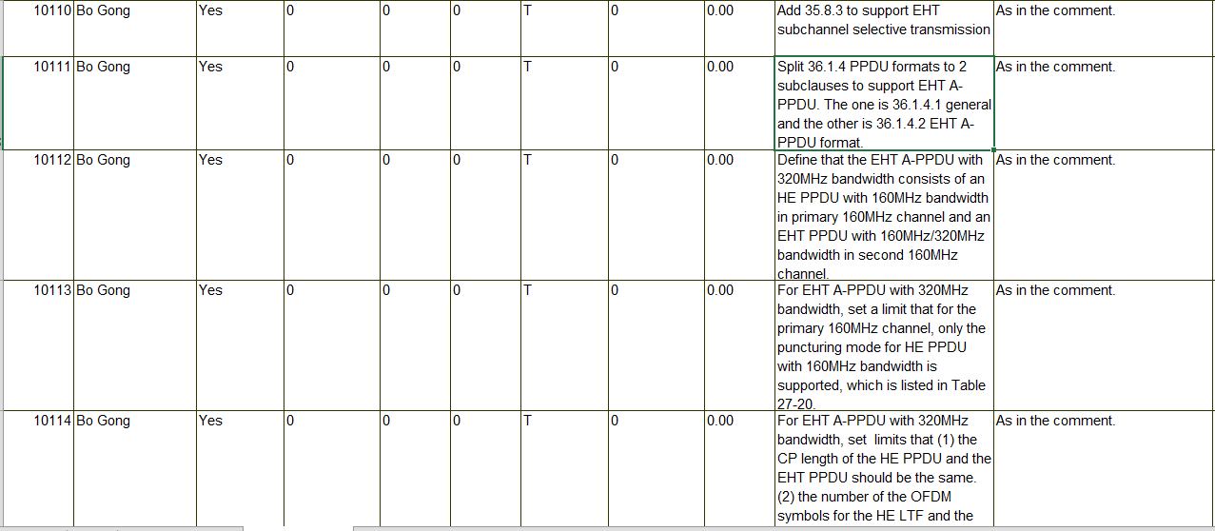
Comments on SST and A-PPDU [1]

Slide 4
Comments on SST and A-PPDU [1]

Slide 5
Agreed SPs for “R2” [2]

Slide 6
Agreed SPs for “R2” [2]
No matter if 11be has R2 or not, the following slides discuss on whether 11be needs SST and/or A-PPDU.

Slide 7
Discussion on SST in S160
Wideband OFDMA is a mandatory feature for 11be. The HE SST only allows 20/80/160 MHz only STA to participate wideband OFDMA in P160 channel. For S160 channel, currently it only allows a STA capable of 320 MHz to participate. This will make a 320MHz OFDMA transmission seldom used.
EHT SST for S160 is needed to make good use of S160.
Potential effect to PHY: if puncturing is still not allowed, then almost no effect to current PHY. If puncturing is allowed (static or dynamic), need to make sure receivers are able to detect and decode the punctured preamble.
If applied, the feature will be optional. No effect to current “R1” STAs.
P160
20/80 MHz only STA in P20/80, HE SST capable 20/80 MHz only STA or 160 MHz only/320 MHz STA in P160
S160
EHT SST capable 20/80/160 MHz only STA/320 MHz STA in S160

Slide 8
Discussion on A-PPDU
Wideband OFDMA is an optional feature for 20/80 MHz only non-EHT HE STAs.
A-PPDU allows EHT AP and STAs to take good use of S80 and S160 channels when most HE STAs are 80 MHz capable.
P80
HE PPDU
~2 times Tput compared with HE PPDU only
S80
EHT PPDU
P80
HE PPDU
S80
EHT PPDU
~4 times Tput compared with HE PPDU only
S160

Slide 9
Discussion on A-PPDU
Moreover, allowing A-PPDU in 11be will further allow HE PPDU, EHT PPDU, and EHT+ PPDU to be in the same A-PPDU transmission in the future. Otherwise, we will only have HE and EHT+ PPDU, or EHT and EHT+ PPDU transmission.
With A-PPDU in 802.11be (3 combinations)
HE PPDU
HE PPDU
EHT PPDU
EHT PPDU
EHT+ PPDU
EHT+ PPDU
EHT+ PPDU
Without A-PPDU in 802.11be (2 combinations)

Slide 10
Discussion on A-PPDU
A-PPDU relies on SST. And relies on EHT SST if EHT PPDU overlaps with S160 channel. Hence if we want to support A-PPDU, we need EHT SST too.
Potential effect to PHY: spectral mask, U-SIG/EHT-SIG/trigger signaling, further optimization on PAPR (phase rotation etc.)…
A tradeoff between further changes and performance. If applied, prefer to introduce as few changes as possible.
If applied, the feature will be optional. No effect to current “R1” STAs.

Slide 11
Summary
Regarding several comments on SST and A-PPDU, a brief introduction on SST and A-PPDU is presented.
The benefits and potential effect to PHY are discussed.
Intend to collect opinions from the group in high level on if 802.11be should have SST and/or A-PPDU. Then based on the feedback, the group can further think how to handle those CRs.

Slide 12
Straw Poll #1
Do you agree to enable SST on S160 for 11be?
Y
N
A

Slide 13
Straw Poll #2
Do you agree to enable A-PPDU for 11be?
Y
N
A

Slide 14
References
11-22-0971-18-00be-ieee-802-11be-lb266-comments
11-20-1935-66-00be-compendium-of-straw-polls-and-potential-changes-to-the-specification-framework-document-part-2

